Slide 1
DishyDishes POC
Group 17

Slide 2
DishyDishes -- A web-based platform allows users to share, view, like, and discuss their recipes.
Stakeholders: cooking enthusiasts, foodies, cooks/chiefs, nutritionists, and even gourmets.
There are a significant number of people who love to cook and are willing to communicate their experience with others, yet they suffer from a lack of a good platform that offers intuitive useability and pleasing aesthetics.

Slide 3
Design Overview
Frontend: Vue 3, Bulma CSS and Quasar
Backend: Java and Spring Boot for the backend
Database: MongoDB

Slide 4
Data Integrity
Industry-leading DNS and CDN provider
HTTPS encrypted data transmission
JWT based authentication with Auth0 and Bcrypt

Slide 5
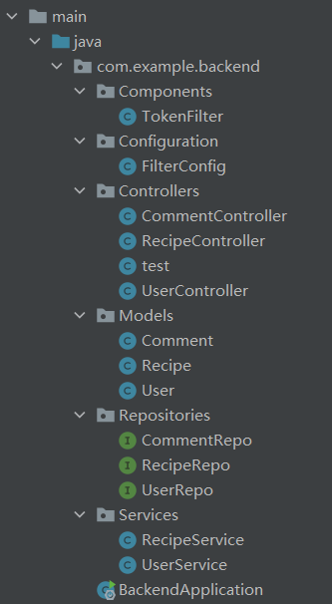
Backend Basic Structure
Modularity
Scalability
Readability
Maintainability
Testability
Separation of concerns

Slide 6
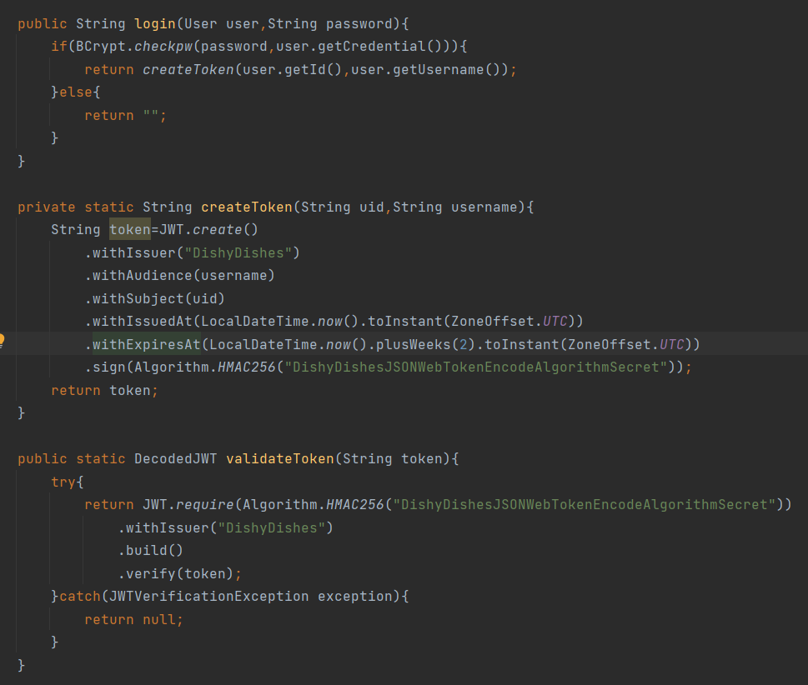
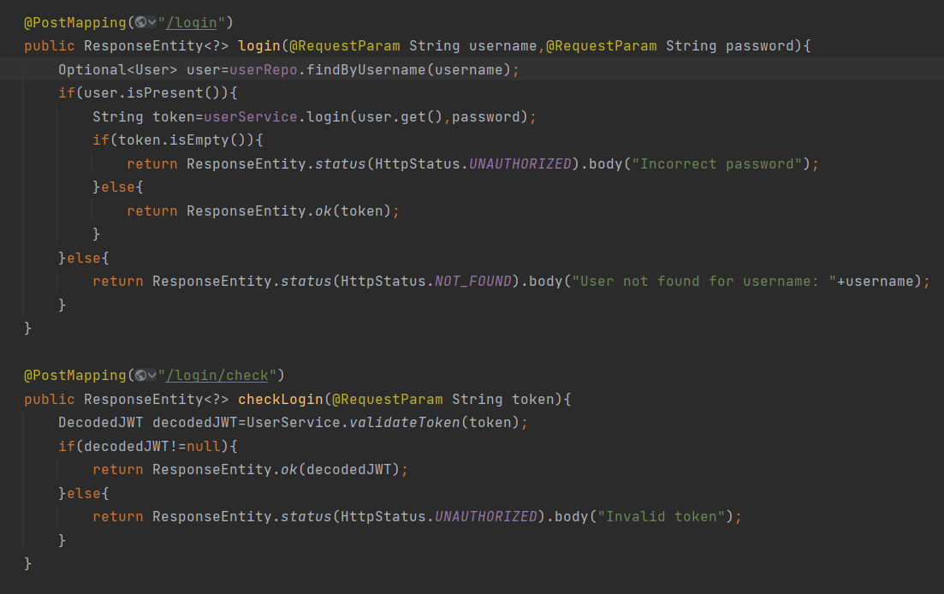
Login and registration
Code blocks showcase

Slide 7
Demo
Let's take a glance at dishydishes.top

