Slide 1

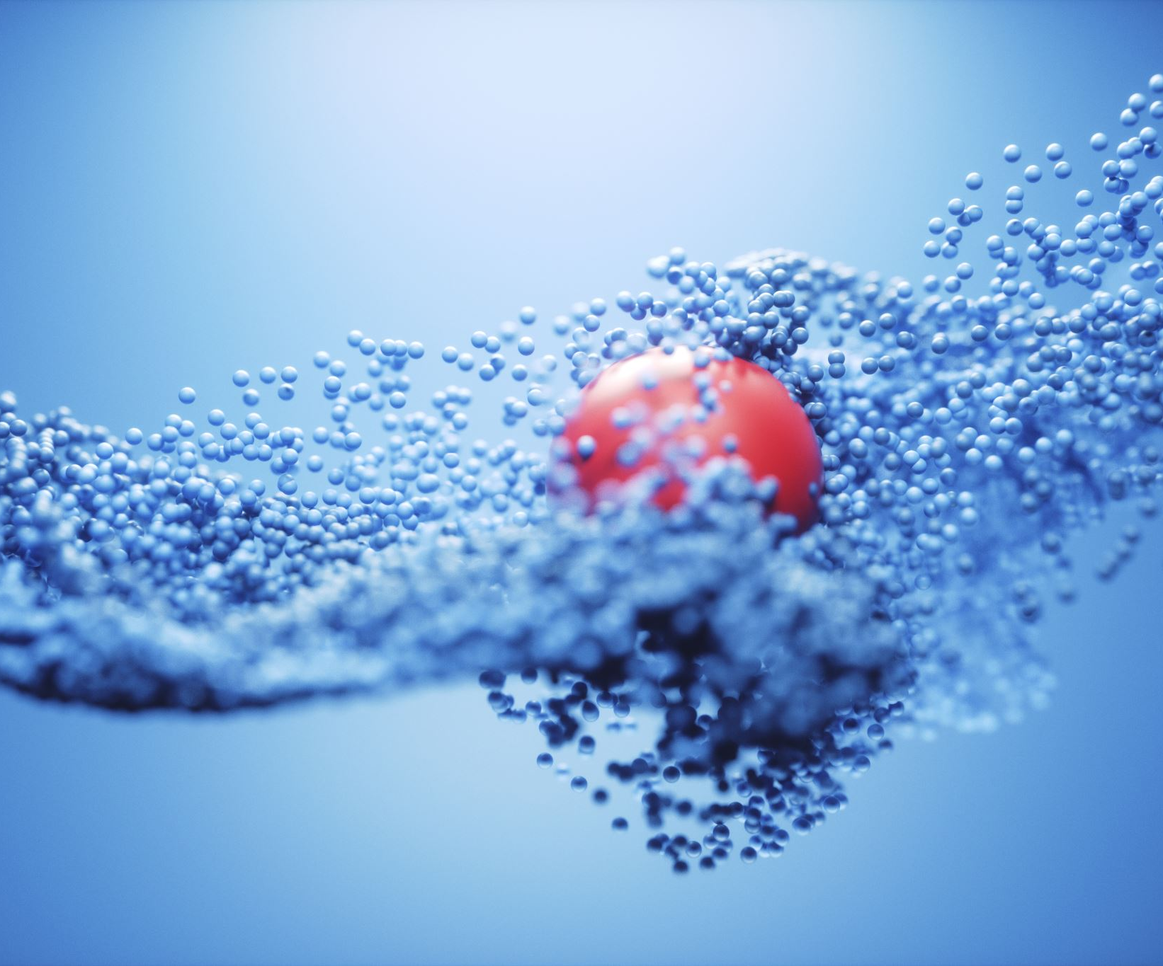
Distillation And Azeotropic seperation
-Sanidhya Singh, 200864
-Harsh Vijayvargia, 200425

Slide 2
Acknowledgement:
I want to express my special gratitude to my project mentors Samanvay Lakhotia and Raju Singh. They gave me a golden opportunity to do this project on the topic “Distillation and azeotropic separation,” which bettered my understanding of these concepts. I also learned a lot of new things.
I am thankful to them.
Also, I want to thank my project partner Harsh Vijayvargiya who helped a lot in finishing this project.

Slide 3
In the next three slides I am going to give short description about all the three assignments which we did in this project.
.

Slide 4
Assignment 1:
Topic: Plot graphs for binary mixture assuming it to be first ideal then real mixture in python/MATLAB and DWsim software
Methodology:
I chose system of 1-butanol and methacrylic acid and arranged an experimental dataset for it.
Then using roult’s law, assuming pressure to be constant at 20 mmHg, I found calculated data, using which I had plotted graphs.
For real mixture using modified roult’s law for real mixtures and assuming that the components follow 2nd order virial equation, I calculated data using which I had plotted graphs.
Using YouTube we learned about the working of DWsim software and implemented the same thing locally.

Slide 5
Assignment 2:
Topic: For the binary system of mixture assuming it first real then ideal, plot y vs x equilibrium curve and show three things with graphs:
Actual number of stages required to achieve separation in distillation column using McCabe-Thiele method
Minimum number of stages required to achieve their separation
Minimum reflux ratio
Methodology:
Using the data obtained in the previous assignment I plotted the equilibrium curve and then followed McCabe-Thiele method step by step to obtain graphs.
Then counted all the lines for actual number of stages.
For minimum number of stages, I assumed the reflux ratio to be infinity
For minimum reflux ratio, I connected the enriching line on equilibrium curve with feed line

Slide 6
Assignment 3:
Topic: Using Dwsim software simulate
Distillation column and verify the results obtained in the previous assignment.
Azeotropic mixture by extractive distillation.
Separation by Pressure Swing Distillation
Methodology:
For our system 1-butanol and methacrylic acid, we chose property package NRTL, assumed feed ratio to be 0.5 and for graph, selected binary phase envelope and obtained the results.
For Azeotropic and Pressure Swing Distillation methods we first made the flowsheet as we learned from YouTube and then simulated it to obtain the required results.

