Slide 1
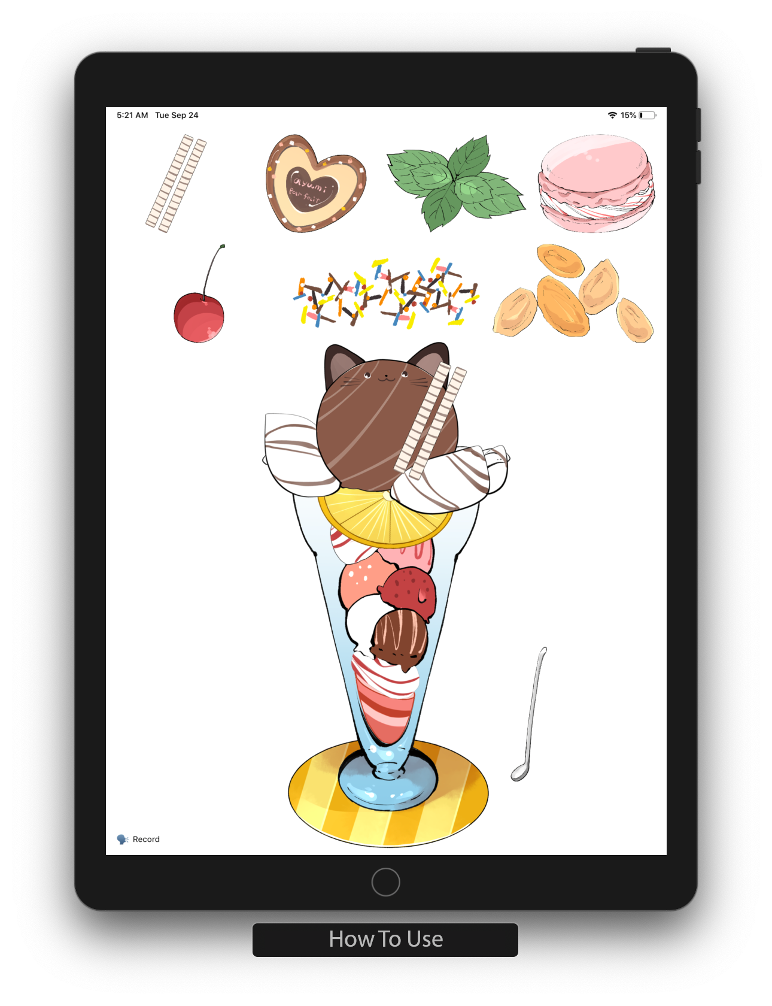





Swipe to change
the parfait part.
Drop to build
your own parfait.
Record your voice to
mix on the parfait.
Share your parfait!

