Slide 1
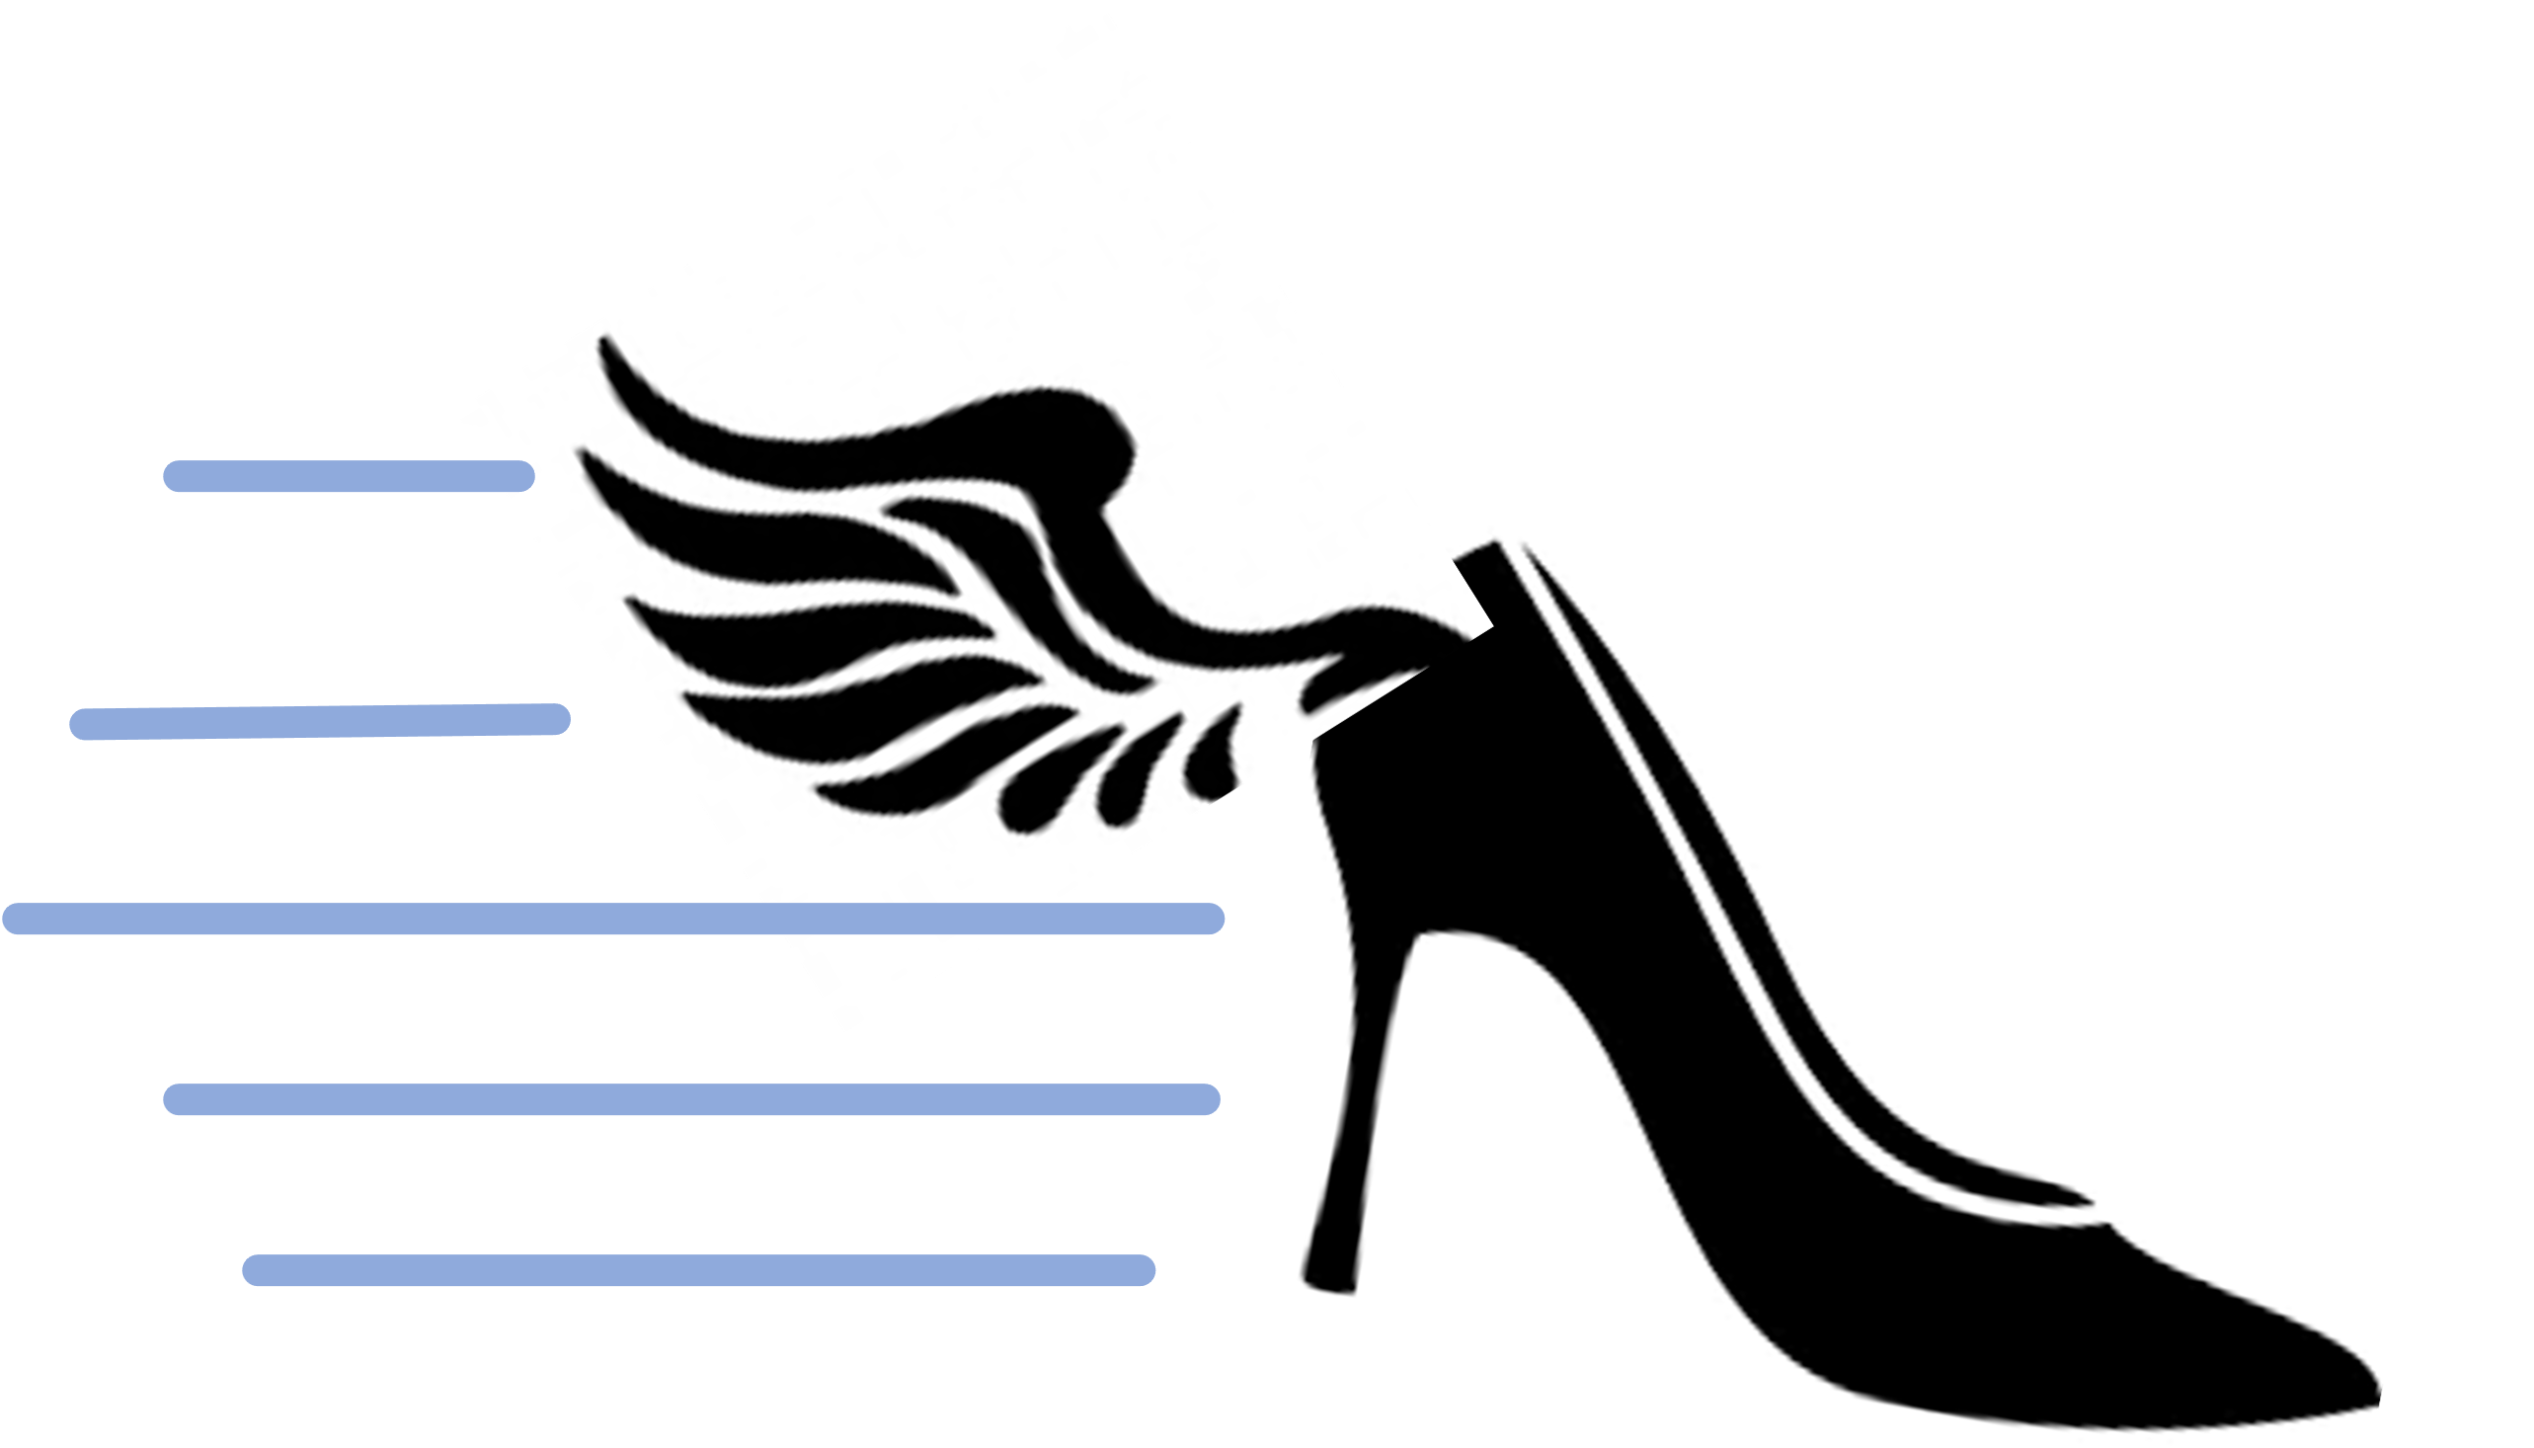
WhoreDash
when taking a break is not an option

