Slide 1
Project 4: Heart Disease
By: Alejandra Bridegroom, Jason Chody, Matthew Vale

Slide 2
Datasets and Cleaning

Slide 3
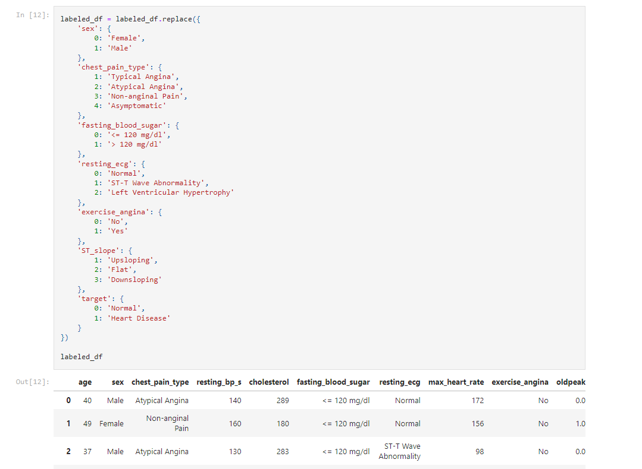
Dataset and
Cleaning
Utilized Jupyter Notebook & Pandas
Updated column names
Created a separate CSV, utilizing a dictionary with the replace method to change the numeric codes with the labels that they represent

Slide 4
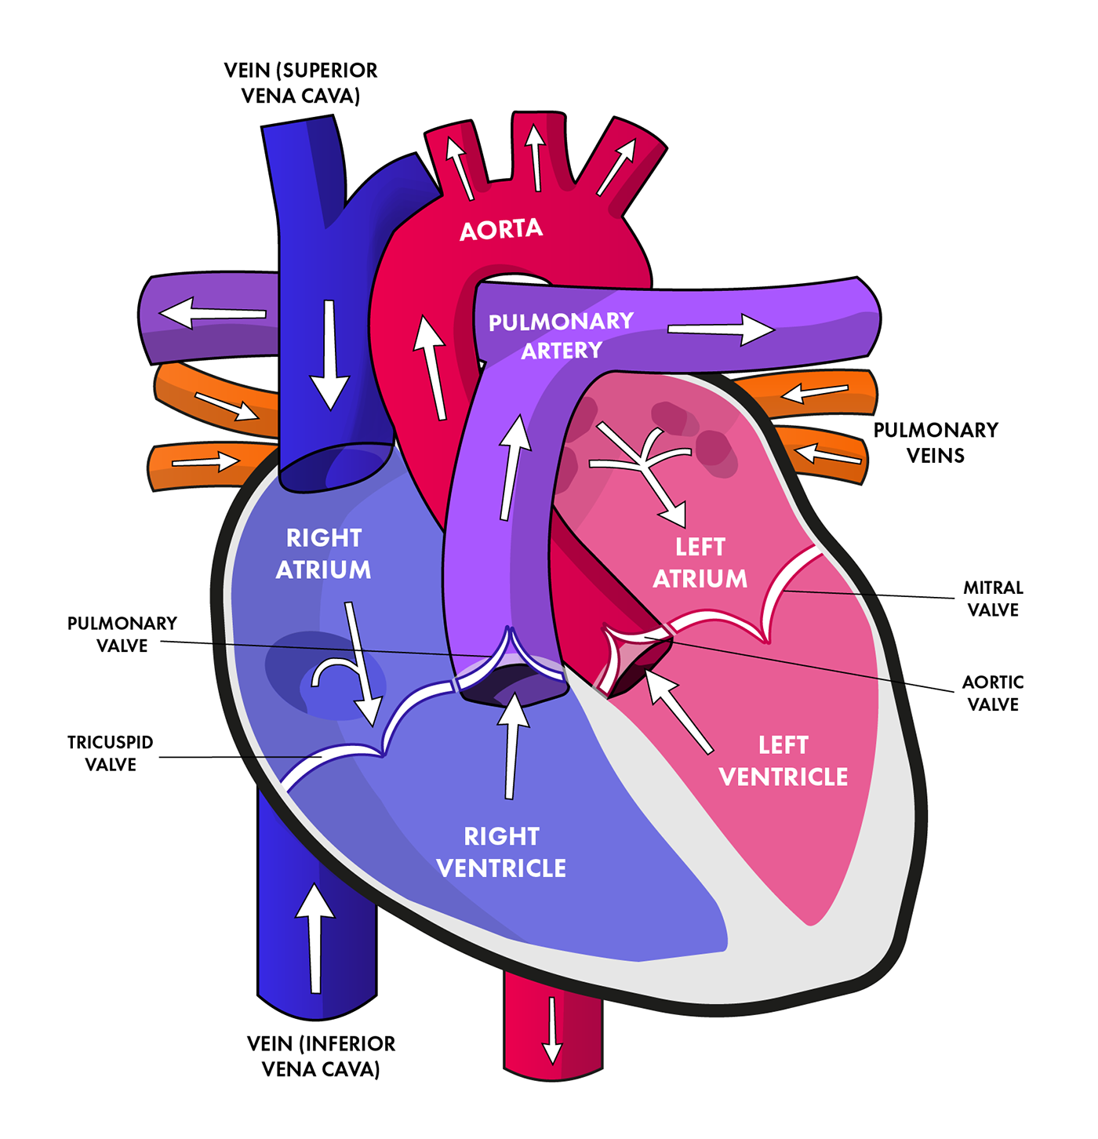
Key Terms to Know
Blood Pressure and Cholesterol
Coronary Heart Disease
Chest Pain Type: Angina
Typical and Atypical Angina
Non-Anginal Pain
Asymptomatic
Exercise Induced Angina
Electrocardiogram

Slide 5
AWS, Google Collab, and PySpark SQL Queries

Slide 6
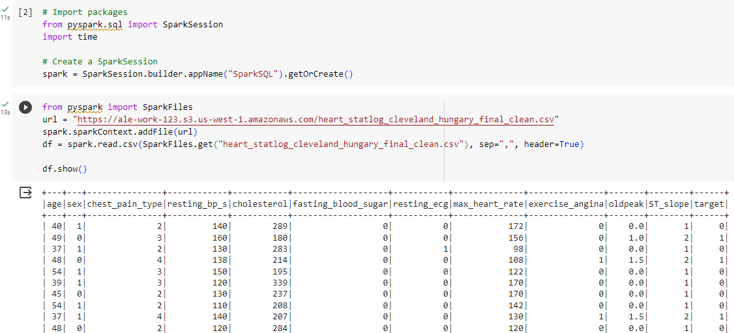
AWS and Google Collab
Set up an AWS S3 bucket that stored our dataset to the cloud
Through Google Collab, we utilized PySpark to run SQL queries on the data in the S3 bucket

Slide 7
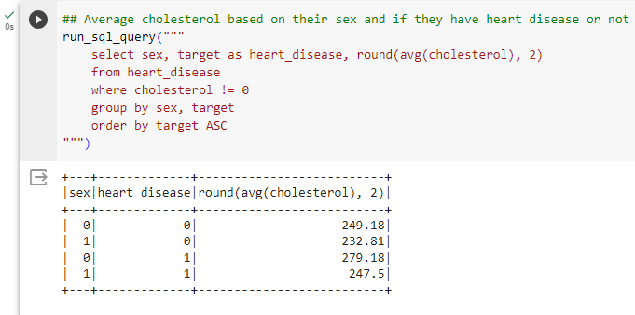
PySpark and SQL Queries
Average cholesterol based on their sex and if they have heart disease or not
Displays females having higher average cholesterol, especially seen with those who have heart disease

Slide 8
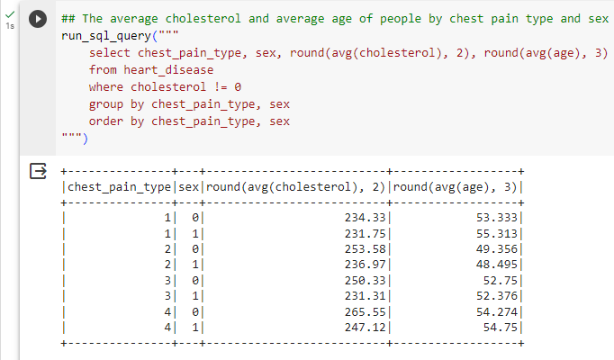
PySpark and SQL Queries
Average cholesterol and age based on chest pain type and the individual's sex
Though the chest pain types differed, the average cholesterol for each group were not too far apart

Slide 9
Tableau Visualization Demonstration

Slide 10
Machine Learning

Slide 11
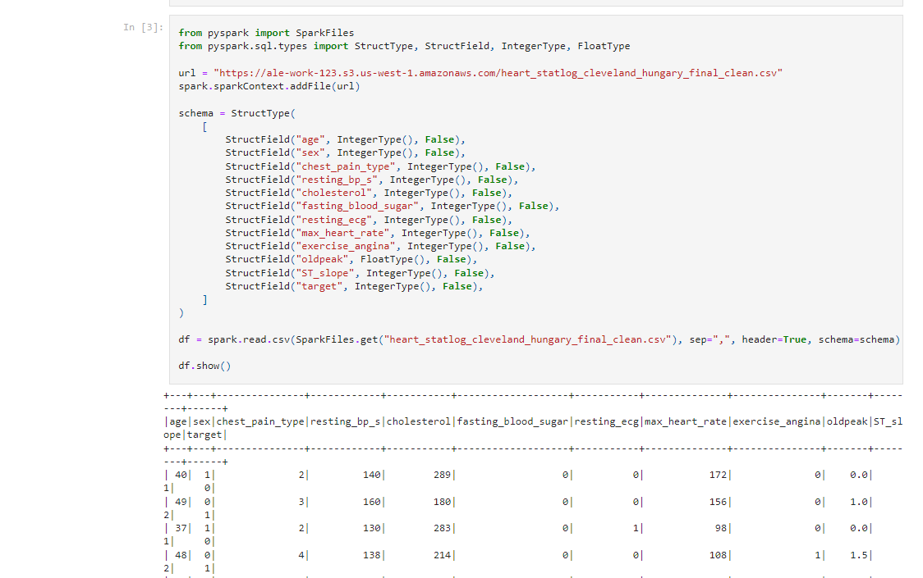
Machine Learning
Due to Spark’s distributed nature, PySpark dataframes cannot be used directly with SciKit. Instead of forgoing the advantages of distributed computing, we used PySpark’s own machine learning.

Slide 12
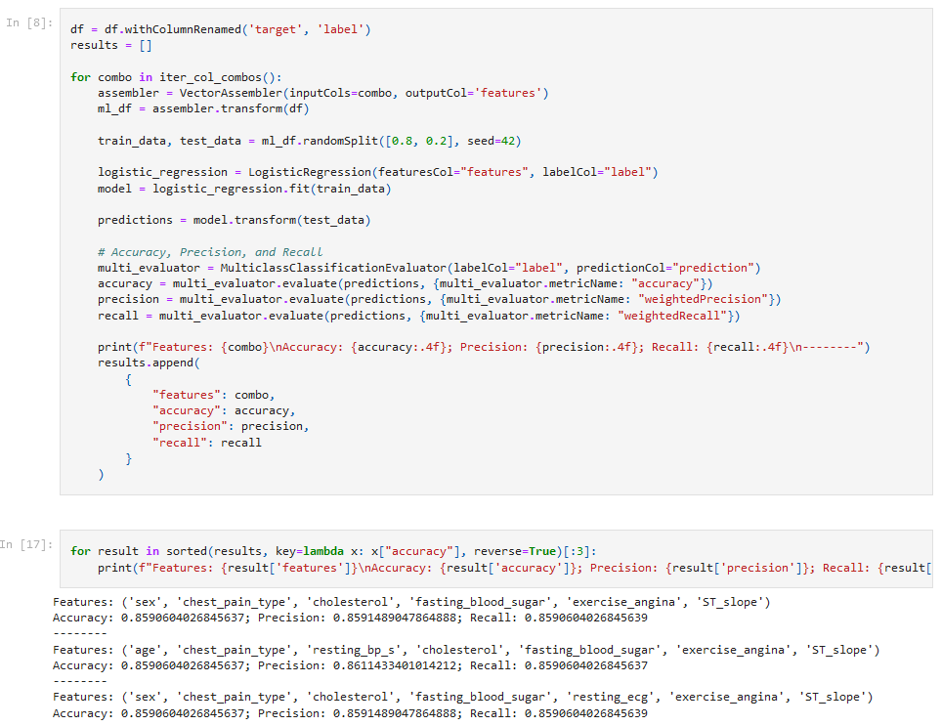
Machine Learning
Machine learning models were able to achieve a fairly impressive level of accuracy.
However, we would not say they were accurate enough for general use.

Slide 13
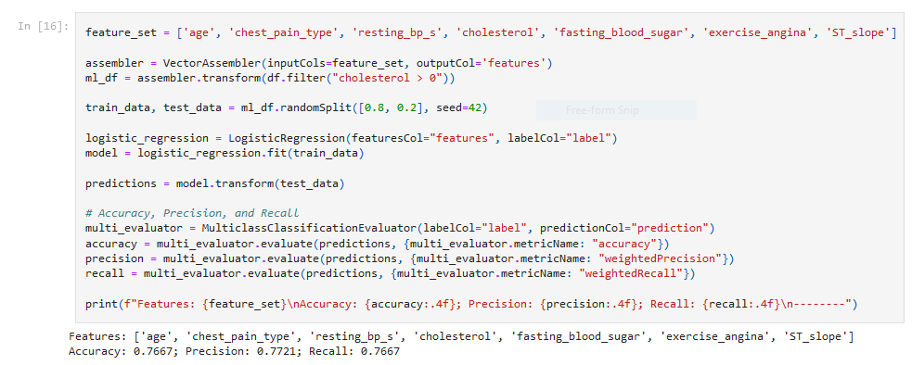
Machine Learning
An interesting note is that our data set had a number of data points where cholesterol was zero. We thought these outliers might skew our data.
However, they decidedly did not.

Slide 14
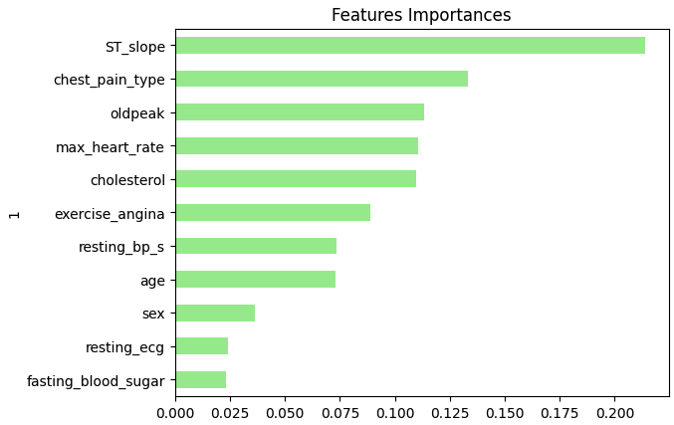
Random Forest Features Importances

Slide 15
Questions?

