Slide 1
A Dual Center Approach to CMA-ES
1033631
Dillon Bourne
University of Guelph

Slide 2
Outline
CMA-ES Review
Problem
DC-CMA-ES Methodology
Test Functions
Experimentation
Results
Conclusion
Future Work

Slide 3
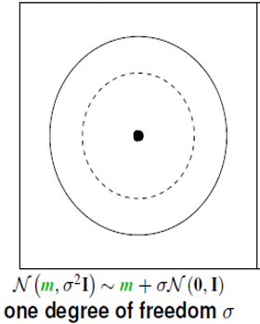
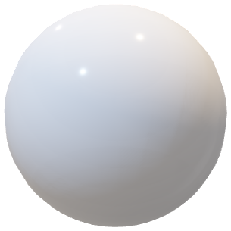
Multivariate Normal Distributions
Image taken from “Tutorial CMAE-ES – Evolutionary Strategies and Covariance Matrix Adaptation” by Anne Auger & Nikolaus Hansen

Slide 4
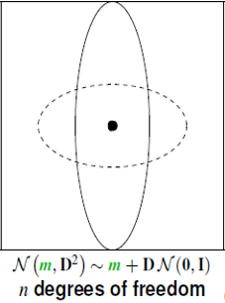
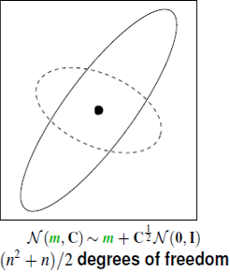
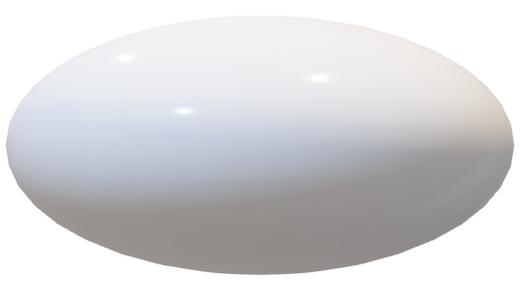
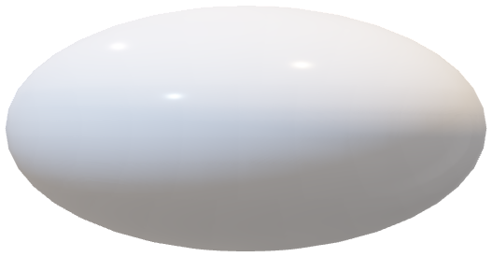
Multivariate Normal Distributions
Image taken from “Tutorial CMAE-ES – Evolutionary Strategies and Covariance Matrix Adaptation” by Anne Auger & Nikolaus Hansen

Slide 5
Estimation Distribution Algorithms (EDA)
Initialize Distribution Model
0.5 | 0.5 | 0.5 | 0.5

Slide 6
Estimation Distribution Algorithms (EDA)
Generate Random Population from the Model
6.5
4.2
8.2
6.0
9.6
1.3
1.7
0.4
1 | 0 | 0 | 0
0 | 1 | 0 | 1
0 | 1 | 0 | 0
1 | 0 | 1 | 1
1 | 0 | 1 | 0
0 | 1 | 1 | 1
1 | 1 | 0 | 0
0 | 0 | 1 | 1
0.5 | 0.5 | 0.5 | 0.5

Slide 7
Estimation Distribution Algorithms (EDA)
Sort Population
Truncation Selection
Average Population To Update Model
0.4
1.3
1.7
4.2
0 | 0 | 1 | 1
0 | 1 | 1 | 1
1 | 1 | 0 | 0
0 | 1 | 0 | 1
0.25 | 0.75 | 0.5 | 0.75

Slide 8
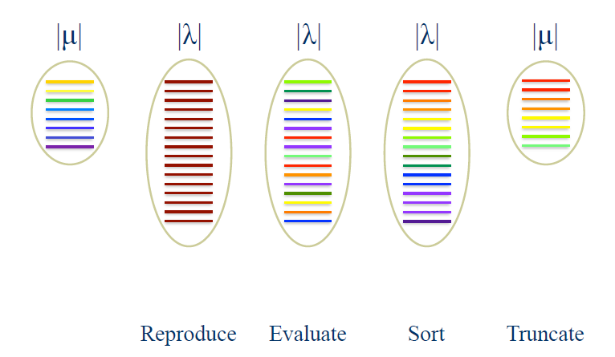
Selection in (µ, λ) – CMAES
Image taken from “Evolutionary Strategies” by Mark Wineberg

Slide 9
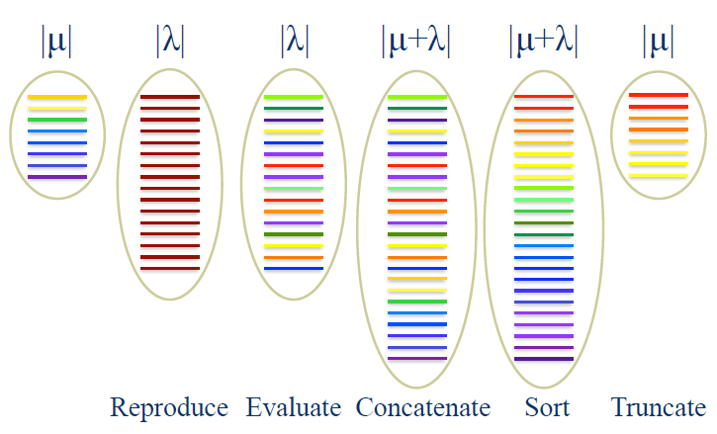
Elitism in (µ+λ)-CMAES
This method caused CMAES to perform poorly on most test functions, especially those with noisy & multi-modal characteristics.
Image taken from “Evolutionary Strategies” by Mark Wineberg

Slide 10
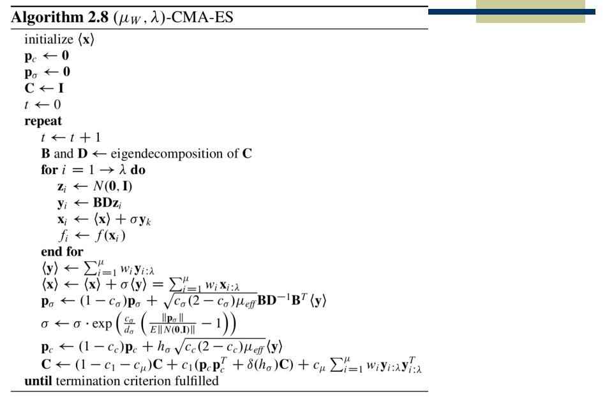
initialization
random sample
evaluate
selection & update center
update step-size
update covariance

Slide 11
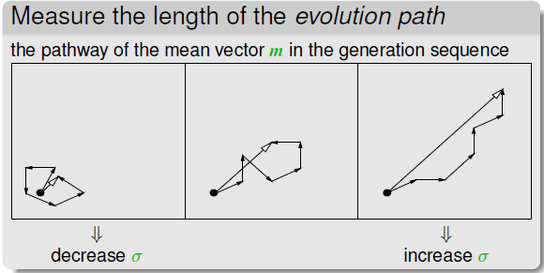

Slide 12
Rank-One and Rank-Mu Updates
The rank-one update was used on it’s own before rank-mu was added.
The rank-mu update was included after to improve the learning rate in large populations.
The rank-mu is the primary mechanism used in large populations and multimodal functions.
The rank-one and rank-mu update can be used together in the covariance matrix update.

Slide 13
Increasing Population (IPOP)
Problem
The default population size which is relatively small, is only suitable for unimodal problems.
Multi-modal problems generally work best with a larger population
Solution
Start out with the default population size
Double the population size after every restart
SO…What determines that the system should restart?

Slide 14
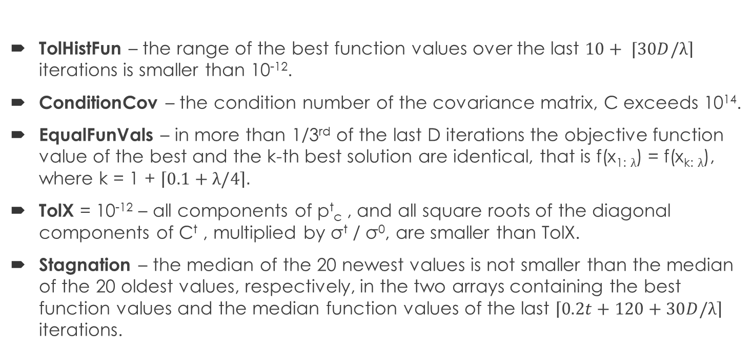
IPOP – Restart Conditions
TolHistFun – the range of the best function values over the last $10+ ⌈30D/\left.λ\right\rceil$ iterations is smaller than 10⁻¹².
ConditionCov – the condition number of the covariance matrix, C exceeds 10¹⁴.
EqualFunVals – in more than 1/3rd of the last D iterations the objective function value of the best and the k-th best solution are identical, that is f(x_{1:} $λ$) = f(x_{k:} $λ$), where k = 1 + $\left\lceil 0.1+λ/4\right\rceil .$
TolX = 10⁻¹² – all components of p^{t}_{c} , and all square roots of the diagonal components of C^{t} , multiplied by σ^{t} / σ⁰, are smaller than TolX.
Stagnation – the median of the 20 newest values is not smaller than the median of the 20 oldest values, respectively, in the two arrays containing the best function values and the median function values of the last $\left\lceil 0.2t+120+30D/λ\right\rceil$ iterations.

Slide 15
Problem
Improving the performance of optimization on multimodal functions is an ongoing problem within the field of optimization
A major part of improving optimization on multimodal functions is avoiding local optima
The CMA-ES algorithm utilizes a single-model Estimation Distribution Algorithm (EDA) to determine a single point in space to perform sampling
Using a single-model EDA limits the exploration of the search space and does not maintain diversity of solutions
The algorithm may be sampling in areas which contain basins of attraction where the global optimum does not reside

Slide 16
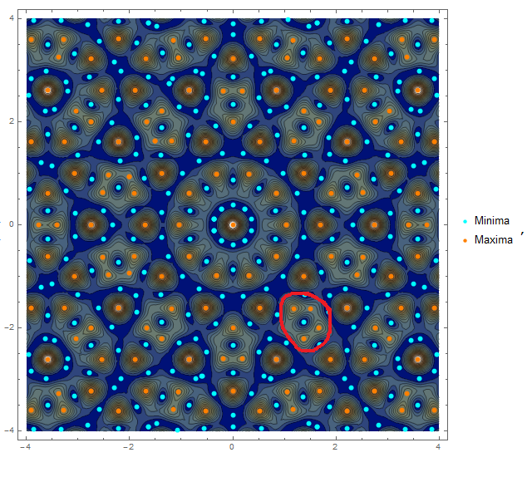
Basins of Attraction

Slide 17
Motivation & Challenges regarding DC-CMA-ES
Motivation
Sampling from more than one origin in the search space should improve range of search and diversity of solutions
It would be less likely for two searching methods (two EDAs) to get trapped in local optima as compared to one
Challenges
Designing a new EDA for the extra search method
Synchronizing the use of two EDAs in the sampling process
Restricting the worst performing EDA from diminishing the overall performance of the algorithm
Determining which EDA is more likely to produce the best solutions

Slide 18
The Elite Center (Extra EDA)
The EDA used to determine the elite center is inspired by well established techniques in Evolutionary Computation such as:
Elitism
The age property of individual solutions
Weighted-Intermediate Recombination
This EDA accumulates the best solutions from each of the most recent g generations (history of elite solutions) in a sliding window in order to determine it’s next sampling point in the search space.
Originally, the next search point was simply the most recent elite solution
However this method of choosing the elite center was very unstable, especially in multimodal fitness landscapes

Slide 19
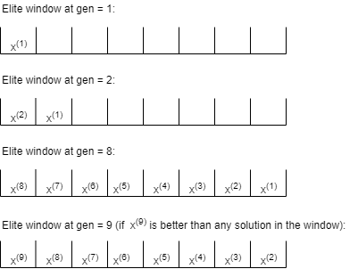
Functionality of the Sliding Window
A sliding window containing elite solutions is used to calculate the elite center and operates as follows:

Slide 20
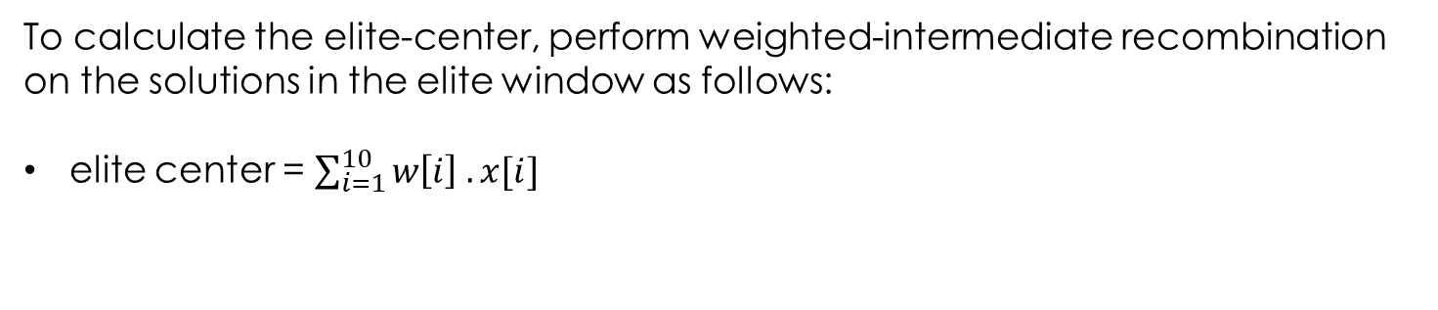
Calculating the Elite Center
history window containing the best solution from each of the 10 most recent generations, x[1:10].
x₁₀ | x₉ | x₈ | x₇ | x₆ | x₅ | x₄ | x₃ | x₂ | x₁
skewed set of log weights, w[1:10]
0.171 | 0.138 | 0.119 | 0.105 | 0.095 | 0.087 | 0.079 | 0.073 | 0.068 | 0.063
To calculate the elite-center, perform weighted-intermediate recombination on the solutions in the elite window as follows:
elite center = $\sum_{i=1}^{10}{w\left[i\right] . x[i]}$

Slide 21
Synchronizing the Sampling Process
One of the challenges associated with DC-CMA-ES was synchronizing the sampling of solutions between two centers.
The number of solutions each center generates is determined by a pair of fixed ratios
ratios where only the original center performs sampling is identical to CMA-ES
Both centers use the same covariance matrix and step-size. Hence, the two EDAs have an overlapping model.
How do they share the same covariance matrix? The master-slave relationship

Slide 22
Synchronizing the Sampling Process: Master-Slave relationship
In this analogy, the master is the original center while the slave is the elite center.
The slave accumulates and manages a fixed number of the best solutions from each generation (regardless of who found the solution) in order to determine where he/she will search next
The master searches for solutions on his own but also takes credit for every solution that the slave finds.
This allows them to share the same covariance matrix, since every solution found by the slave (elite center) is tied back to the (original center), as if the original center did all of the sampling originally.
The master uses the best solutions found by himself/herself and the slave to determine where to search next

Slide 23
Synchronized Sampling Process: Master-Slave Relationship
main center
elite center

Slide 24
Sampling Ratios
Sampling ratios are used to control the number of offspring sampled from each center
Choosing a small ratio for the elite center ensures that the extra EDA will not hinder the power of the underlying CMA-ES algorithm.
For example, if the original center samples ¾ of the population and the elite center samples ¼; when half of the population is truncated during selection, it could eliminate the elite center samples if they were all worse than the original center samples
As the dimensionality (complexity) of the problem increases, we have to be more careful about which center should dominate the sampling process
We came up with two conditional metrics to help make this decision on a per generation basis

Slide 25
Sampling Ratios: Conditional Metrics
Evaluation
Perform a function evaluation on each center
If the elite center has the better fitness value, then increase it’s sampling ratio
Otherwise, sampling ratios remain the same
The drawback of this method is that it uses 2 function evaluations per generation
Rank-Sum
Sum the ranks of the selected original center offspring
Sum the ranks of the selected elite center offspring
Increase the elite center sampling ratio if it has the lowest rank sum
The drawback of this method is that you can’t set the ratios to strictly favor one center

Slide 26
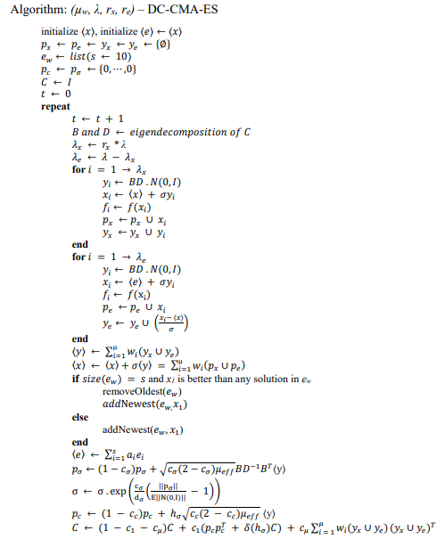
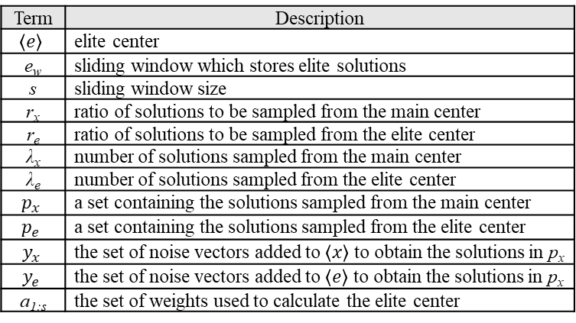
Pseudocode
Term | Description
$$〈e〉$$ | elite center
e_{w} | sliding window which stores elite solutions
s | sliding window size
r_{x} | ratio of solutions to be sampled from the main center
r_{e} | ratio of solutions to be sampled from the elite center
λ_{x} | number of solutions sampled from the main center
λ_{e} | number of solutions sampled from the elite center
$$p_{x}$$ | a set containing the solutions sampled from the main center
$$p_{e}$$ | a set containing the solutions sampled from the elite center
$$y_{x}$$ | the set of noise vectors added to $〈x〉$ to obtain the solutions in p_{x}
$$y_{e}$$ | the set of noise vectors added to $〈e〉$ to obtain the solutions in p_{x}
a_{1:s} | the set of weights used to calculate the elite center
initialization
calculate population sizes from ratios
main center sampling
elite center sampling
tie noise to the main center
manage elite window
update elite center

Slide 27
Experiments
DC-CMA-ES and CMA-ES were run simultaneously using a modified Common Random Number (CRN) simulation
These two CMA-ES algorithms were run 50 times for:
8 test functions
6 dimensions [5,10,25,50,75,100]
at 17 different ratios (including CMA-ES & DC-CMA-ES with conditional metrics)
A fixed budget of function evaluations set to 100n was used (n=dimension)

Slide 28
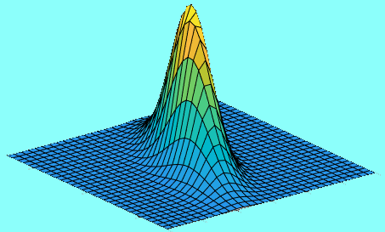

Common Random Numbers (CRN): Fixed Budget
N(0,I) – Spherical Noise
DC-CMA-ES
CMA-ES
Restart Request at 50n evals
Restart & Continue
Reached 100n evals
DC-CMA-ES run
CMA-ES run
Wait (Stop Run)
Reached 100n evals

Slide 29
Common Random Numbers (CRN): Goal-Oriented
Dual-center system
N(0,I) – Spherical Noise
CMA-ES system
500 evals
Did the CMA-ES system win?
Dual-center system wants to restart at 500 evals but has to wait on the other system to restart
900 evals
No, the dual-center system should be given a chance to find the solution before 900 evals.
This system has FOUND the solution first! It never wanted to restart.
DC-CMA-ES run
CMA-ES run
Wait (Stop Run)

Slide 30
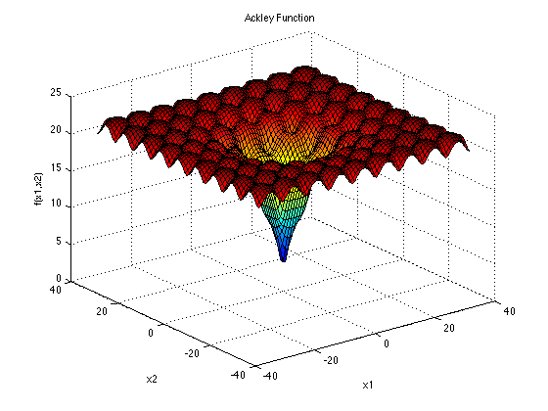
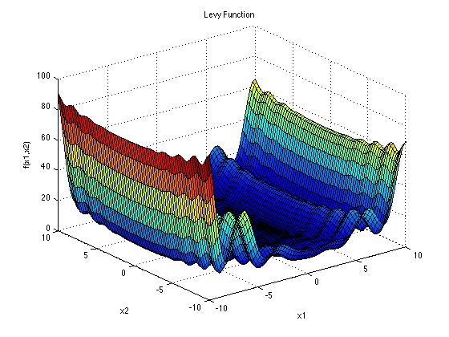
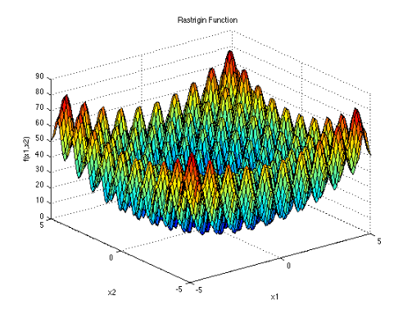
Test Functions: Multimodal
Surjanovic, S & Derek Bingham. (August 2017) . Ackley Function [PNG]. Retrieved from https://www.sfu.ca/~ssurjano/ackley.html
Surjanovic, S & Derek Bingham. (August 2017) . Levy Function [PNG]. Retrieved from https://www.sfu.ca/~ssurjano/levy.html
Surjanovic, S & Derek Bingham. (August 2017) . Rastrigin Function [PNG]. Retrieved from https://www.sfu.ca/~ssurjano/rastr.html

Slide 31
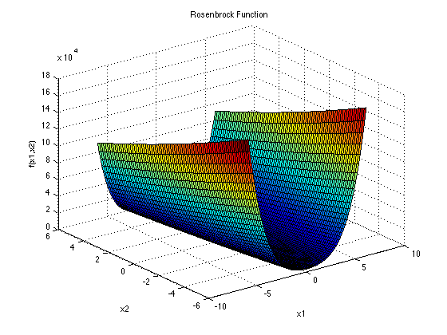
Test Functions: Multimodal
Surjanovic, S & Derek Bingham. (August 2017) . Rosenbrock Function [PNG]. Retrieved from https://www.sfu.ca/~ssurjano/rosen.html
According to Kok & Sandrock (2009), the Rosenbrock function forms additional local minima and many saddle points when the dimensionality is ≥ 4. Since the lowest dimensionality experimented on in this thesis was 5, we consider it as a multimodal function

Slide 32
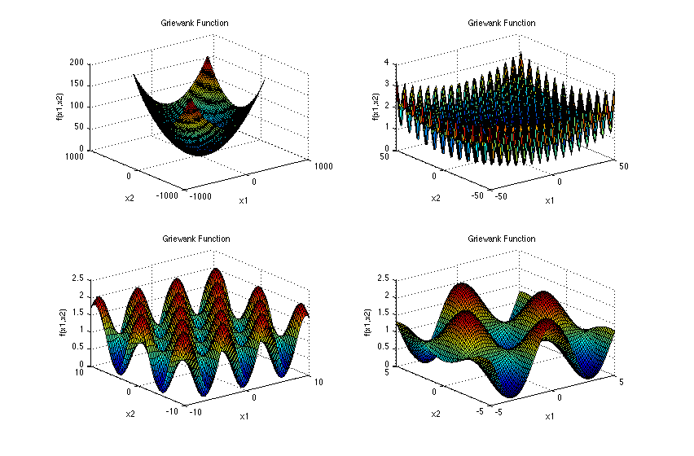
Test Functions: Multimodal
Surjanovic, S & Derek Bingham. (August 2017) . Griewank Function [PNG]. Retrieved from https://www.sfu.ca/~ssurjano/griewank.html

Slide 33
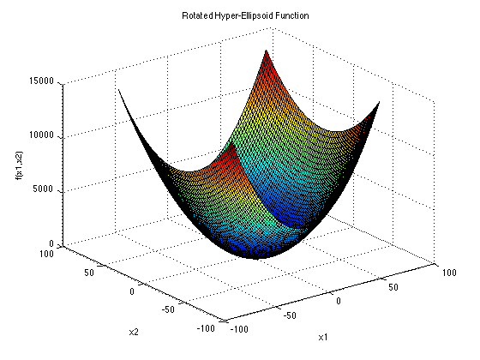
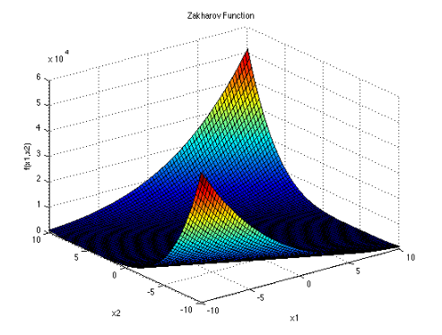
Test Functions: Unimodal
Surjanovic, S & Derek Bingham. (August 2017) . Elliptical Function [PNG]. Retrieved from https://www.sfu.ca/~ssurjano/rothyp.html
Surjanovic, S & Derek Bingham. (August 2017) . Zakharov Function [PNG]. Retrieved from https://www.sfu.ca/~ssurjano/zakharov.html

Slide 34
Results: Main Effects
system | r_{x} | r_{e} | means | group
dualcenter | 0.0 | 1.0 | 0.980726836 | a
dualcenter | 0.25 | 0.75 | 0.47168142 | b
IPOP-CMA-ES | 1.0 | 0.0 | 0.461258262 | b
cond-dualcenter | 0.5-0.5 | 0.0-1.0 | 0.38650352 | c
cond-dualcenter | 0.5-0.5 | 0.25-0.75 | 0.372839137 | cd
cond-dualcenter | 0.75-0.25 | 0.0-1.0 | 0.318215438 | de
rs-dualcenter | 0.5-0.5 | 0.25-0.75 | 0.317761093 | e
cond-dualcenter | 0.75-0.25 | 0.75-0.25 | 0.29230512 | ef
cond-dualcenter | 0.75-0.25 | 0.5-0.5 | 0.287354569 | ef
dualcenter | 0.5 | 0.5 | 0.264913244 | fg
dualcenter | 0.75 | 0.25 | 0.237818369 | gh
cond-dualcenter | 1.0-0.0 | 0.0-1.0 | 0.23457734 | gh
cond-dualcenter | 1.0-0.0 | 0.75-0.25 | 0.232724025 | gh
cond-dualcenter | 1.0-0.0 | 0.25-0.75 | 0.229297767 | ghi
rs-dualcenter | 0.75-0.25 | 0.25-0.75 | 0.228289752 | ghi
cond-dualcenter | 1.0-0.0 | 0.5-0.5 | 0.222463855 | hi
rs-dualcenter | 0.75-0.25 | 0.5-0.5 | 0.196919405 | i

Slide 35
Results: Ackley
function | system | r_{x} | r_{e} | means | group
ackley | dualcenter | 0.0 | 1.0 | 0.17258676 | qrstuv
ackley | dualcenter | 0.25 | 0.75 | 0.050402009 | zABC
ackley | IPOP-CMA-ES | 1.0 | 0.0 | 0.045523428 | BCD
ackley | cond-dualcenter | 0.5-0.5 | 0.25-0.75 | 0.028678235 | CDEF
ackley | cond-dualcenter | 0.5-0.5 | 0.0-1.0 | 0.027855219 | CDEFG
ackley | cond-dualcenter | 0.75-0.25 | 0.0-1.0 | 0.024749275 | DEFG
ackley | cond-dualcenter | 0.75-0.25 | 0.25-0.75 | 0.021943994 | EFG
ackley | cond-dualcenter | 0.75-0.25 | 0.5-0.5 | 0.020970899 | FG
ackley | cond-dualcenter | 1.0-0.0 | 0.5-0.5 | 0.018771639 | FGH
ackley | rs-dualcenter | 0.5-0.5 | 0.25-0.75 | 0.018462547 | FGH
ackley | dualcenter | 0.75 | 0.25 | 0.018326322 | FGH
ackley | cond-dualcenter | 1.0-0.0 | 0.0-1.0 | 0.015897679 | FGH
ackley | cond-dualcenter | 1.0-0.0 | 0.75-0.25 | 0.015860541 | FGH
ackley | dualcenter | 0.5 | 0.5 | 0.015111253 | FGH
ackley | cond-dualcenter | 1.0-0.0 | 0.25-0.75 | 0.014807807 | FGH
ackley | rs-dualcenter | 0.75-0.25 | 0.25-0.75 | 0.014231207 | GH
ackley | rs-dualcenter | 0.75-0.25 | 0.5-0.5 | 0.010339798 | H

Slide 36
Results: Griewank
function | system | r_{x} | r_{e} | means | group
griewank | dualcenter | 0.0 | 1.0 | 0.003230298 | I
griewank | IPOP-CMA-ES | 1.0 | 0.0 | 0.00111369 | J
griewank | dualcenter | 0.25 | 0.75 | 0.000599728 | JK
griewank | cond-dualcenter | 0.5-0.5 | 0.25-0.75 | 0.000492237 | JKL
griewank | cond-dualcenter | 0.5-0.5 | 0.0-1.0 | 0.000457673 | KLM
griewank | cond-dualcenter | 0.75-0.25 | 0.0-1.0 | 0.000367983 | KLMN
griewank | cond-dualcenter | 0.75-0.25 | 0.25-0.25 | 0.000327066 | KLMN
griewank | cond-dualcenter | 0.75-0.25 | 0.5-0.5 | 0.000326331 | KLMN
griewank | cond-dualcenter | 1.0-0.0 | 0.0-1.0 | 0.000234601 | LMNOP
griewank | cond-dualcenter | 1.0-0.0 | 0.75-0.25 | 0.000209169 | LMNOPQ
griewank | dualcenter | 0.75 | 0.25 | 0.000196035 | MNOPQR
griewank | rs-dualcenter | 0.5-0.5 | 0.25-0.75 | 0.000195362 | NOPQR
griewank | dualcenter | 0.5 | 0.5 | 0.000179814 | NOPQR
griewank | rs-dualcenter | 0.75-0.25 | 0.25-0.75 | 0.00016949 | NOPQRS
griewank | cond-dualcenter | 1.0-0.0 | 0.25-0.75 | 0.0001623 | NOPQRS
griewank | cond-dualcenter | 1.0-0.0 | 0.5-0.5 | 0.00015207 | NOPQRS
griewank | rs-dualcenter | 0.75-0.25 | 0.5-0.5 | 0.000126535 | OPQRST

Slide 37
Results: Levy
function | system | r_{x} | r_{e} | means | group
levy | dualcenter | 0.0 | 1.0 | 0.35366576 | op
levy | dualcenter | 0.25 | 0.75 | 0.212533793 | pqrst
levy | cond-dualcenter | 0.5-0.5 | 0.25-0.75 | 0.190381567 | qrst
levy | cond-dualcenter | 0.5-0.5 | 1.0-0.0 | 0.183294987 | qrstu
levy | cond-dualcenter | 0.75-0.25 | 0.0-1.0 | 0.124427824 | tuvwx
levy | cond-dualcenter | 1.0-0.0 | 0.0-1.0 | 0.122342305 | tuvwx
levy | cond-dualcenter | 0.75-0.25 | 0.25-0.75 | 0.119693404 | tuvwx
levy | rs-dualcenter | 0.5-0.5 | 0.25-0.75 | 0.110784515 | uvwx
levy | cond-dualcenter | 1.0-0.0 | 0.25-0.75 | 0.096831509 | vwxy
levy | rs-dualcenter | 0.75-0.25 | 0.25-0.75 | 0.09594786 | vwxy
levy | dualcenter | 0.5 | 0.5 | 0.094950956 | vwxyz
levy | cond-dualcenter | 0.75-0.25 | 0.5-0.5 | 0.077151729 | xyzAB
levy | cond-dualcenter | 1.0-0.0 | 0.5-0.5 | 0.069312447 | xyzAB
levy | cond-dualcenter | 1.0-0.0 | 0.75-0.25 | 0.068530702 | xyzAB
levy | rs-dualcenter | 0.75-0.25 | 0.5-0.5 | 0.058640452 | yzAB
levy | IPOP-CMA-ES | 1.0 | 0.0 | 0.048092132 | ABCD
levy | dualcenter | 0.75 | 0.25 | 0.042312906 | BCDE

Slide 38
Results: Rastrigin
function | system | r_{x} | r_{e} | means | group
rastrigin | IPOP-CMA-ES | 1.0 | 0.0 | 147.1763114 | a
rastrigin | dualcenter | 0.0 | 1.0 | 60.93550937 | bc
rastrigin | cond-dualcenter | 0.5-0.5 | 0.0-1.0 | 59.47970207 | bcd
rastrigin | cond-dualcenter | 1.0-0.0 | 0.0-1.0 | 56.67641212 | bcde
rastrigin | cond-dualcenter | 1.0-0.0 | 0.75-0.25 | 56.20012932 | bcdef
rastrigin | dualcenter | 0.25 | 0.75 | 54.35393177 | bcdefg
rastrigin | cond-dualcenter | 0.75-0.25 | 0.0-1.0 | 54.28960833 | bcdefg
rastrigin | cond-dualcenter | 0.5-0.5 | 0.25-0.75 | 53.50255202 | bcdefg
rastrigin | dualcenter | 0.75 | 0.25 | 53.29764564 | bcdefg
rastrigin | cond-dualcenter | 1.0-0.0 | 0.5-0.5 | 52.8324448 | bcdefg
rastrigin | dualcenter | 0.5 | 0.5 | 52.10532943 | bcdefg
rastrigin | cond-dualcenter | 1.0-0.0 | 0.25-0.75 | 49.92925556 | bcdefg
rastrigin | cond-dualcenter | 0.75-0.25 | 0.5-0.5 | 49.27317944 | bcdefgh
rastrigin | cond-dualcenter | 0.75-0.25 | 0.25-0.75 | 48.16782918 | bcdefghi
rastrigin | rs-dualcenter | 0.5-0.5 | 0.25-0.75 | 47.44091741 | bcdefghi
rastrigin | rs-dualcenter | 0.75-0.25 | 0.25-0.75 | 46.61804273 | bcdefghij
rastrigin | rs-dualcenter | 0.75-0.25 | 0.5-0.5 | 46.61104048 | bcdefghij

Slide 39
Results: Schwefel
function | system | r_{x} | r_{e} | means | groups
schwefel | dualcenter | 0.0 | 1.0 | 0.000477601 | KL
schwefel | IPOP-CMA-ES | 1.0 | 0.0 | 0.000297597 | KLMNO
schwefel | dualcenter | 0.75 | 0.5 | 0.000208435 | LMNOPQ
schwefel | cond-dualcenter | 0.5-0.5 | 0.0-1.0 | 0.000121029 | OPQRSTU
schwefel | dualcenter | 0.5 | 0.5 | 0.000116985 | PQRSTUV
schwefel | cond-dualcenter | 0.75-0.25 | 0.25-0.75 | 0.000102031 | PQRSTUV
schwefel | dualcenter | 0.25 | 0.75 | 0.000101271 | PQRSTUV
schwefel | cond-dualcenter | 0.75-0.25 | 0.5-0.5 | 9.13708E-05 | QRSTUVW
schwefel | cond-dualcenter | 0.75-0.25 | 0.0-1.0 | 7.7823E-05 | RSTUVWX
schwefel | cond-dualcenter | 0.25-0.75 | 0.5-0.5 | 6.85641E-05 | STUVWX
schwefel | cond-dualcenter | 1.0-0.0 | 0.5-0.5 | 5.03215E-05 | TUVWX
schwefel | cond-dualcenter | 1.0-0.0 | 0.25-0.75 | 4.76935E-05 | UVWX
schwefel | cond-dualcenter | 1.0-0.0 | 0.75-0.25 | 4.50668E-05 | VWX
schwefel | rs-dualcenter | 0.75-0.25 | 0.5-0.5 | 3.65884E-05 | WX
schwefel | rs-dualcenter | 0.5-0.5 | 0.25-0.75 | 3.65182E-05 | WX
schwefel | rs-dualcenter | 0.75-0.25 | 0.75-0.25 | 3.37462E-05 | X
schwefel | cond-dualcenter | 1.0-0.0 | 0.0-1.0 | 3.06771E-05 | X

Slide 40
Results: Rosenbrock
function | system | r_{e} | r_{x} | means | group
rosenbrock | dualcenter | 0.0 | 1.0 | 112.6584486 | a
rosenbrock | dualcenter | 0.25 | 0.75 | 67.23614793 | b
rosenbrock | rs-dualcenter | 0.5-0.5 | 0.25-0.75 | 50.02356048 | bcdefg
rosenbrock | dualcenter | 0.5 | 0.5 | 45.60300689 | bcdefghij
rosenbrock | cond-dualcenter | 0.5-0.5 | 0.25-0.75 | 42.04211074 | cdefghij
rosenbrock | cond-dualcenter | 0.75-0.25 | 0.0-1.0 | 41.57827142 | cdefghij
rosenbrock | rs-dualcenter | 0.75-0.25 | 0.5-0.5 | 39.70366715 | cdefghij
rosenbrock | cond-dualcenter | 0.75-0.25 | 0.5-0.5 | 39.44106963 | defghij
rosenbrock | cond-dualcenter | 0.5-0.5 | 0.0-1.0 | 39.07435192 | defghij
rosenbrock | rs-dualcenter | 0.75-0.25 | 0.25-0.75 | 37.33553933 | efghij
rosenbrock | IPOP-CMA-ES | 1.0 | 0.0 | 36.86061248 | efghij
rosenbrock | cond-dualcenter | 0.75-0.25 | 0.25-0.75 | 36.7522971 | fghij
rosenbrock | dualcenter | 0.75 | 0.25 | 35.3719264 | ghij
rosenbrock | cond-dualcenter | 1.0-0.0 | 0.75-0.25 | 32.05685651 | hij
rosenbrock | cond-dualcenter | 1.0-0.0 | 0.5-0.5 | 31.41133945 | ij
rosenbrock | cond-dualcenter | 1.0-0.0 | 0.25-0.75 | 30.58473897 | j
rosenbrock | cond-dualcenter | 1.0-0.0 | 0.0-1.0 | 30.55174864 | j

Slide 41
Results: Elliptical
function | system | r_{x} | r_{e} | means | group
elliptical | dualcenter | 0.0 | 1.0 | 1.410394786 | n
elliptical | dualcenter | 0.25 | 0.75 | 0.461751442 | o
elliptical | cond-dualcenter | 0.5-0.5 | 0.25-0.75 | 0.289695365 | opq
elliptical | cond-dualcenter | 0.5-0.5 | 0.0-1.0 | 0.287194417 | opqr
elliptical | IPOP-CMA-ES | 1.0 | 0.0 | 0.239338247 | pqrs
elliptical | cond-dualcenter | 0.75-0.25 | 0.0-1.0 | 0.186460778 | qrstu
elliptical | cond-dualcenter | 0.75-0.25 | 0.5-0.5 | 0.173988598 | qrstuv
elliptical | rs-dualcenter | 0.5-0.5 | 0.25-0.75 | 0.171752866 | rstuv
elliptical | rs-dualcenter | 0.75-0.25 | 0.25-0.75 | 0.14776988 | stuvw
elliptical | cond-dualcenter | 0.75-0.25 | 0.25-0.75 | 0.146826973 | stuvw
elliptical | dualcenter | 0.5 | 0.5 | 0.145873704 | stuvw
elliptical | cond-dualcenter | 1.0-0.0 | 0.25-0.75 | 0.106912199 | uvwxy
elliptical | dualcenter | 0.75 | 0.25 | 0.097608199 | vwxy
elliptical | rs-dualcenter | 0.75-0.25 | 0.5-0.5 | 0.09671144 | vwxy
elliptical | cond-dualcenter | 1.0-0.0 | 0.0-1.0 | 0.088961955 | wxyzA
elliptical | cond-dualcenter | 1.0-0.0 | 0.75-0.25 | 0.08806114 | wxyzA
elliptical | cond-dualcenter | 1.0-0.0 | 0.5-0.5 | 0.077045025 | xyzAB

Slide 42
Results: Zakharov
function | system | r_{x} | r_{e} | means | group
zakharov | IPOP-CMA-ES | 1.0 | 0.0 | 16.24145573 | k
zakharov | dualcenter | 0.0 | 1.0 | 15.71439568 | kl
zakharov | cond-dualcenter | 0.5-0.5 | 0.0-1.0 | 15.7023013 | kl
zakharov | cond-dualcenter | 0.5-0.5 | 0.25-0.75 | 15.48952502 | kl
zakharov | cond-dualcenter | 1.0-0.0 | 0.75-0.25 | 14.99357513 | klm
zakharov | cond-dualcenter | 0.75-0.25 | 0.5-0.5 | 13.5408201 | klm
zakharov | cond-dualcenter | 1.0-0.0 | 0.5-0.5 | 13.49306437 | klm
zakharov | dual-center | 0.25 | 0.75 | 13.29205583 | klm
zakharov | cond-dualcenter | 0.75-0.25 | 0.0-1.0 | 13.28066326 | klm
zakharov | cond-dualcenter | 1.0-0.0 | 0.25-0.75 | 12.72348326 | klm
zakharov | cond-dualcenter | 0.25-0.75 | 0.75-0.25 | 12.58019552 | klm
zakharov | cond-dualcenter | 1.0-0.0 | 0.0-1.0 | 11.93447709 | klm
zakharov | rs-dualcenter | 0.75-0.25 | 0.5-0.5 | 10.12630348 | lm
zakharov | rs-dualcenter | 0.75-0.25 | 0.25-0.75 | 10.01420532 | lm
zakharov | rs-dualcenter | 0.5-0.5 | 0.25-0.75 | 10.00664763 | lm
zakharov | dualcenter | 0.5 | 0.5 | 9.579555485 | m
zakharov | dualcenter | 0.75 | 0.25 | 9.503907295 | m

Slide 43
Results: Dimension 5
dimension | system | r_{x} | r_{e} | means | group
5 | cond-dualcenter | 1.0-0.0 | 0.75-0.25 | 0.011237 | LM
5 | cond-dualcenter | 1.0-0.0 | 0.5-0.5 | 0.010888 | LM
5 | cond-dualcenter | 0.5-0.5 | 0.25-0.75 | 0.009964 | M
5 | cond-dualcenter | 1.0-0.0 | 0.25-0.75 | 0.009855 | M
5 | cond-dualcenter | 0.75-0.25 | 0.5-0.5 | 0.009834 | M
5 | cond-dualcenter | 0.5-0.5 | 0.0-2.0 | 0.009818 | M
5 | cond-dualcenter | 0.75-0.25 | 0.25-0.75 | 0.009465 | M
5 | cond-dualcenter | 0.75-0.25 | 0.0-1.0 | 0.00918 | M
5 | cond-dualcenter | 1.0-0.0 | 0.0-1.0 | 0.009169 | M
5 | rs-dualcenter | 0.5-0.5 | 0.25-0.75 | 0.004289 | N
5 | IPOP-CMA-ES | 1.0 | 0.0 | 0.004102 | N
5 | dualcenter | 0.75 | 0.25 | 0.003644 | N
5 | dualcenter | 0.0 | 1.0 | 0.003442 | N
5 | dualcenter | 0.25 | 0.75 | 0.003117 | N
5 | rs-dualcenter | 0.75-0.25 | 0.25-0.75 | 0.003012 | N
5 | rs-dualcenter | 0.75-0.25 | 0.5-0.5 | 0.002858 | N
5 | dualcenter | 0.5 | 0.5 | 0.002805 | N

Slide 44
Results: Dimension 10
dimension | system | r_{x} | r_{e} | means | group
10 | cond-dualcenter | 1.0-0.0 | 0.75-0.25 | 0.034572 | I
10 | IPOP-CMA-ES | 1.0 | 0.0 | 0.03433 | I
10 | cond-dualcenter | 0.5-0.5 | 0.25-0.75 | 0.032124 | IJ
10 | cond-dualcenter | 0.75-0.25 | 0.5-0.5 | 0.03063 | IJ
10 | cond-dualcenter | 0.5-0.5 | 0.0-1.0 | 0.02985 | IJ
10 | cond-dualcenter | 0.75-0.25 | 0.25-0.75 | 0.028341 | IJ
10 | cond-dualcenter | 0.75-0.25 | 0.0-1.0 | 0.027562 | IJ
10 | cond-dualcenter | 1.0-0.0 | 0.0-1.0 | 0.027327 | IJ
10 | cond-dualcenter | 1.0-0.0 | 0.5-0.5 | 0.026374 | IJ
10 | cond-dualcenter | 1.0-0.0 | 0.25-0.75 | 0.026157 | IJ
10 | dualcenter | 0.0 | 1.0 | 0.024983 | IJ
10 | rs-dualcenter | 0.5-0.5 | 0.25-0.75 | 0.020118 | JK
10 | dualcenter | 0.25 | 0.75 | 0.018359 | JKL
10 | dualcenter | 0.75 | 0.25 | 0.013727 | KLM
10 | dualcenter | 0.5 | 0.5 | 0.013229 | KLM
10 | rs-dualcenter | 0.75-0.25 | 0.25-0.75 | 0.011782 | LM
10 | rs-dualcenter | 0.75-0.25 | 0.5-0.5 | 0.010649 | LM

Slide 45
Results: Dimension 25
dimension | system | r_{x} | r_{e} | means | group
25 | dualcenter | 0.0 | 1.0 | 0.591967 | wxyz
25 | IPOP-CMA-ES | 1.0 | 0.0 | 0.325685 | AB
25 | dualcenter | 0.25 | 0.75 | 0.248323 | BC
25 | cond-dualcenter | 0.5-0.5 | 0.25-0.75 | 0.220933 | BCD
25 | cond-dualcenter | 0.5-0.5 | 0.0-1.0 | 0.197425 | CDE
25 | cond-dualcenter | 0.75-0.25 | 0.0-1.0 | 0.182599 | CDEF
25 | cond-dualcenter | 0.75-0.25 | 0.5-0.5 | 0.157517 | CDEFG
25 | rs-dualcenter | 0.5-0.5 | 0.25-0.75 | 0.1442 | DEFG
25 | dualcenter | 0.5 | 0.5 | 0.137899 | DEFGH
25 | cond-dualcenter | 0.75-0.25 | 0.25-0.75 | 0.132566 | EFGH
25 | cond-dualcenter | 1.0-0.0 | 0.75-0.25 | 0.13016 | EFGH
25 | cond-dualcenter | 1.0-0.0 | 0.25-0.75 | 0.129862 | EFGH
25 | cond-dualcenter | 1.0-0.0 | 0.0-1.0 | 0.120512 | EFGH
25 | dualcenter | 0.75 | 0.25 | 0.116607 | FGH
25 | cond-dualcenter | 1.0-0.0 | 0.5-0.5 | 0.112087 | FGH
25 | rs-dualcenter | 0.75-0.25 | 0.25-0.75 | 0.101983 | GH
25 | rs-dualcenter | 0.75-0.25 | 0.5-0.5 | 0.090101 | H

Slide 46
Results: Dimension 50
dimension | system | r_{x} | r_{e} | means | groups
50 | dualcenter | 0.0 | 1.0 | 4.083197 | ghi
50 | dualcenter | 0.25 | 0.75 | 1.762478 | nopq
50 | IPOP-CMA-ES | 1.0 | 0.0 | 1.30453 | pqr
50 | rs-dualcenter | 0.5-0.5 | 0.25-0.75 | 1.03152 | rstu
50 | cond-dualcenter | 0.5-0.5 | 0.0-1.0 | 1.007965 | rstuv
50 | cond-dualcenter | 0.5-0.5 | 0.25-0.75 | 0.923587 | rstuvw
50 | cond-dualcenter | 0.75-0.25 | 0.0-1.0 | 0.820638 | stuvwx
50 | rs-dualcenter | 0.75-0.25 | 0.25-0.75 | 0.808048 | stuvwx
50 | cond-dualcenter | 0.75-0.25 | 0.25-0.75 | 0.738633 | tuvwxy
50 | dualcenter | 0.75 | 0.25 | 0.698816 | uvwxy
50 | rs-dualcenter | 0.75-0.25 | 0.5-0.5 | 0.690185 | uvwxyz
50 | cond-dualcenter | 0.75-0.25 | 0.5-0.5 | 0.678047 | vwxyz
50 | dualcenter | 0.5 | 0.5 | 0.585818 | wxyz
50 | cond-dualcener | 1.0-0.0 | 0.25-0.75 | 0.528891 | xyz
50 | cond-dualcenter | 1.0-0.0 | 0.0-1.0 | 0.503505 | yzA
50 | cond-dualcenter | 1.0-0.0 | 0.75-0.25 | 0.479242 | yzA
50 | cond-dualcenter | 1.0-0.0 | 0.5-0.5 | 0.435083 | zA

Slide 47
Results: Dimension 75
dimension | system | r_{x} | r_{e} | means | group
75 | dualcenter | 0.0 | 1.0 | 14.38816 | b
75 | dualcenter | 0.25 | 0.75 | 5.622925 | fg
75 | IPOP-CMA-ES | 1.0 | 0.0 | 4.134013 | ghi
75 | cond-dualcenter | 0.5-0.5 | 0.0-1.0 | 3.015878 | ijkl
75 | dualcenter | 0.5 | 0.5 | 2.890998 | ijkl
75 | rs-dualcenter | 0.5-0.5 | 0.25-0.75 | 2.653593 | jklm
75 | cond-dualcenter | 0.5-0.5 | 0.25-0.75 | 2.315674 | klmn
75 | rs-dualcenter | 0.75-0.25 | 0.25-0.75 | 2.106456 | lmn
75 | dualcenter | 0.75 | 0.25 | 2.067891 | lmno
75 | cond-dualcenter | 0.75-0.25 | 0.0-1.0 | 1.852074 | mnop
75 | cond-dualcener | 0.75-0.25 | 0.5-0.5 | 1.764421 | nopq
75 | cond-dualcenter | 0.75-0.25 | 0.25-.75 | 1.718551 | nopq
75 | rs-dualcenter | 0.75-0.25 | 0.5-0.5 | 1.567011 | nopq
75 | cond-dualcenter | 1.0-0.0 | 0.0-1.0 | 1.342304 | opqr
75 | cond-dualcenter | 1.0-0.0 | 0.25-0.75 | 1.181608 | qrs
75 | cond-dualcenter | 1.0-0.0 | 0.5-0.5 | 1.170769 | qrs
75 | cond-dualcenter | 1.0-0.0 | 0.75-0.25 | 1.130551 | qrst

Slide 48
Results: Dimension 100
dimension | system | r_{x} | r_{e} | means | group
100 | dualcenter | 0.0 | 1.0 | 40.28188 | a
100 | dualcenter | 0.25 | 0.75 | 15.10568 | b
100 | IPOP-CMA-ES | 1.0 | 0.0 | 10.46242 | bc
100 | dualcenter | 0.5 | 0.5 | 9.298715 | cd
100 | rs-dualcenter | 0.5-0.5 | 0.25-0.75 | 8.361673 | cde
100 | cond-dualcenter | 0.5-0.5 | 0.0-1.0 | 6.895625 | def
100 | cond-dualcenter | 0.5-00.5 | 0.25-0.75 | 6.839608 | def
100 | dualcenter | 0.75 | 0.25 | 6.088878 | efg
100 | rs-dualcenter | 0.75-0.25 | 0.25-0.75 | 5.993764 | efg
100 | cond-dualcenter | 0.75-0.25 | 0.0-1.0 | 5.812736 | fg
100 | cond-dualcenter | 0.75-0.25 | 0.25-0.75 | 5.54501 | fgh
100 | rs-dualcenter | 0.75-0.25 | 0.5-0.5 | 5.359464 | fgh
100 | cond-dualcenter | 0.75-0.25 | 0.5-0.5 | 4.286006 | ghi
100 | cond-dualcenter | 1.0-0.0 | 0.0-1.0 | 3.662443 | hij
100 | cond-dualcenter | 1.0-0.0 | 0.5-0.5 | 3.494681 | ijk
100 | cond-dualcenter | 1.0-0.0 | 0.25-0.75 | 3.252008 | ijk
100 | cond-dualcenter | 1.0-0.0 | 0.75-0.25 | 2.943785 | ijkl

Slide 49
Conclusion
Since the systems that sampled strictly using one of the EDAs both performed worse than the DC-CMA-ES systems with equal sampling ratios or original EDA domination ratios, we can conclude that:
using two search methods for optimization is an effective strategy
especially for highly multimodal functions
with increasing dimension
still managed to be effective on some unimodal functions
The use of the conditional metric becomes very useful as dimensionality increases, even though it uses extra evaluations
when this metric is used to choose which center should dominate sampling, strictly sampling from the elite center when appropriate proved to be very rewarding

Slide 50
Future Work
Add more EDAs to the system
Separate the models (use different covariance matrices and step-size
Use a dynamic window size for the elite sliding window according to problem dimension
Test the effectiveness of the Common Random Number simulation

Slide 51
References
Auger, A., & Hansen, N. (2013). Tutorial CMA-ES. Proceeding of the Fifteenth Annual Conference Companion on Genetic and Evolutionary Computation Conference Companion - GECCO 13 Companion. doi:10.1145/2464576.2483910
Wineberg, M. (2018). 1 Evolution Strategies [PDF Slides].
Wineberg, M. (2018). 7 CMA-ES [PDF Slides].
Wineberg, M. (2018). 8 IPOP [PDF Slides].
Wineberg, M. (2018). 4 Estimation of Distribution Algorithms [PDF Slides].
Kok, S., & Sandrock, C. Locating and Characterizing the Stationary Points of the Extended Rosenbrock Function. Evolutionary Computation, vol. 17, no. 3, pp. 437-453.

