Slide 1
Dual-center CMA-ES
1033631
Dillon Bourne
University of Guelph

Slide 2
Outline
CMA-ES Review
Motivation
Dual-center CMA-ES System
Results
Planned course of work

Slide 3
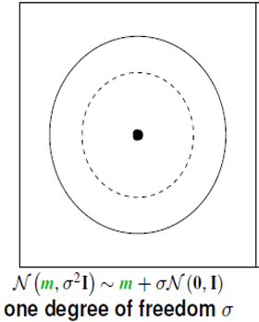
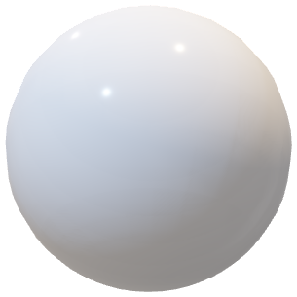
Multivariate Normal Distribution
Image taken from “Tutorial CMAE-ES – Evolutionary Strategies and Covariance Matrix Adaptation” by Anne Auger & Nikolaus Hansen

Slide 4
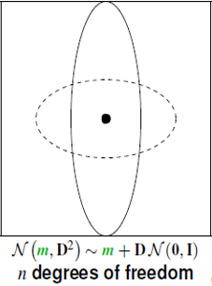
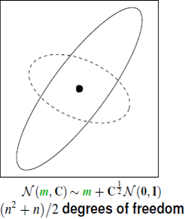
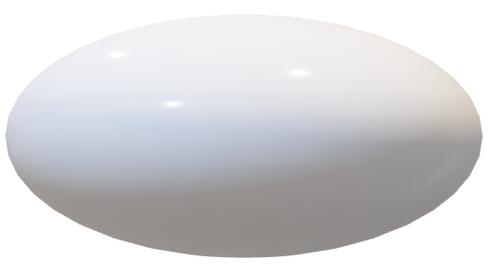
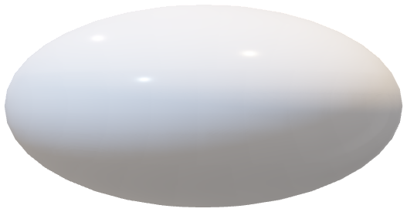
Multivariate Normal Distributions
Image taken from “Tutorial CMAE-ES – Evolutionary Strategies and Covariance Matrix Adaptation” by Anne Auger & Nikolaus Hansen

Slide 5
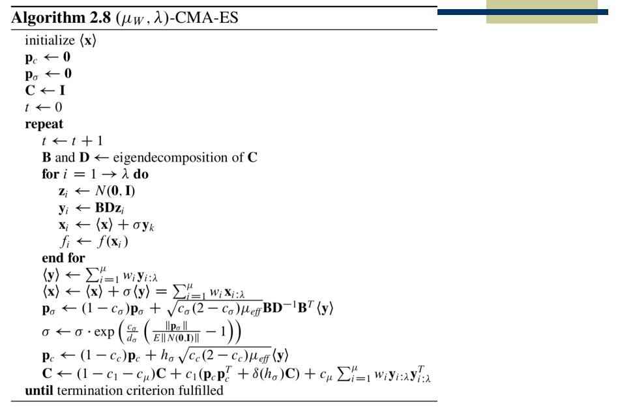
initialization
random sample
evaluate
selection & update center
update step-size
update covariance

Slide 6
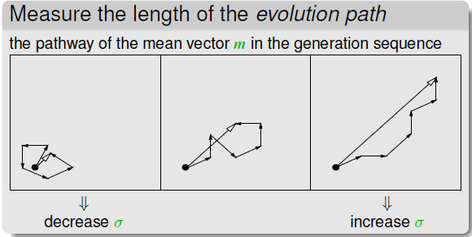

Slide 7
rank-one update matrix
rank-µ update matrix

Slide 8
Rank-One and Rank-Mu Updates
The rank-one update was used on it’s own before rank-mu was added.
The rank-mu update was included after to improve the learning rate in large populations.
The rank-mu is the primary mechanism used in large populations and multimodal functions.
The rank-one and rank-mu update can be used together in the covariance matrix update.

Slide 9
Increasing Population (IPOP)
Problem
The default population size which is relatively small, is only suitable for unimodal problems.
Multi-modal problems generally work best with a larger population
Solution
Start out with the default population size
Double the population size after every restart
SO…What determines that the system should restart?

Slide 10
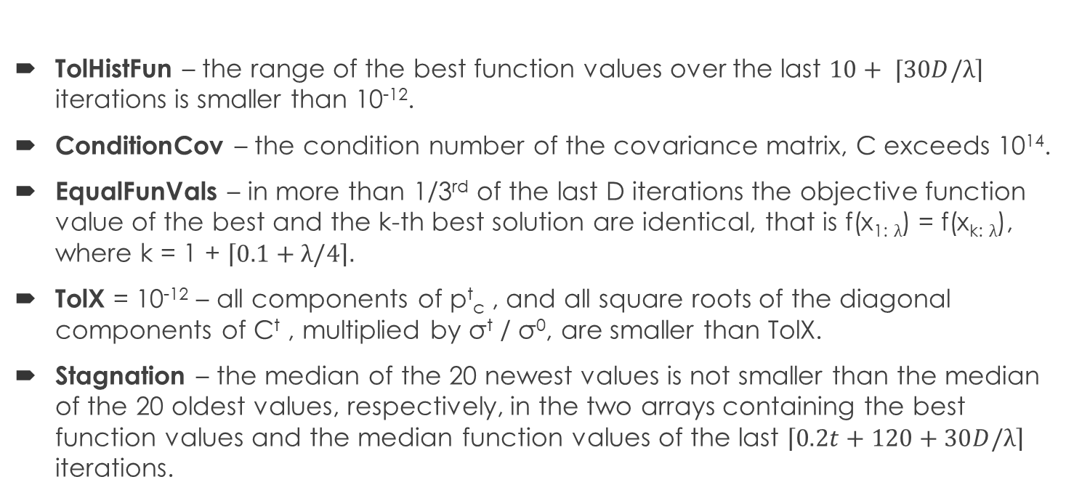
IPOP – Restart Conditions
TolHistFun – the range of the best function values over the last $10+ ⌈30D/\left.λ\right\rceil$ iterations is smaller than 10⁻¹².
ConditionCov – the condition number of the covariance matrix, C exceeds 10¹⁴.
EqualFunVals – in more than 1/3rd of the last D iterations the objective function value of the best and the k-th best solution are identical, that is f(x_{1:} $λ$) = f(x_{k:} $λ$), where k = 1 + $\left\lceil 0.1+λ/4\right\rceil .$
TolX = 10⁻¹² – all components of p^{t}_{c} , and all square roots of the diagonal components of C^{t} , multiplied by σ^{t} / σ⁰, are smaller than TolX.
Stagnation – the median of the 20 newest values is not smaller than the median of the 20 oldest values, respectively, in the two arrays containing the best function values and the median function values of the last $\left\lceil 0.2t+120+30D/λ\right\rceil$ iterations.

Slide 11
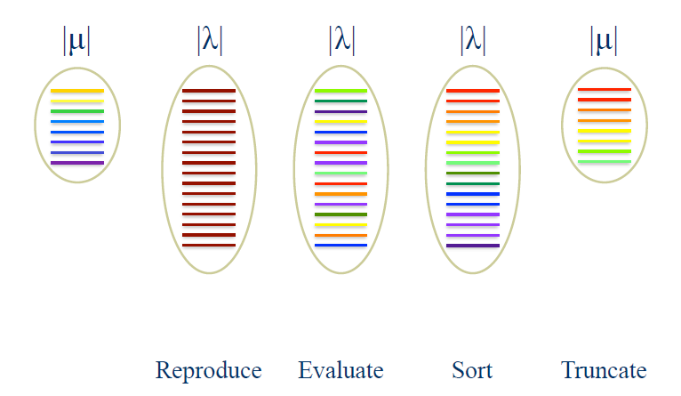
Selection in (µ, λ) – CMAES
Image taken from “Evolutionary Strategies” by Mark Wineberg

Slide 12
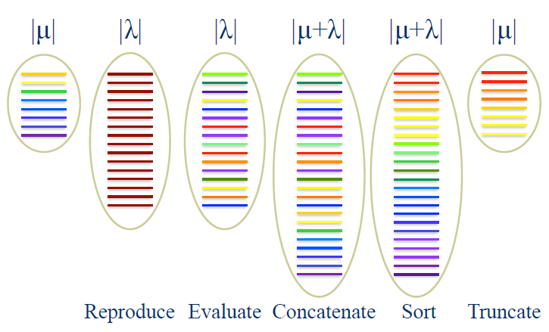
Elitism in (µ+λ)-CMAES
This method caused CMAES to perform poorly on most test functions, especially those with noisy & multi-modal characteristics.
Image taken from “Evolutionary Strategies” by Mark Wineberg

Slide 13
Motivation for Dual-center CMA-ES
The divergence towards this new idea came from an inability to understand why (μ + λ)-CMA-ES performs poorly on multimodal functions.
So we decided to approach elitism in an unorthodox way in hope of obtaining a better understanding of why it would perform poorly.
The main ideology behind Dual-center CMA-ES is that there is second center, which is calculated based on a window of previous best solutions, much like how elitism takes into consideration previous best solutions in it’s selection process.

Slide 14
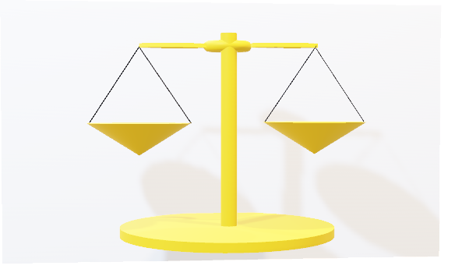
Motivation for Dual-center CMA-ES
How do you generate solutions from two-centers?
How does the system know how many solutions each center generates?
adaptive Solution Generation System

Slide 15
Dual-center CMAES System
This system features two additions to regular (µ,λ)-CMAES:
A 2nd center which I call the ‘best’ or ‘elite’ center
An Adaptive Method for generating solutions from the each of the centers
The best center is calculated using a history of the best offspring from previous generations.
The adaptive method for generating solutions utilizes a scoring system to determine how many of the λ offspring will be generated from the original center and the best center.

Slide 16
The Best Center (2nd center)
Calculating the best center involves two parameters:
history window size
weight distribution for averaging the solutions in the history window
The use of a history window gives the best center more stability
just using the previous generation’s best solution as best center can easily throw the search off-course if that ‘best solution’ wasn’t so good at all.
the average of a group of the best solutions from previous generations decreases the variance of the best center
The most suitable size of the window is still to be determined
the best results seen so far were using size 10
but perhaps there may be some relationship with the window size and population size, or window size and problem dimension

Slide 17
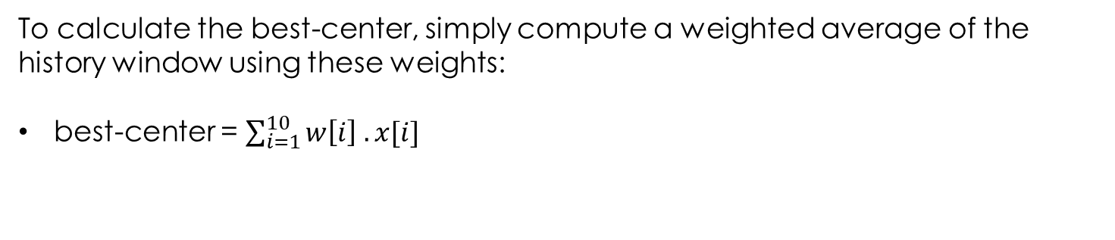
The Best Center (2nd center)
history window for best solutions of the 10 most recent generations, x[1:10]
x₁₀ | x₉ | x₈ | x₇ | x₆ | x₅ | x₄ | x₃ | x₂ | x₁
set of log weights as showing in previous settings, w[1:10]
0.171 | 0.138 | 0.119 | 0.105 | 0.095 | 0.087 | 0.079 | 0.073 | 0.068 | 0.063
To calculate the best-center, simply compute a weighted average of the history window using these weights:
best-center = $\sum_{i=1}^{10}{w\left[i\right] . x[i]}$

Slide 18
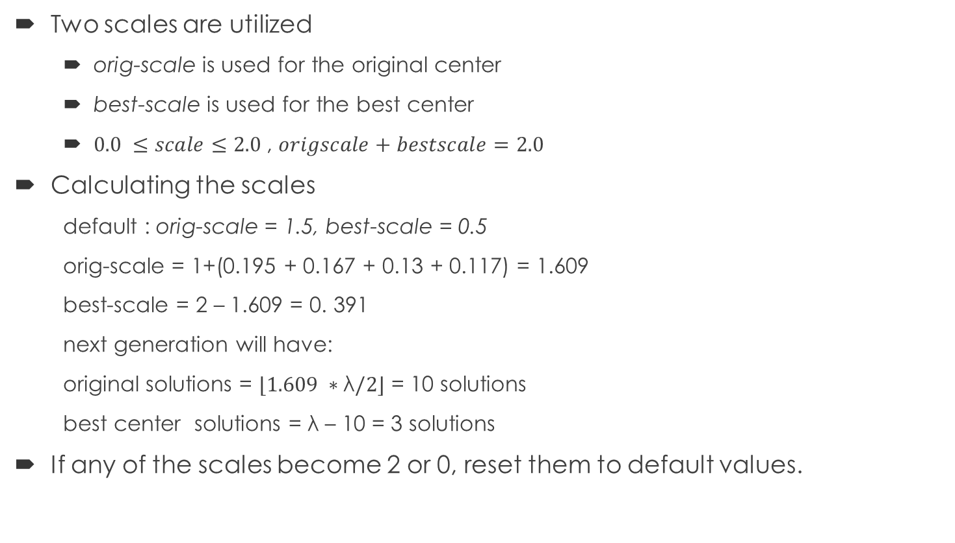
Adaptive Solution Generation System
Two scales are utilized
orig-scale is used for the original center
best-scale is used for the best center
$0.0 ≤scale≤2.0$, $origscale+bestscale=2.0$
Calculating the scales
default : orig-scale = 1.5, best-scale = 0.5
orig-scale = 1+(0.195 + 0.167 + 0.13 + 0.117) = 1.609
best-scale = 2 – 1.609 = 0. 391
next generation will have:
original solutions = $⌊1.609 ∗\text{λ}/2⌋$ = 10 solutions
best center solutions = λ – 10 = 3 solutions
If any of the scales become 2 or 0, reset them to default values.
µ | 6
λ | 13
w | array of weights
w[1] | 0.245 | best
w[2] | 0.195 | orig
w[3] | 0.167 | orig
w[4] | 0.146 | best
w[5] | 0.130 | orig
w[6] | 0.117 | orig

Slide 19
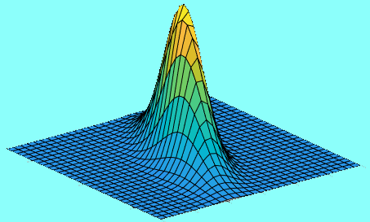
Common Random Numbers (CRN)
Dual-center system
N(0,I) – Spherical Noise
CMA-ES system
500 evals
Did the CMA-ES system win?
Dual-center system wants to restart at 500 evals but has to wait on the other system to restart
900 evals
No, the dual-center system should be given a chance to find the solution before 900 evals.
This system has FOUND the solution first! It never wanted to restart.

Slide 20
Common Random Numbers (CRN)
Dual-center system
N(0,I) – Spherical Noise
CMA-ES system
Since the other system has found it’s solution, dual-center can restart.
In other words, dual-center has a chance to catch up before 900 evals
500 evals
FOUND at 850 evals
FOUND at 900 evals
Since dual-center found a better solution than CMA-ES before 900 evals. It is the WINNER

Slide 21
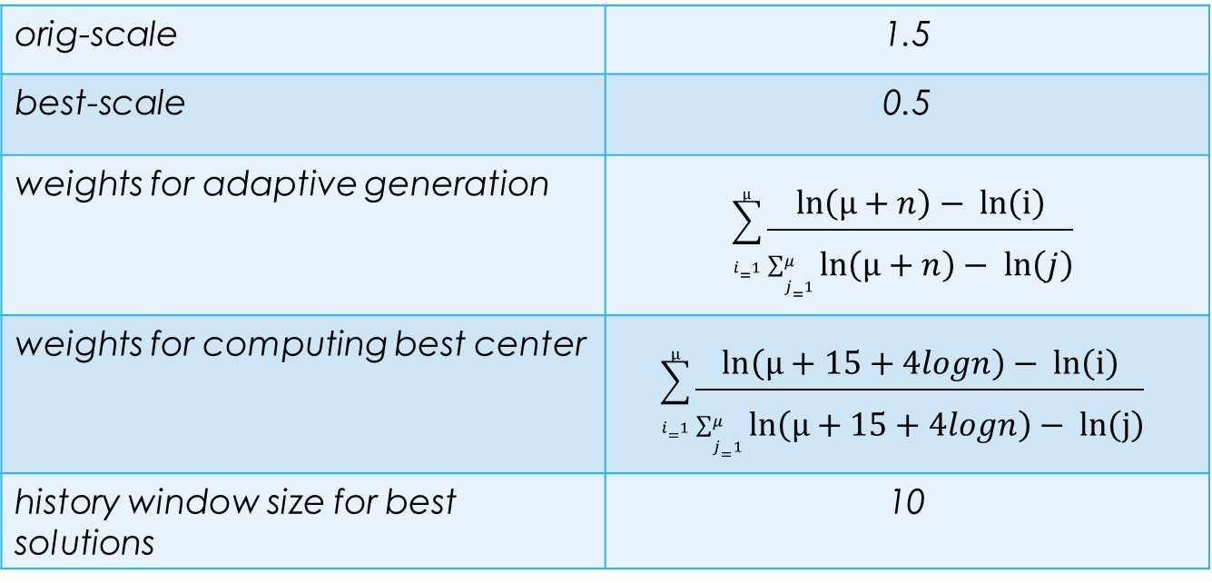
Settings
orig-scale | 1.5
best-scale | 0.5
weights for adaptive generation | $$\sum_{i=1}^{µ}{\frac{ln\left(μ+n\right)− ln­\left(i\right)}{\sum_{j=1}^{μ}{ln\left(μ+n\right)− ln­\left(j\right)}}}$$
weights for computing best center | $$\sum_{i=1}^{μ}{\frac{ln\left(μ+15+4logn\right)− ln­\left(i\right)}{\sum_{j=1}^{μ}{ln\left(μ+15+4logn\right)− ln­\left(j\right)}}}$$
history window size for best solutions | 10
Why?
Why?

Slide 22
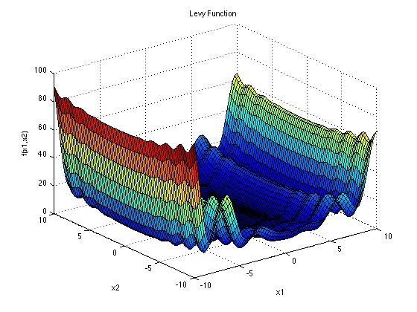
Results
Surjanovic, S & Derek Bingham. (August 2017) . Levy Function [PNG]. Retrieved from https://www.sfu.ca/~ssurjano/levy.html
Levy Function
dimension | normal wins | dual-center wins
5 | 12 | 38
10 | 17 | 33
25 | 19 | 31
50 | 15 | 35

Slide 23
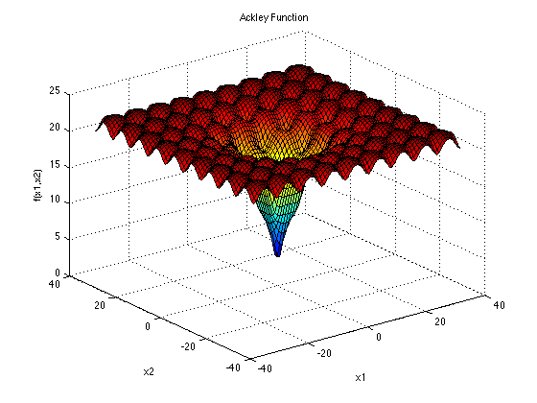
Results
Surjanovic, S & Derek Bingham. (August 2017) . Ackley Function [PNG]. Retrieved from https://www.sfu.ca/~ssurjano/ackley.html
Ackley Function
dimension | normal wins | dual-center wins
5 | 9 | 41
10 | 3 | 47
25 | 11 | 39
50 | 13 | 37

Slide 24
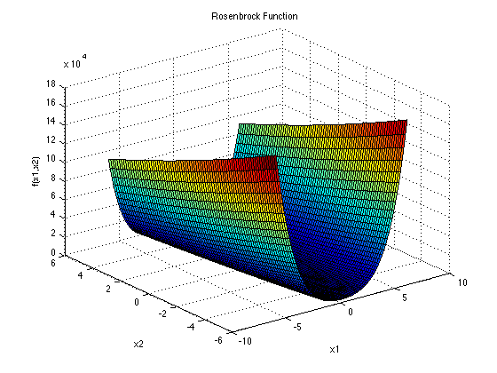
Results
Surjanovic, S & Derek Bingham. (August 2017) . Rosenbrock Function [PNG]. Retrieved from https://www.sfu.ca/~ssurjano/rosen.html
Rosenbrock Function
dimension | normal wins | dual-center wins
5 | 16 | 34
10 | 2 | 48
25 | 1 | 49
50 | 6 | 44

Slide 25
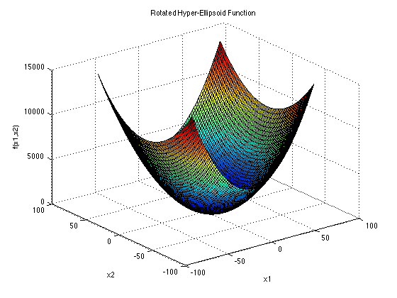
Results
Surjanovic, S & Derek Bingham. (August 2017) . Elliptical Function [PNG]. Retrieved from https://www.sfu.ca/~ssurjano/rothyp.html
Elliptical Function
dimension | normal wins | dual-center wins
5 | 19 | 31
10 | 6 | 44
25 | 12 | 38
50 | 22 | 28

Slide 26
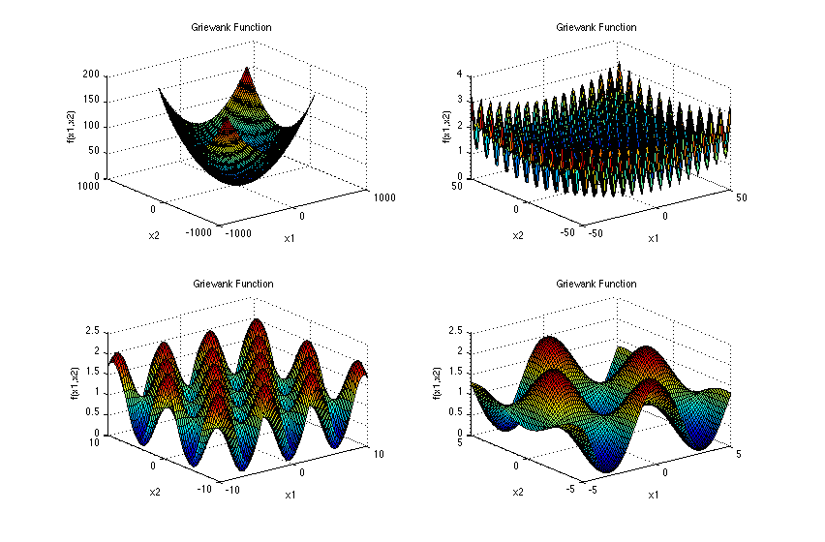
Results
Griewank Function
dimension | normal wins | dual-center wins
5 | 20 | 30
10 | 9 | 41
25 | 8 | 42
50 | 14 | 36
Surjanovic, S & Derek Bingham. (August 2017) . Griewank Function [PNG]. Retrieved from https://www.sfu.ca/~ssurjano/griewank.html

Slide 27
Results without Adaptive Solution Generation System
rosenbrock
dimension | normal wins | dualcenter wins
5 | 11 | 39
10 | 1 | 49
25 | 3 | 47
50 | 2 | 48
levy
dimension | normal wins | dualcenter wins
5 | 14 | 36
10 | 13 | 37
25 | 19 | 31
50 | 22 | 28
elliptical
dimension | normal wins | dualcenter wins
5 | 17 | 33
10 | 3 | 47
25 | 8 | 42
50 | 25 | 25
ackley
dimension | normal wins | dualcenter wins
5 | 12 | 38
10 | 4 | 46
25 | 5 | 45
50 | 13 | 37
griewank
dimension | normal wins | dualcenter wins
5 | 15 | 35
10 | 8 | 42
25 | 12 | 38
50 | 18 | 32

Slide 28
Planned course of work
To provide conclusive evidence as to why improvements were seen.
Experiment with parameters to find a balance of improvements across the entire function test suite.

Slide 29
References
Auger, A., & Hansen, N. (2013). Tutorial CMA-ES. Proceeding of the Fifteenth Annual Conference Companion on Genetic and Evolutionary Computation Conference Companion - GECCO 13 Companion. doi:10.1145/2464576.2483910
Wineberg, M. (2018). 1 Evolution Strategies [PDF Slides].
Wineberg, M. (2018). 7 CMA-ES [PDF Slides].
Wineberg, M. (2018). 8 IPOP [PDF Slides].

