Slide 1
MNIST Digit Recognizer
Morgan Baker

Slide 2
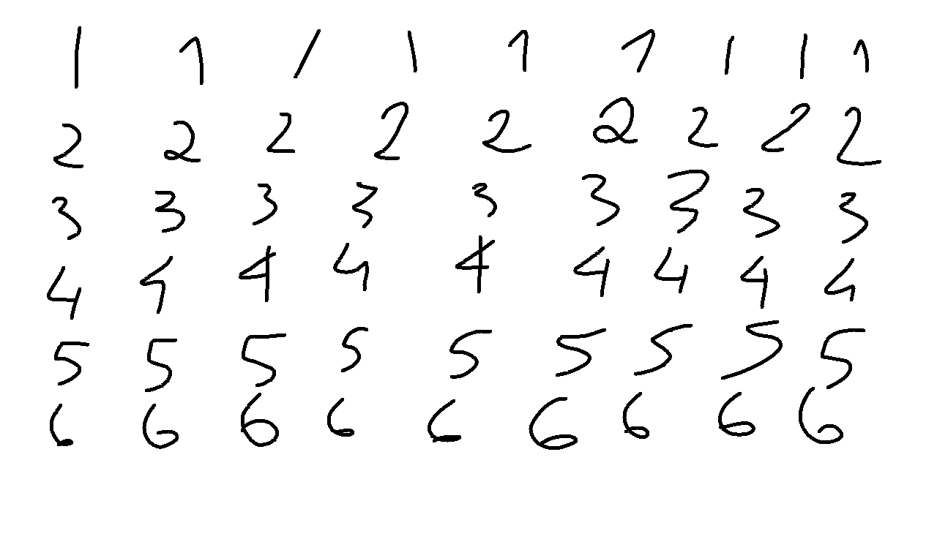
Introduction
Handwritten digits
Notes:
Talk about the uses for this, like government forms and accurate database inputs

Slide 3
MNIST Dataset
A dataset created by the National Institute of Standards and Technology
There is a list of methods that have been used.
Notes:
Talk about the history of MNIST

Slide 4
Concept
Taking the data and trying to get the lowest error

Slide 5
Background and Hypothesis
There have been many attempts to make an accurate model
http://yann.lecun.com/exdb/mnist/index.html
Notes:
Talk about how many times this problem has been tackled, and maybe use the link. Also mention that on kaggle, around 20 people have gotten an accuracy of 100%

Slide 6
Methodology: K Nearest Neighbors
Ran a simple K nearest neighbors
Took about an hour or two to complete.
94% accuracy.
Notes:
You

Slide 7
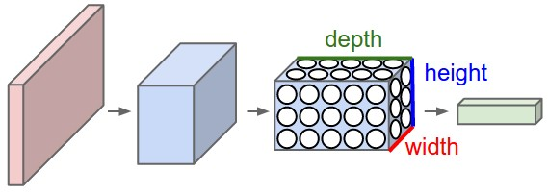
Methodology: Convolutional Neural Network
Use a convolutional neural network to read the digits
Neural Networks for Images
Three layers
Convolutional
Pooling
Fully Connected
About 96% accuracy
Notes:
Convolutional layer groups neurons into regions, Pool layer uses downsampling to minimize dimensions, and FC layer is the output layer.

Slide 8
Methodology: Random Forest
The last algorithm on my list
Creates a bunch of different decision trees and takes the majority vote.
Haven’t tested it yet
Notes:
Make the example of Random Forest how everyone’s a decision tree.

Slide 9
Testing and Hypothesis
The goal is to have a error rate of <2%
K Nearest Neighbors unfortunately does not meet that goal, but Random Forest hopefully could.

Slide 10
Sources
"Random Forests Leo Breiman and Adele Cutler." Random Forests - Classification Description. Berkeley.edu, n.d. Web. 07 Dec. 2016.
David Dalisay Junior Data Scientist at Booz Allen Hamilton, Michael McCarthy Cofounder, Kevin Beaulieu Software Engineer, and Rizwan Mallal Chief Operating Officer, Forum Systems. "Machine Learning Mastery." Machine Learning Mastery. Jason Brownlee, 14 Nov. 2016. Web. 07 Dec. 2016.
"Digit Recognizer." Digit Recognizer | Kaggle. Kaggle, 25 July 2012. Web. 07 Dec. 2016.
LeCun, Yann, Corrina Cortes, and Christopher J.C. Burges. "THE MNIST DATABASE." MNIST Handwritten Digit Database, Yann LeCun, Corinna Cortes and Chris Burges. NYU, n.d. Web. 07 Dec. 2016.

