Slide 1
MNIST Digit Recognizer
Morgan Baker

Slide 2
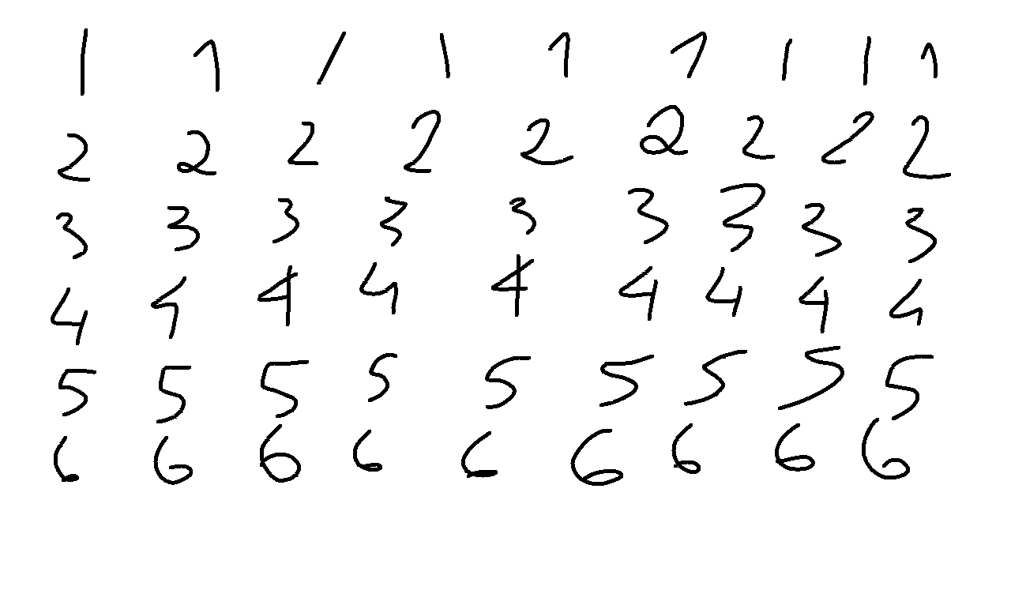
Introduction
Handwritten digits

Slide 3
MNIST Dataset
A dataset created by the National Institute of Standards and Technology
There is a list of methods that have been used.

Slide 4
Concept
Taking the data and trying to get the lowest error

Slide 5
Background
There have been many attempts to make an accurate model
http://yann.lecun.com/exdb/mnist/index.html

Slide 6
Methodology
Use a convolutional neural network to read the digits
Notes:
This is pretty simpl e

Slide 7
Convulsional Neural Network
Neural Networks for Images
Three layers
Convolutional
Pooling
Fully Connected
Notes:
Convolutional layer groups neurons into regions, Pool layer uses downsampling to minimize dimensions, and FC layer is the output layer.

Slide 8
In the case of the MNIST data…
The first layer takes the image and makes a 5 x 5 grid.
Layer 2 pools the grid to a size of 2 x 2
The final layer has 10 neurons to give the 10 different possibilities

Slide 9
Testing and Hypothesis
The goal is to have a error rate of >2%
K Nearest Neighbors unfortunately does not meet that goal

