Slide 1
SimSDF: Physically-Based Simulation with Signed Distance Fields
Xilai Dai, Barry Lyu, Zichen Wang

Slide 2
Physical Models
String
Deformable object
Rigid bodies

Slide 3
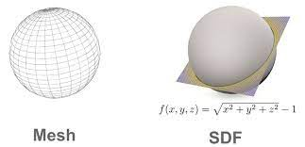
SDF
Given a point x, SDF(x) returns the signed distance from x the nearest object
Supports arbitrary geo-
metry
Nice gradients

Slide 4
@ti.dataclass
class Object:
""" Base class for all objects in the scene.
This class serves as an interface for all objects in the scene.
It is not meant to be instantiated."""
o : vec2 # origin (center of mass)
R : vec2 # rotation (cosine/sine pair)
v : vec2 # linear velocity
ω : float # angular velocity
m : float # mass
I : float # moment of inertia
size: float # collision detection radius
@ti.func
def sdf(self, x):
"""Get the signed distance from a point to the object"""
pass

Slide 5
Rigid Body Simulation
Collision Detection
- Faster with SDF!
Collision Response
- Same as before!
Numerical Integration
- Same as before!

Slide 6
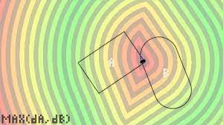
Rigid Body Simulation (cont.)
Given a point x and two object A and B, if SDF_A(x) < 0 and SDF_B(x) < 0, then a collision happens
Instead of checking all
edges for a separating edge,
we propose to sample for
potential colliding points.

Slide 7
Soft Body Simulation
Force/impulse as gradient on the SDF

Slide 8
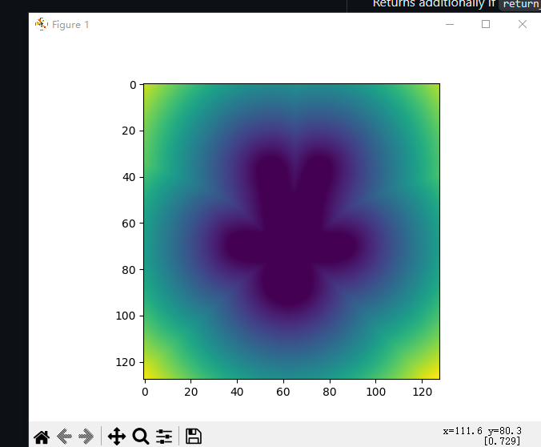
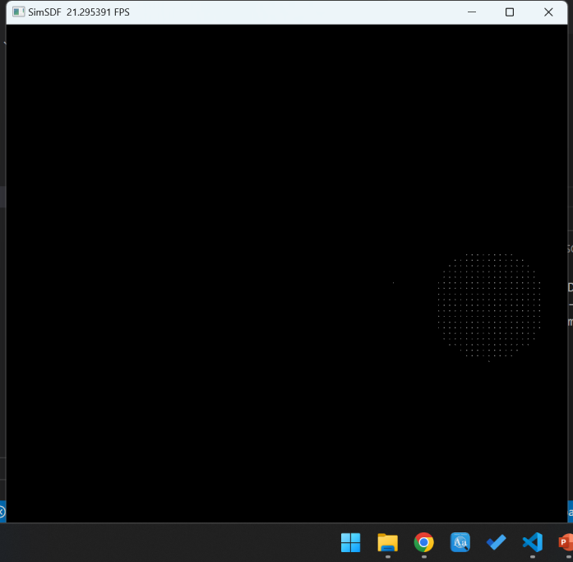
Demos

