Slide 1
Desarrollando microservicios
Reactivos y Asíncronos
JoeDayz | 2025

Slide 2
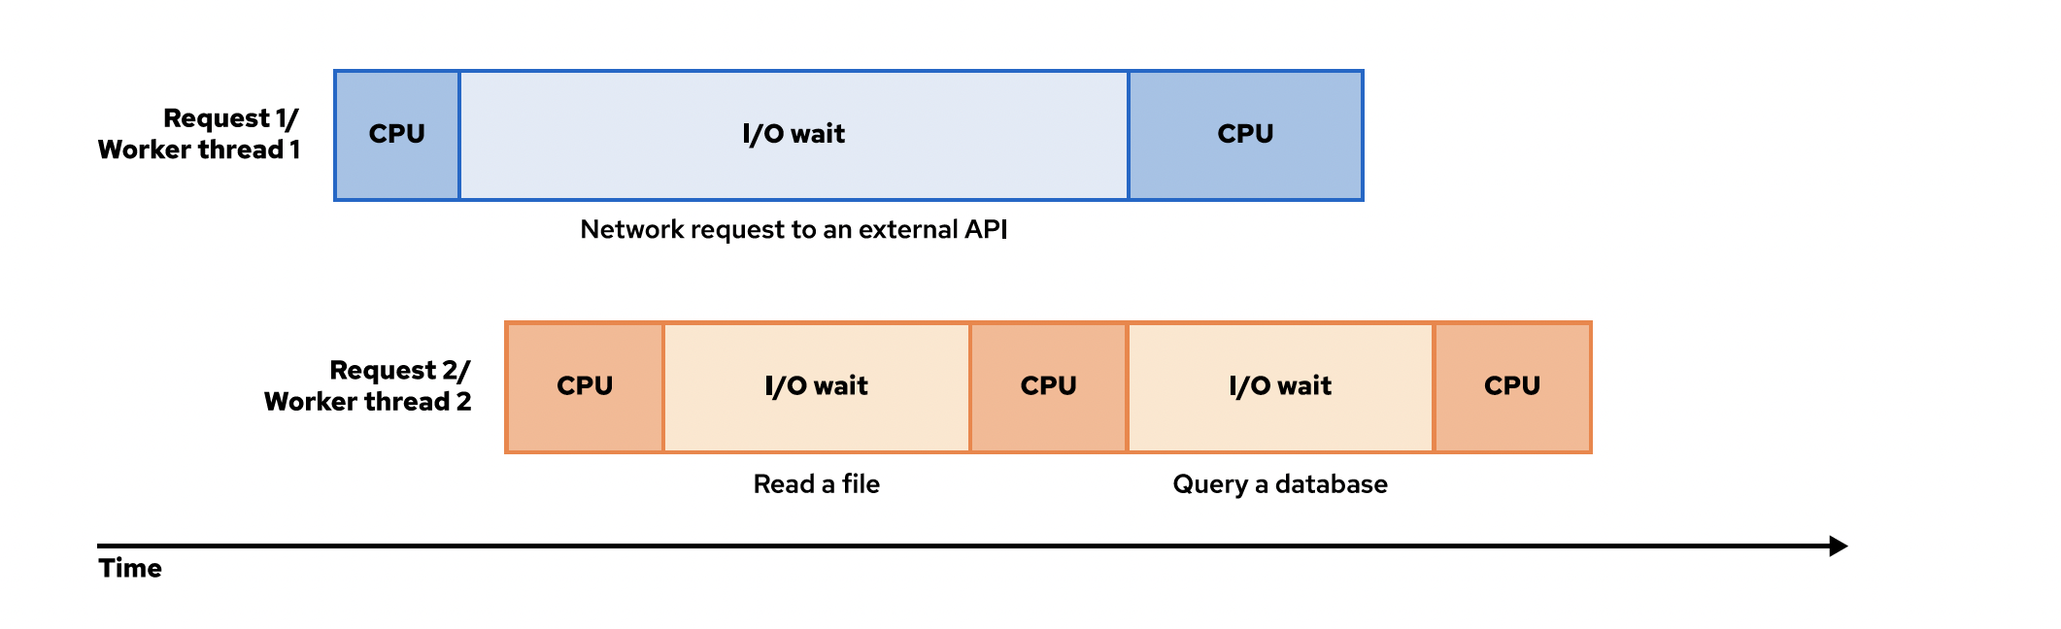
Blocking I/O

Slide 3
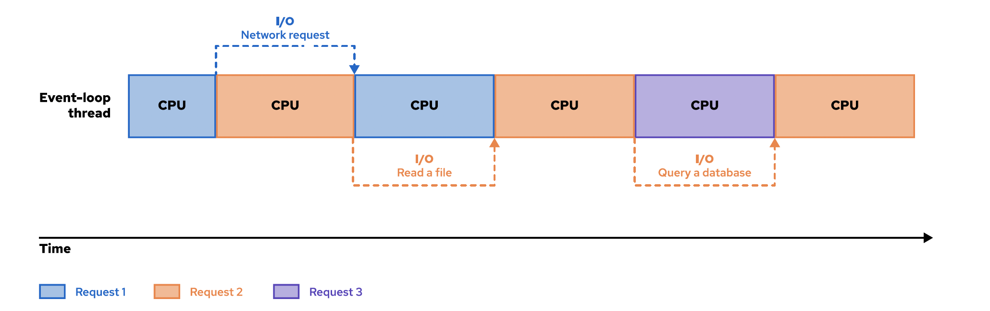
NO Blocking I/O

Slide 4
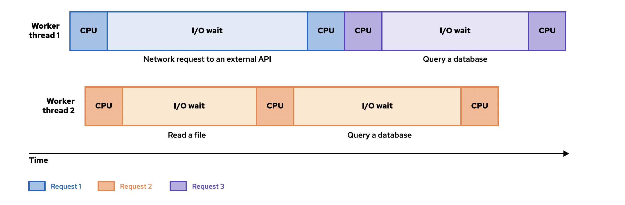
2 Worker Threads atendiendo 3 Requests

Slide 5
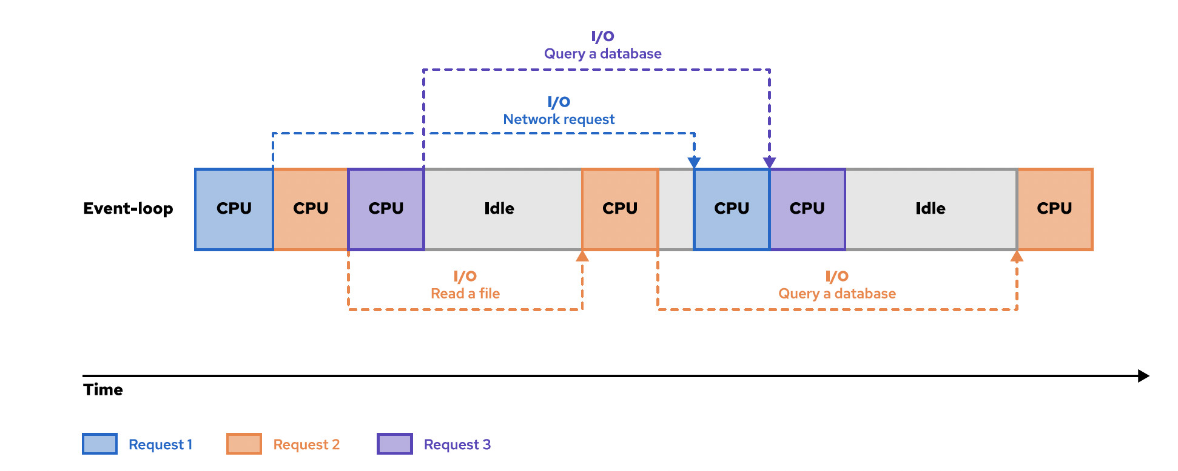
2 Event Loop Threads atendiendo 3 Requests

Slide 6
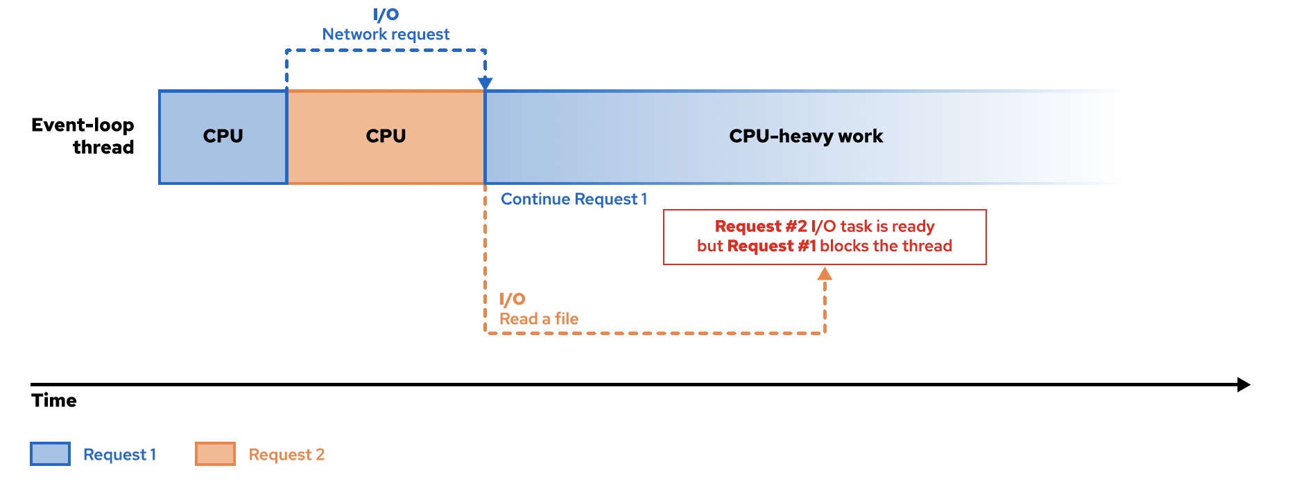
No bloquees el Event Loop

Slide 7
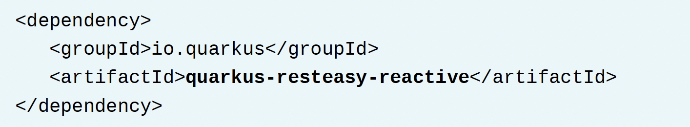
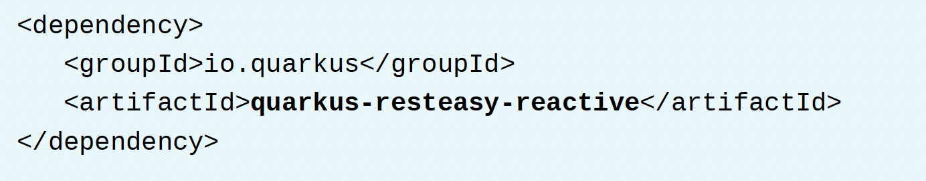
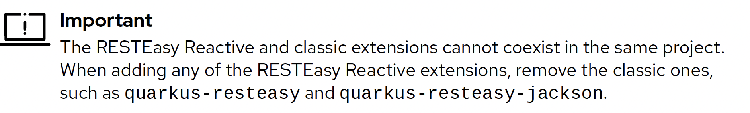
Extensiones Reactivas

Slide 8
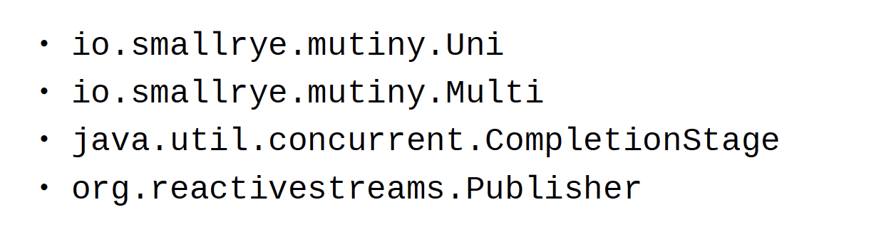
RESTEasy reactivo
¿Cómo se da cuenta que debe aplicar NO Blocking?

Slide 9
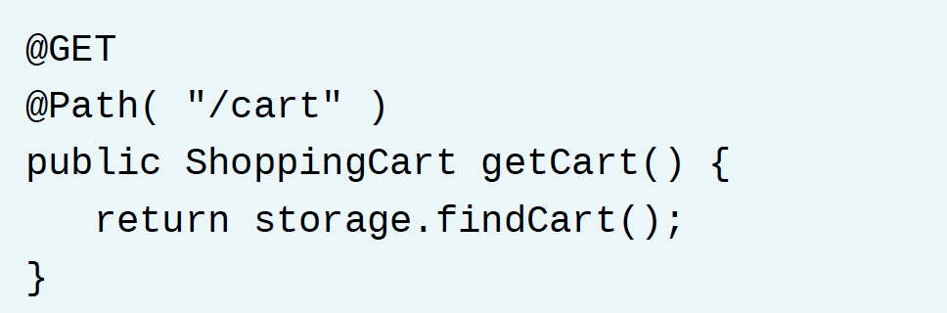
Quarkus lo va a ejecutar blocking o no blocking?

Slide 10
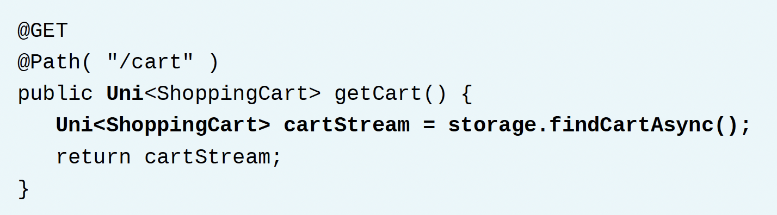
Aquí tenemos un endpoint no blocking

Slide 11
io.smallrye.common.annotation.Blocking
Indicates that a method is blocking. RESTEasy Reactive runs the method in a worker thread.
io.smallrye.common.annotation.NonBlocking
Indicates that a method is non-blocking. RESTEasy Reactive runs the method in an eventloop thread.

Slide 12
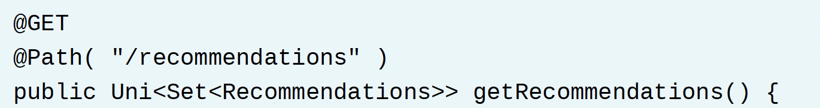
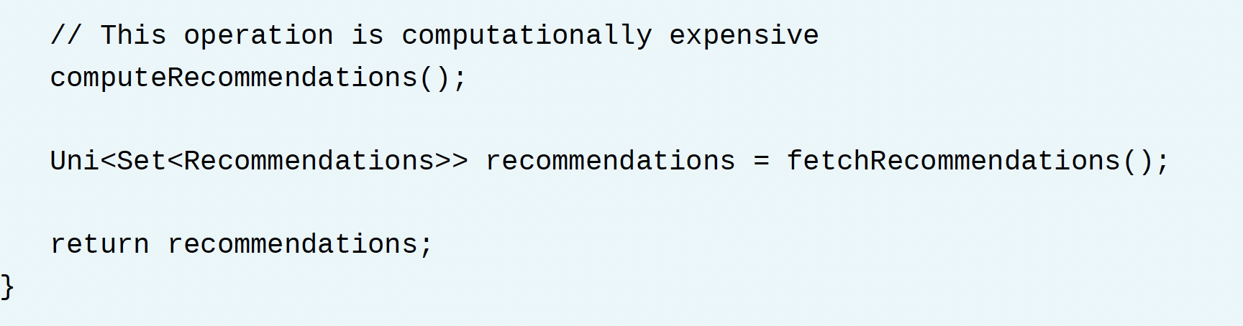
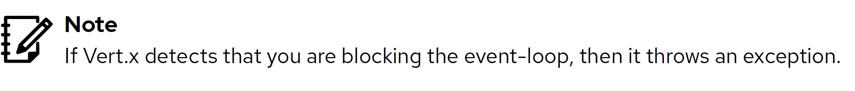
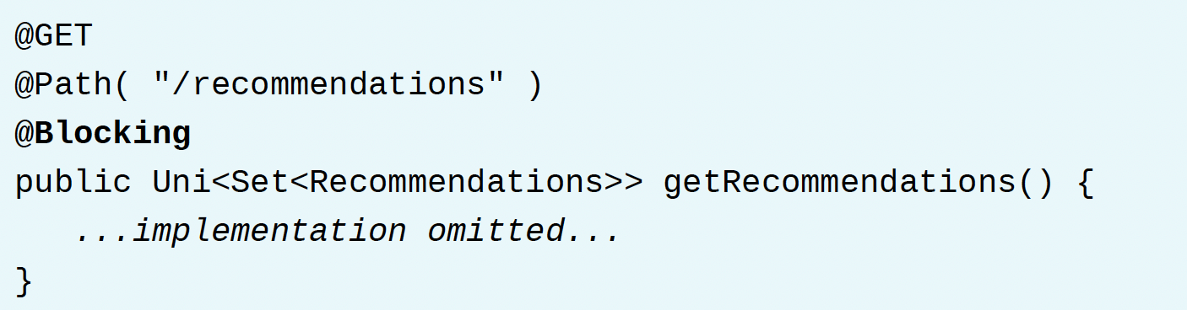

Slide 13
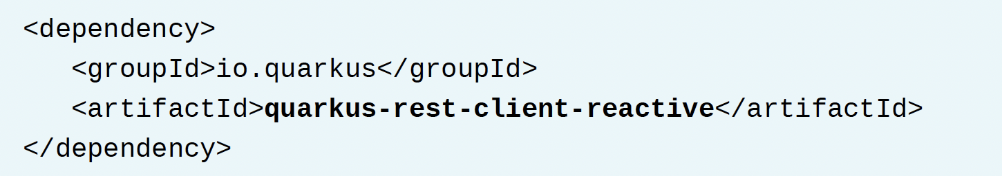
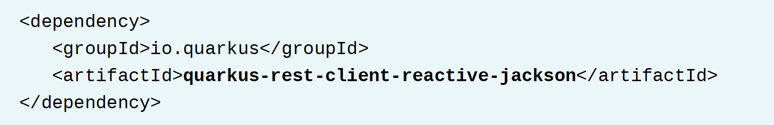
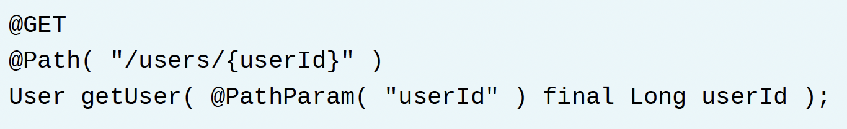
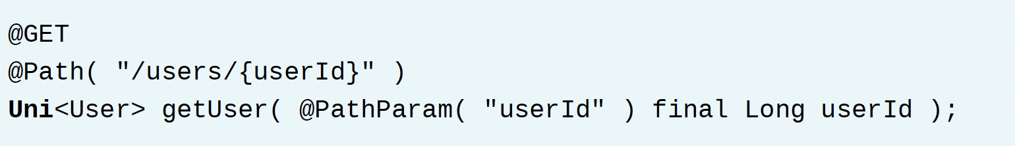
Extensiones Reactivas
Ejemplo:

Slide 14
Recursos
Reactividad
- https://www.reactivemanifesto.org/
- https://quarkus.io/version/2.13/guides/quarkus-reactive-architecture
- https://quarkus.io/version/2.13/guides/resteasy-reactive
- https://smallrye.io/smallrye-mutiny/1.7.0/

