Slide 1
Mutiny
Reactive Library
JoeDayz | 2025

Slide 2
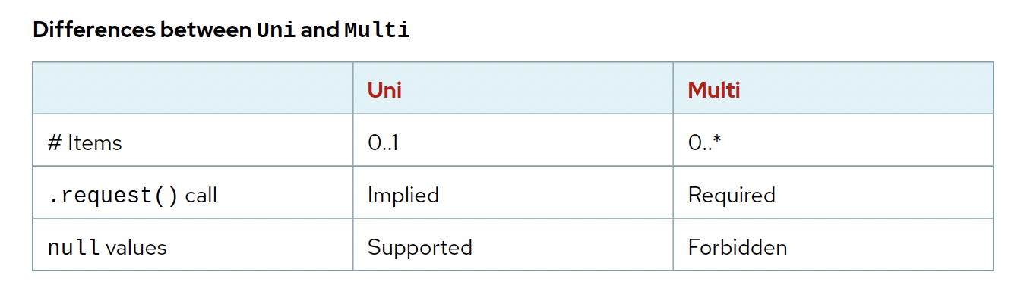
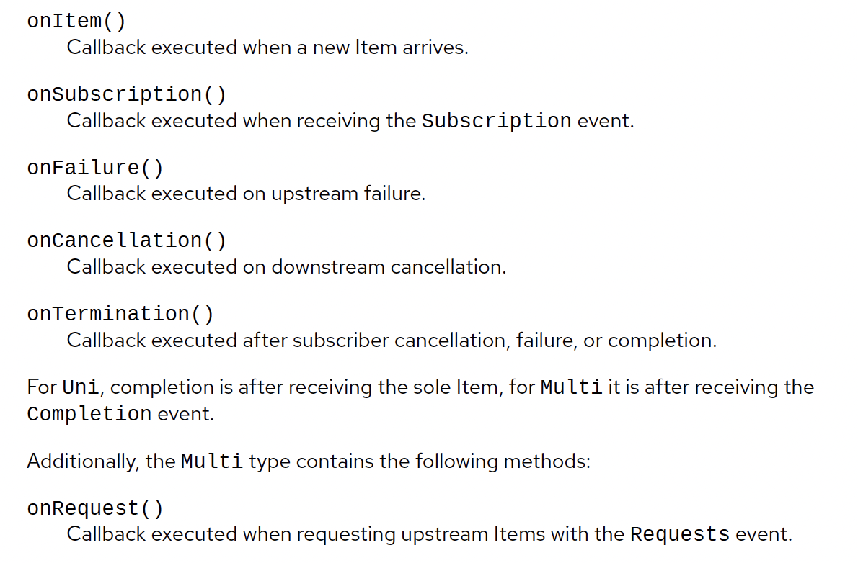
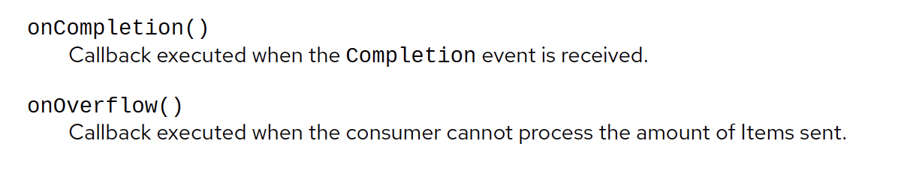
io.smallrye.mutiny

Slide 3
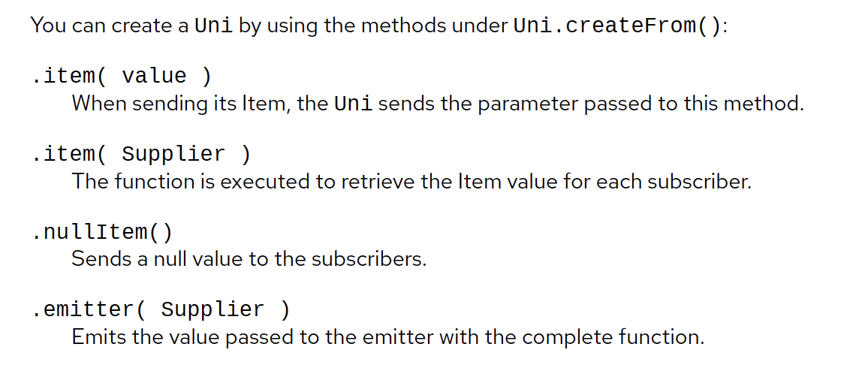
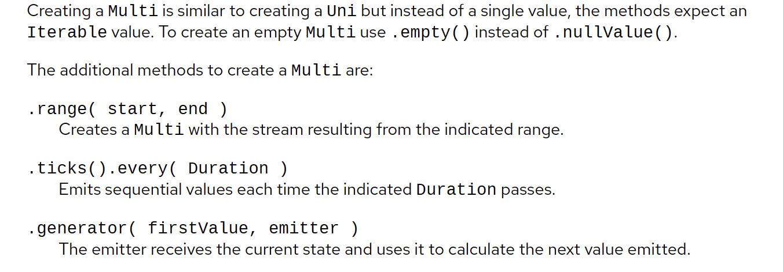
Crear Uni y Multi

Slide 4
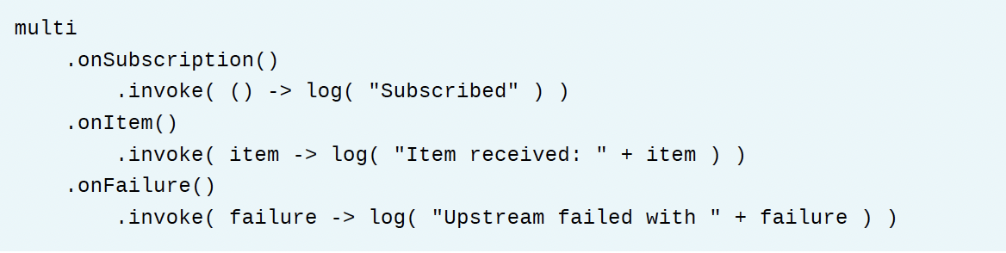
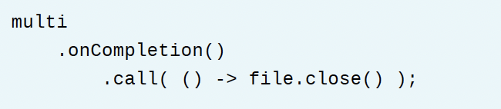
Observación de Eventos

Slide 5
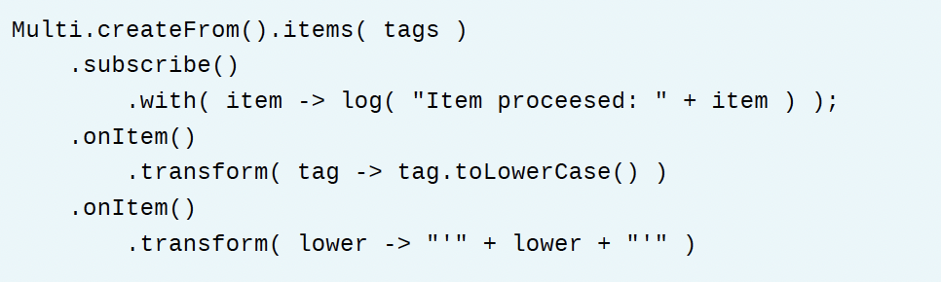
Transformando Items

Slide 6
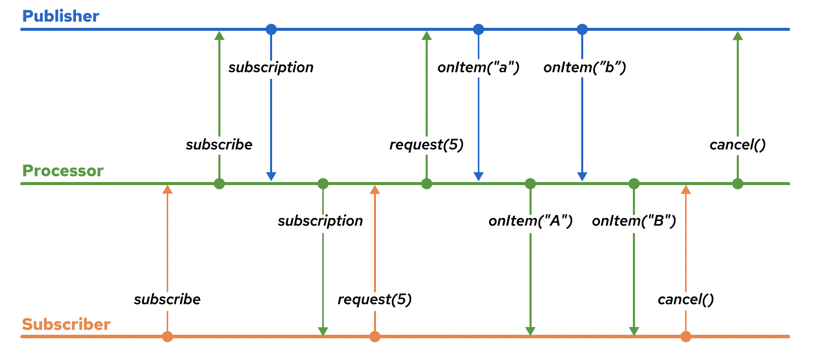
Reactive workflows

Slide 7
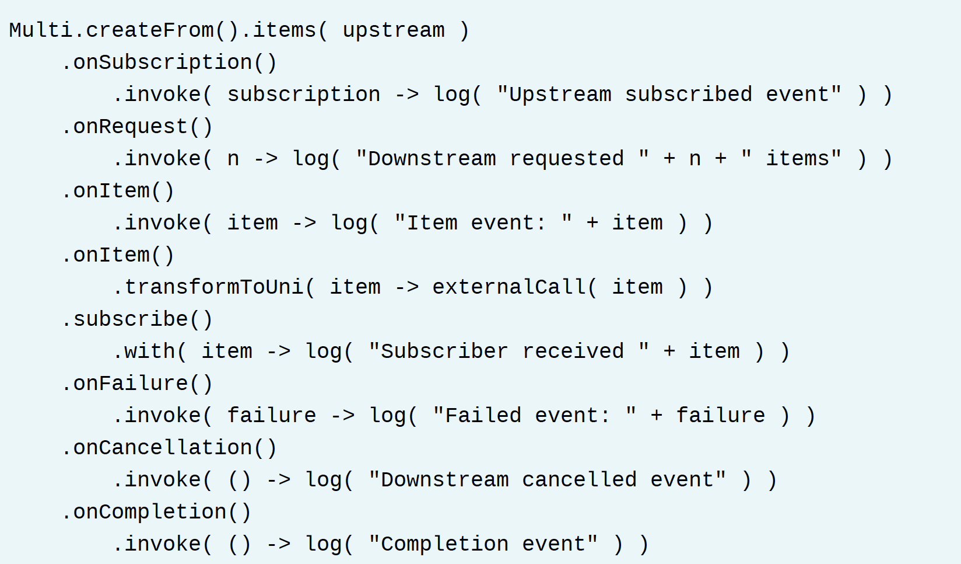
Reactive workflows

Slide 8
Reactive panache

Slide 9
Recursos
https://developers.redhat.com/promotions/building-reactive-microservices-in-java
https://smallrye.io/smallrye-mutiny/1.7.0/
https://hibernate.org/reactive/

