Slide 1
Introduction to Git & GitHub
Source Code Management
Gino Cubeddu
IBM Cloudant

Slide 2
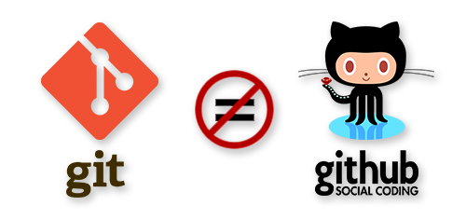

Slide 3

What is Git?
Version Control System
Easily Manage Code
Free To Use

Slide 4

What is GitHub?
Git Hosting Service
Huge Community
Free or Paid

Slide 5
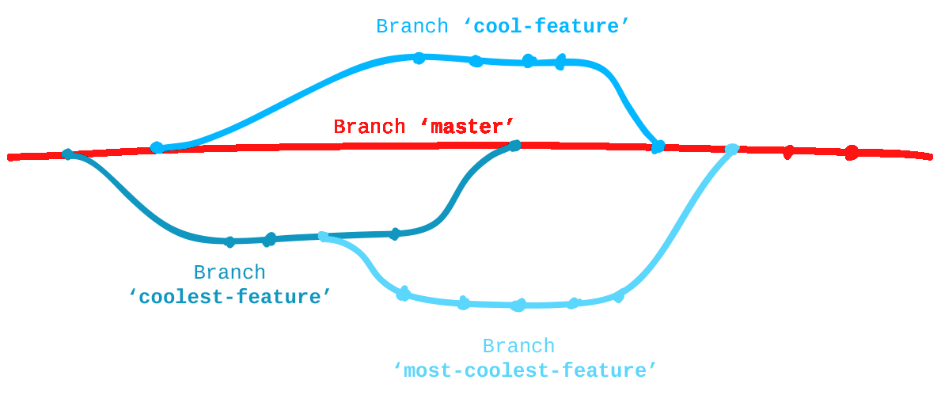
Version Control
Collaboration
Revert Changes
Explore Previous Code
Releases
Track Changes

Slide 6
Using Git & GitHub
Git Bash
Git GUI
Git Shell
GitHub GUI
Working Locally

Slide 7
Authentication
SSH key
GitHub User/Pass
Working Locally

Slide 8
Why Use Version Control

Slide 9
Core Commands
git clone – Used to pull a copy of your repo from GitHub to your local machine
git status – Used to show what has been changed locally since the last commit
git diff – Used to show what has changed within files since the last commit
git add $FILE – Used to add a file to be committed

Slide 10
Core Commands
git commit – Used to open an editor in order to write your commit message
git commit -m “YOUR MESSAGE”– Used to commit without opening an editor
git push – Used to push your committed changes to the remote repo
git pull – Used to pull the latest changes from the remote repo

Slide 11
Core Commands
git checkout $BRANCH-NAME – Used switch to a different branch
git checkout -b $BRANCH-NAME – Used to create and switch to a new branch

Slide 12
A Note About Visual Studio and Git
Notes:
Visual Studio asdf fd

Slide 13
GitHub Username Form
http://bit.ly/2zn18YD
or
https://goo.gl/forms/18kBZaOXSrJSC8Rs2

Slide 14
Do The First Two Exercises
http://bit.ly/2ihRv2k
or
https://github.com/GinoCubeddu/Worcester-Future-Week-Git-Talk
Notes:
Do The First Two Exercises

Slide 15
Rebase Example

Slide 16
Keeping in Sync With Master

Slide 17
Any Questions?
Email: gino.cubeddu@ibm.com
GitHub: https://github.com/GinoCubeddu

