Slide 1
Introduction to Git & GitHub
Source Code Management
Gino Cubeddu
IBM Cloudant

Slide 2
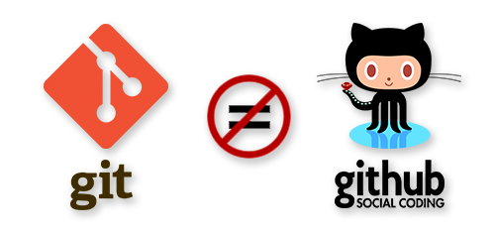

Slide 3

What is Git?
Version Control System
Easily Manage Code
Free To Use

Slide 4

What is GitHub?
Git Hosting Service
Huge Community
Free or Paid

Slide 5

Student Developer Pack
Free GitHub Pro
Free access to services
https://education.github.com/pack

Slide 6
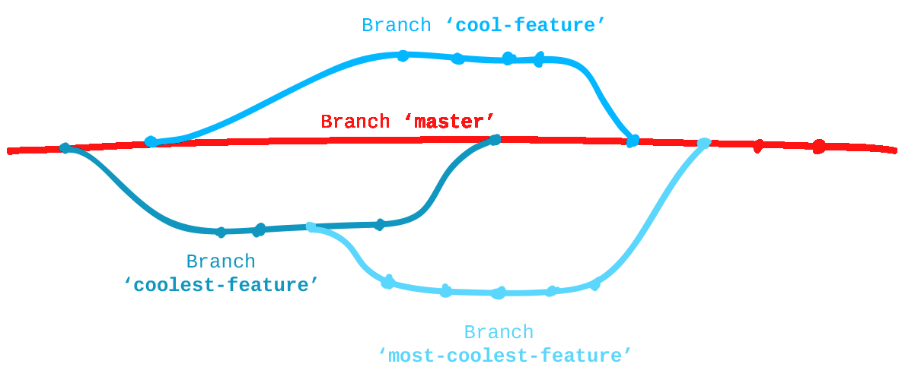
Version Control
Collaboration
Revert Changes
Explore Previous Code
Releases
Track Changes

Slide 7
Using Git & GitHub
Git Bash
Git GUI
Git Shell
GitHub GUI
Working Locally

Slide 8
Authentication
SSH key
GitHub User/Pass
Working Locally

Slide 9
Why Use Version Control

Slide 10
Core Commands
git clone – Used to pull a copy of your repo from GitHub to your local machine
git status – Used to show what has been changed locally since the last commit
git diff – Used to show what has changed within files since the last commit
git add $FILE – Used to add a file to be committed

Slide 11
Core Commands
git commit – Used to open an editor in order to write your commit message
git commit -m “YOUR MESSAGE”– Used to commit without opening an editor
git push – Used to push your committed changes to the remote repo
git pull – Used to pull the latest changes from the remote repo

Slide 12
Core Commands
git checkout $BRANCH-NAME – Used switch to a different branch
git checkout -b $BRANCH-NAME – Used to create and switch to a new branch

Slide 13
GitHub Username Form
http://bit.ly/2zn18YD
or
https://goo.gl/forms/18kBZaOXSrJSC8Rs2

Slide 14
Do The First Two Exercises
http://bit.ly/2ihRv2k
or
https://github.com/GinoCubeddu/Worcester-Future-Week-Git-Talk
Notes:
Do The First Two Exercises

Slide 15
Rebase Example

Slide 16
Keeping in Sync With Master
F1
F2
M1
M2
M3

Slide 17
Keeping in Sync With Master
F1
F2
F1
F2
M1
M2
M3
M3

Slide 18
Any Questions?
Email: gino.cubeddu@ibm.com
GitHub: https://github.com/GinoCubeddu

