Slide 1

Project 1
Giovanni Herrera

Slide 2
Technologies Used
HDFS (Hadoop distributed file system)
Hive
Dbeaver (used as GUI for hive)

Slide 3
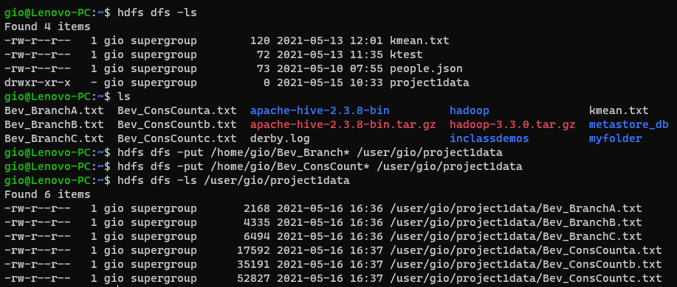
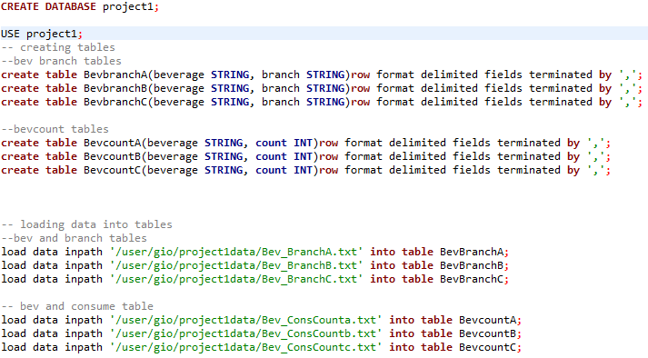
Loading Our Data

Slide 4
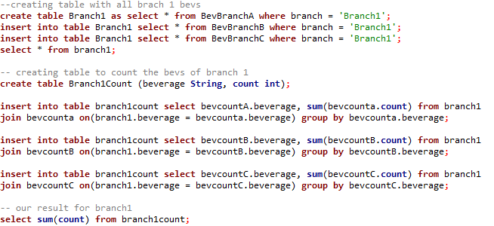

Answering Question 1 Part 1
What is the total number of consumers for branch 1?
Our Result:

Slide 5
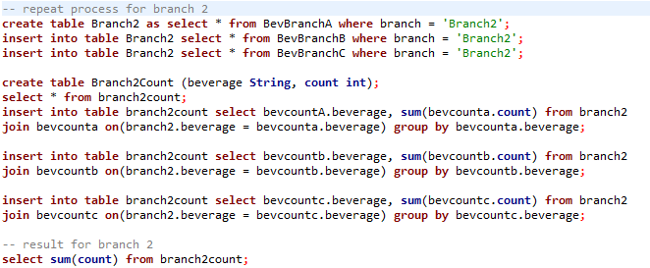

Answering Question 1 Part 2
What is the total number of consumers for branch 2?
Our result:

Slide 6
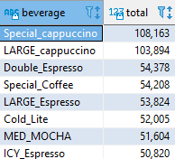
Answering Question 2 Part 1
What is the most consumed beverage on branch 1?
Our result:

Slide 7
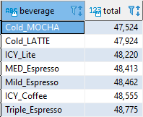
Answering Question 2 Part 2
What is the least consumed beverage on branch 2?
Our result:

Slide 8
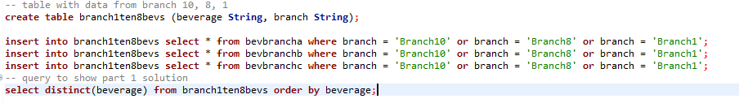
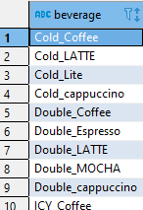
Answering Question 3 Part 1
What are the beverages available in branch 1, branch 8, and branch 10?
Our result set consisted of 44 entries,
The first 10 are shown here.

Slide 9
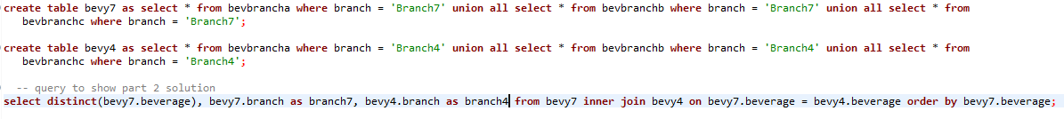
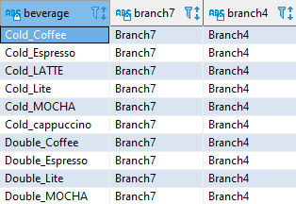
Answering Question 3 Part 2
What are the common beverages available in Branch 4 and Branch 7?
Our result set consisted of 51 entries,
The first 10 are shown here.

Slide 10
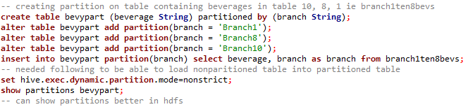
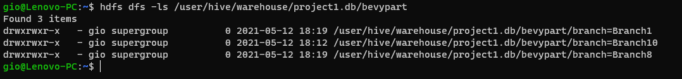
Answering Question 4 Part 1
Create a partition for part 3, created partition of table containing branch 1, 8, 10 beverages.
The following shows how our table was partitioned where it is stored in hdfs.

Slide 11

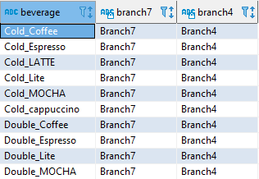
Answering Question 4 Part 2 and 3
Creating an index on our partitioned table, creating a view for drinks in table 4 and 7.
Index
Result:
View Result:

Slide 12
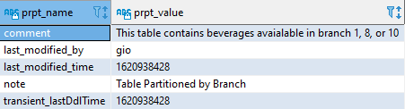
Answering Question 5
Alter a tables properties to add a note and a comment.
Our note and comment:

Slide 13
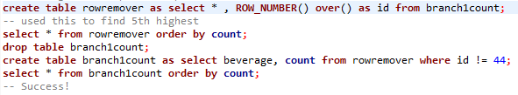
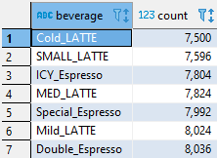
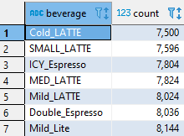
Answering Question 6
Remove row 5 from table for scenario 1.
Before:
After:

