Slide 1

Distributed Data Analysis
6.25 Million Chess Games
Giorgio Gobbin
Matricola: 683071
January 29, 2026

Slide 2

Research Questions
RQ1
Supervised Learning
Can we predict the winner based on ELO ratings and opening strategies?
RQ2
Unsupervised Learning
Can players be segmented into distinct style profiles?
RQ3
Pattern Mining
Are there hidden patterns connecting openings to outcomes?

Slide 3




Dataset Overview
6,256,184
4+ GB
July 2016
Lichess.org
Total Games
Data Size
Time Period
Platform
Understanding the ELO System
A method to calculate relative skill levels in zero-sum games. Ratings range from ~700 (Beginner) to 3000+ (Super Grandmaster), with average around 1500-1700. After each game, the winner takes points from the loser based on expected outcome.

Slide 4
Data Quality Assessment
Exceptionally High Quality Dataset
Duplicate Rows
Only 1 duplicate
Excellent
Missing Values
< 0.07% in rating columns
Excellent
Core Columns
Zero missing (AN, Result, ECO)
Perfect

Slide 5
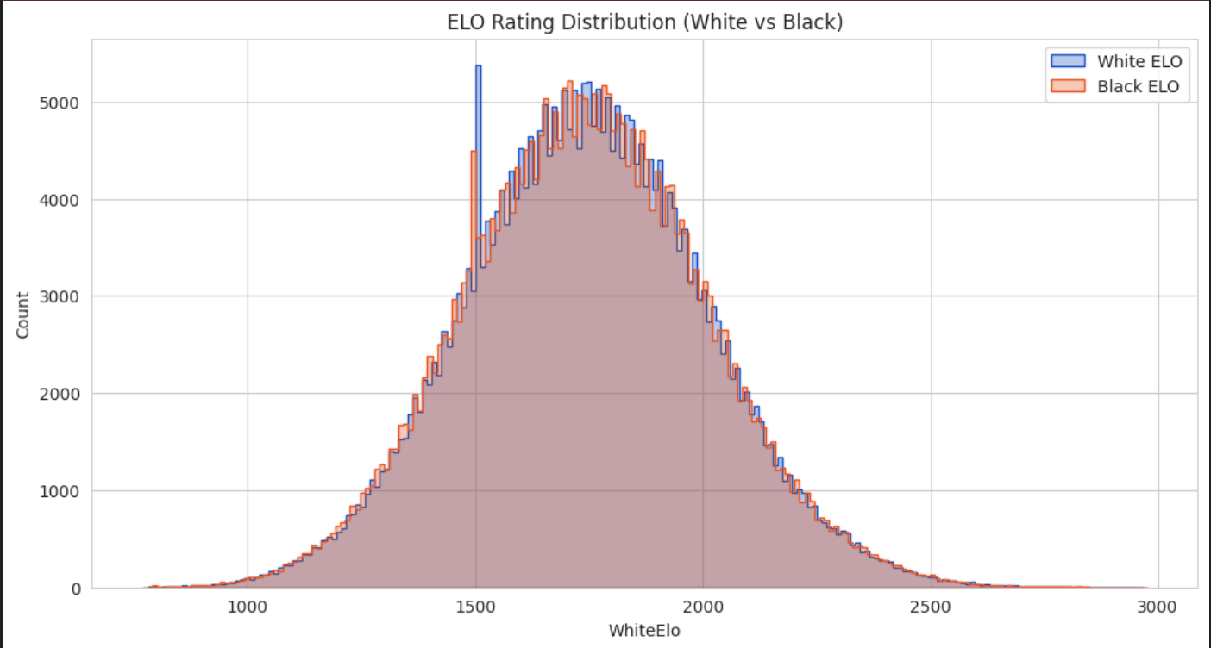
Data Quality Assessment
🔍 Key Finding:
300 ≤ x ≤ 3000
Mean ≃ 1741
StDev ≃ 266
Spike = 1500

Slide 6
Data Processing Pipeline
Cleaning & Feature Engineering
Advanced Window Functions
Filtered abandoned games
Converted Result to numerical labels
Created EloDiff feature (White ELO - Black ELO)
Derived GameLength from move sequences
Used PySpark Window Functions to identify reference games for each opening strategy without expensive self-joins.
spec = Window.partitionBy('ECO')
.orderBy(desc('WhiteElo'))
df_ranked = df.withColumn('Rank',
row_number().over(spec))
top_games = df_ranked
.filter(col('Rank') == 1)
Computing Environment
Platform: Kaggle Notebooks
Accelerator: NVIDIA T4 GPU x2
Framework: PySpark 3.x

Slide 7

Supervised Learning: Predicting the Winner
Random Forest Classifier
Feature Importance
Model: Random Forest
Accuracy: 63%
Baseline: 33% (random guessing)
Challenge: High-cardinality ECO variable (solved with maxBins=1000)
💡 Key Insight
EloDiff is the dominant predictor.
Skill gap between players is the most reliable factor for predicting game outcome. GameLength shows minimal predictive power.

Slide 8

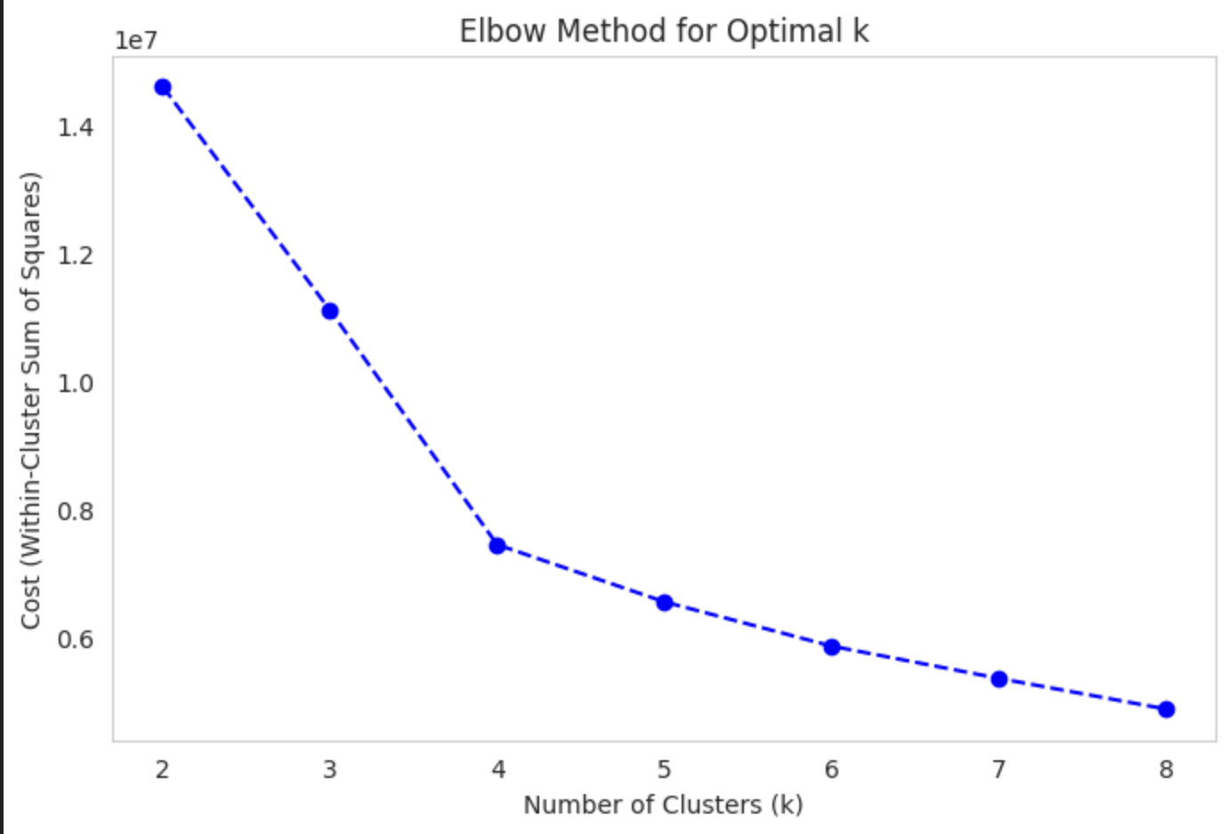
Player Segmentation: K-Means Clustering
Methodology
Four Distinct Player Profiles
Algorithm: K-Means Clustering
Features: AverageElo, GameLength, EloGap
Optimal k: 4 (determined via Elbow Method)
Cluster 0: Masters
Avg ELO ~1952, standard games, low EloGap
Cluster 1: Beginners
Avg ELO ~1545, shortest games (~407 chars)
Cluster 2: Mismatches
Massive EloGap (~407 points vs avg 100)
Cluster 3: Marathons
Avg ELO ~1745, exceptionally long (4x avg)

Slide 9
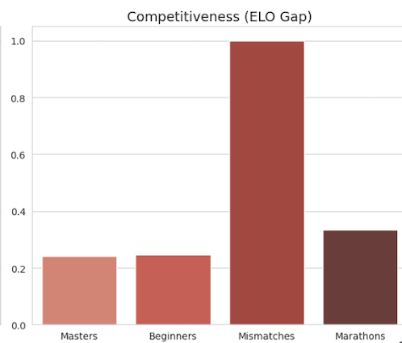
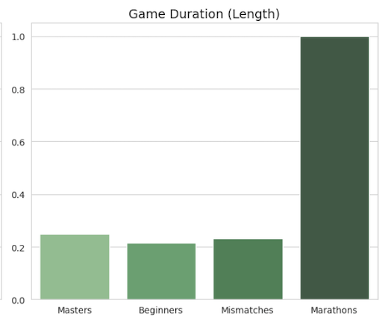
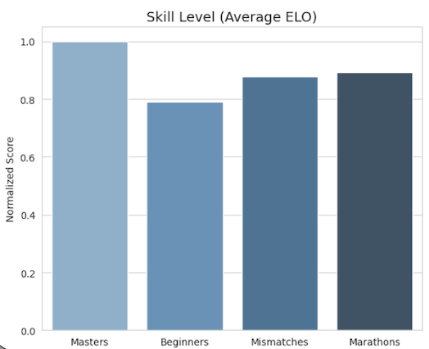
Player Segmentation: K-Means Clustering
🎯 Critical Discovery:
🏆 Masters -> Highest ELO
⏳ Marathons -> Highest Duration
⚖️ Mismatches -> Highest ELO Gap
⚖️ Mismatches -> Highest ELO Gap

Slide 10

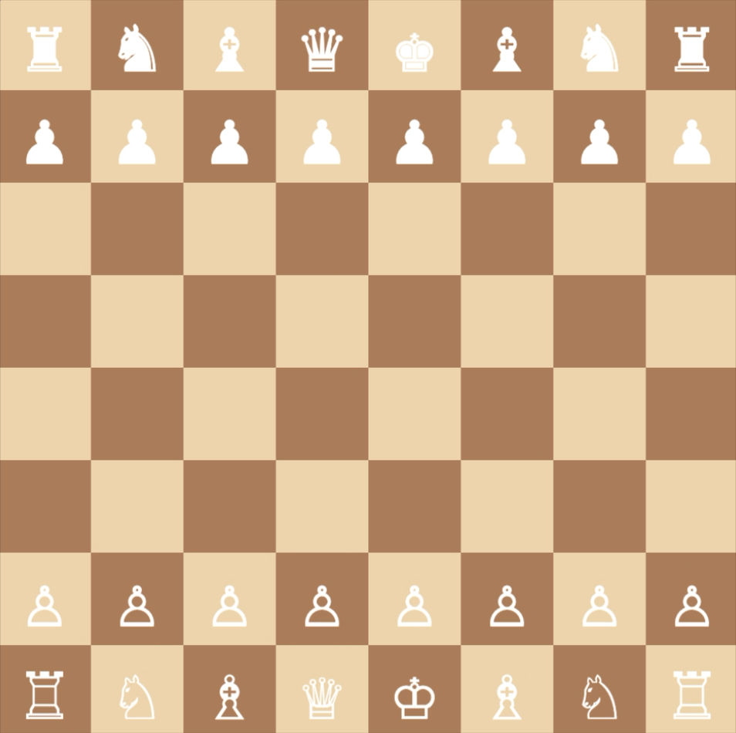
Pattern Mining: Association Rules
FPGrowth Algorithm
Discovered frequent patterns and association rules between opening strategies and game results, revealing hidden correlations in the data.
⚠️ The 'Van't Kruijs' Trap
Association Rule with 53.1% Confidence:
{Van't Kruijs Opening} ⇒ {Black Win}
The Van't Kruijs Opening (1. e3) is statistically weak for White. Unlike aggressive moves that fight for the center, 1. e3 is passive, restricting the Queen's Bishop and surrendering first-move advantage. The data validates this theoretical flaw: this passive setup correlates with a sharp increase in Black's win rate.

Slide 11

Regression Analysis: Game Length Prediction
Hypothesis Testing
Results
Hypothesis: Higher skill difference leads to shorter games (quick checkmate)
Method: Linear Regression (GameLength ~ EloDiff)
R² Score
0.0003
Coefficient
-0.0405
🔬 Scientific Interpretation
The R² score is effectively zero — this negative result is scientifically important as it disproves the hypothesis.
A large skill gap does NOT statistically guarantee a shorter game on Lichess. Possible explanations: stronger players may prolong games for practice, experimentation, or simply enjoying their advantage rather than forcing quick checkmates.

Slide 12

Key Findings
1.
ELO rating difference is the primary predictor of chess outcomes with 63% accuracy
2.
K-Means identified 4 distinct player profiles, including a unique 'Marathon Games' cluster
3.
Pattern Mining revealed that passive openings like Van't Kruijs flip odds in favor of Black (53%)
4.
Game duration is NOT correlated with skill gap — disproving the 'quick mate' hypothesis

Slide 13

Thank You
Giorgio Gobbin
Matricola: 683071
giorgio.gobbin@studenti.unipd.it

