Slide 1

STUDY OF DYNAMIC CORRELATION FOR RISK ASSESSMENT IN FINANCE: AN ANALYSIS OF THE NASDAQ 100 WITH AND WITHOUT THE EFFECT OF COVID-19
Master of Science in
FINANCE
Supervisor
Professor Giuliana Passamani
Giovanni Pedone

Slide 2
Purpose
The objective is to analyse the dynamic pairwise correlations between an aggregated index and selected securities from the Nasdaq 100, with a view to applying them to portfolio risk calculations using Value at Risk (VaR) and Expected Shortfall (ES)
Construction of a Macroeconomic–Financial Index Cluster Analysis of the Nasdaq 100
multivariate
Calculation of Dynamic Risk Measures VaR and ES using Variance-Covariance Approach
Analysis of Dynamic Pairwise Correlations between Index and Selected Securities
univariate

Slide 3
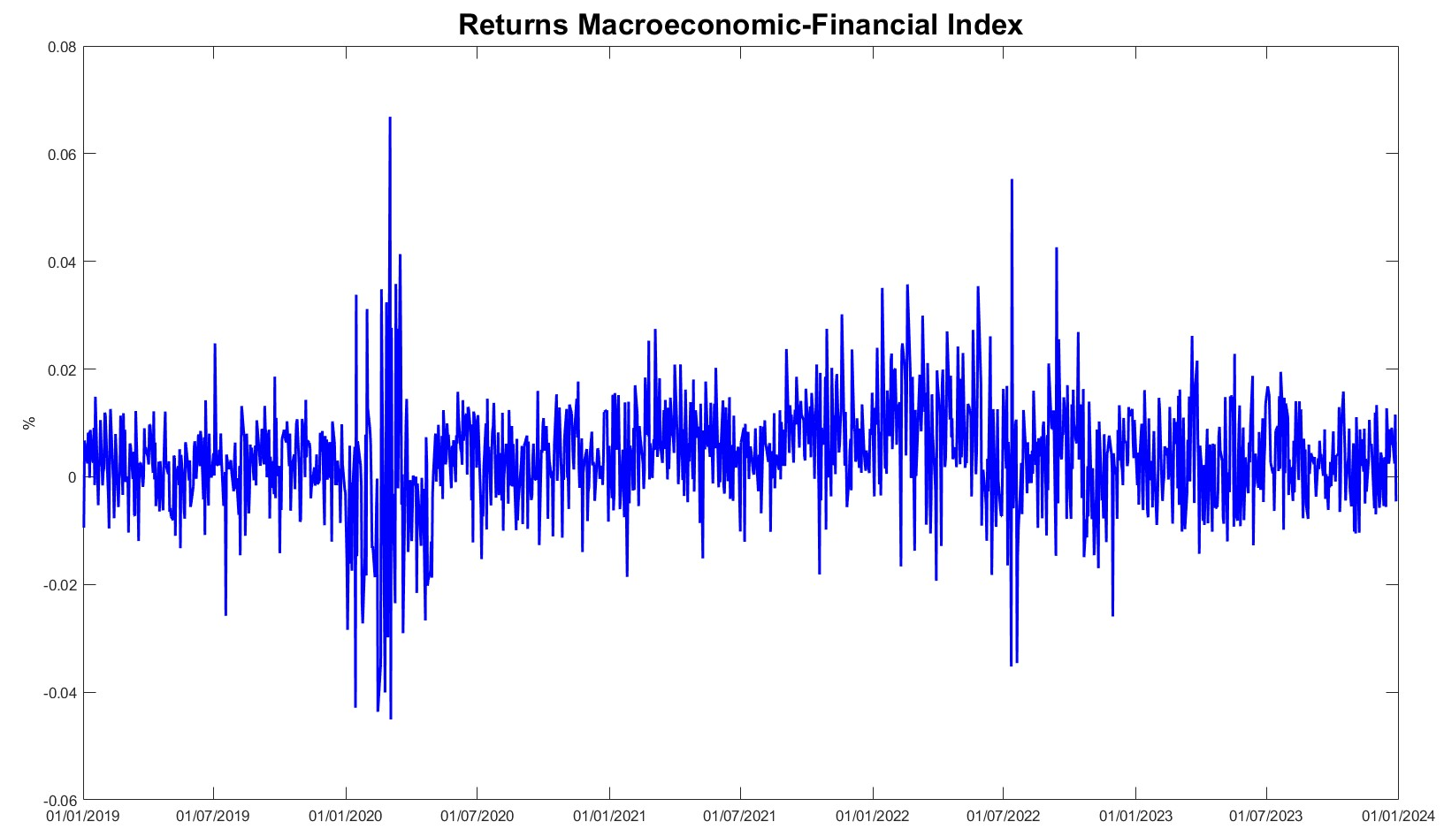
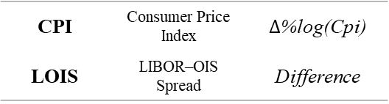
Macroeconomic-Financial Index
GOLD | Commodity | Return
WTI | US Oil | Return
VIX | Proxy Vol. Impl. | Return
FVX | Treasury 5Y | Difference
CPI | Consumer Price Index | $∆$%log(Cpi)
LOIS | LIBOR–OIS Spread | Difference
All data are on a daily basis.

Slide 4
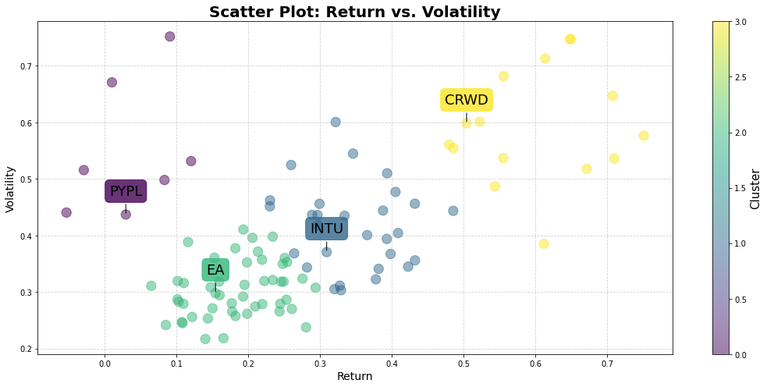
Cluster Analysis Results
Cluster | Closest Ticker | Average Returns | Volatility | Ret-Vol
0 | INTU | 0.3093 | 0.3705 | mid-mid
1 | CRWD | 0.5044 | 0.5984 | high-high
2 | PYPL | 0.0296 | 0.4369 | low-high
3 | EA | 0.1546 | 0.2978 | low-low
To make the group as representative as possible of the Nasdaq 100, we have added the four largest capitalisation stocks of the index to the results: Microsoft (MSFT), Apple (AAPL), Nvidia (NVDA), Amazon (AMZN).

Slide 5
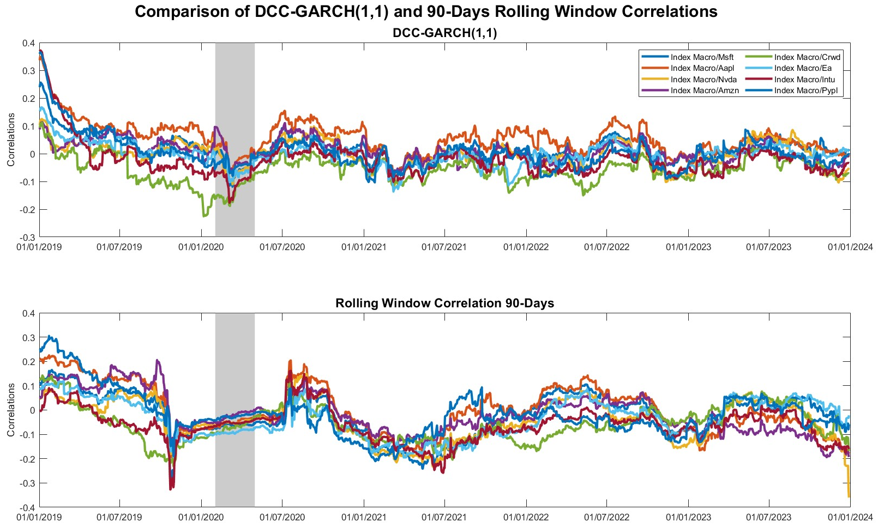

Dynamic Correlations (${\hat{Γ}}_{t}^{DCC}$)

Slide 6
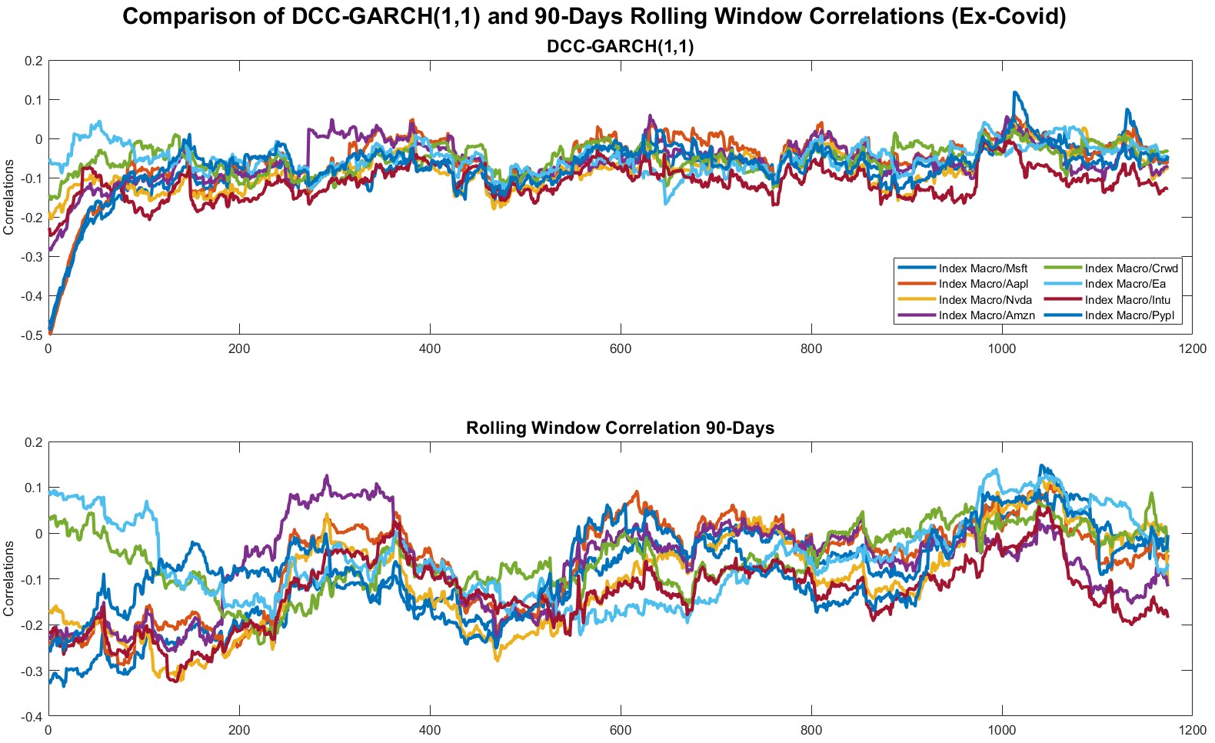

Dynamic Correlations (${\hat{Γ}}_{t}^{DCC}$), Ex–Covid*
*The term ‘Ex-Covid' denotes the exclusion of data relating to the months of February, March and April 2020 from the dataset.

Slide 7
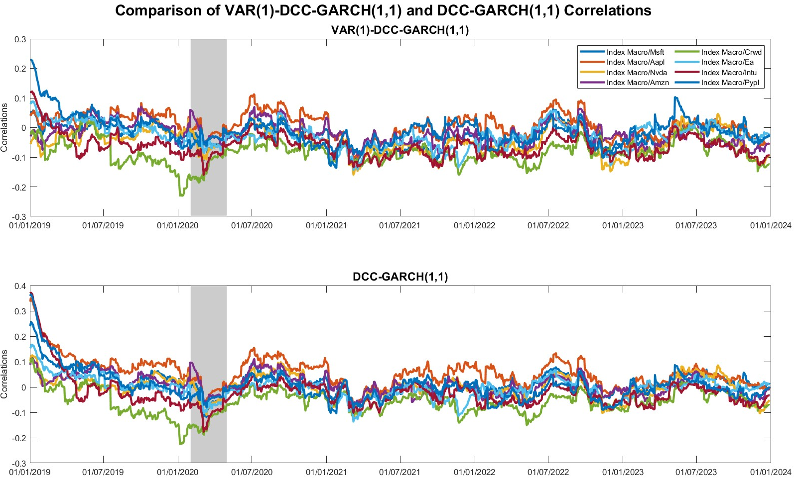

Dynamic Correlations (${\hat{Γ}}_{t}^{VAR−DCC}$)

Slide 8
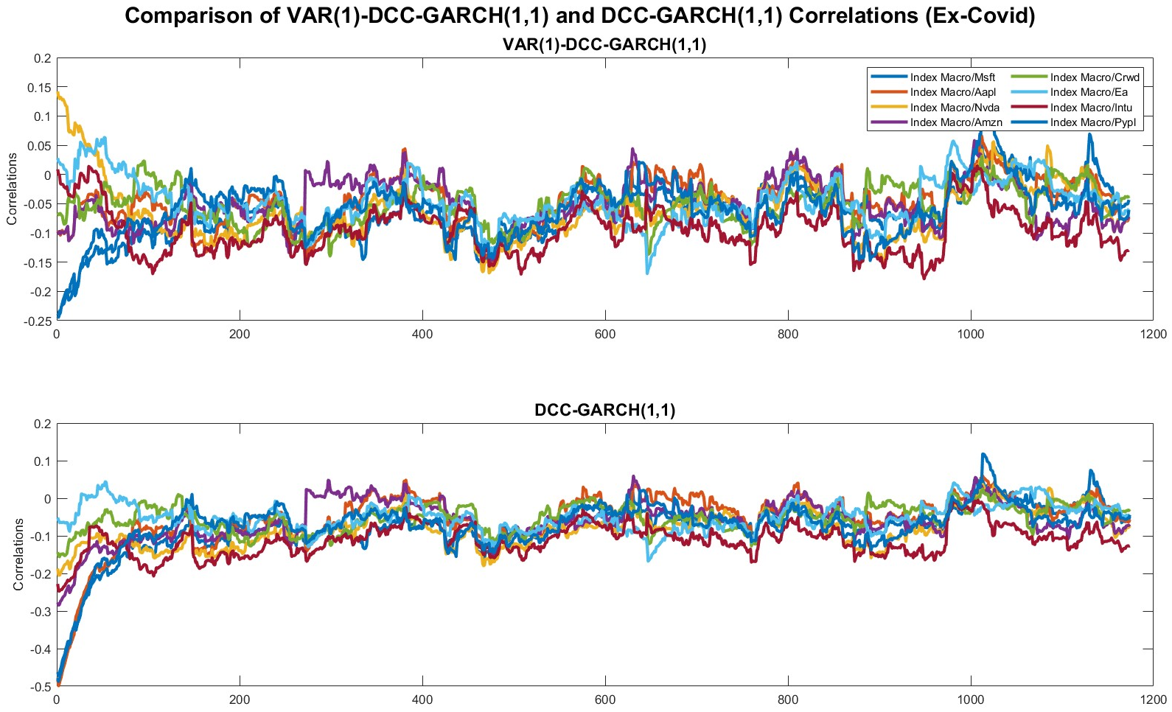
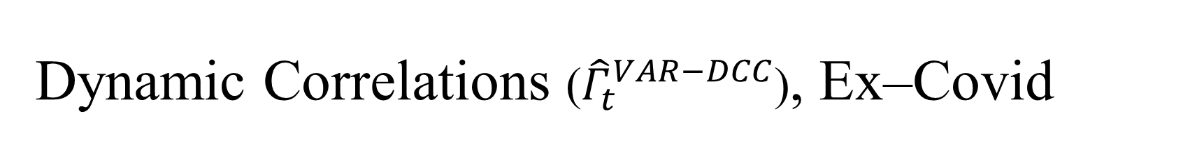
Dynamic Correlations (${\hat{Γ}}_{t}^{VAR−DCC}$), Ex–Covid

Slide 9
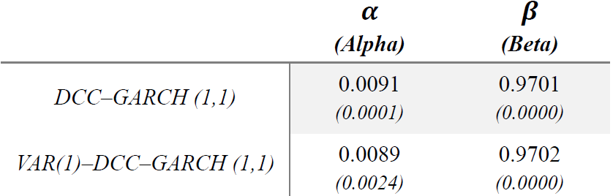
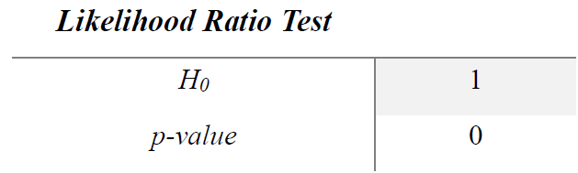
Model Selection
As seen for the trend in correlations, the parameter estimates also differ marginally: in particular, for both models, the impact of new information on correlations (𝛼) is limited, while the persistence of correlations (𝛽) tends to remain stable over time. The results are corroborated by the significant p-values.
Comparing the log-likelihood, however, the results confirm that the VAR(1)–DCC–GARCH(1,1) model offers a better fit to the data:

Slide 10
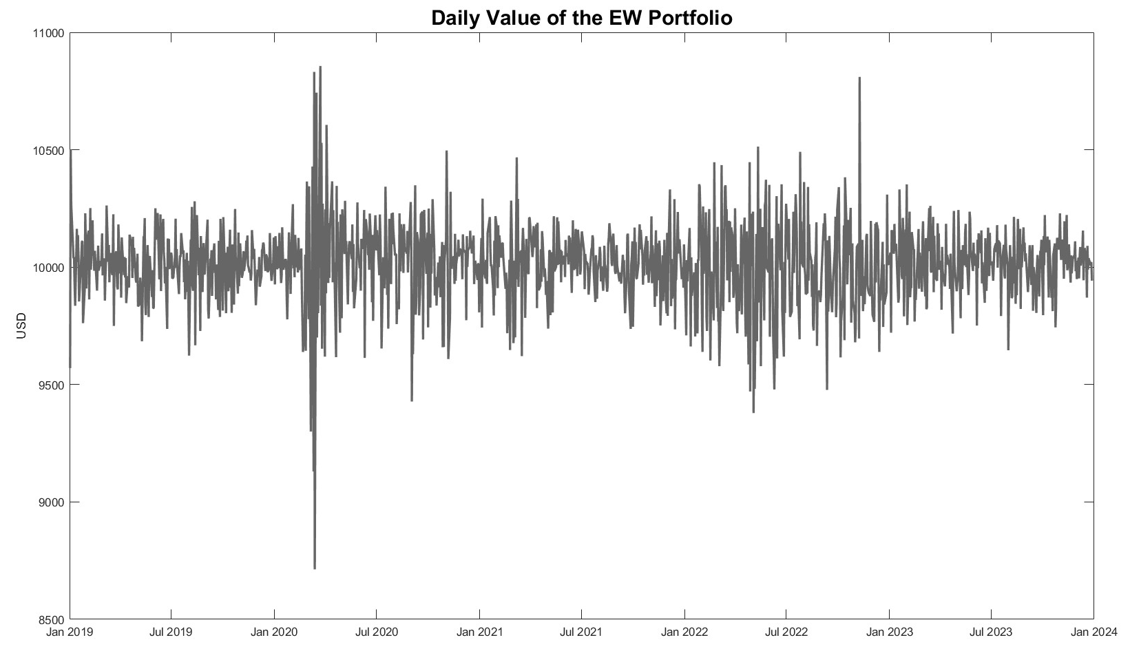
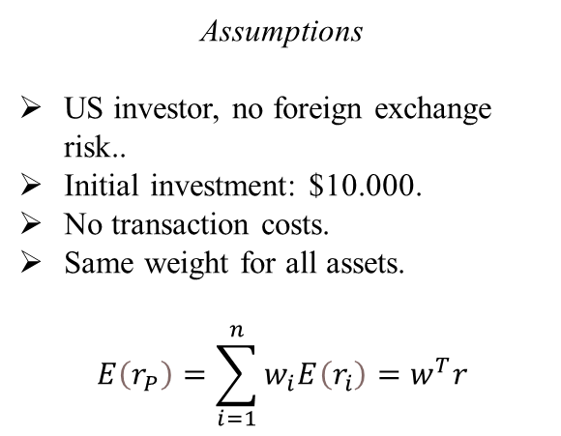
Empirical Results: Portfolio Construction
Assumptions
US investor, no foreign exchange risk..
Initial investment: $10.000.
No transaction costs.
Same weight for all assets.
$$E\left(r_{P}\right)=\sum_{i=1}^{n}{w_{i}E\left(r_{i}\right)=w^{T}r}$$

Slide 11
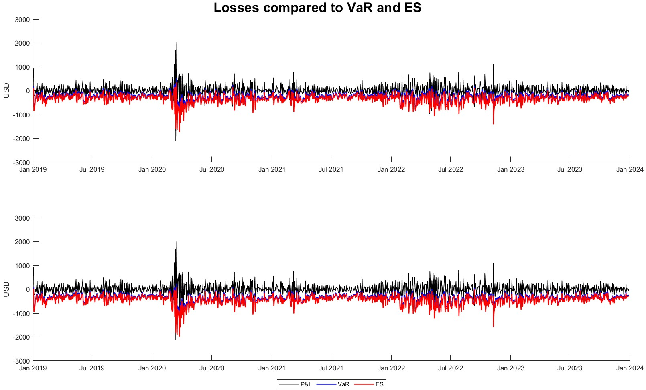
Empirical Results: Parametric Approach

Slide 12
Empirical Results: Parametric Approach
Measures of Risk | Average
 | Covid | Ex–Covid
VaR_{95%} | –271.34 | –338.05
VaR_{99%} | –378.82 | –466.59
ES_{95%} | –337.24 | –416.86
ES_{99%} | –423.27 | –530.50

Slide 13
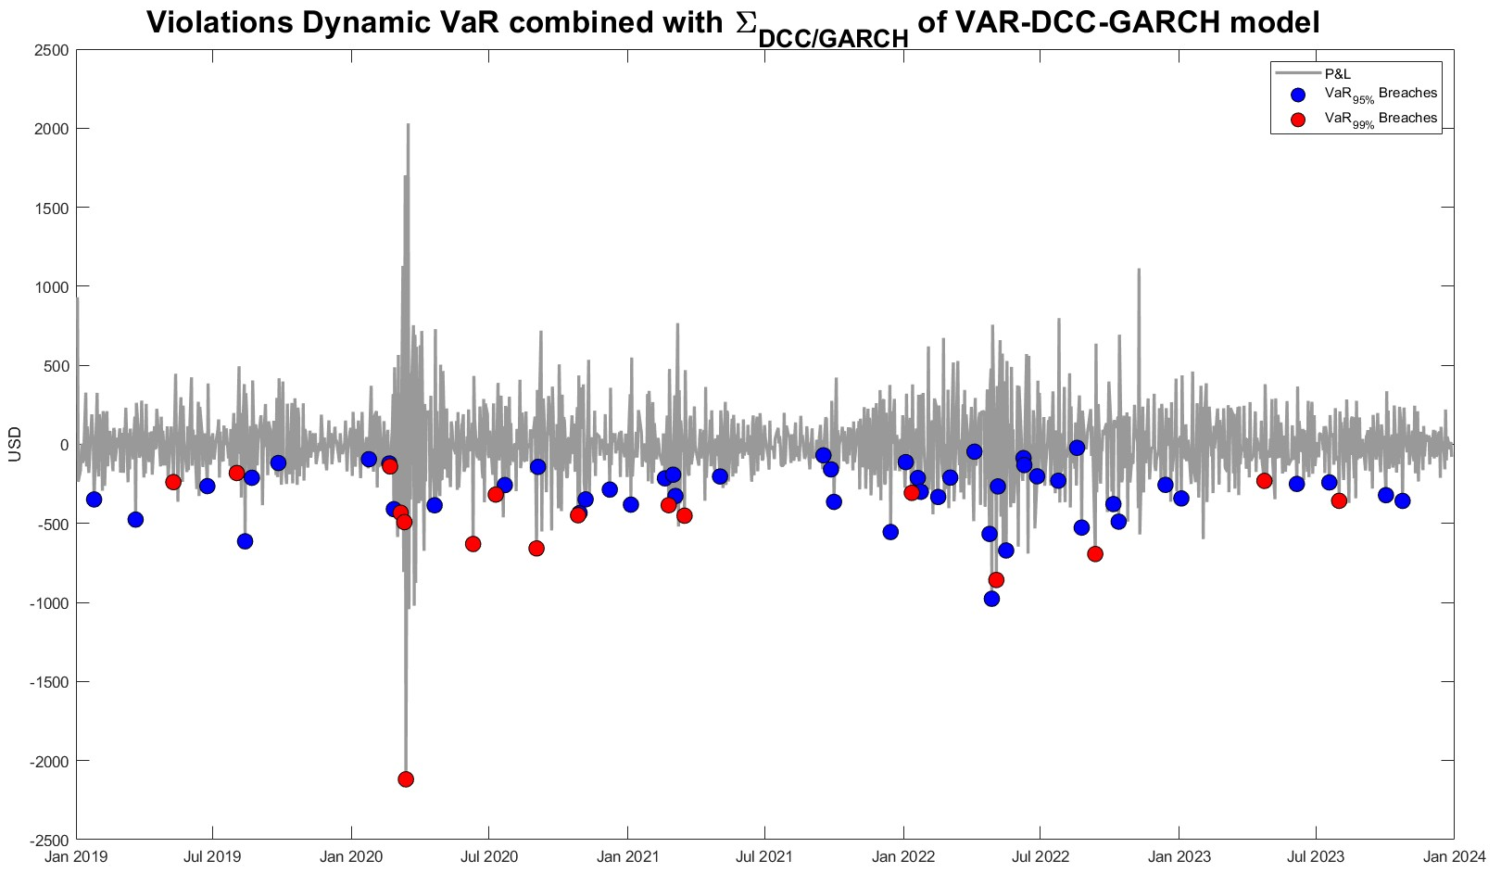
Empirical Results: VaR Breaches

Slide 14
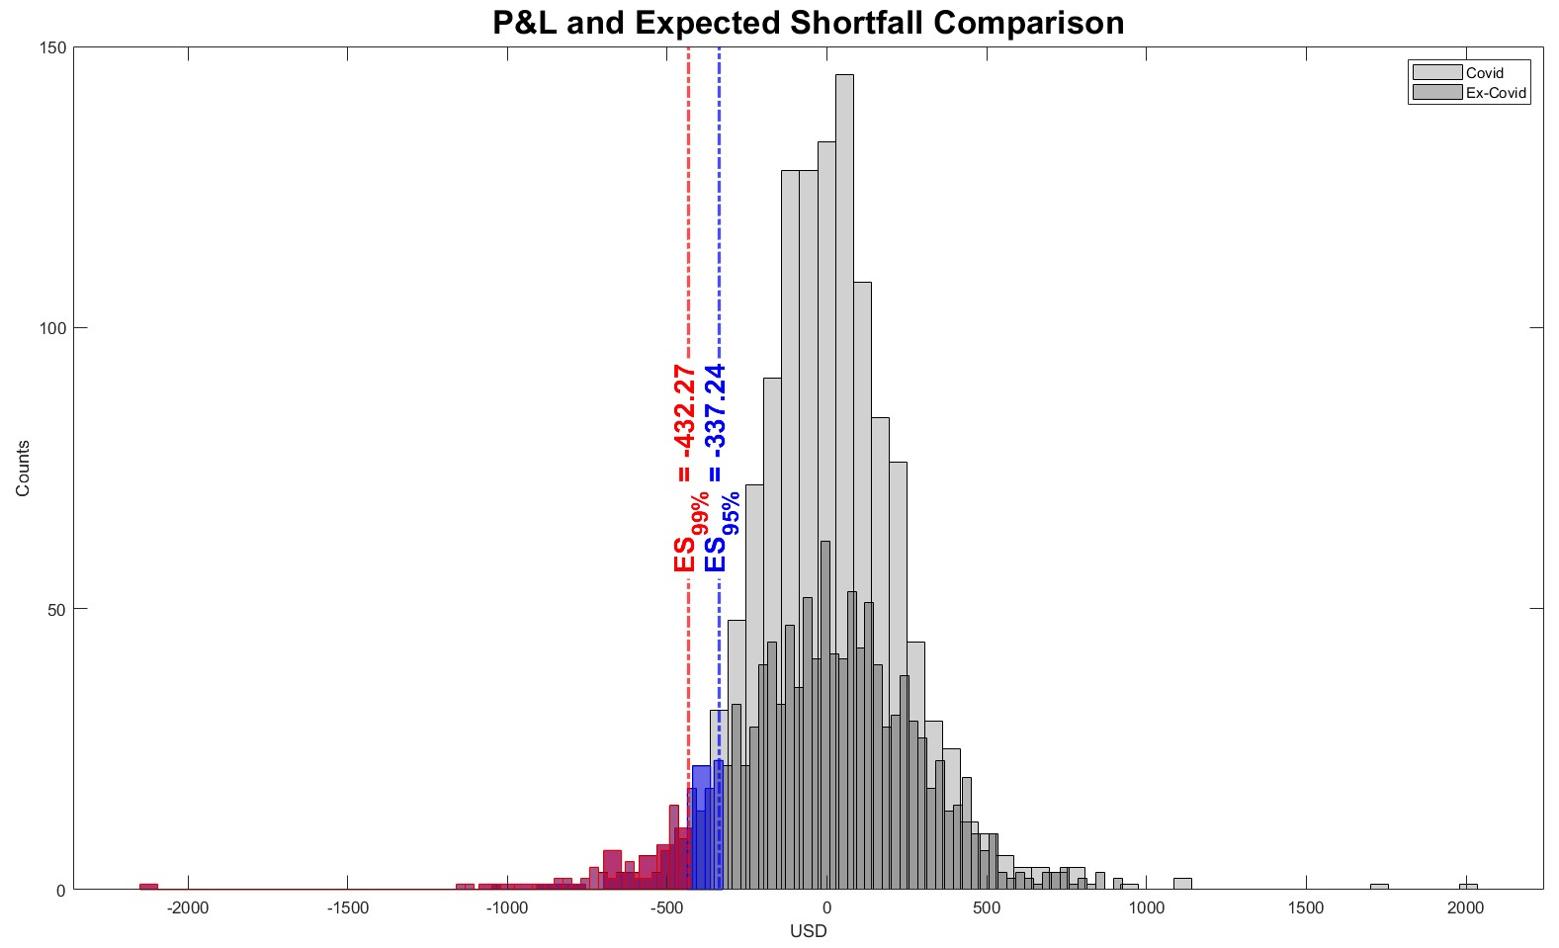
Empirical Results: Expected Shortfall

Slide 15
Conclusions
Construction of a Macroeconomic–Financial Index Cluster Analysis of the Nasdaq 100
multivariate
Calculation of Dynamic Risk Measures VaR and ES using Variance-Covariance Approach
Analysis of Dynamic Pairwise Correlations between Index and Selected Securities
univariate
Importance of data analysis methodologies.
More sophisticated econometric techniques are decisive for more accurate modelling of second-order conditional moments.
The exclusion of the most volatile months of the pandemic reduced the frequency of regime shifts between positive and negative correlations, stabilizing the correlation dynamics.
The adoption of ES provides, compared to VaR, a more precise view of potential risk.
The exclusion of the most volatile months of the pandemic showed higher potential losses, suggesting the presence of other risk dynamics.

