Slide 1

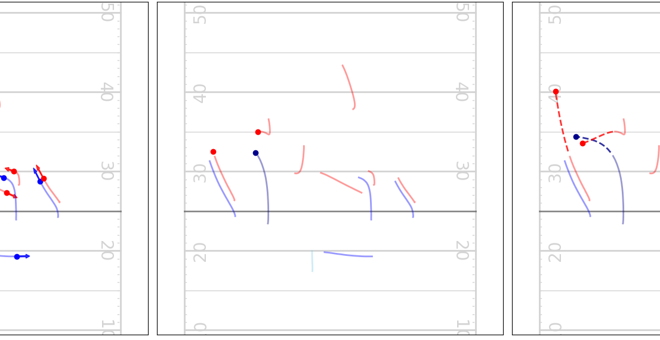
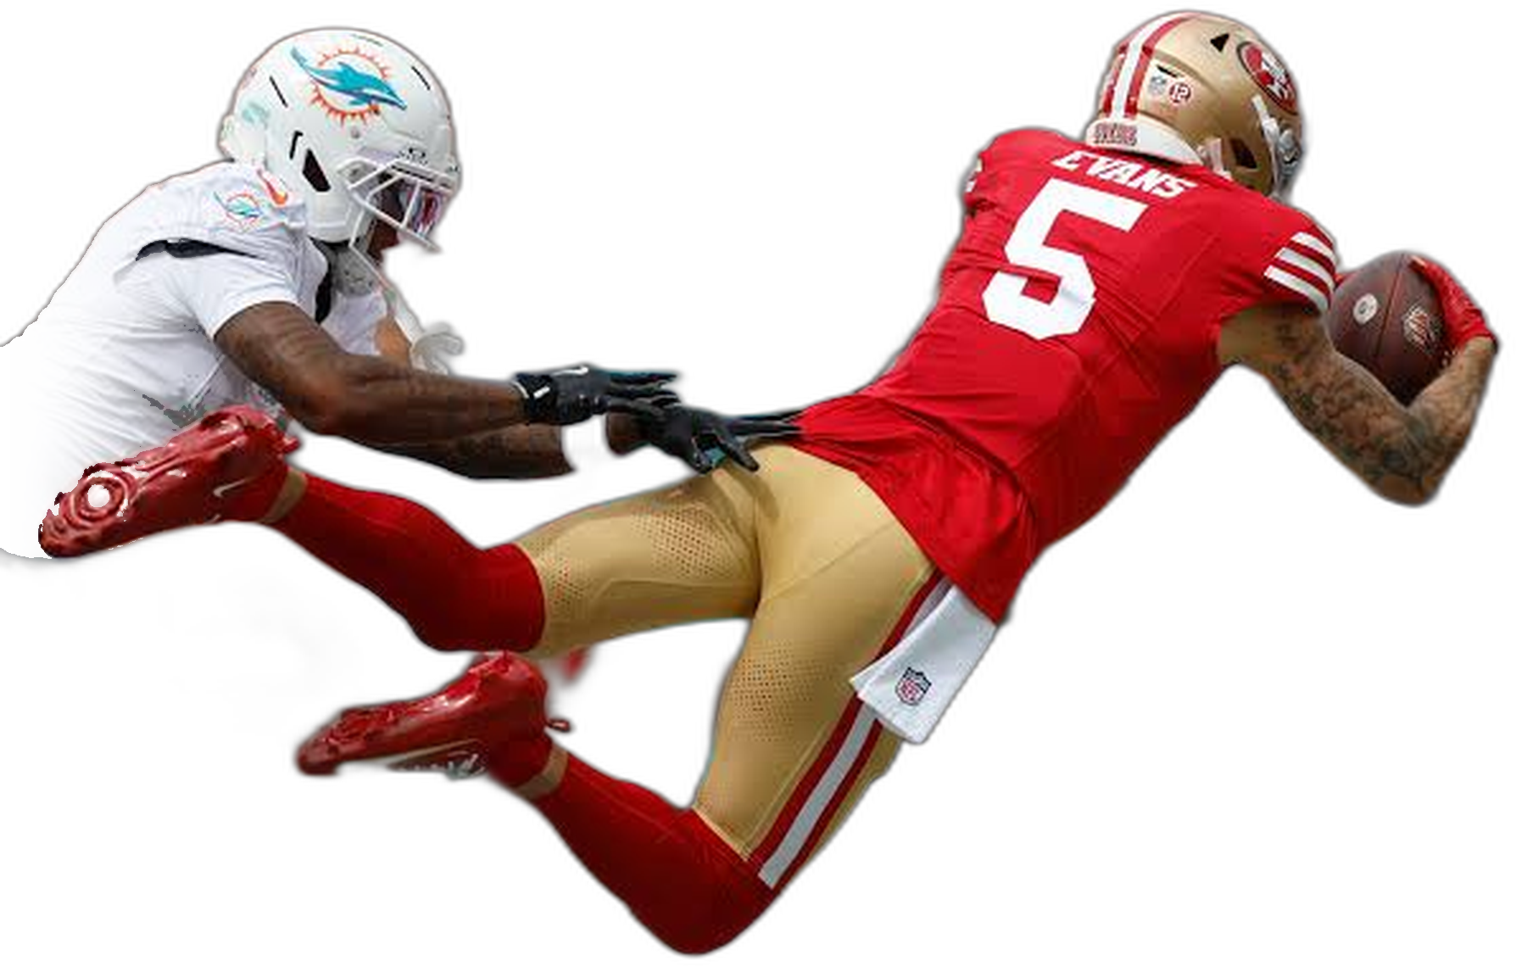
From Tactics to Trajectories
BIG DATA BOWL 2026
Predicting player movement with Graph Neural Networks
Giovanni Ponzuoli
Big Data Analytics and Text Mining
Notes:
American football is a highly tactical, play-based sport: every play starts from a scripted pre-snap formation, and its outcome depends on the coordinated movement of 22 players executing, and reacting to, a specific tactical plan: receivers running precise routes, defenders covering in man or zone schemes, the quarterback reading the defense and timing the throw. Once the ball is thrown, the play stops being scripted: receivers adjust their route to the ball's flight, defenders close distance or break on the ball, and the outcome of the play, catch, pass defensed, interception, is decided by a few seconds of movement that cannot be fully anticipated from the pre-snap formation alone. Task: predict each receiver's and defender's trajectory while the ball is in the air, from tracking data up to the throw. Why this task: it turns the tactical, multi-agent nature of football directly into a machine learning problem, naturally a graph learning problem, players as nodes, spatial and temporal relations as edges, a strong fit for graph neural networks and attention mechanisms, the core topics of the course. It also combines several AI sub-problems in one pipeline: structured feature engineering from raw tracking data, graph construction, attention-based representation learning, and a custom multi-term loss, a complete case study rather than a single isolated technique.

Slide 2
Introduction
Ponzuoli Giovanni -
- Big Data Analytics and Text Mining
BIG DATA BOWL 2026
WHY THIS PROJECT
A lifelong passion for the NFL and a taste for graph learning led me to the Kaggle NFL Big Data Bowl 2026, the challenge behind this project
THE TACTICS
American football is a play-based sport: formation and routes are scripted, with receivers running precise routes and defenders covering in man or zone schemes,
but once the ball is thrown the script ends and a few seconds of movement decide the outcome
THE AI ANGLE
How players move relative to each other and the ball is a graph-learning problem (players as nodes, relations as edges), a natural fit for graph neural networks and attention mechanisms
Predict a subset of players' trajectories while the ball is in the air,
from raw tracking data up to the throw
THE TASK
Notes:
American football is a highly tactical, play-based sport: every play starts from a scripted pre-snap formation, and its outcome depends on the coordinated movement of 22 players executing, and reacting to, a specific tactical plan: receivers running precise routes, defenders covering in man or zone schemes, the quarterback reading the defense and timing the throw. Once the ball is thrown, the play stops being scripted: receivers adjust their route to the ball's flight, defenders close distance or break on the ball, and the outcome of the play, catch, pass defensed, interception, is decided by a few seconds of movement that cannot be fully anticipated from the pre-snap formation alone. Task: predict each receiver's and defender's trajectory while the ball is in the air, from tracking data up to the throw. Why this task: it turns the tactical, multi-agent nature of football directly into a machine learning problem, naturally a graph learning problem, players as nodes, spatial and temporal relations as edges, a strong fit for graph neural networks and attention mechanisms, the core topics of the course. It also combines several AI sub-problems in one pipeline: structured feature engineering from raw tracking data, graph construction, attention-based representation learning, and a custom multi-term loss, a complete case study rather than a single isolated technique.

Slide 3
Ponzuoli Giovanni -
- Big Data Analytics and Text Mining
BIG DATA BOWL 2026
1-2. Setup, Data and Preprocessing
THE APPROACH
An end-to-end pipeline: structured feature engineering from raw tracking data, graph construction, attention-based representation learning and a custom multi-term loss
SETUP AND REPRODUCIBILITY
A single Config object holds every parameter in one place. Seeds are reset at the start of every run with cuDNN in deterministic mode, on a GPU runtime (Colab T4)
DATA LOADING
Weekly tracking data (pre and post-throw) and supplementary play context are loaded in parallel into one NFLData object
CLEANING AS
MODELING
Inconsistent position labels are unified (e.g. LB/MLB to ILB) and miscoded players are corrected from physical and usage evidence, so the one-hot role encoding stays consistent
PLAY FILTER
Only plays with a passer and at least K+1 players per frame are kept, since the KNN spatial graph needs that minimum

Slide 4
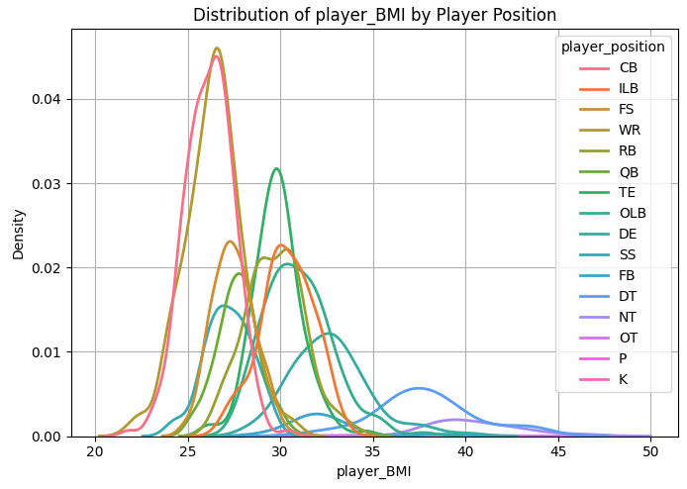
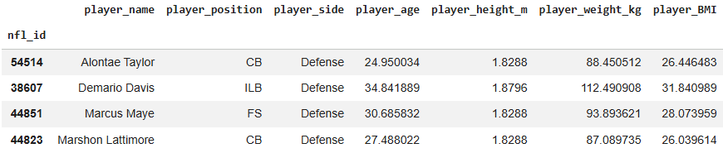
Ponzuoli Giovanni -
- Big Data Analytics and Text Mining
BIG DATA BOWL 2026
3. Players Physique Inspection
PHYSICAL PROFILE
A per-player table of age, height, weight and BMI is built and studied by position, since physical traits heavily dictate role dynamics on the field
DUAL NORMALIZATION
Each attribute is normalized twice — a global z-score and a within-position
z-score — so the network receives both how big a player is overall and how big he is for his specific role
players_df.head(4)

Slide 5
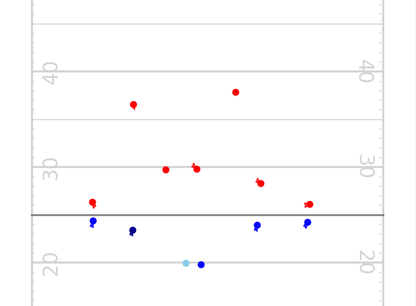
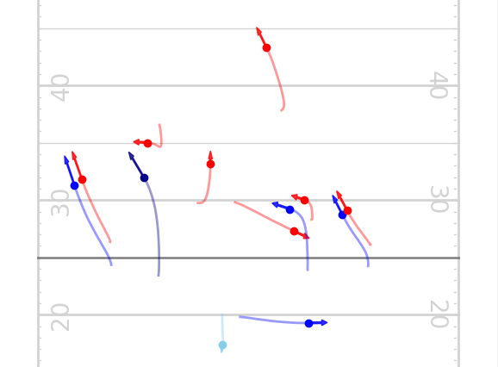
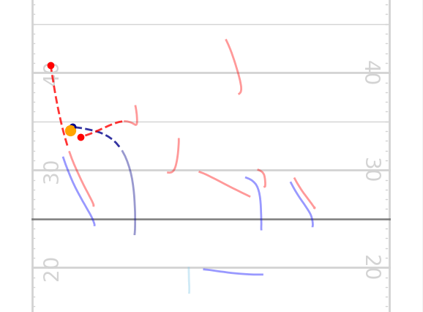
Ponzuoli Giovanni -
- Big Data Analytics and Text Mining
BIG DATA BOWL 2026
4. Plays:Standardization and Visualization
DIRECTION STANDARDIZATION
Every play that moves left is mirrored so all plays face the same direction — removing a degree of freedom the model would otherwise have to learn from data instead of getting for free
VISUALIZATION TOOLING
Frame-by-frame play visualization built here is used to qualitatively inspect the trained model's predictions against ground truth
Frame 1 - Start
Frame 22 - Pre-Pass
Frame 34 - Post-Pass
ball
offense
passer
defense
target
Part to Predict

Slide 6
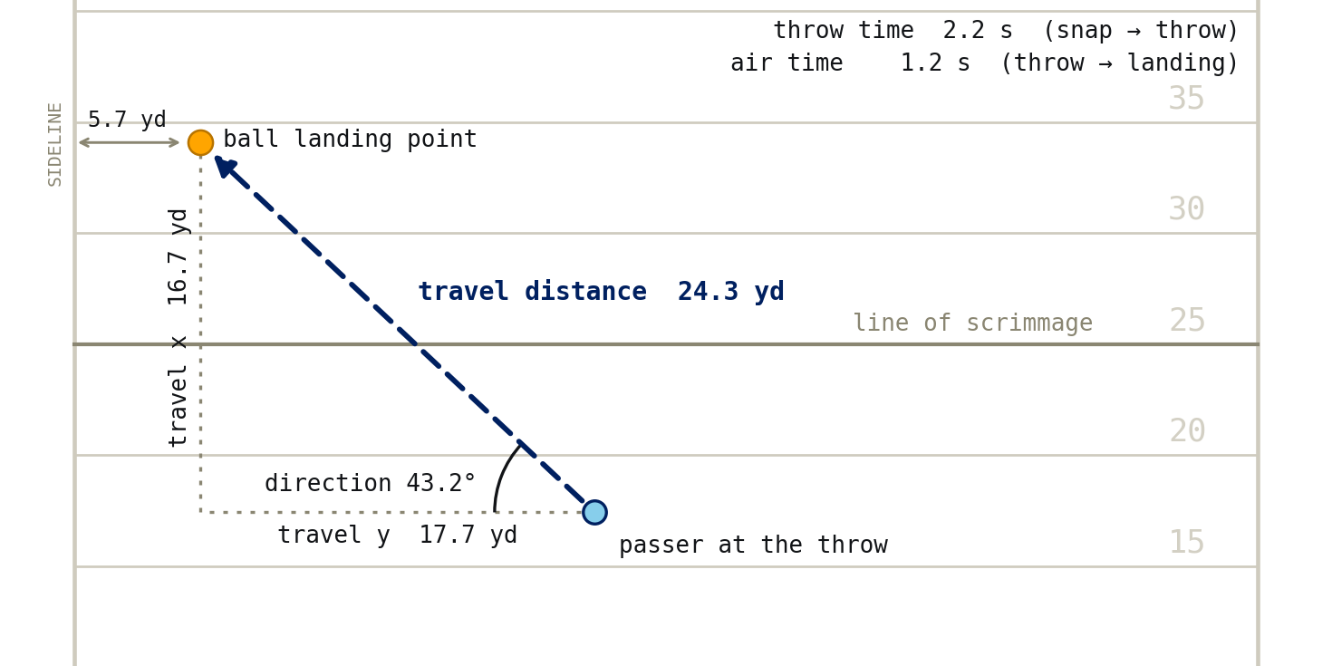
Ponzuoli Giovanni -
- Big Data Analytics and Text Mining
BIG DATA BOWL 2026
5. Play Features
BALL-TRAJECTORY FEATURES
Ball statistics are computed directly from the tracking data: throw time, air time, landing point, travel distance and direction. They become part of the model's global input vector
DESCRIPTIVE VS. MODEL FEATURES
Receiver and defender statistics are computed as well, but only some of them feed the model; the rest serve the analysis alone. This deliberate separation keeps what the model sees apart from what is used to understand the data
example play: game 2023101900, play 78

Slide 7
Ponzuoli Giovanni -
- Big Data Analytics and Text Mining
BIG DATA BOWL 2026
6. Model Inputs
NODE FEATURES
(36-DIM)
Kinematics (position, speed, acceleration, direction, orientation), one-hot role, physical attributes (global + within-position z-scores), and one-hot side and position — one vector per player per frame
kinematics
6
role
4
physical
8
side
2
position
16
EDGE FEATURES
(7-DIM)
Two distinct edge types, kept separate on purpose: spatial edges (k-nearest players in the same frame) and temporal edges (a player linked to himself in the next frame) — each gets its own attention branch in the model
distance
1
dx
1
dy
1
Δ speed
1
Δ accel.
1
Δ dir.
1
Δ orient.
1
GLOBAL FEATURES
(60-DIM)
Play-level context (score, down, formation, route, expected points, etc.), controlled by a global_mode switch that is the first axis of the ablation study; min–max normalization uses bounds fixed a priori, so no validation/test statistic leaks into training
play context: score, down, formation, route, …
46
ball trajectory
14

Slide 8
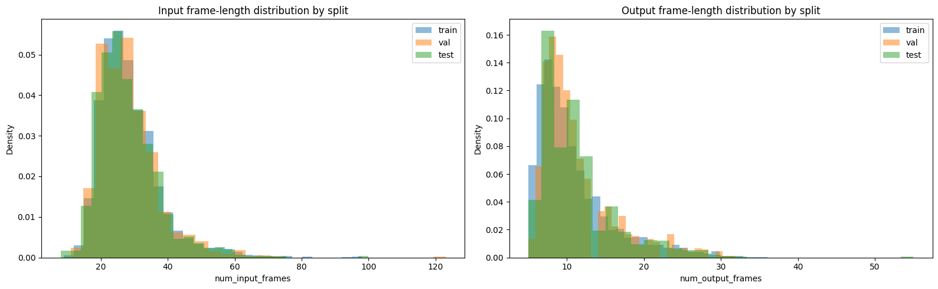
Ponzuoli Giovanni -
- Big Data Analytics and Text Mining
BIG DATA BOWL 2026
7. Data Pipeline
STRATIFIED SAMPLING
Plays are binned by rank (frequency), not raw value, and sampled as evenly as possible across bins, so rare short and long plays are not drowned out by the most common lengths
SPLIT BY PLAY LENGTH
Train, validation and test are stratified on the same bins and split strictly by play, verified with an explicit assertion that no play appears in two sets
BATCHES
BatchProvider turns the padded tensors into PyG graph batches, building the graphs once per global_mode and re-collating them for different batch sizes

Slide 9
Ponzuoli Giovanni -
- Big Data Analytics and Text Mining
BIG DATA BOWL 2026
8. Model’s Architecture
PLAY GRAPH
{one graph per play}
node features
36-dim
edge features
7-dim
SPATIAL GAT
knn same frame
20-dim
FUSE
Linear 62 → 62
[+ global features]
62-dim per node
LAST FRAME
concat last
frame (x, y)
64-dim per player
pad to 17 players
MLP REGRESSOR
64 → 256 → 188 ReLU
94 frames (x, y)
OUTPUT
(x, y)
of every player
up to 94 frames
TEMPORAL GAT
same player f → f+1 42-dim
GLOBAL FEATURES
Linear → 62-dim
ATTENTION LAYER
Every player in every frame is a node. A graph attention layer updates it by weighting its neighbors with a learned attention score that also reads the edge features
SPATIO-TEMPORAL ENCODER
The layer runs in two branches, spatial (k-nearest players, same frame) and temporal (same player, next frame), fused by a linear layer into a 62-dim embedding; the projected global features are then added to every node
ONE-SHOT DECODING
Per player, the last-frame embedding plus its last (x, y) goes through an MLP that outputs all future positions at once, with no recurrence

Slide 10







Ponzuoli Giovanni -
- Big Data Analytics and Text Mining
BIG DATA BOWL 2026
8. Encoder’s Architecture
FRAME f
ONE GAT LAYER — UPDATING NODE i's EMBEDDING
same mechanism for both edge types below — separate weights, separate neighbor set, per branch
i
$$x_{i},x_{j}∈ℝ^{36}$$
(node features)
$$e_{ij}∈ℝ^{7}$$
(edge features)
node_proj (Linear)
edge_proj (Linear)
$$h_{i},h_{j}∈ℝ^{d}$$
$${\tilde{e}}_{ij}∈ℝ^{d}$$
$$e_{ij}=LeakyReLU\left(a⋅\left[h_{i}‖h_{j}‖{\tilde{e}}_{ij}\right]\right)$$
attention: Linear (3d → 1), scalar score per edge
FRAME f + 1
$$α_{ij}={softmax}_{j}\left(e_{ij}\right)$$
normalized over node i's neighbors in this branch
k
$${message}_{ij}=α_{ij}⋅\left(h_{j}+{\tilde{e}}_{ij}\right)$$
$h_{i}^{branch}=\sum_{j}{{message}_{ij}}$
sum over i's neighbors in this branch
$$h_{i}^{branch}∈ℝ^{d}$$
spatial edge — k-nearest neighbors, same frame
SPATIAL BRANCH
neighbors: k-nearest, frame f
hidden dim: 20
TEMPORAL BRANCH
neighbor: self, frame f → f+1
hidden dim: 42
temporal edge — same player, frame f → f+1
node i — target player p, frame f
node k — same player p, frame f+1
final model: hidden_dim=64 →
→ encoder hidden 62 = 20 (spatial) + 42 (temporal) →
→ fuse (Linear 62 → 62) →
→ $h_{i}∈ℝ^{62}$
offensive node — neighbor player, same frame
defensive node — neighbor player, same frame
other node — player outside the k-nearest

Slide 11
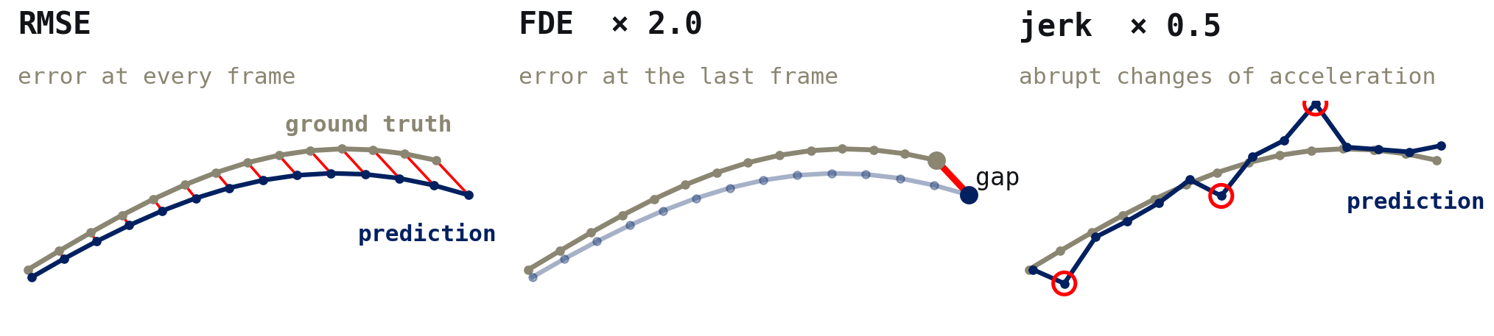
Ponzuoli Giovanni -
- Big Data Analytics and Text Mining
BIG DATA BOWL 2026
9. Training and Baseline
DATASET AND SPLIT
Most of the work uses a 5k-play dataset: 3,000 training, 1,000 validation and 1,000 test plays, stratified by play length and shared by every experiment
LOSS VS. METRIC
Metric: masked RMSE in yards. A composite loss with contributions from RMSE + FDE (Final Displacement Error, last valid frame) + jerk, which offsets the one-shot decoder's lack of continuity
Loss =
+
+
OPTIMIZER AND SCHEDULE
AdamW at 2e-3 with gradient clipping 1.0; ReduceLROnPlateau halves the LR after 6 epochs without a 1% gain (9 halvings in the final model); early stopping never fired, so all runs used 100 epochs and the best checkpoint is tested
STARTING POINT
Batch size 8, hidden_dim 64, no global features, 1 GAT layer, regressor width 256 → test RMSE 1.032 yards — the reference point the next chapter improves on

Slide 12
Ponzuoli Giovanni -
- Big Data Analytics and Text Mining
BIG DATA BOWL 2026
10. Sequential Hyperparameter Search
ABLATIONS
Five parameters are ablated one at a time around a baseline: presence or absence of global features, batch size, hidden dimension, regressor width and number of GAT layers: a final study then repeats the chosen configuration on larger datasets
GREEDY SEARCH
Instead of a full grid the search is greedy and coordinate-wise: each stage fixes the previous stage's winner and varies a single axis, so every new run changes exactly one thing and its effect stays attributable
PROGRESSION
global features
none,all
→
batch size
1,8,64
→
hidden dimension
8,64,256
→
regressor width
64,256,512
→
GAT layers
1,2,3
THE RUBRIC
Every stage is judged on the same rubric — tradeoffs, training time, parameter count and result — because the goal is the smallest, fastest model that does not sacrifice accuracy, not simply the lowest error

Slide 13
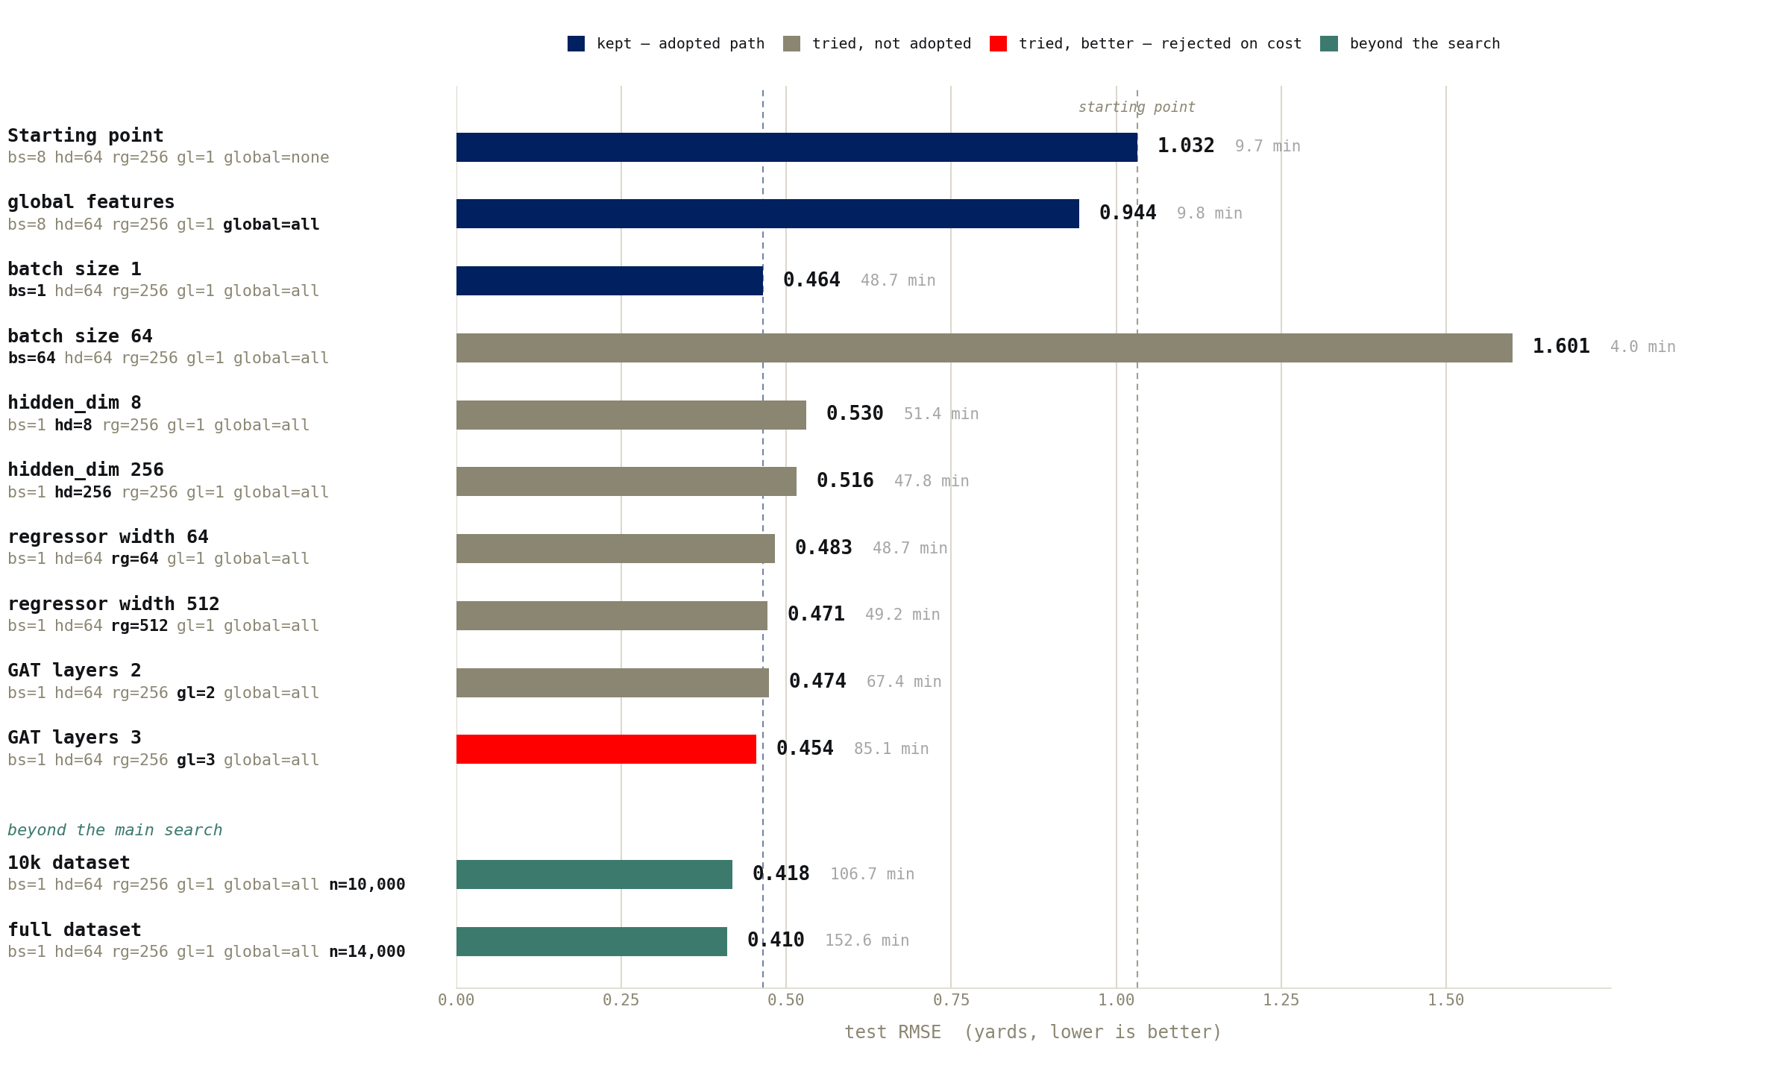
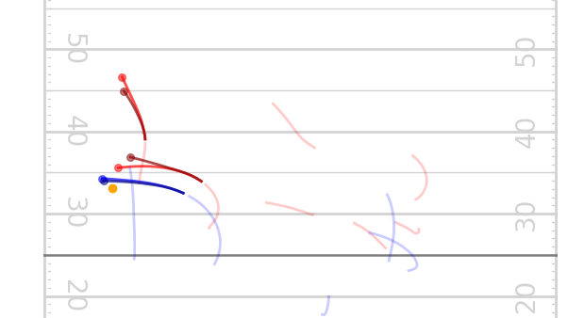
Ponzuoli Giovanni -
- Big Data Analytics and Text Mining
BIG DATA BOWL 2026
11. Results — The Search, Run by Run
TEST PLAY
predicted vs. real trajectories
dark: predictions - light: real paths

Slide 14
Ponzuoli Giovanni -
- Big Data Analytics and Text Mining
BIG DATA BOWL 2026
12. Discussion and Conclusions
0.410 yards
test RMSE of the final experiment
75,620
trainable parameters
−60%
RMSE vs. the starting baseline
COMPETITIVE RESULT
The winner of the challenge scored 0.463 RMSE on the hidden test set, which may well contain more difficult plays than my local split, so a comparable value on the local test could emerge as good work
KNOWN LIMITATION
Error is highly uneven across play types: under 0.02 yards² MSE on structured routes vs. over 2 yards² on scrambles or broken plays
FUTURE WORK
The parameter count was kept intentionally low; augmentation, dropout and other regularization techniques, a Gaussian Negative Log-Likelihood loss and a GAT with more layers could all improve generalization, while an RMSE breakdown by route type would show where the remaining error concentrates

