Slide 1
Parallel Particle Filter with OpenMP
Cappelletti Giovanni mat. 185260

Slide 2
Launch the system using ROS+Rviz
To run the program:
  CD in the project directory and source the overlay for each terminal
    source /opt/ros/foxy/setup.bash
    source install/setup.bash
In one terminal launch rviz2
In another terminal launch the node
  ros2 launch particle_filter demo_particlelaunch.xml
In another terminal run the bag:
  ros2 bag play <rosbag-directory>

Slide 3
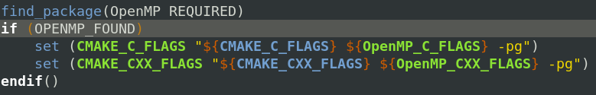
First step: identify the slowest function
Project build with colcon
Tool to analyse the program: Gprof
Add dependencies in the file “CmakeLists.txt”
And in “demo_particlelaunch.xml”
Every version also analysed with omp_get_wtime() function
  Gprof isn’t perfectly suitable for parallel programs analysis

Slide 4
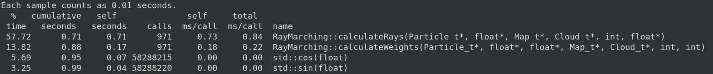
First step: identify the slowest function
After running the system (a bag recording)
  Node gets stopped with ctrl+c (clean stop) then run Gprof to profile the application using the gmon.out and redirecting to a file:
    gprof path-to-pf_node_executable gmon.out > analysis.txt
“calculateRays” is the function with the most demanding computing time → target of parallelization

Slide 5
Function calculateRays: higly parallel
Most of the function can be parallelized
  Each thread can work using his private memory, then update the “particles” variable
    Note: every thread access a different memory location* when writing the results, so synch on writes is not needed – good!
  Concurrent memory reads can be parallel, these are done e.g. when accessing the function’s parameters
Program runs on a machine with 4 cores (in this case, a virtual machine)
* Each thread writes in a single location of an array inside an array of struct – no race conditions should happen
particles[i].rays[j] = out

Slide 6
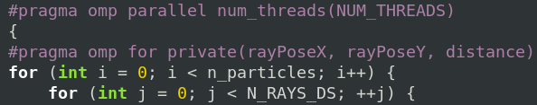
OpenMP Parallelization
Pragma directives used to parallelize the particles computation
  Create a parallel section, then distribute the work done in the for loop among the threads
  Some variables are shared by default in openmp, privatization of these elements is needed to avoid problems (segfault during the node execution)
    These variables are declared outside the parallel section and used to store the function’s arguments values for each thread, they could be declared inside the section with no difference in terms of code correctness and execution time

Slide 7
Measuring execution time
To measure the execution time (in seconds), the wall time is useful and openmp provides a function to get it
  At the beginning, before entering the parallel section:
    double wtime_start = omp_get_wtime();
  After exiting the parallel section:
    double wtime_end = omp_get_wtime();
    double wtime = wtime_end – wtime_start;
The sequential version of the program takes in average 2.2 ms
  Every measure shown is an average of about one thousand calls (depends on the number of messages arrived on the topic). Of course int the first calls the function takes a little more time ot execute than the last ones – the power of caches!

Slide 8
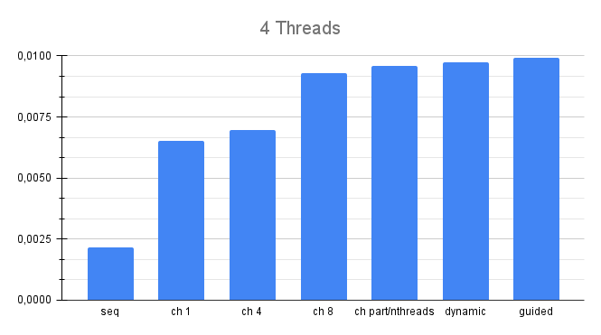
Scheduling policy
Scheduling the work in different ways has an impact on the system performance Problem: the program is still slower than sequential version
4 static scheduling versions with different chunk sizes

Slide 9
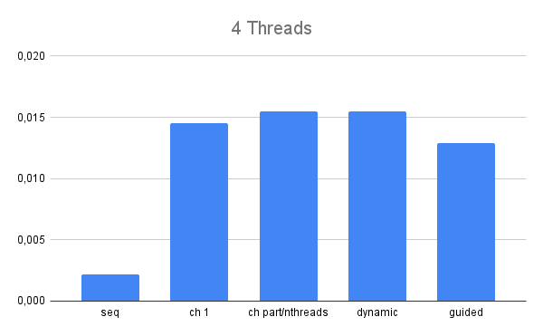
First solution: collapse the loop execution
If we assume the load is unbalanced (it could be the cause for this results), collapsing the nested loops might be a good idea, since more iterations get assigned to each thread
Results:
Worse than before!
Load balancing doesn’t seem to be the issue here

Slide 10
Other solutions
Since each thread has to read the same function arguments, try using the firstprivate clause, so that everyone has a private copy of the arguments.
  The average execution time is 14 ms, a lot slower than sequential version (2.2 ms)
Unfortunately, things doesn’t seem to improve… in facts each thread copies the values once in the beginning of its execution, so it makes sense
Another possible solution: scale out the number of threads
  Instead of using a number of threads equal to the number of cores in the machine, scale this number out by using more threads (always a multiple of the core number to avoid idle cores)

Slide 11
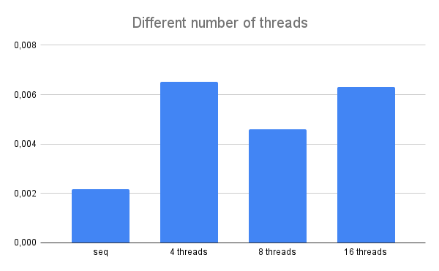
Scale out threads
By using 8 threads instead of 4 threads, the execution time seems to be smaller
Now different scheduling policies can be used to see if results could be improved

Slide 12
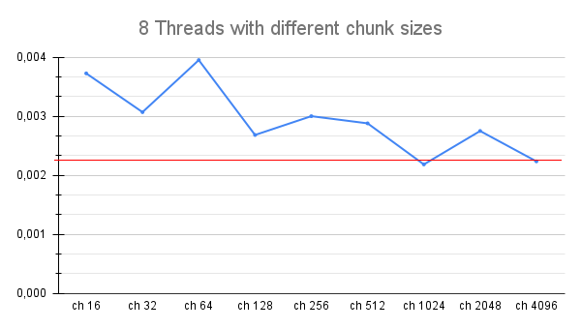
Scheduling policies with 8 threads
The best configuration seems to be achieved when using 8 threads (on a 4 core virtual machine) with chunk size 1024
Consideration: in the worst case, the loop has 18000 iterations (300 particles * 60 rays). Since the number of threads isn’t too high, distributing more iterations to each thread seems to be the key point.
However, using more iterations than N_Iters/N_threads does unbalance the load, with some threads having little to no iterations to work on – it’s a waste of resources.
Seq

Slide 13
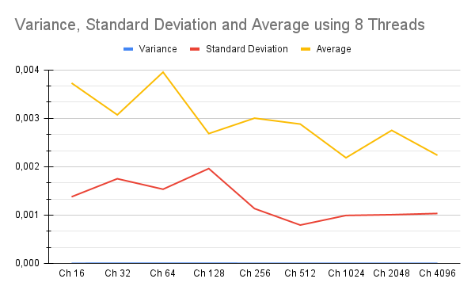
Variance and Standard Deviation of the results

Slide 14
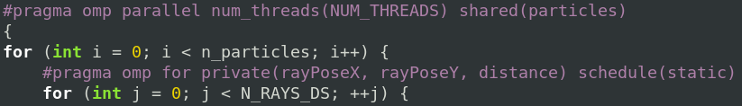

[Not working] Alternative solution
Another solution could be to distribute only the inner loop work among the threads
  This solution however does not work, the node segfaults and the data values are not correct
    Simple to visualize on Rviz: the particles get spawned outside the circuit!
  A possible Idea: synchronize writes in memory
In cases like this an atomic operation should be preferred, but since the work is done on structs openmp does not allow it
Despite that, the program is still uncorrect and presents the same problems as before

Slide 15
Conclusions
The program has been parallelized with openmp and synchronization primitives have been avoided, however performance has not improved by a lot compared to the sequential version. Possible causes:
  The overhead of creating a parallel section is not negligible
  At the end of the parallel section there’s a barrier, some threads that finish first have to wait for the other threads
    Even with a nowait clause on the worksharing pragma, things does not change: the load seems in fact to be well balanced
  Multithreading is done on a virtual machine on virtual cores and the computation is cpu-bound → a lot of context switches

