Slide 1
Iowa_Liquor_Sales
File created on: 5/1/24 6:58:45 PM CDT

Slide 2
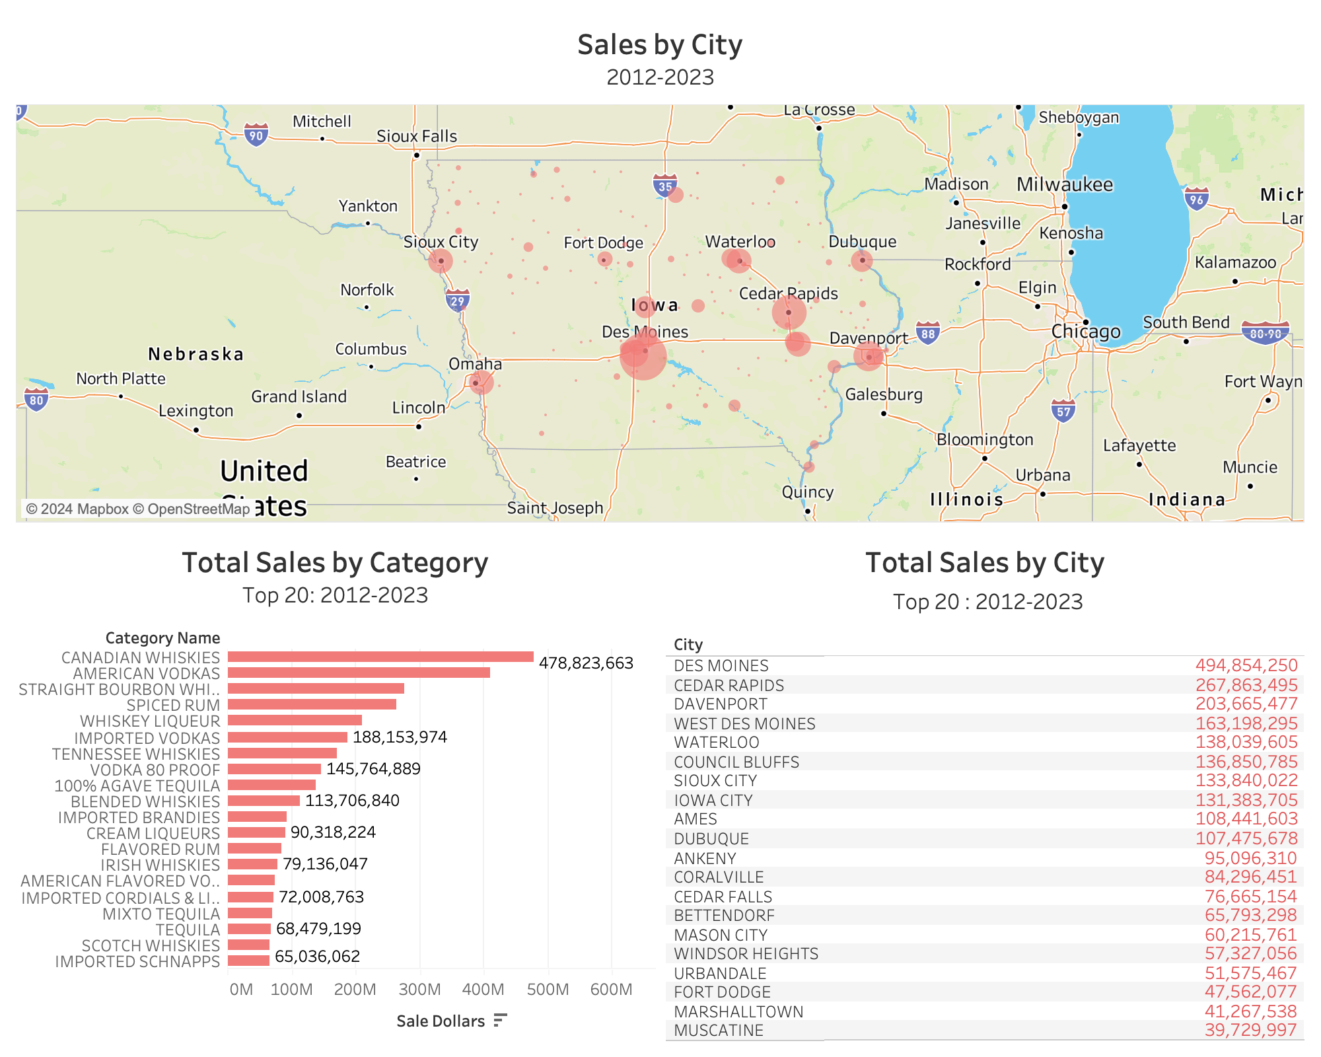

Slide 3
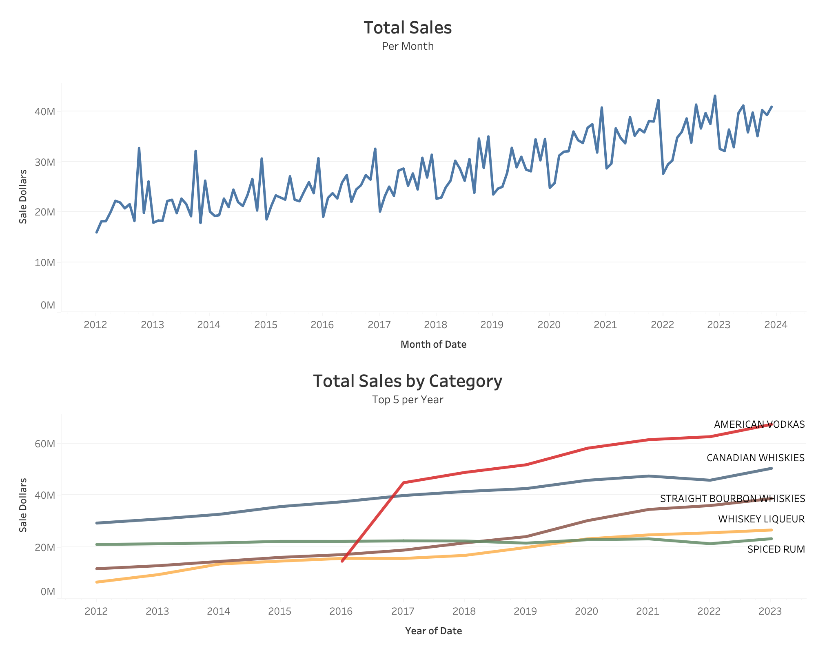

Slide 4
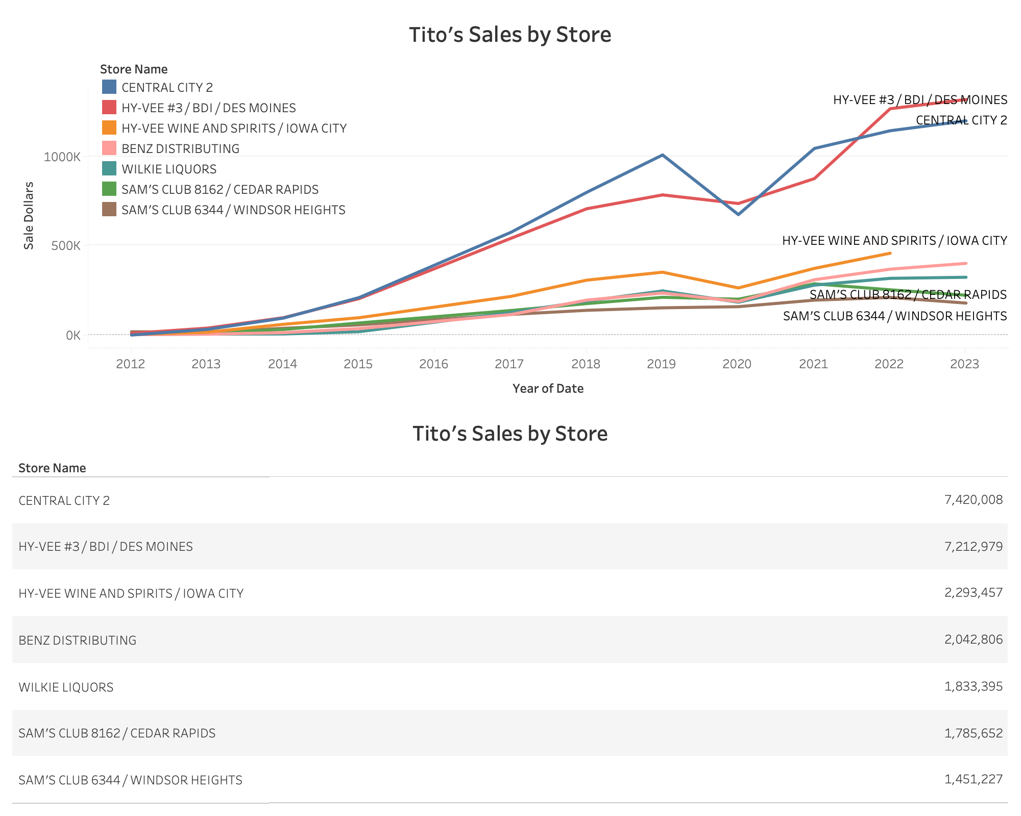

Slide 5
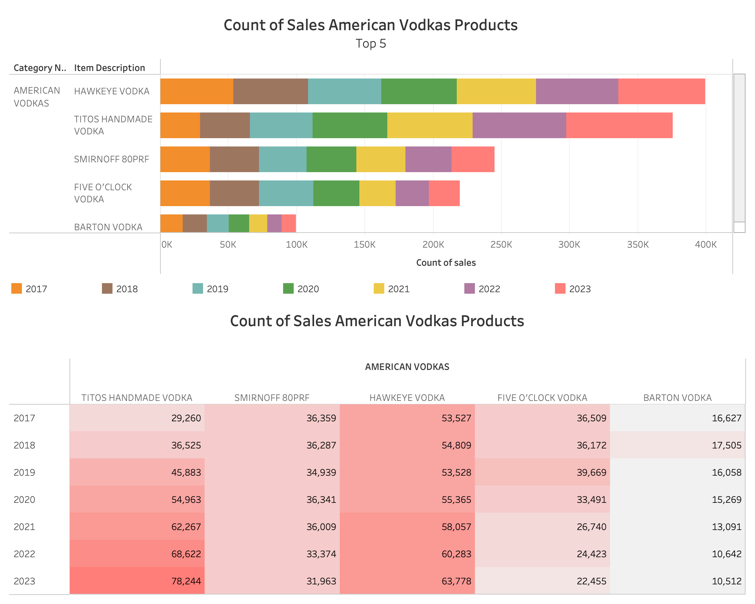

Slide 6
