Slide 1
SQL vs NoSQL
Comparative Performance Benchmark: PostgreSQL vs MongoDB in Football Analytics

Slide 2
Context and Objective
Architectural Dilemma: Addressing the critical choice between Relational (SQL) and Document (NoSQL) paradigms.
Real-World Use Case: Utilizing the EA Sports FC 25 dataset containing over 17,000 professional player profiles.
Key Question: Answering "which database performs best in which specific context”
Core Objective: The goal is not to declare an absolute winner, but to determine contextual suitability.

Slide 3
The Dataset
Dataset Origin: A comprehensive database derived from EA Sports FC 25, containing over 17,000 professional player profiles with 50+ attributes.
SQL (PostgreSQL) - Normalized Schema: Designed a strict relational schema with 8 interconnected tables (Players, Teams, Leagues, Stats, Nationalities).
NoSQL (MongoDB) - Embedded Pattern: Implemented a denormalized "Embedded Data" pattern, creating comprehensive, autonomous JSON documents.

Slide 4
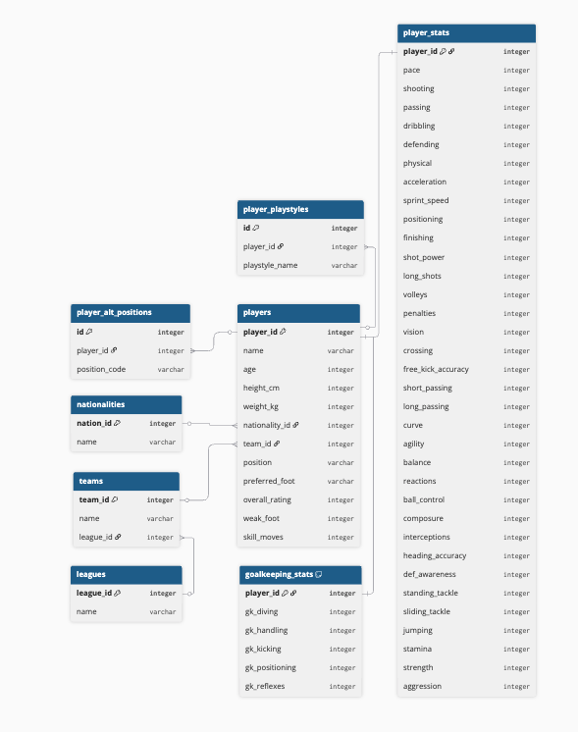
SQL Schema
To ensure Referential Integrity the raw CSV data was transformed into 8 interconnected tables.
Challenges faced:
Primary Key Collision
Atomicity Violation
Sparse Data Handling

Slide 5
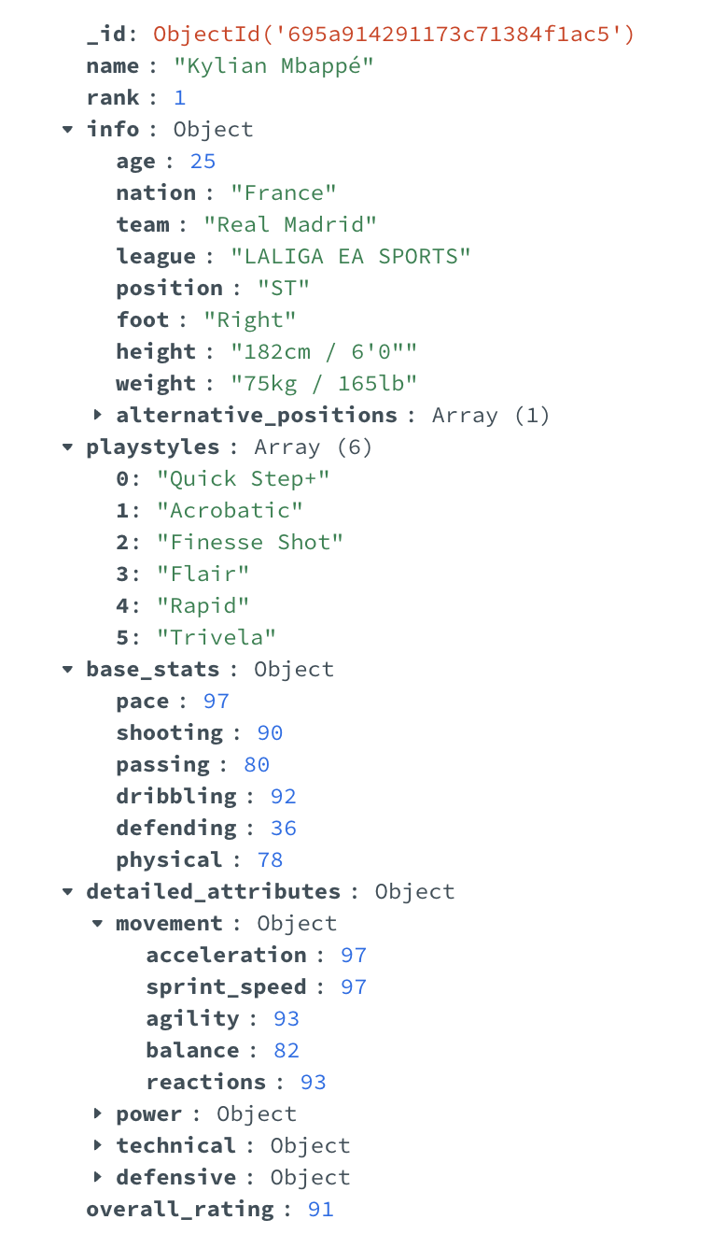
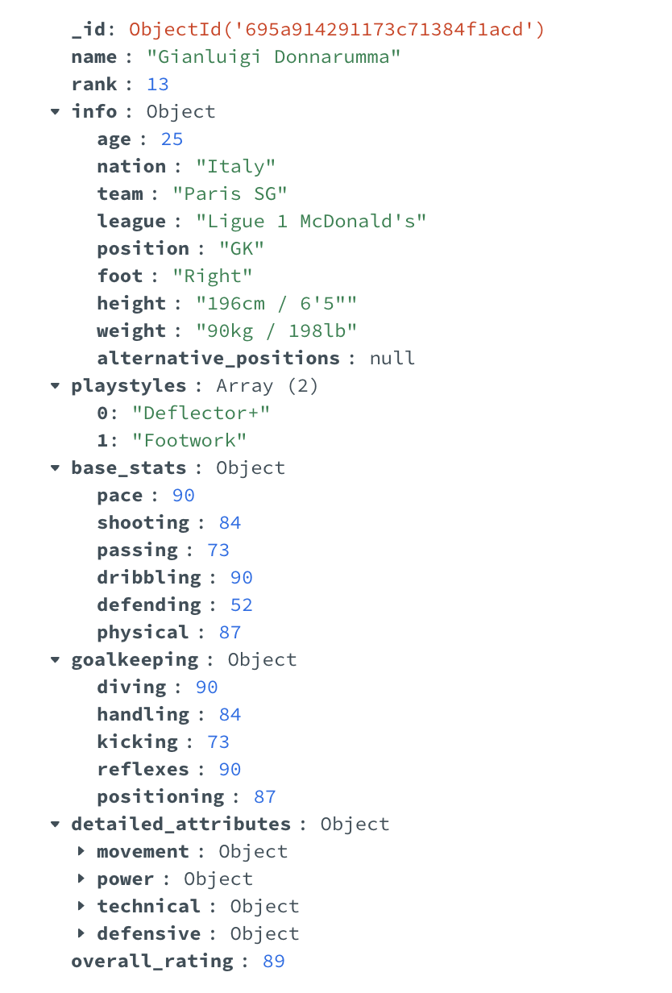
NoSQL Modeling
Denormalized model. Each player is stored as a single, self-contained JSON Document.
Native Array Handling
Polymorphism
No JOIN

Slide 6
The 9 Benchmark Queries
9 benchmark queries to assess 3 key dimensions:
Pure Performance: Response times for massive Joins and Aggregations.
Syntactic Complexity: Ease of writing queries for polymorphic data structures.
Flexibility (Schema Evolution): The ability to adapt to structural changes without incurring downtime.
Q1:Multi-Join | Q2: Analytics & Group By | Q3: Mass Update (Write)
Q4: Text Search (Regex) | Q5: Polymorphism | Q6: Array Filtering
Q7: Intra-document Comparison | Q8: Window Functions | Q9: Schema Evolution

Slide 7
The Queries
Q1: "Find all French players who play for Real Madrid.”
Q2:"Calculate the average age for every Nation that has at least 30 registered players."
Q3:"Increase the 'Stamina' stat by +1 for all players over 30 years old."
Q4:"Find players whose name starts with 'Ro' playing for a team ending in 'United'."
Q5:"Find players who are either elite Goalkeepers (Diving > 88) OR elite Dribblers (Dribbling > 90).”
Q6:"Find players who possess BOTH the 'Flair' AND 'Rapid' playstyles."
Q7:"Find players whose Passing stat is at least 15 points higher than their Shooting stat.”
Q8:"Identify the single highest-rated player for every specific League."
Q9:"Add a new “scouting_status” column and set it to 'High Potential' for all players Under-21."

Slide 8
Methodology & Environment
Exact timings were captured using native internal profilers—EXPLAIN ANALYZE for PostgreSQL and the .explain("executionStats") cursor for MongoDB—to obtain precise execution times in milliseconds.
Beyond raw speed, I evaluated Syntactic Complexity (Developer Experience) by analyzing the query logic and lines of code required to solve complex problems.
All benchmarks were executed on identical hardware configurations to ensure strict resource parity (CPU/RAM) and guarantee a scientifically fair comparison.

Slide 9
Performance Query
Objective: Calculate average age grouped by nationality for nations with 30+ players (Q2).
SQL Automatic Indexing
MongoDB COLLSCAN
Small Dataset Factor (Entire DB fits in RAM, masking SQL JOIN costs.)
Aggregation Pipeline overhead

Slide 10
Syntactic Complexity
Objective: Find players who possess BOTH the ”Flair" AND "Rapid" playstyles (Q6).
Structural Fragmentation (SQL)
Verbosity (SQL)
Natural Array Modeling (MongoDB)
Declarative Power (MongoDB)
Efficiency

Slide 11
Flexibility
Objective: Add a NEW “scouting_status” field to ALL Under-21 players (Q9).
Structural Rigidity (SQL)
Production Risks (SQL)
Global Impact (SQL)
Atomic Evolution (MongoDB)
Sparse Attributes (MongoDB)

Slide 12
Prestational Benchmark

Slide 13
Verbosity Benchmark

Slide 14
LOC Benchmark

Slide 15
Conclusions
Performance: A "Tied Game" with Specialized Roles
PostgreSQL: Dominates in Structured Analytics (Q2) and massive updates on fixed-width columns (Q3), leveraging 40+ years of optimization for mathematical operations.
MongoDB: Wins on Complex Data Retrieval, specifically for Polymorphism (Q5) and Many-to-Many filtering (Q6), where data locality eliminates the need for expensive Joins.
Developer Experience: The "LOC vs. Verbosity" Paradox
Lines of Code (LOC): SQL wins visually. Being a declarative language, SQL commands are often compact. MongoDB's JSON structure consumes more vertical space due to formatting (brackets/braces).
Cognitive Verbosity: MongoDB wins logically. Despite using more lines, MongoDB requires significantly fewer "logical concepts" (keywords) to achieve the result. SQL forces high cognitive load (Joins, Groups, Having) to reconstruct data relationships.

Slide 16
Verdict
Specialized Tools for Distinct Problems:
Choose SQL when: Data integrity (ACID), complex reporting, relationship stability are the priority, and the workload fits within Vertical Scaling limits (Single-Node Performance)
Choose NoSQL when: You need Schema Flexibility (CI/CD), high read throughput on heterogeneous data (Polymorphism), developer-friendly syntax, and Horizontal Scalability (Sharding) to handle massive, distributed datasets.

Slide 17

Github project repository
Project Repository Scan to access the complete implementation:
FC 25 Dataset (17k+ Players)
PostgreSQL vs MongoDB Scripts
Performance Test Results

