Slide 1
Template
Project information
Goal (2 sentences)
Design - High Level Proposal (2-3 sentences + Image and/or link to details)
Application (1 sentence)
References
Questions, Suggestions, Doubts?

Slide 2
OnChip Team
Team members:
Alex Mantilla <alex-mantilla> (M-I)
Sebastián Suárez (B)
Jose Algarin (B)
Ramón Sarmiento (B)
Julián Romero (B)
*And some occasional contributor
Fabián Chacón (B)
Jorge Angarita (M)
Ricardo Vergel (M-I)
Luisa Dovale (M-I)
Team background
Academic Experience:
M: MSc Student at UIS
B: BSc Student at UIS
Work Experience
I: Experience on industry
Notes:
JAP: Indicate that we already have experience with open-source EDA tools, and the fact that we participated in the Chipathon 2024

Slide 3
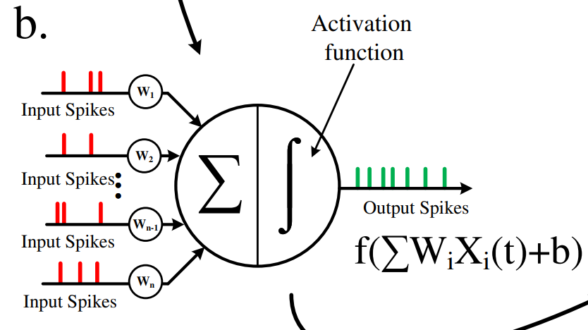
OnChip Team
Project Title: Ring Oscillator-Based Spiking Neuron in MOSbius
Our goal is to implement a neuron circuit, the basic building block of a more complex neural network.
In the MOSBius context, we envision modularity through the implementation of scalable digital gates and comparator strength definition.
Image taken from M. Besrour et al., "Analog Spiking Neuron in 28 nm CMOS"
Notes:
JAP: When mentioning the term "spiking neuron," emphasize that it is a more realistic model than the classical implementation. In this case, the inputs are a series of spikes, and the information relates to the timing of these spikes.

Slide 4
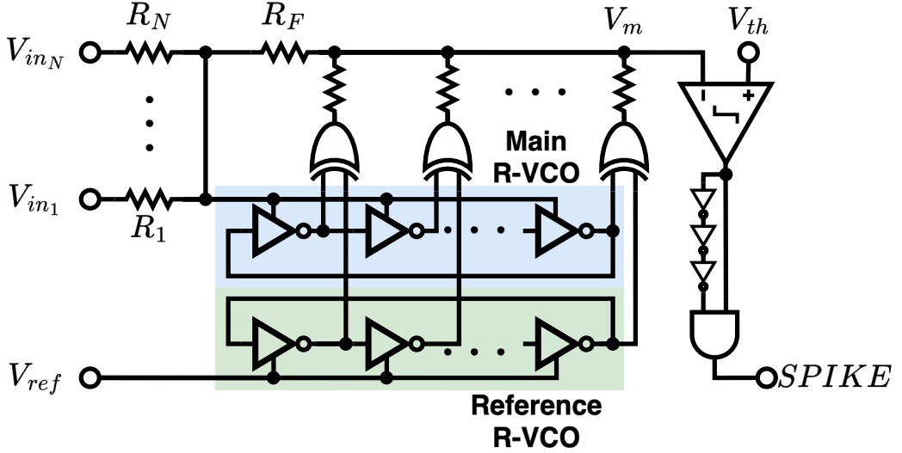
OnChip Team
The chosen architecture uses a RO-based low pass filter for a LIF* neuron implementation.
Image taken from S. Sanjeet, et al, "Systematic Design of Ring VCO-Based SNN - Translating Training Parameters to Circuits”
*Leaky Integrate and Fire
Notes:
JAP: I think we should highlight the fact that this is a “time-domain” low pass filter, it does not require an operational amplifier. An LPF is necessary because the leaky integrate-and-fire model requires a leaky integrator.

Slide 5
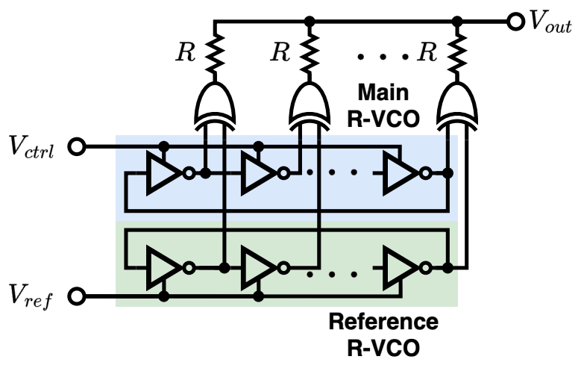
OnChip Team
Design approach: The LPF requires an integrator composed of a pair of ring oscillator voltage-controlled oscillators (VCOs) and XOR-based phase detectors. These will be separated into different MOSbius modules.
Image taken from S. Sanjeet, et al, "Systematic Design of Ring VCO-Based SNN - Translating Training Parameters to Circuits”
Notes:
JAP: The core of the implementation is the time-domain integrator, which you can see here. I'm not sure if we should show the reference that came up with this idea (it was used for analog filters but not for LIF Neurons). The reference is:
B. Drost, M. Talegaonkar and P. K. Hanumolu, "Analog Filter Design Using Ring Oscillator Integrators," in IEEE Journal of Solid-State Circuits, vol. 47, no. 12, pp. 3120-3129, Dec. 2012, doi: 10.1109/JSSC.2012.2225738.

Slide 6
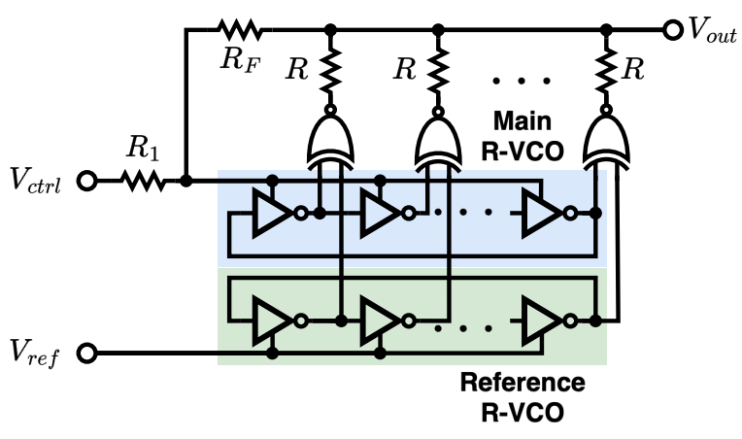
OnChip Team
Design approach: A low-pass filter can be implemented by incorporating external feedback resistors. The neuron will be completed after adding the comparator and edge detector, which are two additional MOSbius modules.
External
Resistors
Image taken from S. Sanjeet, et al, "Systematic Design of Ring VCO-Based SNN - Translating Training Parameters to Circuits”
Notes:
JAP: Indicate the different module variations, i.e. the logic gate strength. I’m not sure if we should mention the number of pads.
For example, we can select and connect INV, INVX2, or INVX4 gates according to the ring oscillator requirements. The same applies to NAND and XOR gates. Additionally, the comparator strength can be adjusted through the use of final inverter stages and the gm input stage

Slide 7
OnChip Team
Application:
Future continuations of this work would seek a complete integration for a open source spiking neural networks (SNNs) accelerator.
Within the current scope, this project employs a MOSbius-based implementation to illustrate to EE students how complex systems can be built using fundamental circuits, such as VCOs, comparators, and phase detectors.
References:
[1] S. Sanjeet, S. Das, S. -H. W. Chiang, M. Fujita and B. D. Sahoo, "Systematic Design of Ring VCO-Based SNN - Translating Training Parameters to Circuits," 2024 IEEE 67th International Midwest Symposium on Circuits and Systems (MWSCAS).
[2] M. Besrour et al., "Analog Spiking Neuron in 28 nm CMOS," 2022 20th IEEE Interregional NEWCAS Conference (NEWCAS), Quebec City, QC, Canada, 2022, pp. 148-152, doi: 10.1109/NEWCAS52662.2022.9842088.

