Slide 1
Business Processes Development Giordano Tinella 288520

Slide 2
Agenda
The Context
The Business Process Model
The Code
The Interface
A Pratical Example

Slide 3
The Context
Retrieve Data From the User
Interact With Services
Elaborate the Data
Communicate the Data to the User
Two REST services:
User Service
Zones Service
One SOAP Service:
Posting Service

Slide 4
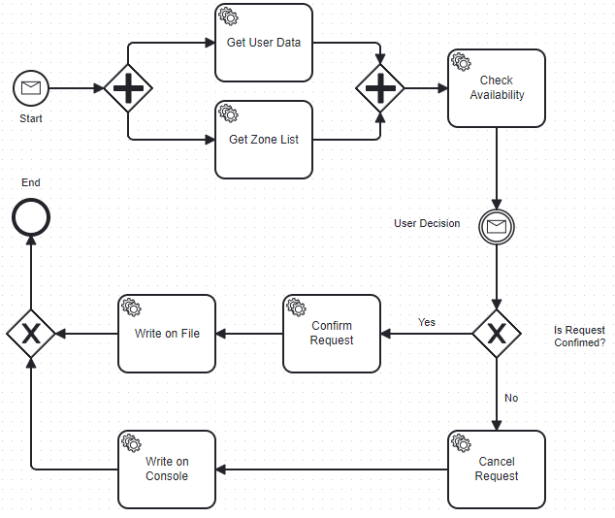

The Business Process Model

Slide 5
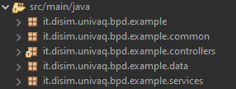


The Code

Slide 6


The Interface

Slide 7
A Pratical Example

