Slide 1
Advanced Verification and Validation (2024) Giordano Tinella

Slide 2
Agenda
The Context
Java Microbenchmark Harness (JMH)
The Exposed APIs
The Interface

Slide 3
The Context
What are Verification and Validation ?
How to achieve good requirements ?
The chosen environment (eclipse-collections)

Slide 4

Java Microbenchmark Harness (JMH)
JMH (Java Microbenchmark Harness) is a framework developed by the OpenJDK community for creating, running, and analyzing microbenchmarks in Java.
The JSON file generated using JMH can include various types of information.

Slide 5
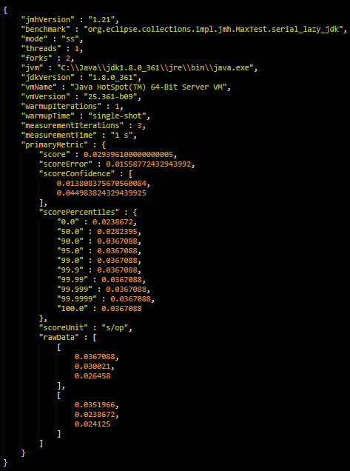
Java Microbenchmark Harness (JMH)

Slide 6

The Exposed APIs
A REST service was built using node.js. It exposes the following APIs:
Add a Commit (POST) → http://localhost:5000/jmh/commits
Get all the Commits (GET) → http://localhost:5000/jmh/commits
Delete a Commit (DELETE) → http://localhost:5000/jmh/commits/<id>

Slide 7

The Interface
An interface was built using React. It allows the visualization of all benchmarks present in the system, and for each benchmark, the data is exposed using different metrics.

Slide 8

The Deploy
As a final step, the entire environment was built and deployed using Docker.

Slide 9
Live Demo

