Slide 1
Data Analytics:
Dataset of Activities
Martina Nolletti, Giordano Tinella, Marta Pagliaricci
26 Giugno 2023

Slide 2
Summary
Description of the dataset
Structure
Data cleaning
Exploratory Analysis
Distribution
Boxplot
Correlation matrix
Unsupervised Learning
Clustering
Supervised Learning
Decision Tree
SVM
Neural Network
Conclusions

Slide 3
Description of the dataset
Our dataset consists of:
19 activities;
8 subjects;
60 segments;
5 units: torso (T), right arm (RA), left arm (LA), right leg (RL), left leg (LL);
3 sensors on each unit: each sensor measures 3 coordinates.

Slide 4



Description of the dataset: Structure
Data is organized in a series of folders, which structure is defined as follows:
Root: a01 – a19;
Node: p1 – p8;
Leaf: s01 – s60.

Slide 5
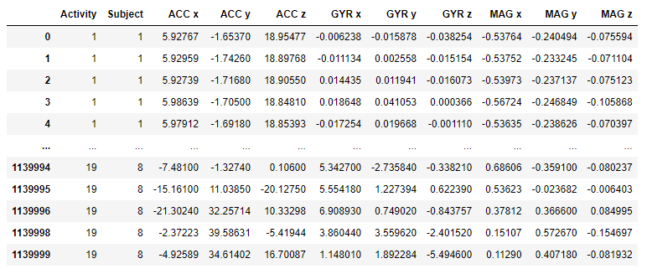
Data Cleaning

Slide 6
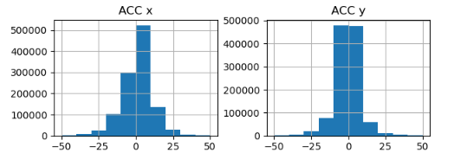
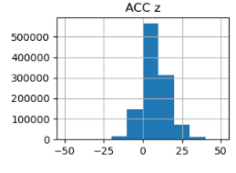
Exploratory Analysis: Distribution (ACC)

Slide 7
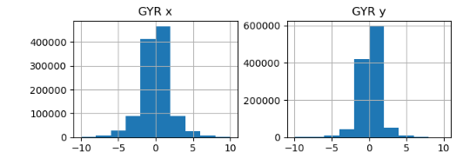
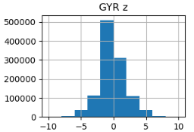
Exploratory Analysis: Distribution (GYR)

Slide 8
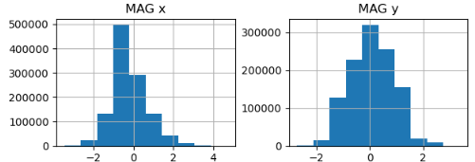
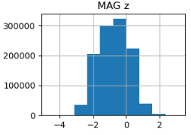
Exploratory Analysis: Distribution (MAG)

Slide 9
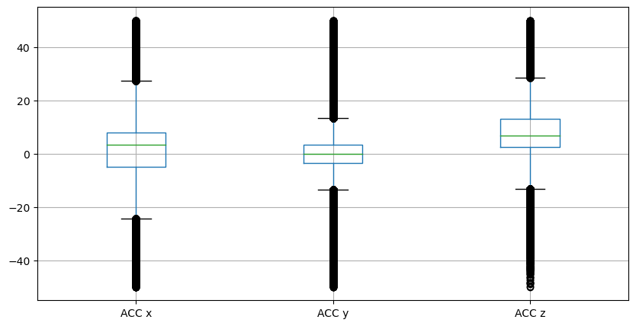
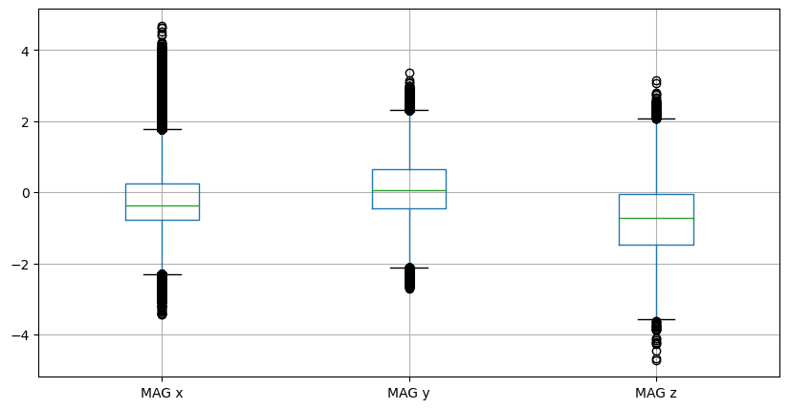
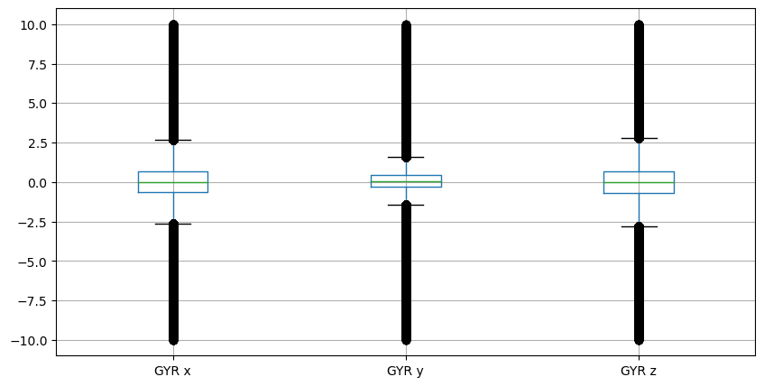
Exploratory Analysis: Boxplot

Slide 10
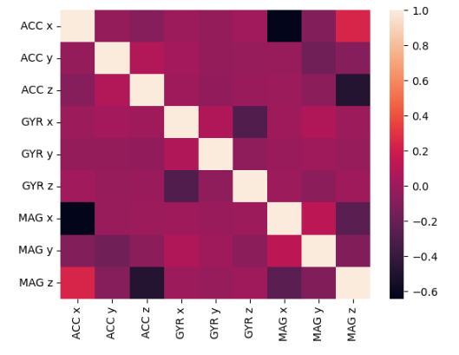
Exploratory Analysis: Correlation matrix

Slide 11
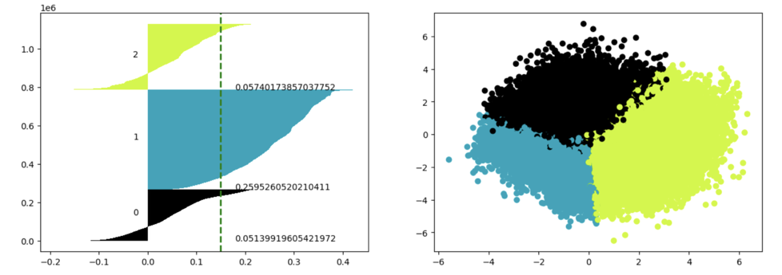
Unsupervised Learning: Clustering

Slide 12
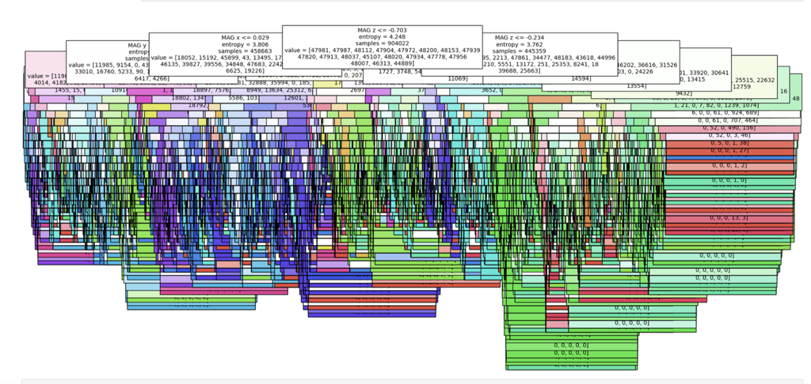

Supervised Learning: Decision Tree

Slide 13
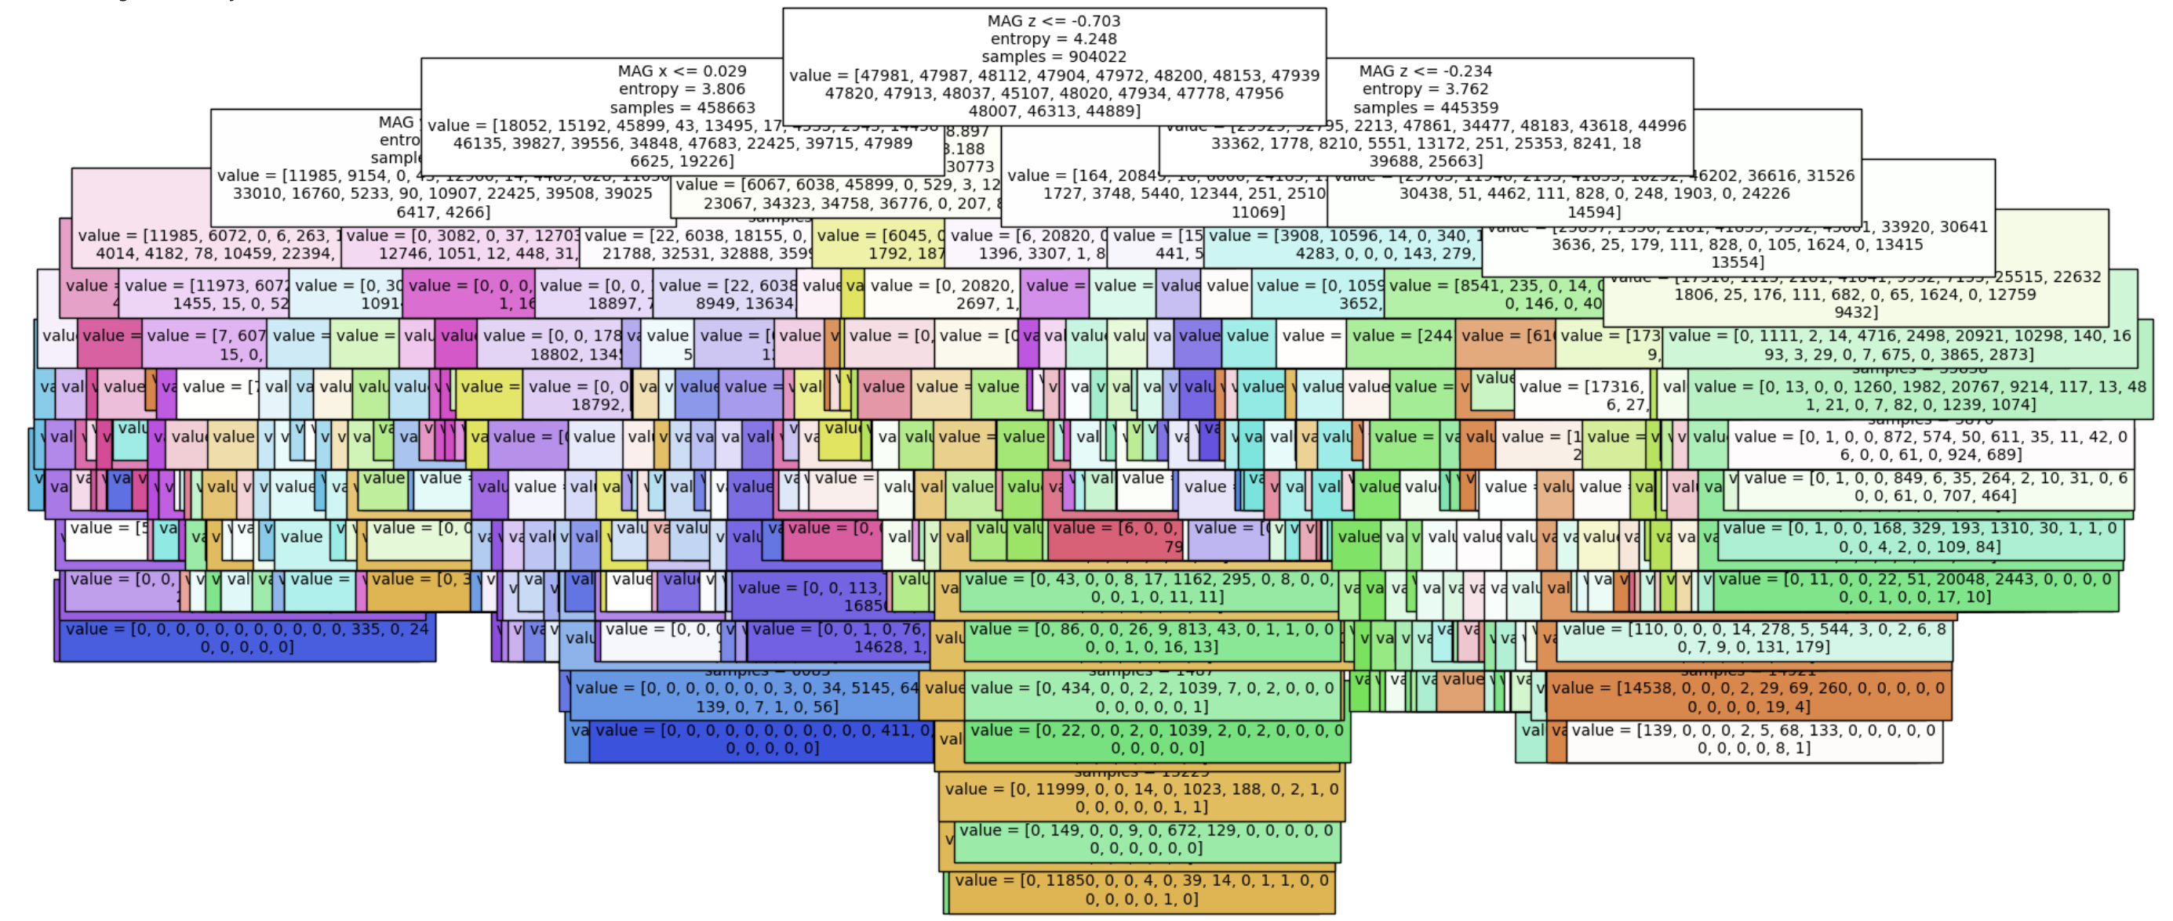

Supervised Learning: Pruned Decision Tree

Slide 14
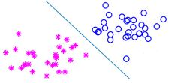

Supervised Learning: SVM

Slide 15
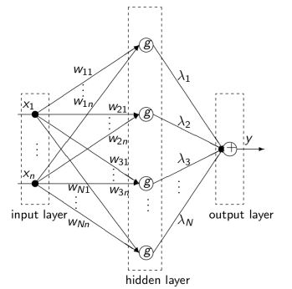

Supervised Learning: Neural Network

Slide 16
Conclusions
A global dataset is needed
Data are balanced
Data responded well in the training phase
Dataset size

