Slide 1
Building a Smarter Food Ecosystem: The Role of IoT and Adaptive Systems
Giordano Tinella

Slide 2
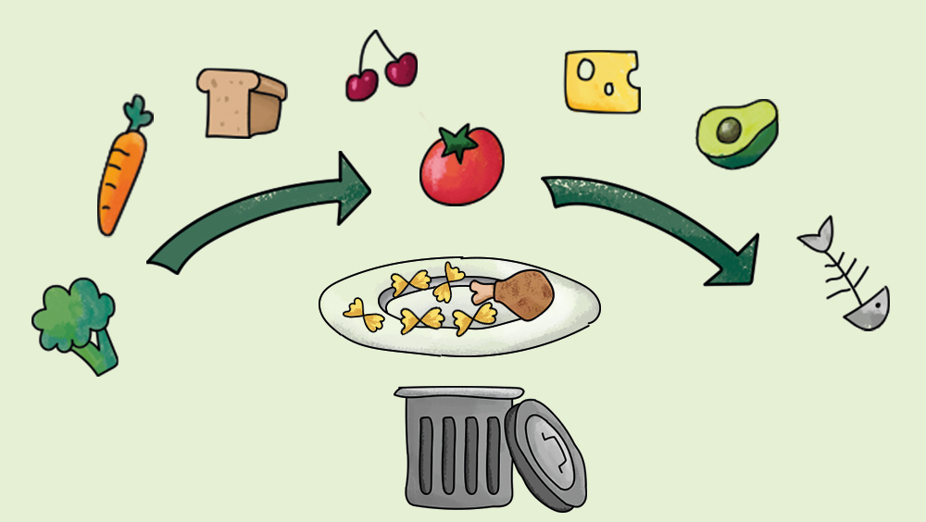
Introduction
Why we need to care about food waste?

Slide 3

Introduction
The conseguences of food waste are:
Environmental Impact
Resource Depletion
Hunger and Food Insecurity
Ethical Concerns
And many others …

Slide 4

Monitoring The World: IoT Devices
IoT devices have revolutionized the way we interact with the external world.

Slide 5

Monitoring The World: SA Systems
Self Adaptive Systems are able to change their behavior at runtime as a response to changes in their environment or in the system itself.

Slide 6
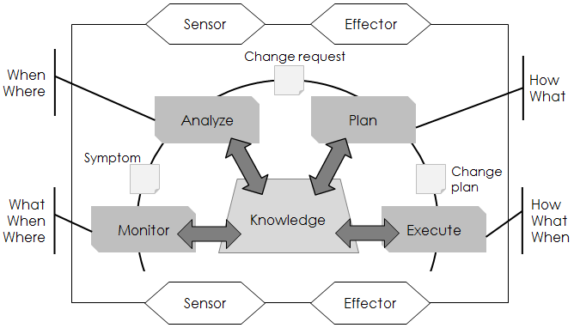
System Model: The MAPE-K loop
The iterative process of monitoring, analyzing, planning, executing, and incorporating knowledge enables effective management and optimization of complex systems.

Slide 7
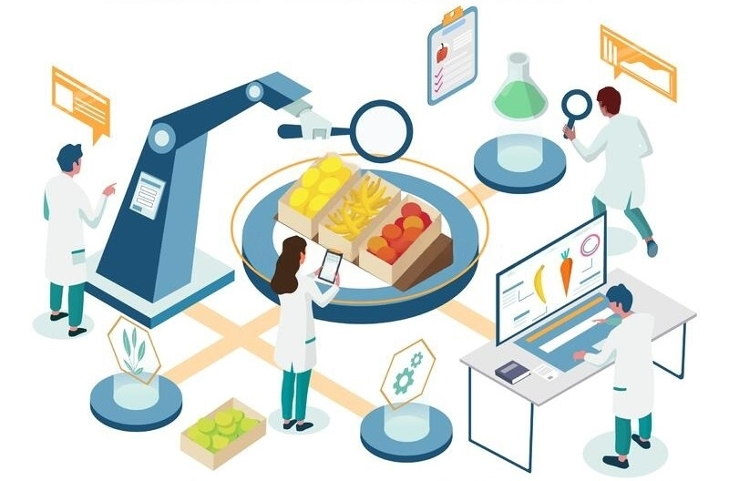
Practical Example: Feed me, Feed me
Feed me, Feed me is an IoT based ecosystem to support food security; that is to ensure sufficient, safe, and nutritious food to the global population.

Slide 8
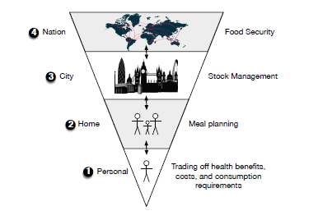
Practical Example: Feed me, Feed me
The project can be described at four levels of granularity:
Personal
Family
Community
Nation

Slide 9

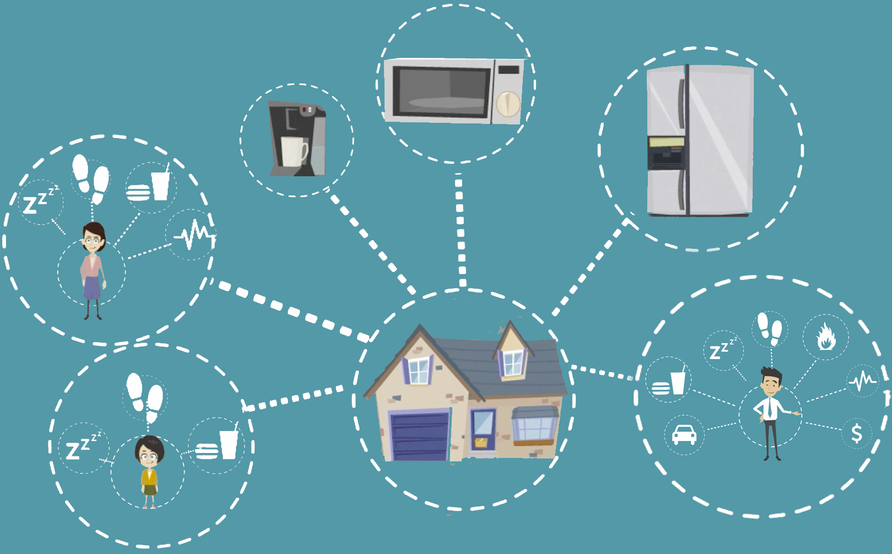
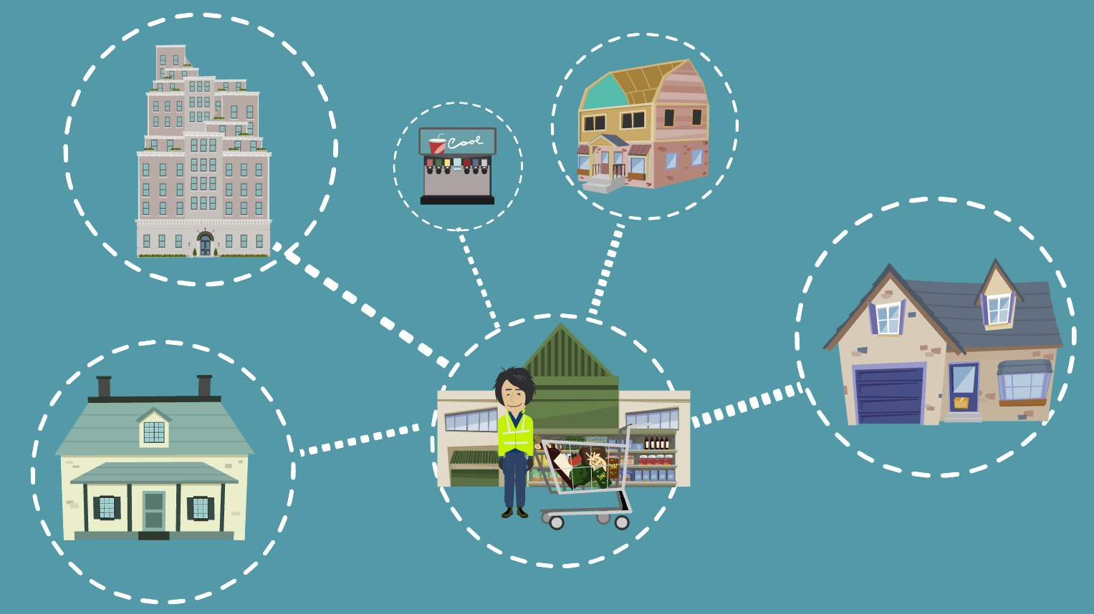
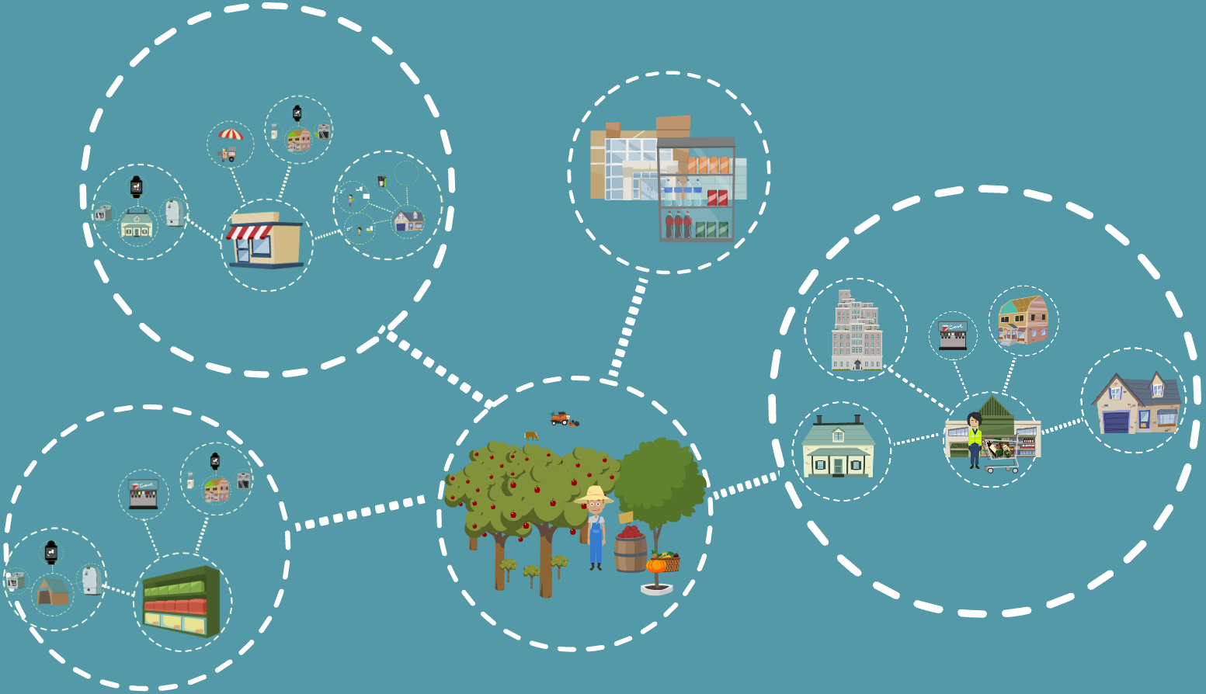
Some Scenarios

Slide 10

Practical Example: Feed me, Feed me
The project has many challenges:
Security & Privacy
Interoperability
Adaptation

Slide 11
Conclusion
Problem: Food Waste
Tools: IoT and SA Systems
Possible Solution: Feed me, Feed me

Slide 12
References
An Overview of Design Patterns for Self-Adaptive Systems in the Context of the Internet of Things: Christian Krupitzer, Timur Temizer, Thomas Prantl and Claudia Raibulet.
Feed me, Feed me: An Exemplar for Engineering Adaptive Software: Amel Bennaceur, Ciaran Mccormick, Jesús García Galán, Charith Perera, Andrew Smith, Andrea Zisman and Bashar Nuseibeh.

