Slide 1


Slide 2
ATM Cashflow Prediction
Giorgi Kokaia

Slide 3
Data Exploration
Total number of ATMs | 1,343
Active ATMs | 942
Start Date | 01-01-2017
End Date | 31-12-2019

Slide 4
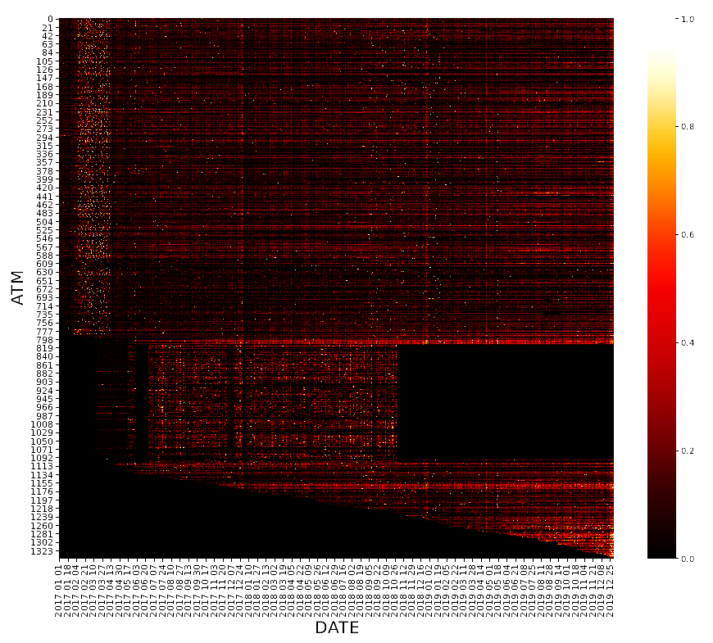
ATM activity heatmap
Group 1 – Full historical data
Group 2 – Inactive
Group 3 – Recently added

Slide 5
Prediction methods
ATM Groups | Description | Prediction
Group 1 | Full historical data | Average of respective day and month
Group 2 | Inactive last month | 0
Group 3 | Recently Opened | Average of respective day and month Average of respective day Average of historical data

Slide 6
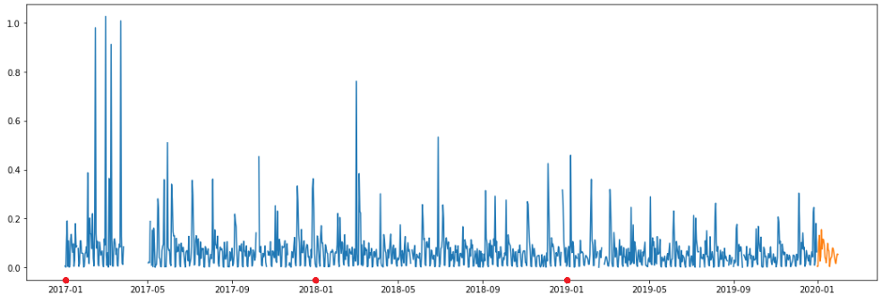
Average of respective day and month

Slide 7
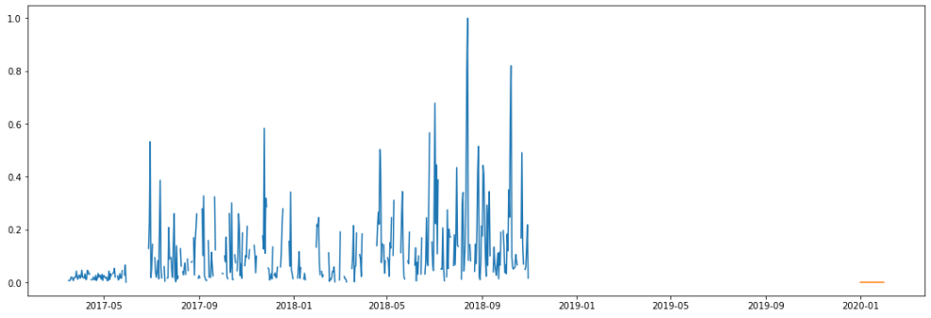
Zero

Slide 8
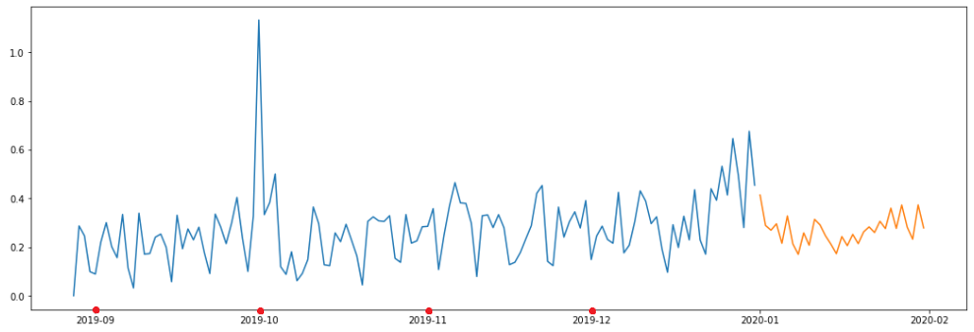
Average of respective day

Slide 9
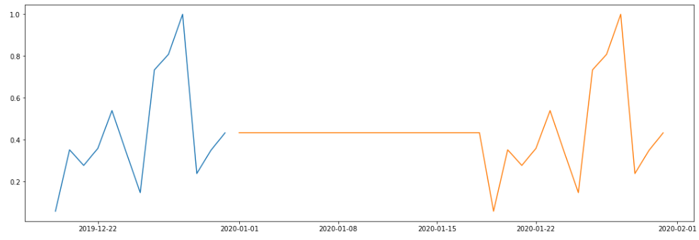
Average of historical data

