Slide 1
Self-Supervised Pretraining for Prostate Segmentation on Micro-Ultrasound Images
Giorgi Karazanashvili
CS675

Slide 2
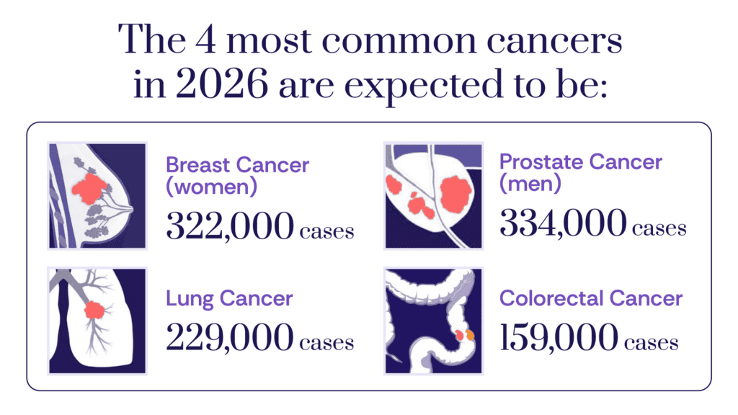
Background
#1 diagnosis among men (ACS, 2026)
Expert annotation of micro-US is expensive
Micro-US operates at 29 MHz, 4x conventional ultrasound resolution
CAN we pretrain on unlabeled scans to reduce annotation needs?
Notes:
Prostate cancer is the most common cancer diagnosis among men, with 334,000 expected cases in 2026. Micro-ultrasound is a newer imaging modality that operates at 29 MHz, about four times the frequency of conventional ultrasound, which gives it much higher spatial resolution for visualizing tissue microstructure during biopsy. The problem is that getting expert annotations on these images requires urologist time, which is expensive and doesn't scale. So the question driving this project is whether we can pretrain a model on the unlabeled scans themselves and then need fewer labeled examples to get good segmentation."
Why Dice + BCE loss? Dice loss directly optimizes the Dice coefficient, which is the standard evaluation metric in medical segmentation. But Dice loss alone has gradient issues when the prediction or ground truth is nearly empty (edge slices with barely any prostate). BCE provides stable per-pixel gradients everywhere, so combining them gives both metric-aligned optimization from Dice and training stability from BCE. This combination is used in MicroSegNet [1] on this exact dataset.
Why HD95 as the second metric? Dice measures overall overlap between prediction and ground truth, but it doesn't tell you about boundary quality. A prediction could have 0.85 Dice but have jagged, irregular boundaries. HD95 (95th percentile Hausdorff distance) measures the worst-case boundary error, ignoring the top 5% of outliers. It's the standard companion metric to Dice in medical segmentation because clinically, boundary precision matters for things like biopsy guidance and treatment planning. Using the 95th percentile instead of the maximum Hausdorff distance makes it robust to single-pixel outliers.
Why patient-level split instead of random slice split? Slices from the same patient volume are very similar to each other (adjacent slices share most of their content). If you randomly split slices, you'd have nearly identical slices in train and test, which inflates your metrics and doesn't reflect real-world generalization where you're segmenting a new patient you've never seen.
Why lr=1e-4 for fine-tuning vs 1e-3 for pretraining? During pretraining, the encoder starts from random weights and needs to learn everything from scratch, so a higher learning rate is appropriate. During fine-tuning, the encoder already has useful weights from pretraining, so a lower rate avoids destroying those learned features in the first few gradient updates.
Why no skip connections in the autoencoder but skip connections in the U-Net? Different goals. The autoencoder's job is to force the encoder to learn a good bottleneck representation. Skip connections would let it cheat by passing raw pixels directly to the decoder. The U-Net's job is to produce precise segmentation masks, and skip connections are essential for preserving fine spatial detail at each resolution level that would otherwise be lost through the bottleneck.
Why 256 x 256 input size? The original volumes are 1372 x 962, which is too large for a U-Net in terms of GPU memory and compute. 256 x 256 is a standard size in medical image segmentation that balances resolution with computational cost. It's large enough to preserve anatomically relevant detail for prostate segmentation.
Why adjacent-slice stacking instead of 3D convolutions? A full 3D architecture would be more principled but requires significantly more GPU memory and more training data to avoid overfitting. Stacking three adjacent slices as RGB-like channels is a lightweight way to give the model depth context while using standard 2D convolutions. This is a common approach in medical imaging when volumetric data is available but resources are limited.

Slide 3
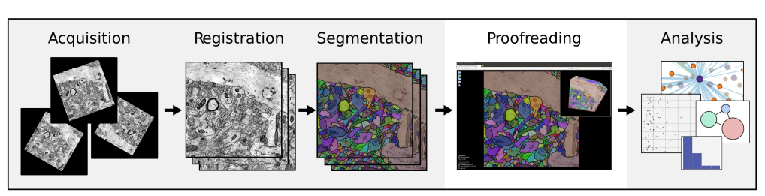
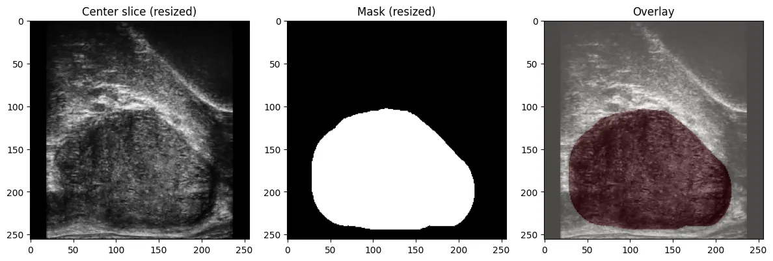
Dataset
Micro-Ultrasound Prostate Segmentation Dataset (Zenodo, 75 patients)
Input: 3-channel adjacent-slice stacking, resized to 256 x 256
Notes:
The dataset is from Zenodo, 75 patients in NIfTI format, split 55 train and 20 test. Each volume is 1372 by 962 pixels with 33 to 45 axial slices depending on the patient. For each slice, I stack the previous, current, and next slice as three channels, which gives the model spatial context along the depth axis without needing a full 3D architecture. Everything is resized to 256 by 256 and normalized to zero-one. The images here show a center slice, its binary expert mask, and the overlay
Why Dice + BCE loss? Dice loss directly optimizes the Dice coefficient, which is the standard evaluation metric in medical segmentation. But Dice loss alone has gradient issues when the prediction or ground truth is nearly empty (edge slices with barely any prostate). BCE provides stable per-pixel gradients everywhere, so combining them gives both metric-aligned optimization from Dice and training stability from BCE. This combination is used in MicroSegNet [1] on this exact dataset.
Why HD95 as the second metric? Dice measures overall overlap between prediction and ground truth, but it doesn't tell you about boundary quality. A prediction could have 0.85 Dice but have jagged, irregular boundaries. HD95 (95th percentile Hausdorff distance) measures the worst-case boundary error, ignoring the top 5% of outliers. It's the standard companion metric to Dice in medical segmentation because clinically, boundary precision matters for things like biopsy guidance and treatment planning. Using the 95th percentile instead of the maximum Hausdorff distance makes it robust to single-pixel outliers.
Why patient-level split instead of random slice split? Slices from the same patient volume are very similar to each other (adjacent slices share most of their content). If you randomly split slices, you'd have nearly identical slices in train and test, which inflates your metrics and doesn't reflect real-world generalization where you're segmenting a new patient you've never seen.
Why lr=1e-4 for fine-tuning vs 1e-3 for pretraining? During pretraining, the encoder starts from random weights and needs to learn everything from scratch, so a higher learning rate is appropriate. During fine-tuning, the encoder already has useful weights from pretraining, so a lower rate avoids destroying those learned features in the first few gradient updates.
Why no skip connections in the autoencoder but skip connections in the U-Net? Different goals. The autoencoder's job is to force the encoder to learn a good bottleneck representation. Skip connections would let it cheat by passing raw pixels directly to the decoder. The U-Net's job is to produce precise segmentation masks, and skip connections are essential for preserving fine spatial detail at each resolution level that would otherwise be lost through the bottleneck.
Why 256 x 256 input size? The original volumes are 1372 x 962, which is too large for a U-Net in terms of GPU memory and compute. 256 x 256 is a standard size in medical image segmentation that balances resolution with computational cost. It's large enough to preserve anatomically relevant detail for prostate segmentation.
Why adjacent-slice stacking instead of 3D convolutions? A full 3D architecture would be more principled but requires significantly more GPU memory and more training data to avoid overfitting. Stacking three adjacent slices as RGB-like channels is a lightweight way to give the model depth context while using standard 2D convolutions. This is a common approach in medical imaging when volumetric data is available but resources are limited.

Slide 4
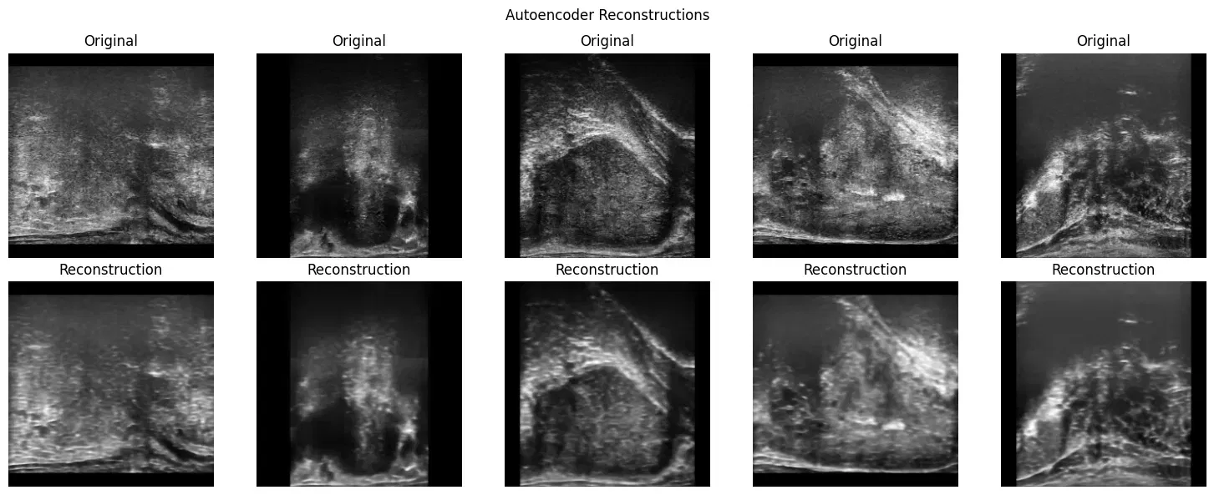
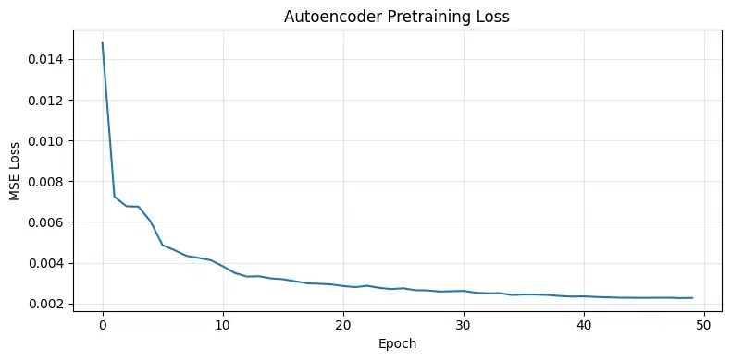
Approach
First train the encoder, then attach it to a U-Net decoder and train end-to-end
4-stage encoder (64/128/256/512), no skip connections in decoder
MSE loss, Adam lr, 50 epochs
Final MSE: 0.0023 (~5% pixel error)
Notes:
The approach has two stages. First, I pretrain a convolutional autoencoder on all 2,152 slices from the 55 training patients using only the images, no masks. The encoder has four stages going from 3 channels up to 512, and the key design choice is that the autoencoder decoder has no skip connections. This forces the bottleneck to actually learn a complete representation of the image. If I gave it skip connections, it could just pass raw pixels through and learn nothing useful. The autoencoder trained for 50 epochs with MSE loss and converged to 0.0023, which is about 5 percent pixel intensity error. The reconstructions on the left show it captured the anatomy and tissue structure well. After pretraining, I throw away the decoder and keep only the encoder weights
Why Dice + BCE loss? Dice loss directly optimizes the Dice coefficient, which is the standard evaluation metric in medical segmentation. But Dice loss alone has gradient issues when the prediction or ground truth is nearly empty (edge slices with barely any prostate). BCE provides stable per-pixel gradients everywhere, so combining them gives both metric-aligned optimization from Dice and training stability from BCE. This combination is used in MicroSegNet [1] on this exact dataset.
Why HD95 as the second metric? Dice measures overall overlap between prediction and ground truth, but it doesn't tell you about boundary quality. A prediction could have 0.85 Dice but have jagged, irregular boundaries. HD95 (95th percentile Hausdorff distance) measures the worst-case boundary error, ignoring the top 5% of outliers. It's the standard companion metric to Dice in medical segmentation because clinically, boundary precision matters for things like biopsy guidance and treatment planning. Using the 95th percentile instead of the maximum Hausdorff distance makes it robust to single-pixel outliers.
Why patient-level split instead of random slice split? Slices from the same patient volume are very similar to each other (adjacent slices share most of their content). If you randomly split slices, you'd have nearly identical slices in train and test, which inflates your metrics and doesn't reflect real-world generalization where you're segmenting a new patient you've never seen.
Why lr=1e-4 for fine-tuning vs 1e-3 for pretraining? During pretraining, the encoder starts from random weights and needs to learn everything from scratch, so a higher learning rate is appropriate. During fine-tuning, the encoder already has useful weights from pretraining, so a lower rate avoids destroying those learned features in the first few gradient updates.
Why no skip connections in the autoencoder but skip connections in the U-Net? Different goals. The autoencoder's job is to force the encoder to learn a good bottleneck representation. Skip connections would let it cheat by passing raw pixels directly to the decoder. The U-Net's job is to produce precise segmentation masks, and skip connections are essential for preserving fine spatial detail at each resolution level that would otherwise be lost through the bottleneck.
Why 256 x 256 input size? The original volumes are 1372 x 962, which is too large for a U-Net in terms of GPU memory and compute. 256 x 256 is a standard size in medical image segmentation that balances resolution with computational cost. It's large enough to preserve anatomically relevant detail for prostate segmentation.
Why adjacent-slice stacking instead of 3D convolutions? A full 3D architecture would be more principled but requires significantly more GPU memory and more training data to avoid overfitting. Stacking three adjacent slices as RGB-like channels is a lightweight way to give the model depth context while using standard 2D convolutions. This is a common approach in medical imaging when volumetric data is available but resources are limited.

Slide 5
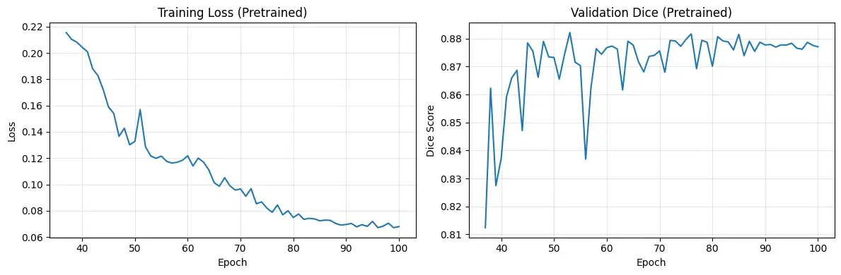
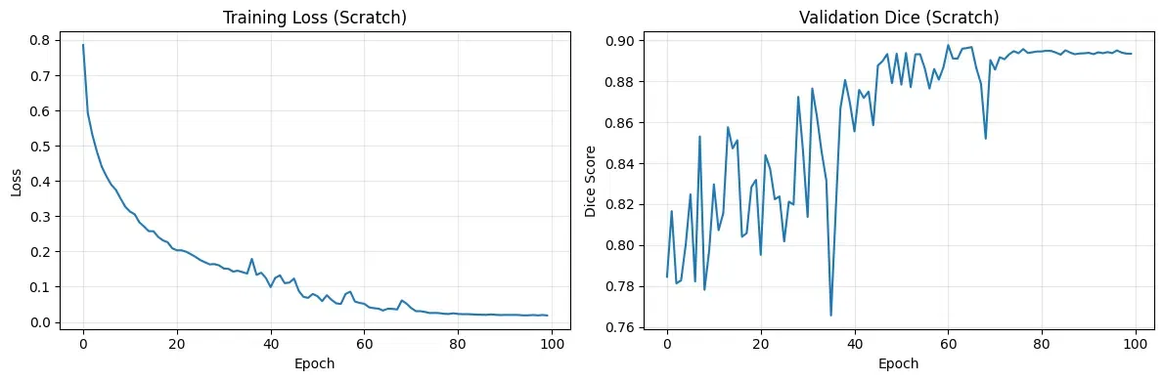
Approach
Pretrained encoder + decoder with skip connections
Dice + BCE loss, Adam lr, 100 epochs
Patient-level split: 45 train, 10 val, 20 test
Notes:
For the second stage, I attach the pretrained encoder to a U-Net decoder that does use skip connections from all four encoder levels. The loss is Dice plus binary cross-entropy, Adam optimizer at a lower learning rate of 1e-4 since we're fine-tuning pretrained weights, and it trains for 100 epochs. I split the 55 training patients into 45 for fine-tuning and 10 for validation, with the 20 test patients held out from everything. The split is at the patient level to prevent data leakage, since slices from the same volume are highly correlated. I trained the same architecture from scratch as a baseline. The training curves show the pretrained model's loss and validation Dice on top, and the scratch model on the bottom."
Why Dice + BCE loss? Dice loss directly optimizes the Dice coefficient, which is the standard evaluation metric in medical segmentation. But Dice loss alone has gradient issues when the prediction or ground truth is nearly empty (edge slices with barely any prostate). BCE provides stable per-pixel gradients everywhere, so combining them gives both metric-aligned optimization from Dice and training stability from BCE. This combination is used in MicroSegNet [1] on this exact dataset.
Why HD95 as the second metric? Dice measures overall overlap between prediction and ground truth, but it doesn't tell you about boundary quality. A prediction could have 0.85 Dice but have jagged, irregular boundaries. HD95 (95th percentile Hausdorff distance) measures the worst-case boundary error, ignoring the top 5% of outliers. It's the standard companion metric to Dice in medical segmentation because clinically, boundary precision matters for things like biopsy guidance and treatment planning. Using the 95th percentile instead of the maximum Hausdorff distance makes it robust to single-pixel outliers.
Why patient-level split instead of random slice split? Slices from the same patient volume are very similar to each other (adjacent slices share most of their content). If you randomly split slices, you'd have nearly identical slices in train and test, which inflates your metrics and doesn't reflect real-world generalization where you're segmenting a new patient you've never seen.
Why lr=1e-4 for fine-tuning vs 1e-3 for pretraining? During pretraining, the encoder starts from random weights and needs to learn everything from scratch, so a higher learning rate is appropriate. During fine-tuning, the encoder already has useful weights from pretraining, so a lower rate avoids destroying those learned features in the first few gradient updates.
Why no skip connections in the autoencoder but skip connections in the U-Net? Different goals. The autoencoder's job is to force the encoder to learn a good bottleneck representation. Skip connections would let it cheat by passing raw pixels directly to the decoder. The U-Net's job is to produce precise segmentation masks, and skip connections are essential for preserving fine spatial detail at each resolution level that would otherwise be lost through the bottleneck.
Why 256 x 256 input size? The original volumes are 1372 x 962, which is too large for a U-Net in terms of GPU memory and compute. 256 x 256 is a standard size in medical image segmentation that balances resolution with computational cost. It's large enough to preserve anatomically relevant detail for prostate segmentation.
Why adjacent-slice stacking instead of 3D convolutions? A full 3D architecture would be more principled but requires significantly more GPU memory and more training data to avoid overfitting. Stacking three adjacent slices as RGB-like channels is a lightweight way to give the model depth context while using standard 2D convolutions. This is a common approach in medical imaging when volumetric data is available but resources are limited.

Slide 6
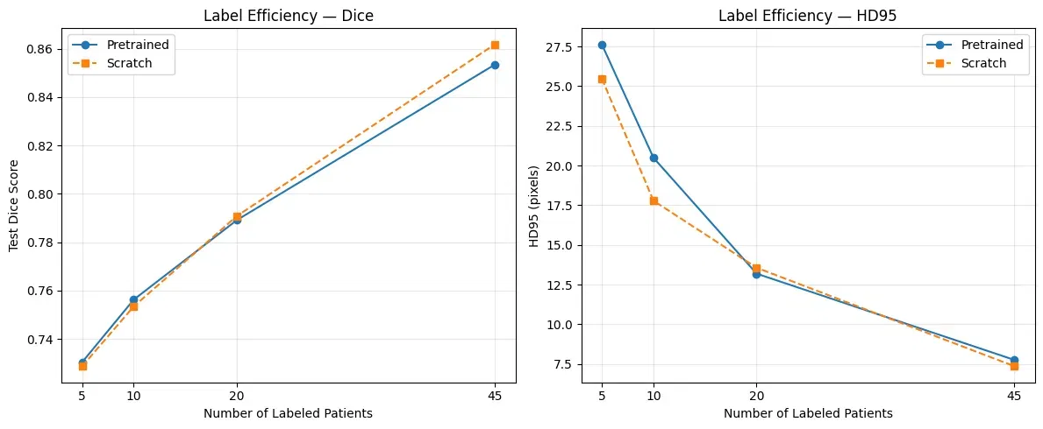
Results
Pretrained: Dice 0.853, HD95 7.75 px
Scratch: Dice 0.862, HD95 7.36 px
Notes:
Here are the label-efficiency curves, which are the core result. I trained both models at 5, 10, 20, and 45 labeled patients and evaluated on the test set. On Dice, pretrained has a very small advantage at 5 and 10 patients, but the gap closes at 20 and scratch actually wins at 45. On HD95, which measures boundary precision, scratch is actually better at 5 and 10 patients. At full labels, scratch gets Dice 0.862 versus 0.853 for pretrained, and HD95 7.36 versus 7.75. So with enough data, scratch slightly wins on both metrics
Why Dice + BCE loss? Dice loss directly optimizes the Dice coefficient, which is the standard evaluation metric in medical segmentation. But Dice loss alone has gradient issues when the prediction or ground truth is nearly empty (edge slices with barely any prostate). BCE provides stable per-pixel gradients everywhere, so combining them gives both metric-aligned optimization from Dice and training stability from BCE. This combination is used in MicroSegNet [1] on this exact dataset.
Why HD95 as the second metric? Dice measures overall overlap between prediction and ground truth, but it doesn't tell you about boundary quality. A prediction could have 0.85 Dice but have jagged, irregular boundaries. HD95 (95th percentile Hausdorff distance) measures the worst-case boundary error, ignoring the top 5% of outliers. It's the standard companion metric to Dice in medical segmentation because clinically, boundary precision matters for things like biopsy guidance and treatment planning. Using the 95th percentile instead of the maximum Hausdorff distance makes it robust to single-pixel outliers.
Why patient-level split instead of random slice split? Slices from the same patient volume are very similar to each other (adjacent slices share most of their content). If you randomly split slices, you'd have nearly identical slices in train and test, which inflates your metrics and doesn't reflect real-world generalization where you're segmenting a new patient you've never seen.
Why lr=1e-4 for fine-tuning vs 1e-3 for pretraining? During pretraining, the encoder starts from random weights and needs to learn everything from scratch, so a higher learning rate is appropriate. During fine-tuning, the encoder already has useful weights from pretraining, so a lower rate avoids destroying those learned features in the first few gradient updates.
Why no skip connections in the autoencoder but skip connections in the U-Net? Different goals. The autoencoder's job is to force the encoder to learn a good bottleneck representation. Skip connections would let it cheat by passing raw pixels directly to the decoder. The U-Net's job is to produce precise segmentation masks, and skip connections are essential for preserving fine spatial detail at each resolution level that would otherwise be lost through the bottleneck.
Why 256 x 256 input size? The original volumes are 1372 x 962, which is too large for a U-Net in terms of GPU memory and compute. 256 x 256 is a standard size in medical image segmentation that balances resolution with computational cost. It's large enough to preserve anatomically relevant detail for prostate segmentation.
Why adjacent-slice stacking instead of 3D convolutions? A full 3D architecture would be more principled but requires significantly more GPU memory and more training data to avoid overfitting. Stacking three adjacent slices as RGB-like channels is a lightweight way to give the model depth context while using standard 2D convolutions. This is a common approach in medical imaging when volumetric data is available but resources are limited.

Slide 7
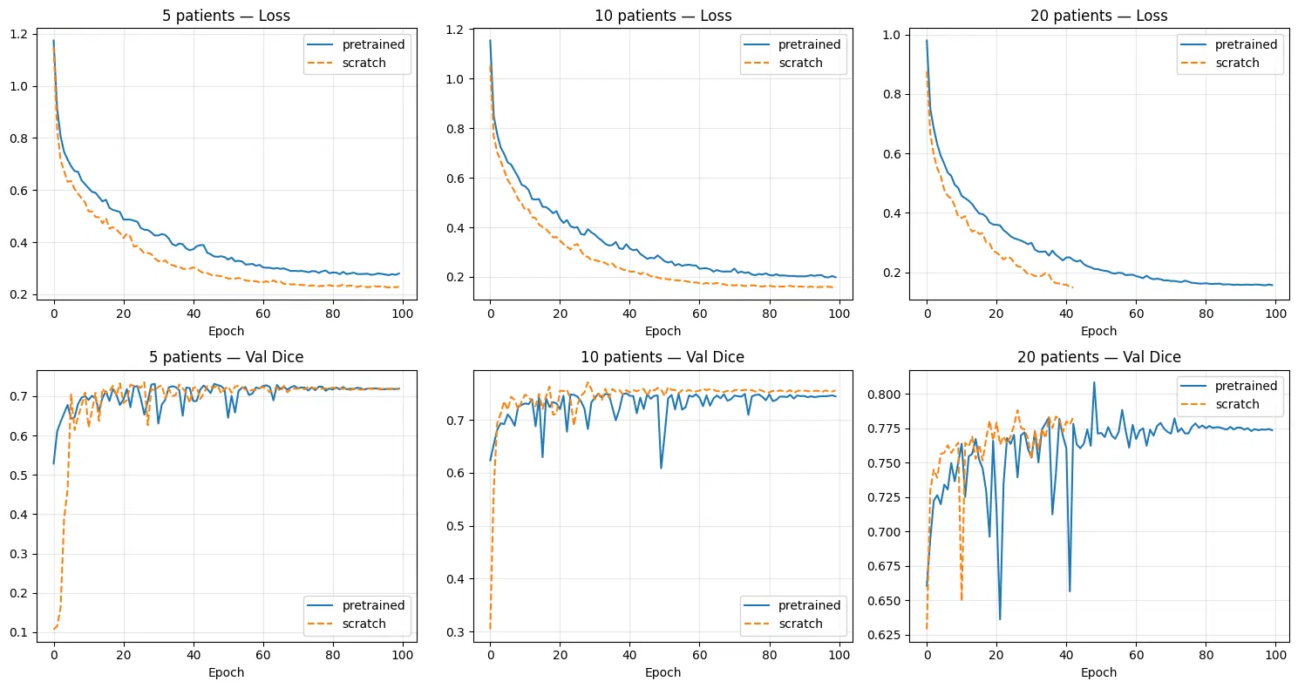
Convergence Analysis
5/10/20/45 patient results
pretrained has tiny Dice edge at 5 and 10 patients, but scratch has better HD95 at those same levels
Notes:
The training curves at reduced label counts tell a more interesting story. Look at the val Dice plots on the bottom row. At 5 patients, pretrained starts around 0.5 Dice at epoch 1 while scratch starts near 0.1. That's a huge head start from the pretrained features. But scratch catches up by around epoch 20 to 30 and reaches the same final performance. The same pattern holds at 10 and 20 patients. So the main benefit of pretraining is faster convergence, not better final accuracy. The pretrained model has a tiny Dice edge at 5 and 10 patients in the final numbers, but scratch has better HD95 at those same levels, meaning tighter boundaries
Why Dice + BCE loss? Dice loss directly optimizes the Dice coefficient, which is the standard evaluation metric in medical segmentation. But Dice loss alone has gradient issues when the prediction or ground truth is nearly empty (edge slices with barely any prostate). BCE provides stable per-pixel gradients everywhere, so combining them gives both metric-aligned optimization from Dice and training stability from BCE. This combination is used in MicroSegNet [1] on this exact dataset.
Why HD95 as the second metric? Dice measures overall overlap between prediction and ground truth, but it doesn't tell you about boundary quality. A prediction could have 0.85 Dice but have jagged, irregular boundaries. HD95 (95th percentile Hausdorff distance) measures the worst-case boundary error, ignoring the top 5% of outliers. It's the standard companion metric to Dice in medical segmentation because clinically, boundary precision matters for things like biopsy guidance and treatment planning. Using the 95th percentile instead of the maximum Hausdorff distance makes it robust to single-pixel outliers.
Why patient-level split instead of random slice split? Slices from the same patient volume are very similar to each other (adjacent slices share most of their content). If you randomly split slices, you'd have nearly identical slices in train and test, which inflates your metrics and doesn't reflect real-world generalization where you're segmenting a new patient you've never seen.
Why lr=1e-4 for fine-tuning vs 1e-3 for pretraining? During pretraining, the encoder starts from random weights and needs to learn everything from scratch, so a higher learning rate is appropriate. During fine-tuning, the encoder already has useful weights from pretraining, so a lower rate avoids destroying those learned features in the first few gradient updates.
Why no skip connections in the autoencoder but skip connections in the U-Net? Different goals. The autoencoder's job is to force the encoder to learn a good bottleneck representation. Skip connections would let it cheat by passing raw pixels directly to the decoder. The U-Net's job is to produce precise segmentation masks, and skip connections are essential for preserving fine spatial detail at each resolution level that would otherwise be lost through the bottleneck.
Why 256 x 256 input size? The original volumes are 1372 x 962, which is too large for a U-Net in terms of GPU memory and compute. 256 x 256 is a standard size in medical image segmentation that balances resolution with computational cost. It's large enough to preserve anatomically relevant detail for prostate segmentation.
Why adjacent-slice stacking instead of 3D convolutions? A full 3D architecture would be more principled but requires significantly more GPU memory and more training data to avoid overfitting. Stacking three adjacent slices as RGB-like channels is a lightweight way to give the model depth context while using standard 2D convolutions. This is a common approach in medical imaging when volumetric data is available but resources are limited.

Slide 8
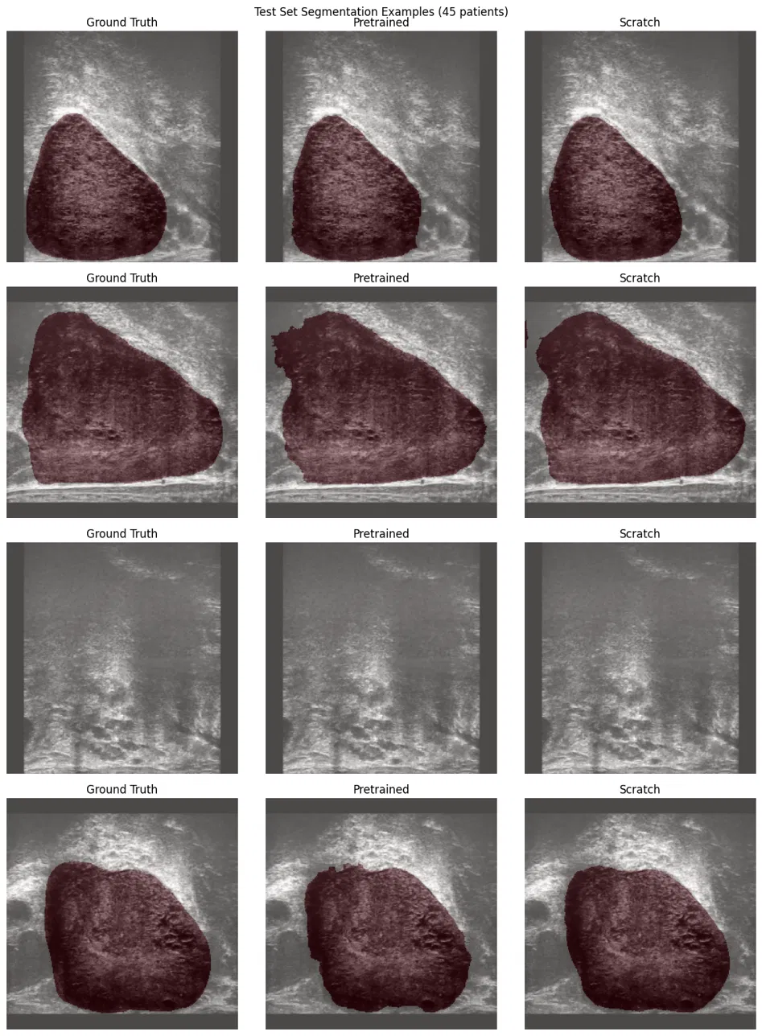
Discussion
With full labels, scratch slightly outperforms pretrained.
Reconstruction-based pretraining learns texture/structure but not boundaries
All differences are less than 1% Dice and likely within noise for a 20-patient test set
Notes:
The hypothesis was that pretraining would help most when labels are scarce. The Dice results weakly support this, but HD95 contradicts it. My interpretation is that reconstruction-based pretraining teaches the encoder about image texture and global structure, which helps with overall region overlap, but the features are not boundary-focused, so HD95 doesn't benefit. The qualitative examples on the right show both models produce similar segmentations on mid-volume slices. The third row is an edge slice with barely any prostate, and both models correctly produce near-empty masks. The practical takeaway is that if you have a limited compute budget and can only run a few epochs, pretraining gives you a usable model much faster
Why Dice + BCE loss? Dice loss directly optimizes the Dice coefficient, which is the standard evaluation metric in medical segmentation. But Dice loss alone has gradient issues when the prediction or ground truth is nearly empty (edge slices with barely any prostate). BCE provides stable per-pixel gradients everywhere, so combining them gives both metric-aligned optimization from Dice and training stability from BCE. This combination is used in MicroSegNet [1] on this exact dataset.
Why HD95 as the second metric? Dice measures overall overlap between prediction and ground truth, but it doesn't tell you about boundary quality. A prediction could have 0.85 Dice but have jagged, irregular boundaries. HD95 (95th percentile Hausdorff distance) measures the worst-case boundary error, ignoring the top 5% of outliers. It's the standard companion metric to Dice in medical segmentation because clinically, boundary precision matters for things like biopsy guidance and treatment planning. Using the 95th percentile instead of the maximum Hausdorff distance makes it robust to single-pixel outliers.
Why patient-level split instead of random slice split? Slices from the same patient volume are very similar to each other (adjacent slices share most of their content). If you randomly split slices, you'd have nearly identical slices in train and test, which inflates your metrics and doesn't reflect real-world generalization where you're segmenting a new patient you've never seen.
Why lr=1e-4 for fine-tuning vs 1e-3 for pretraining? During pretraining, the encoder starts from random weights and needs to learn everything from scratch, so a higher learning rate is appropriate. During fine-tuning, the encoder already has useful weights from pretraining, so a lower rate avoids destroying those learned features in the first few gradient updates.
Why no skip connections in the autoencoder but skip connections in the U-Net? Different goals. The autoencoder's job is to force the encoder to learn a good bottleneck representation. Skip connections would let it cheat by passing raw pixels directly to the decoder. The U-Net's job is to produce precise segmentation masks, and skip connections are essential for preserving fine spatial detail at each resolution level that would otherwise be lost through the bottleneck.
Why 256 x 256 input size? The original volumes are 1372 x 962, which is too large for a U-Net in terms of GPU memory and compute. 256 x 256 is a standard size in medical image segmentation that balances resolution with computational cost. It's large enough to preserve anatomically relevant detail for prostate segmentation.
Why adjacent-slice stacking instead of 3D convolutions? A full 3D architecture would be more principled but requires significantly more GPU memory and more training data to avoid overfitting. Stacking three adjacent slices as RGB-like channels is a lightweight way to give the model depth context while using standard 2D convolutions. This is a common approach in medical imaging when volumetric data is available but resources are limited.

Slide 9
Future work and conclusion
Masked autoencoders or contrastive methods may learn better spatial features
Transformer-based architectures could learn richer features through self-attention over patches
Notes:
"A few directions could improve on this. Masked autoencoders, where you mask out patches and reconstruct them, might force the encoder to learn more about spatial structure and boundaries rather than just texture. Contrastive methods treating different slices of the same patient as positive pairs are another option. The dataset also has non-expert annotations from three additional annotators that could be used for semi-supervised training. One important caveat is that 55 patients may simply not be enough unlabeled data for pretraining to show a clear advantage. A larger unlabeled pool with a small labeled subset would be a fairer test. In conclusion, self-supervised pretraining with a convolutional autoencoder provides faster convergence but limited final accuracy gains on this small dataset Why Dice + BCE loss? Dice loss directly optimizes the Dice coefficient, which is the standard evaluation metric in medical segmentation. But Dice loss alone has gradient issues when the prediction or ground truth is nearly empty (edge slices with barely any prostate). BCE provides stable per-pixel gradients everywhere, so combining them gives both metric-aligned optimization from Dice and training stability from BCE. This combination is used in MicroSegNet [1] on this exact dataset.
Why HD95 as the second metric? Dice measures overall overlap between prediction and ground truth, but it doesn't tell you about boundary quality. A prediction could have 0.85 Dice but have jagged, irregular boundaries. HD95 (95th percentile Hausdorff distance) measures the worst-case boundary error, ignoring the top 5% of outliers. It's the standard companion metric to Dice in medical segmentation because clinically, boundary precision matters for things like biopsy guidance and treatment planning. Using the 95th percentile instead of the maximum Hausdorff distance makes it robust to single-pixel outliers.
Why patient-level split instead of random slice split? Slices from the same patient volume are very similar to each other (adjacent slices share most of their content). If you randomly split slices, you'd have nearly identical slices in train and test, which inflates your metrics and doesn't reflect real-world generalization where you're segmenting a new patient you've never seen.
Why lr=1e-4 for fine-tuning vs 1e-3 for pretraining? During pretraining, the encoder starts from random weights and needs to learn everything from scratch, so a higher learning rate is appropriate. During fine-tuning, the encoder already has useful weights from pretraining, so a lower rate avoids destroying those learned features in the first few gradient updates.
Why no skip connections in the autoencoder but skip connections in the U-Net? Different goals. The autoencoder's job is to force the encoder to learn a good bottleneck representation. Skip connections would let it cheat by passing raw pixels directly to the decoder. The U-Net's job is to produce precise segmentation masks, and skip connections are essential for preserving fine spatial detail at each resolution level that would otherwise be lost through the bottleneck.
Why 256 x 256 input size? The original volumes are 1372 x 962, which is too large for a U-Net in terms of GPU memory and compute. 256 x 256 is a standard size in medical image segmentation that balances resolution with computational cost. It's large enough to preserve anatomically relevant detail for prostate segmentation.
Why adjacent-slice stacking instead of 3D convolutions? A full 3D architecture would be more principled but requires significantly more GPU memory and more training data to avoid overfitting. Stacking three adjacent slices as RGB-like channels is a lightweight way to give the model depth context while using standard 2D convolutions. This is a common approach in medical imaging when volumetric data is available but resources are limited.

