Slide 1
There are two easy types of web scraping…
By table
Free text
Two tools are needed
The rvest R package
A CSS selector tool (e.g. SelectorGadget)
More complex web scraping may require other packages or different tools (e.g. Python)

Slide 2
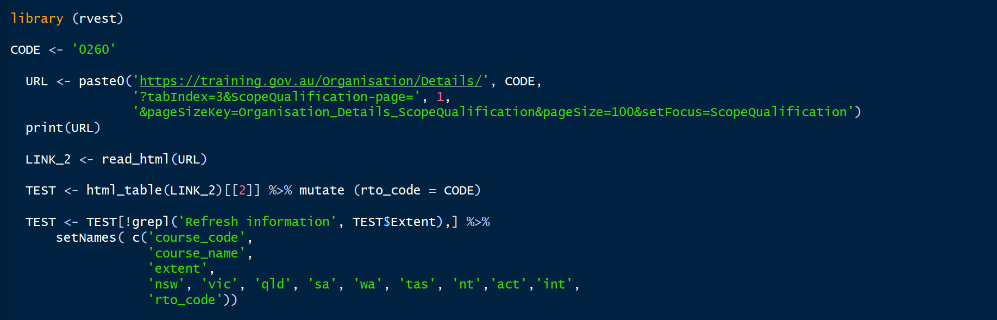
Web scraping a table

Slide 3
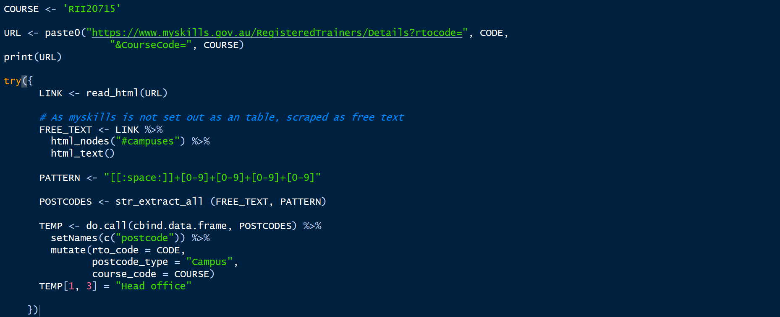
Web scraping free text

