Slide 1
Numerical Methods for Partial Differential Equations
Unsteady and incompresible Navier-Stokes problem
Micucci Francesco
Miani Giorgio
Pasquini Pietro

Slide 2
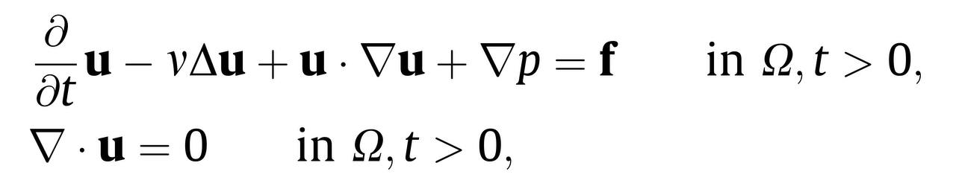
Strong Formulation

Slide 3
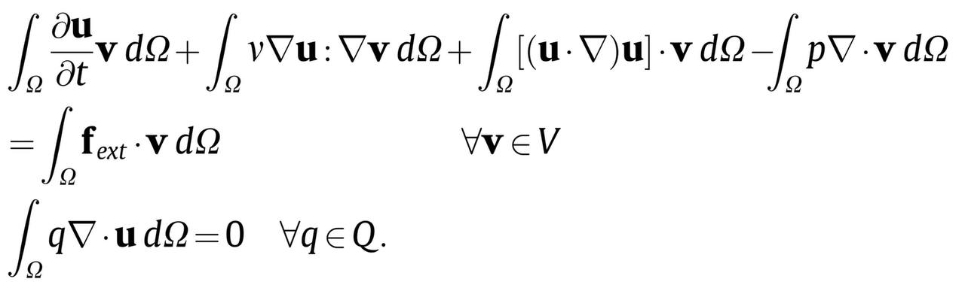
Semi-Discrete Weak Formulation
We introdue two spaces
we introduce two test functions v ∈ V and q ∈ Q, we multiply on both sides and using partial integration we obtain the following formulation

Slide 4
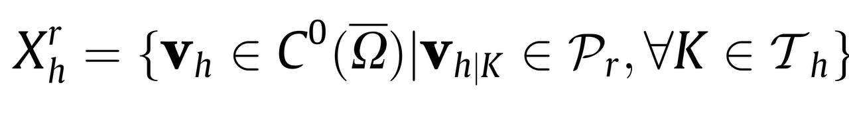
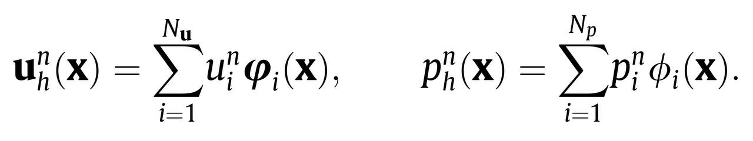

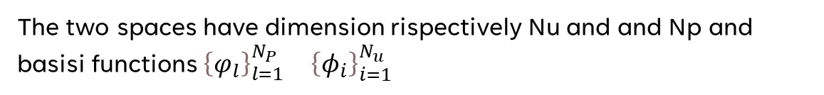
Galerkin Finite Element Formulation
We introdue two finite element spaces
$V_{h}=V ∩{[X}_{h}^{p}(\text{Ω}$)$]^{3}$
$$Q_{h}=Q ∩X_{h}^{q}(\text{Ω}\text{)}$$
Where in general:
The two spaces have dimension rispectively Nu and and Np and basisi functions ${{\left\{φ_{l}\right\}}_{l=1}^{N_{P}}}_{}$ ${{\left\{φ_{i}\right\}}_{i=1}^{N_{u}}}_{}$

Slide 5
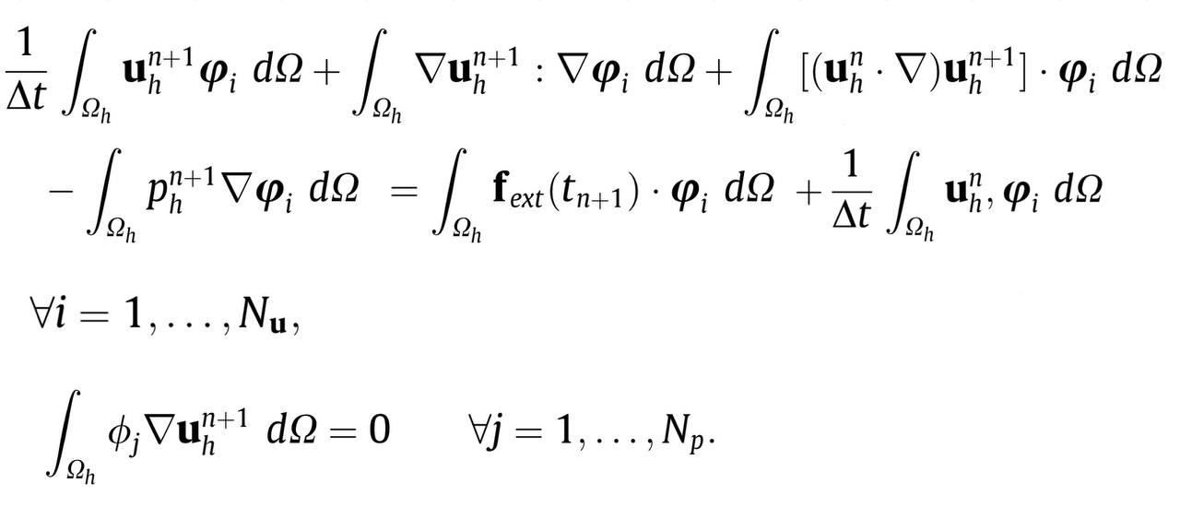
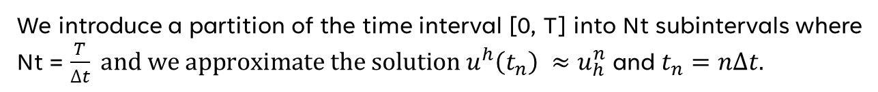
FULLY DISCRETE FORMULATION
We introduce a partition of the time interval [0, T] into Nt subintervals where Nt = $\frac{T}{∆t} and we approximate the solution {u^{h}\left(t_{n}\right) ≈u}_{h}^{n}$ and $t_{n}=n∆t.$

Slide 6
Boundary conditions
$$u∙n=0 on {\text{Γ}}_{wall}$$
$\left(μ∇u ∙n −pn\right)∙t=0$ $on {\text{Γ}}_{wall}$
$$u=0 on {\text{Γ}}_{c}$$
$$u=U_{INLET} on {\text{Γ}}_{IN}$$

Slide 7


Linearization
CONVECTIVE FORM
SKREW SYMMETRIC FORM
ROTATION FORM
SEMI-IMPLICIT
$$u_{h}^{n} ∙ ∇u_{h}^{n+1}$$

Slide 8
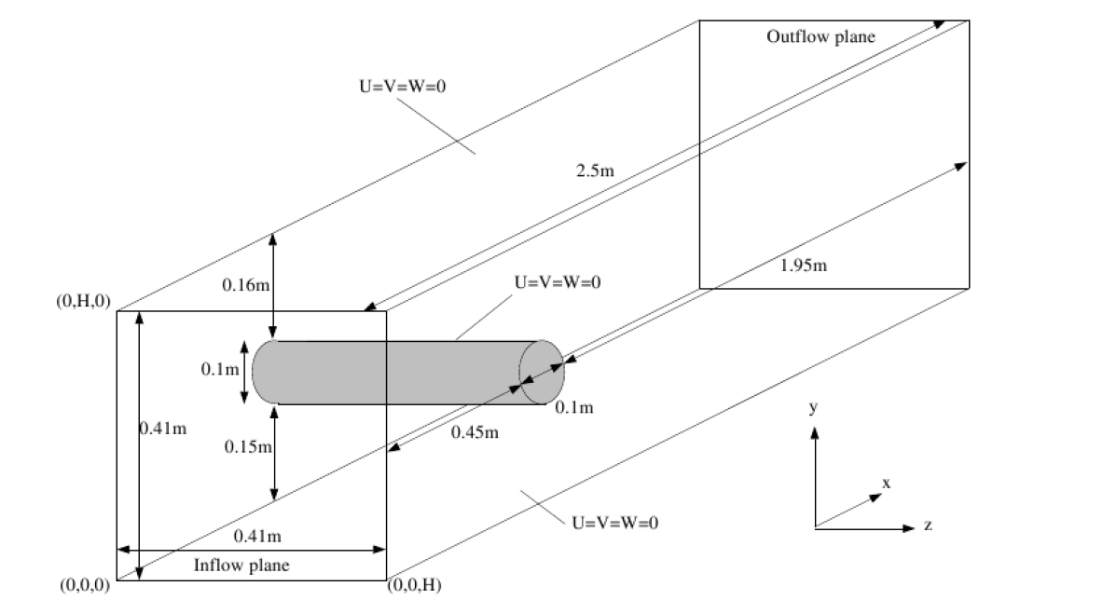
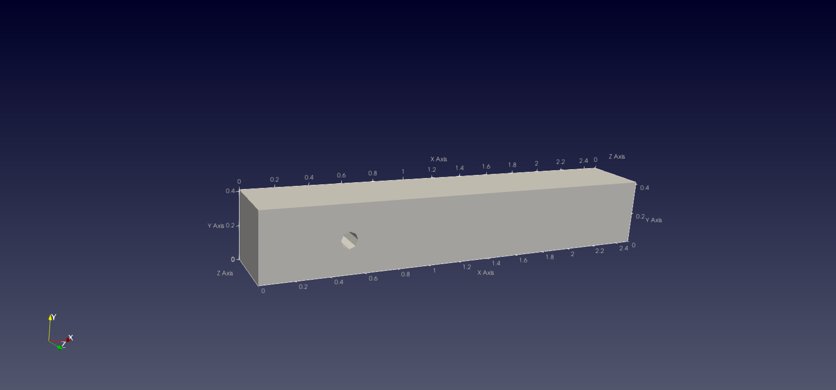
Domain and meshes

Slide 9
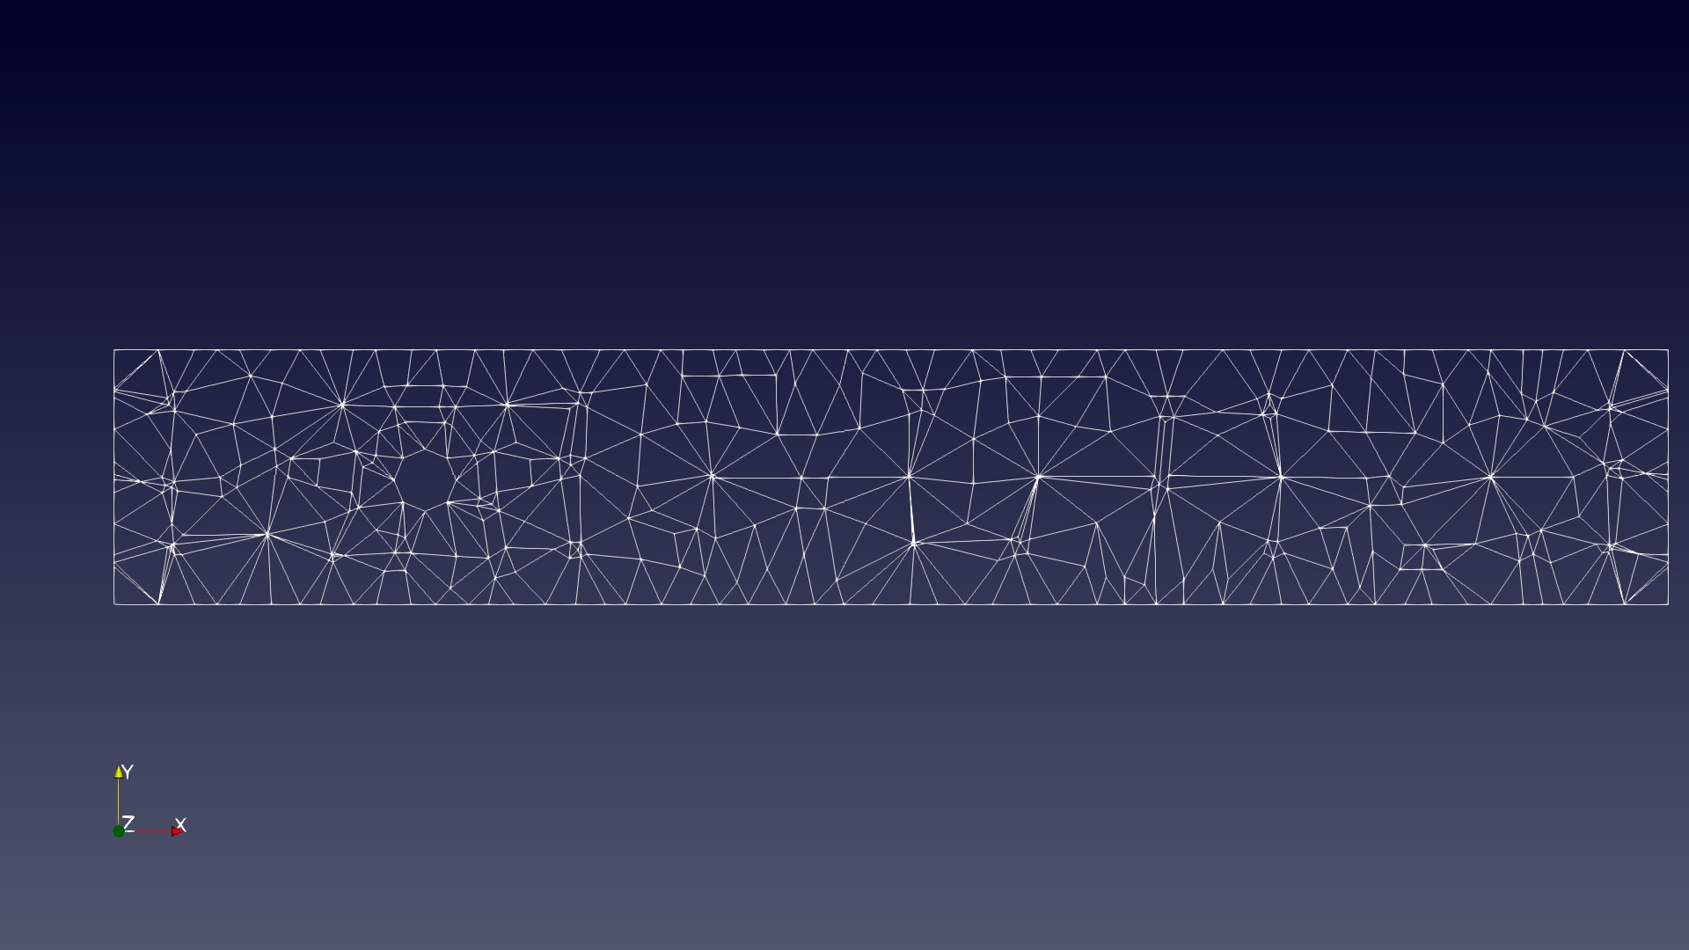
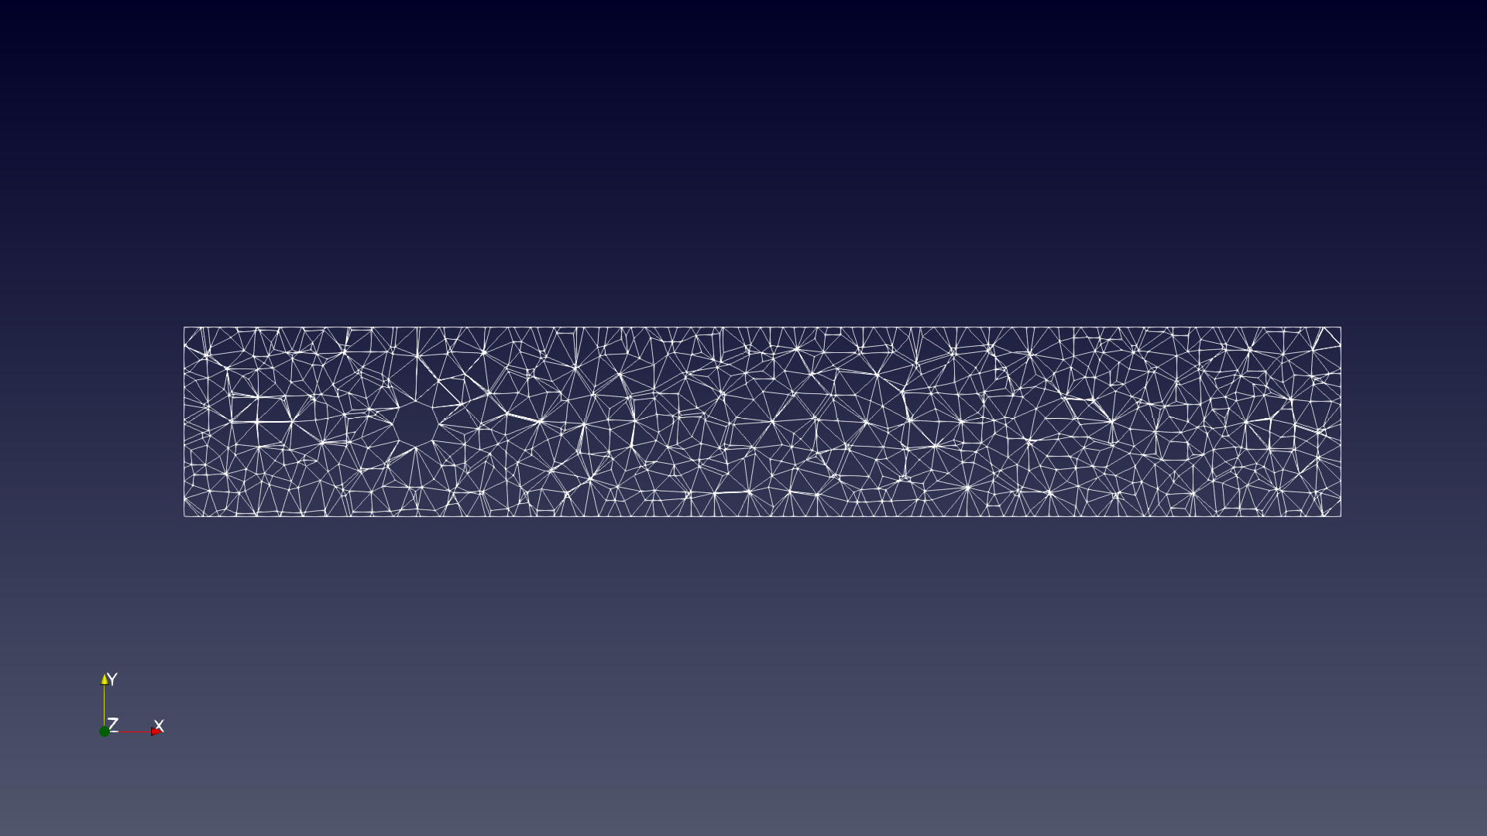
We created 3 differente meshes using different discretization of the domain
h = 0.1;
# elem = 3044
Dof = 17633
h = 0.05;
# elem = 16156
Dof = 82370

Slide 10
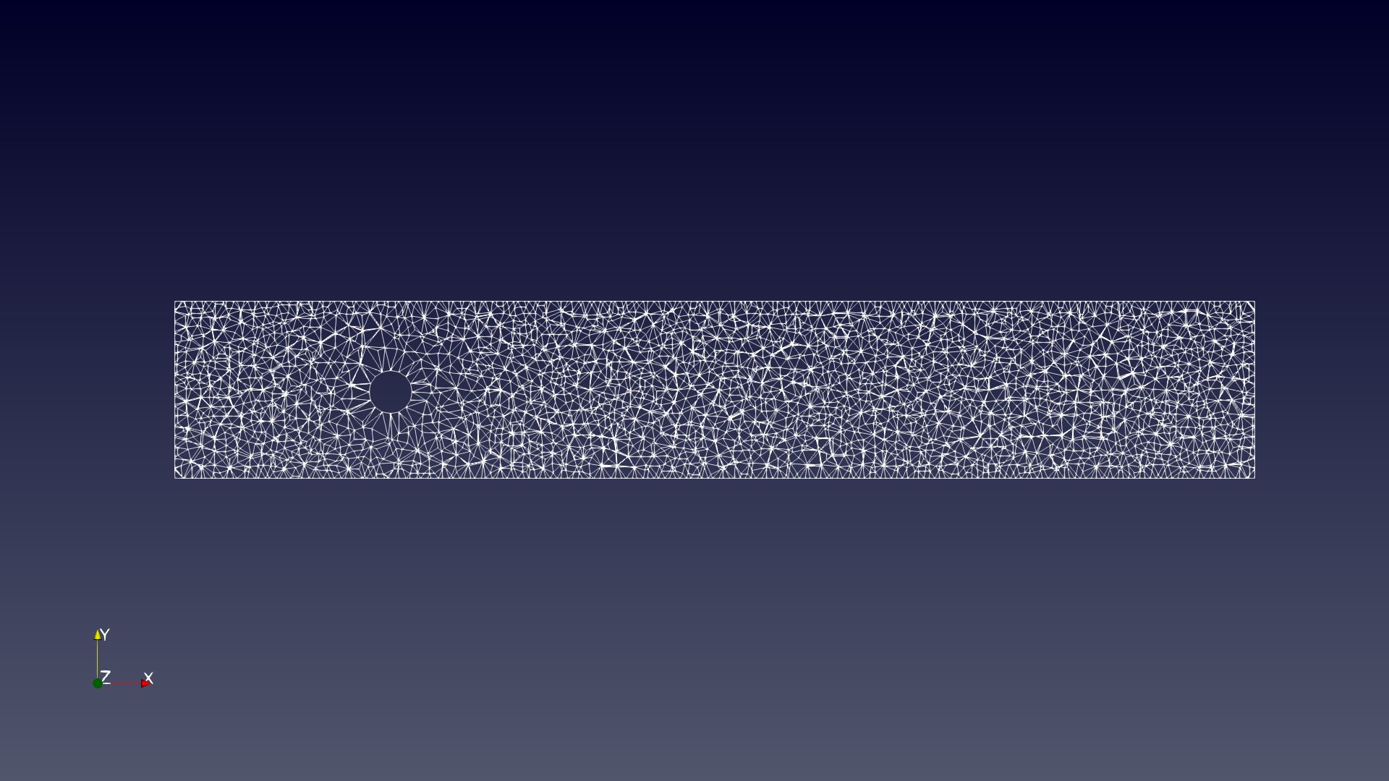
h = 0.025
# elem = 117614
Dof = 542600

Slide 11
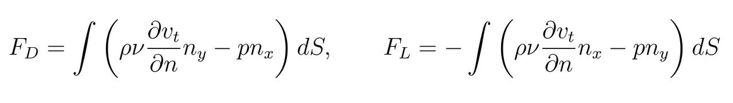

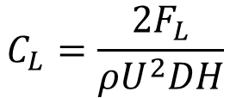
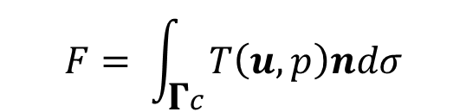

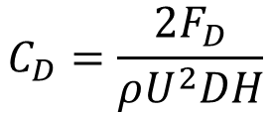

Drag and lift coefficents
$$C_{L}=\frac{2F_{L}}{ρU^{2}DH}$$
$$C_{D}=\frac{2F_{D}}{ρU^{2}DH}$$
$$F_{D}=F⋅\left(\begin{matrix}1 \\ 0\end{matrix}\right)$$
$$F= \int_{\text{Γ}c}{T\left(u, p\right)ndσ}$$
$$F_{L}=F⋅\left(\begin{matrix}0 \\ 1\end{matrix}\right)$$
$$T\left(u, p\right)= μ∇u −pI$$

Slide 12
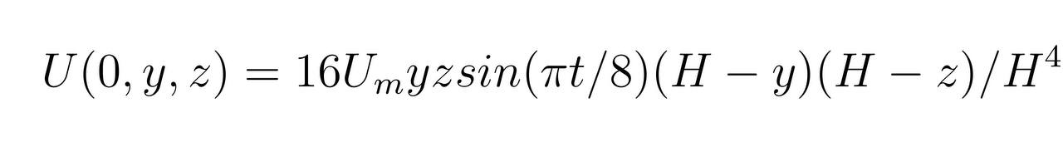
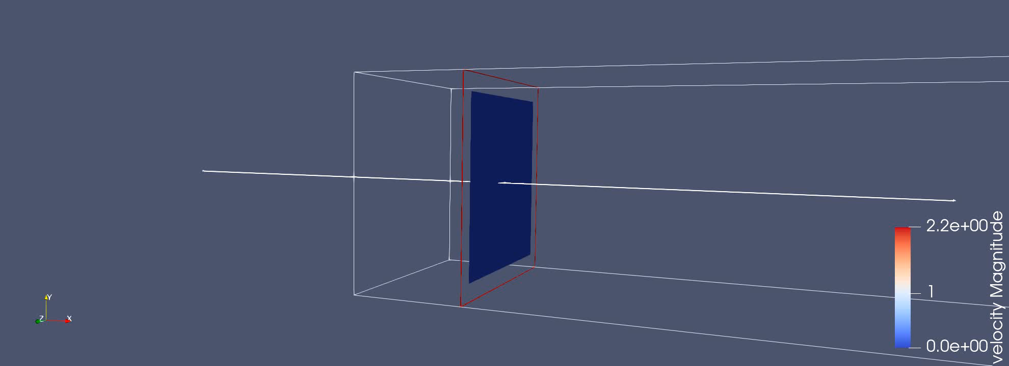

Slide 13




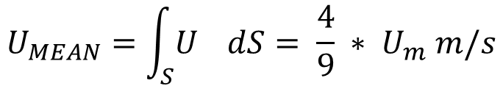



Parameters
$$μ=0.05, 0.02, 0.01, 0.005$$
$$ρ =1.0$$
$Re=\frac{ρU_{MEAN}D}{v}$ = 2, 5, 10, 20
$$U_{m}=2.25 m/s$$
$$U_{MEAN}=\int_{S}{U_{}}dS= \frac{4}{9} ∗ U_{m} m/s$$
$$T=8 s$$
$$∆t=0.125, 0.0625, 0.03125$$
$$f_{ext}=0$$

Slide 14
Time vs Reynolds for different meshes

Slide 15

Time vs $∆t$for different meshes

Slide 16
Time PC vs time cluster

Slide 17
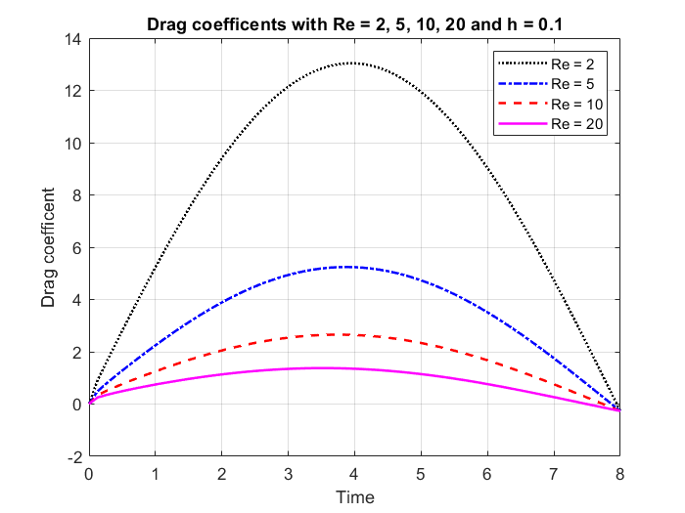

DRAG AND LIFT COMPARISON

Slide 18
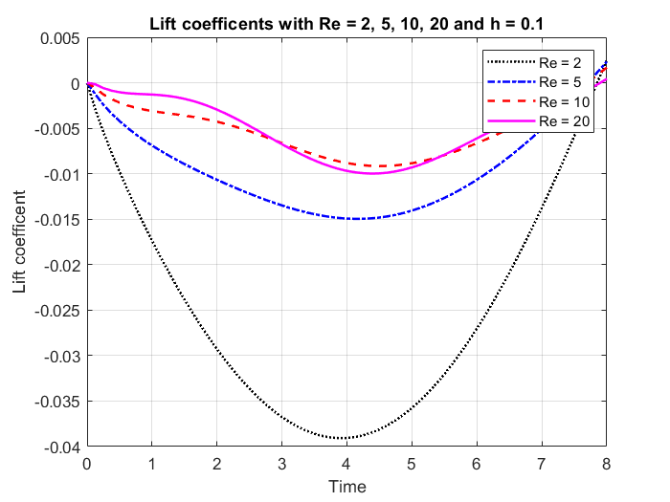
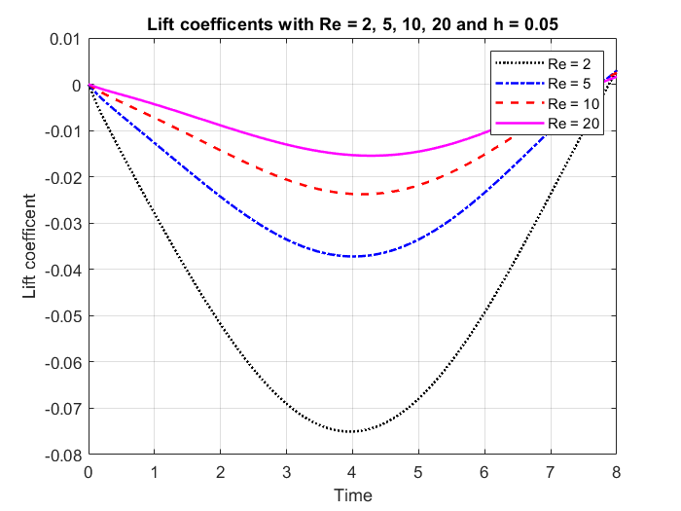

Slide 19
PRECONDITIONERS

Slide 20
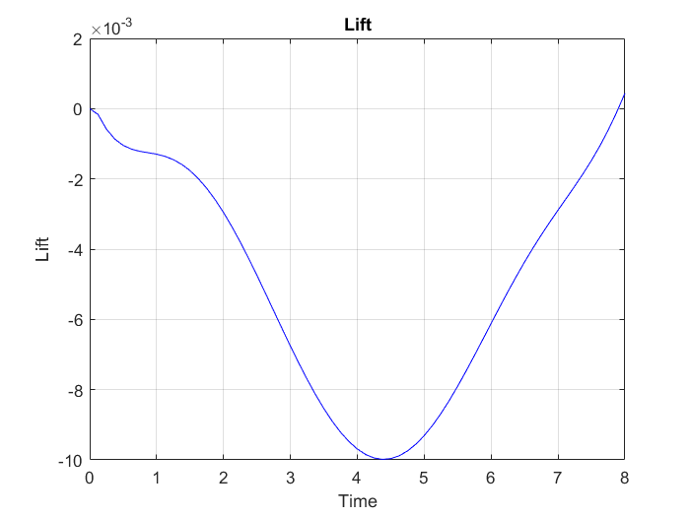
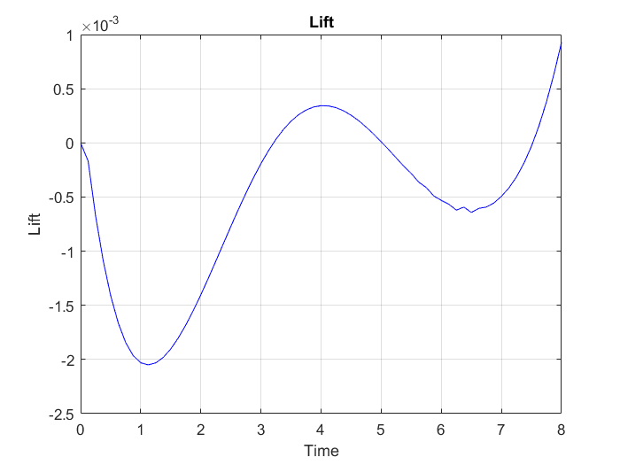
SKREW SYMMETRIC
Dt = 0,125, h = 0.1
CONVECTIVE FORM
RE | C.F | S.S.F
2 | 592.6 s | 681.8 s
5 | 1095 s | 1394 s
10 | 1720 s | 1347 s
20 | 3083 s | 1882 s
Re = 20
SKREW SYMMETRIC

