Slide 1
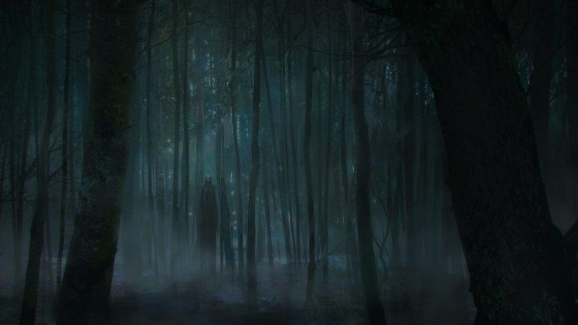
Horror “Movieland”
A chilling experience
Participants:
Giorgio Nocerino - 0124002311
Antonietta Giordano - 0124002421
Martina Raimo - 0124002358

Slide 2


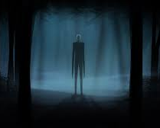
Objective of the Project
The idea is to develop a web app capable of containing horror movies and similar by category of sub-genres with unknown titles. Furthermore, the films will be divided by section by category (genre) and then by director.

Slide 3
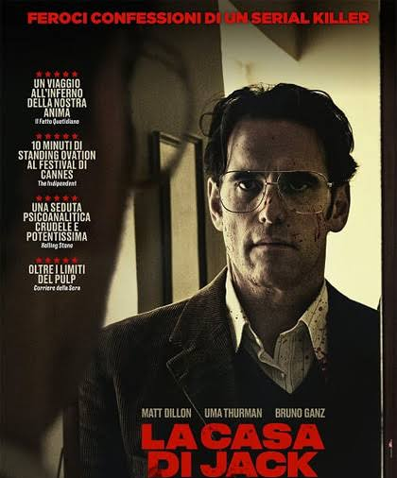
Example (director and genre)
Horror/thriller-> Lars von trier -> film: la casa di jack.-> score:3.8/5.

Slide 4
Features - 1
Users will be tested to identify their preferences and ensure a better cinematic experience.
And with each answer, a possible movie that the user might like will be simulated.

Slide 5
Features - 2
Users are given the opportunity to collect their favorite films and mark them in a section called the Wish List, in order to keep track of the cinematic experience.
In addition, users are given the opportunity to directly enter the streaming links that lead to the movie.

Slide 6
Languages used
Front-end side: HTML5 (con frameworks: Bootstrap), CSS3, JAVASCRIPT, Node.js
Back-end side: Python, DB (SQLite)

Slide 7
THANKS FOR YOUR ATTENTION

