Slide 1
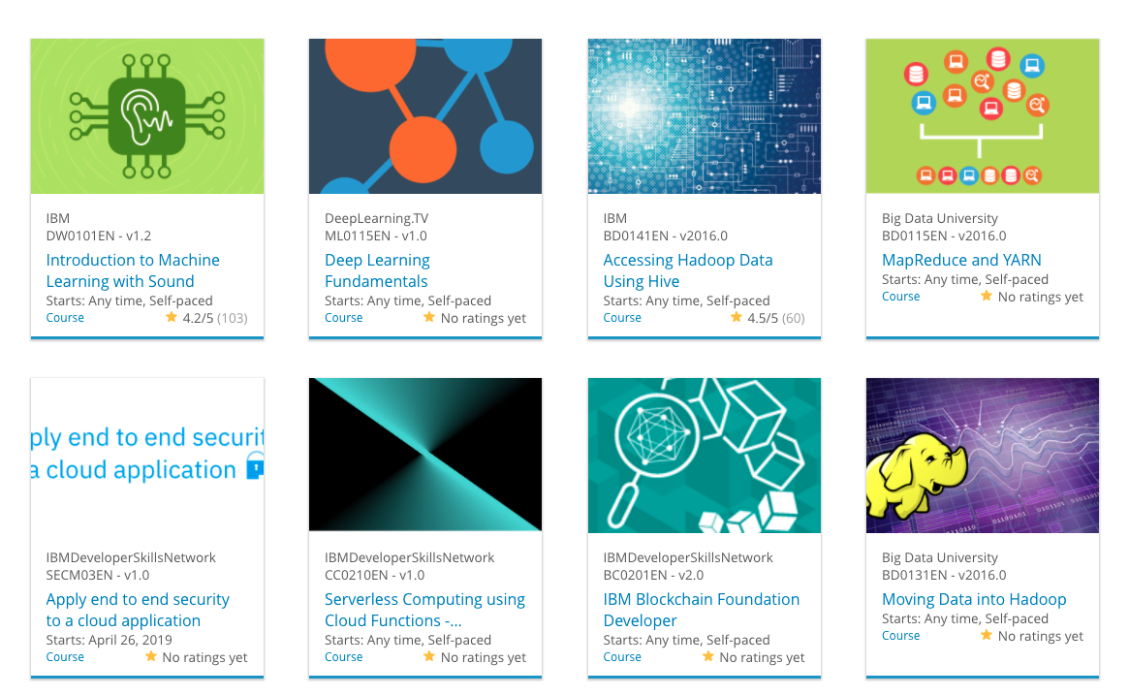

Build a Personalized Online Course Recommender System with Machine Learning
Jorge Luis Suarez Bula
03/01/2024

Slide 2

Outline
Introduction and Background
Exploratory Data Analysis
Content-based Recommender System using Unsupervised Learning
Collaborative-filtering based Recommender System using Supervised learning
Conclusion
Appendix

Slide 3
Introduction
This project is part of the capstone module of the IBM Machine Learning Specialization, its main purpose is to apply the different techniques and concepts learned all throughout the specialization and put them together in a simple yet functional application. The recommender system intends to generate course recommendations based on different approaches such as: user profile, course similarity, clustering, collaborative filtering, course rating predictions using neural networks and others.
The recommendations should be aligned with the courses of interest for a specific user. Thus, providing recommendations that are suitable to the user’s interest or even recommending courses the user did not really think he would be interested in.
It is expected that the recommendations generated with the different approaches keep a close relationship between them yet are not the same. This endowed the app with the capabilities to generate different list of recommendations in case of being necessary.

Slide 4
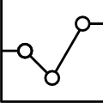
Exploratory Data Analysis
The data for developing this project is provided by IBM. This data includes information about the courses available, their descriptions, the topics they fit in, the status of the courses each user is enrolled in, the bag of words for each course (which was previously obtained), a similarity matrix between the courses, information about the topics each user is interested in.

Slide 5
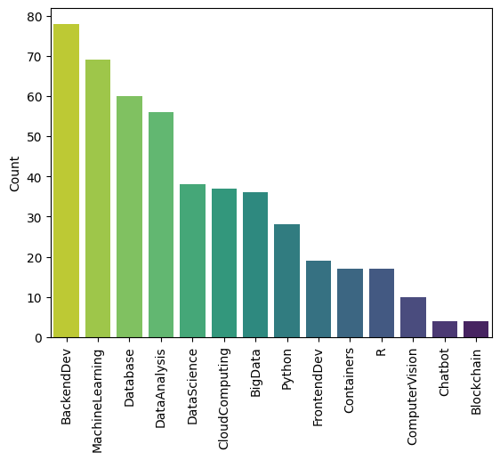
Course counts per genre
As shown in the bar chart, the most popular genres are Backend development and those associated with Data Science and cloud computing. The less popular courses are those associated with Blockchain and building chatbots.
It is interesting to notice that python courses are more popular than R courses, being these two languages the most popular for Data Science.

Slide 6
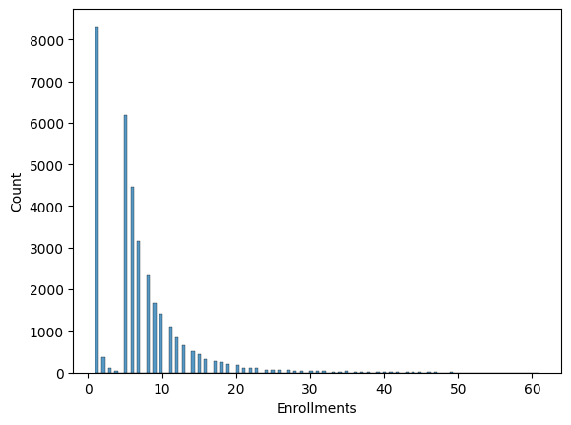
Course enrollment distribution
The histogram shows that many users enroll in just one or two courses and many of them in less than ten.
Just a few users enroll in a great number of courses. This might show that most users have clearly defined interests.

Slide 7
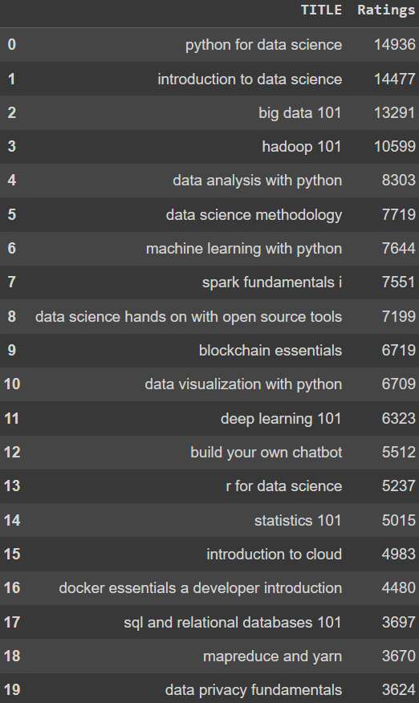
20 most popular courses
In the twenty most popular courses the most of them are strongly related to Data Science and Python. There are some of them related to containers, blockchain and databases.

Slide 8
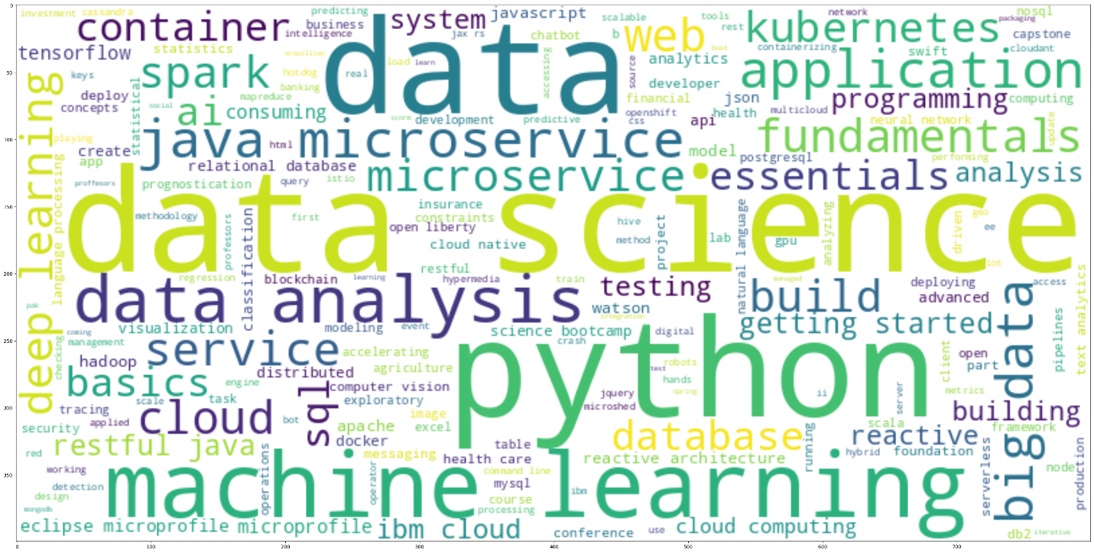
Word cloud of course titles
The word cloud clearly reflects the topics of the most popular courses which are: Data Science, machine learning, Python, containers, databases, big data. It is strongly correlated with the list shown in the previous slide.

Slide 9
Content-based Recommender System using Unsupervised Learning
Cluster2
Cluster1

Slide 10
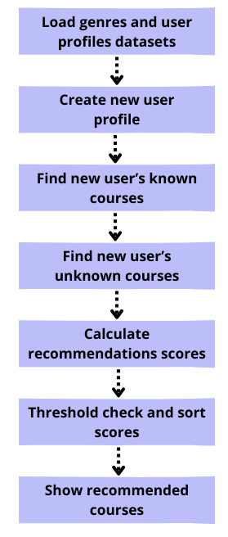
Flowchart of content-based recommender system using user profile and course genres
First, a user's profile dataframe and a course genre dataframe will be loaded. A new user is added to the first dataframe. Finding the new user’s known courses and with the list of all courses the unknown courses for the new users are found. Executing the dot product between the new user profile vector and each unknown course genre vectors the recommendation score for each unknown course is calculated, the threshold is check and then the courses above the threshold are sorted to be recommended to the user.

Slide 11
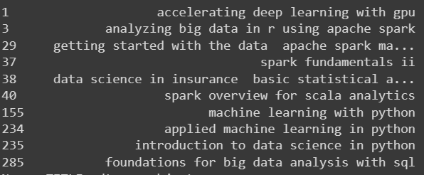
Evaluation results of user profile-based recommender system
For the user profile-based recommender system, the recommendation score for all the unknown courses for the users were calculated, the threshold was checked and then the courses above the threshold were sorted out and the recommended courses to each users depending on the number of the recommendations asked by the user.
The image show the top 10 most recommended courses across all test users.

Slide 12
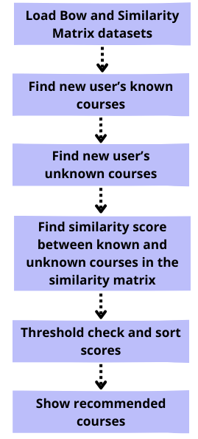
Flowchart of content-based recommender system using course similarity
First, the BoW and Similarity matrix dataset will be loaded. Finding the new user’s known courses and with the list of all courses the unknown courses for the new users are found. the similarity score between the known the unknown courses for the users were found in the similarity matrix, the threshold was checked and then the courses above the threshold were sorted out to be recommended to the user.

Slide 13
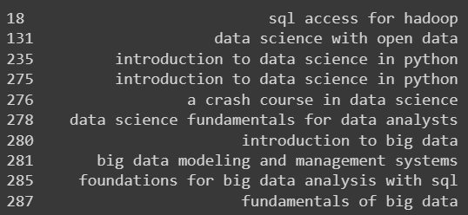
Evaluation results of course similarity based recommender system
For the course similarity-based recommender system, the similarity score between the known the unknown courses for the users were found in the similarity matrix, a threshold of 0.6 was defined and then checked, the courses above the threshold were sorted out and the recommended courses to each users depending on the number of the recommendations asked by the user.
On average, a number of 12 unseen courses were recommended to each user in the test user dataset.
The image show the top 10 most recommended courses across all test users and the.

Slide 14
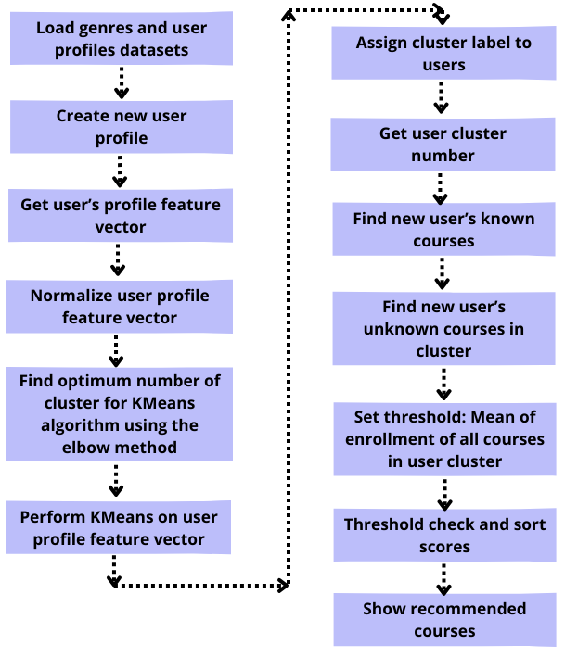
Flowchart of clustering-based recommender system
First, the user profiles and genres datasets will be loaded. A new user is added to the first dataframe. The user’s profile vector will be obtained from the user profile dataset and then it will be normalized. To find the optimum number of clusters for the clustering algorithm, the elbow method will be performed. Then the KMeans algorithm will be performed on the user profile vector and the clusters label will be assign to each user in the test users' dataset. For each user, its cluster number is retrieved as well as all the courses belonging to that cluster. The mean of enrollments of all the courses in the cluster is calculated and set as the threshold, the courses in the cluster above the threshold were sorted out and then recommended to the user.

Slide 15
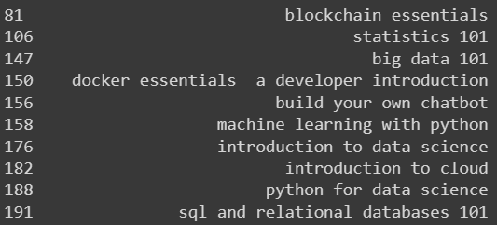
Evaluation results of clustering-based recommender system
For the clustering-based recommender system, the mean of enrollments of all the courses in each cluster was defined as the threshold and then checked, the courses above the threshold were sorted out and the recommended courses to each users depending on the number of the recommendations asked by the user.
On average, a number of 12 unseen courses were recommended to each user in the test user dataset.
The image show the top 10 most recommended courses across all test users and the.

Slide 16
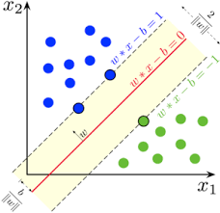
Collaborative-filtering Recommender System using Supervised Learning

Slide 17
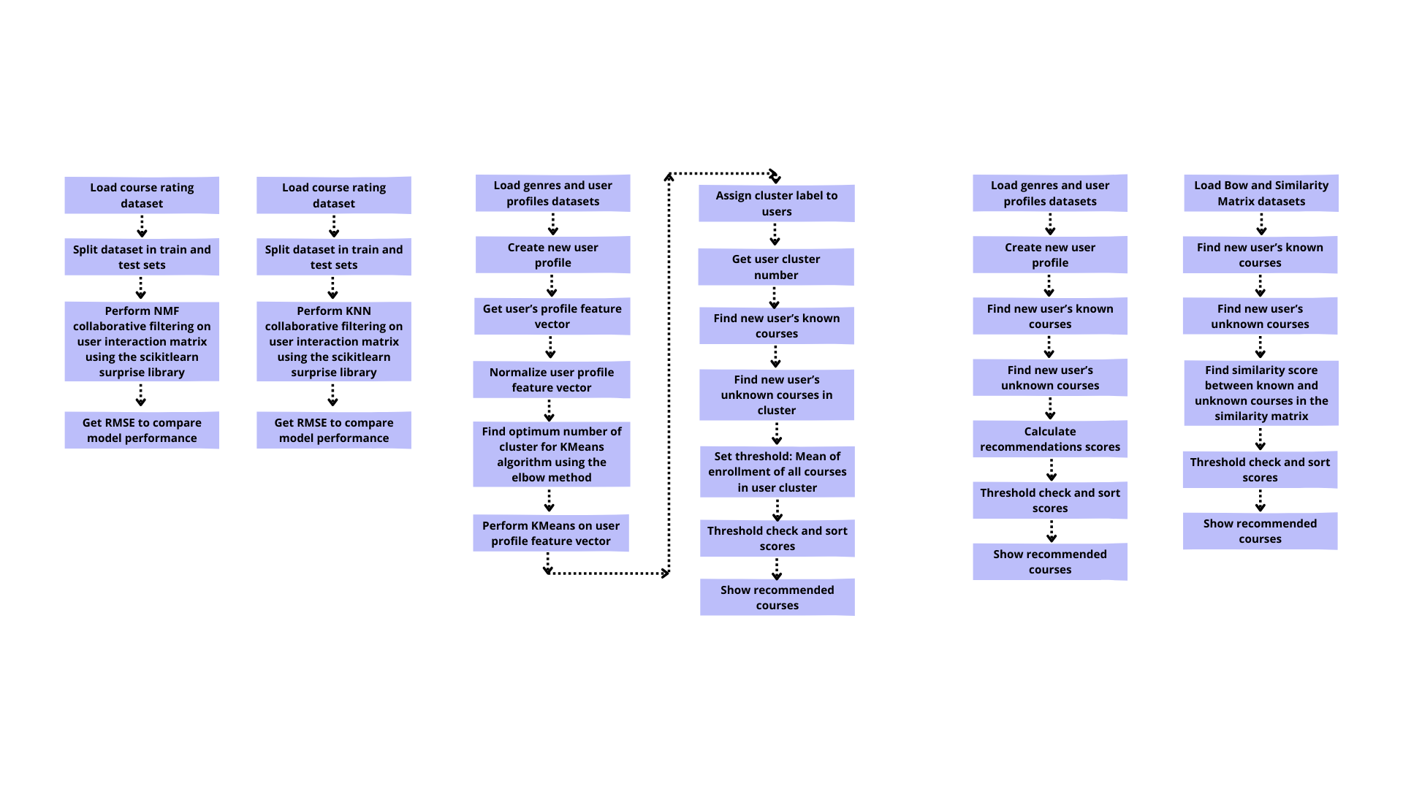
Flowchart of KNN based recommender system
First, the course rating dataset will be loaded. The dataset is split between train and test sets. From scikitlearn the surprise library is imported and the KNNBasic model is used to build the recommender system. Once the model is fitted to the train data and the predictions on the test set are generated, the RMSE is obtained.
For this case, the RMSE obtained is equal to 0.2164.

Slide 18
Flowchart of NMF based recommender system
First, the course rating dataset will be loaded. The dataset is split between train and test sets. From scikitlearn the surprise library is imported and the NMF model is used to build the recommender system. Once the model is fitted to the train data and the predictions on the test set are generated, the RMSE is obtained.
For this case, the RMSE obtained is equal to 0.2085.

Slide 19
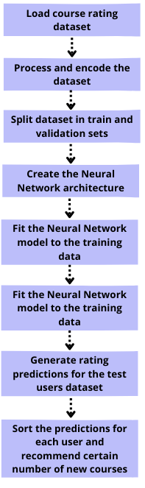
Flowchart of Neural Network Embedding based recommender system
First, the course rating dataset will be loaded. The dataset is split between train and validation sets. Create the architecture of the Neural Network, that will take two one-hot encoded vectors as input (user and item), it will then generate two embedding vectors. Then, executing the dot product between the user and item embedding vectors to get a rating estimation. Once the model is fit and validated, the ratings for the test users are generated, sorted out and recommended to the user depending on how many courses the user asked for.
For this case, the RMSE obtained is equal to 0.1220

Slide 20
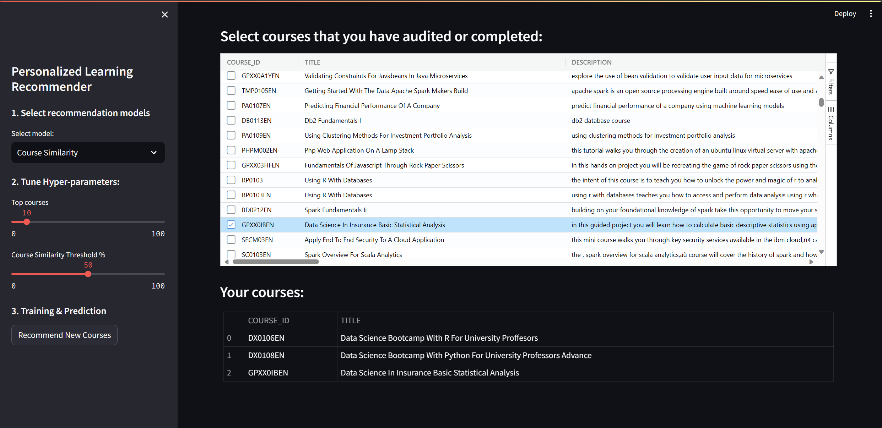
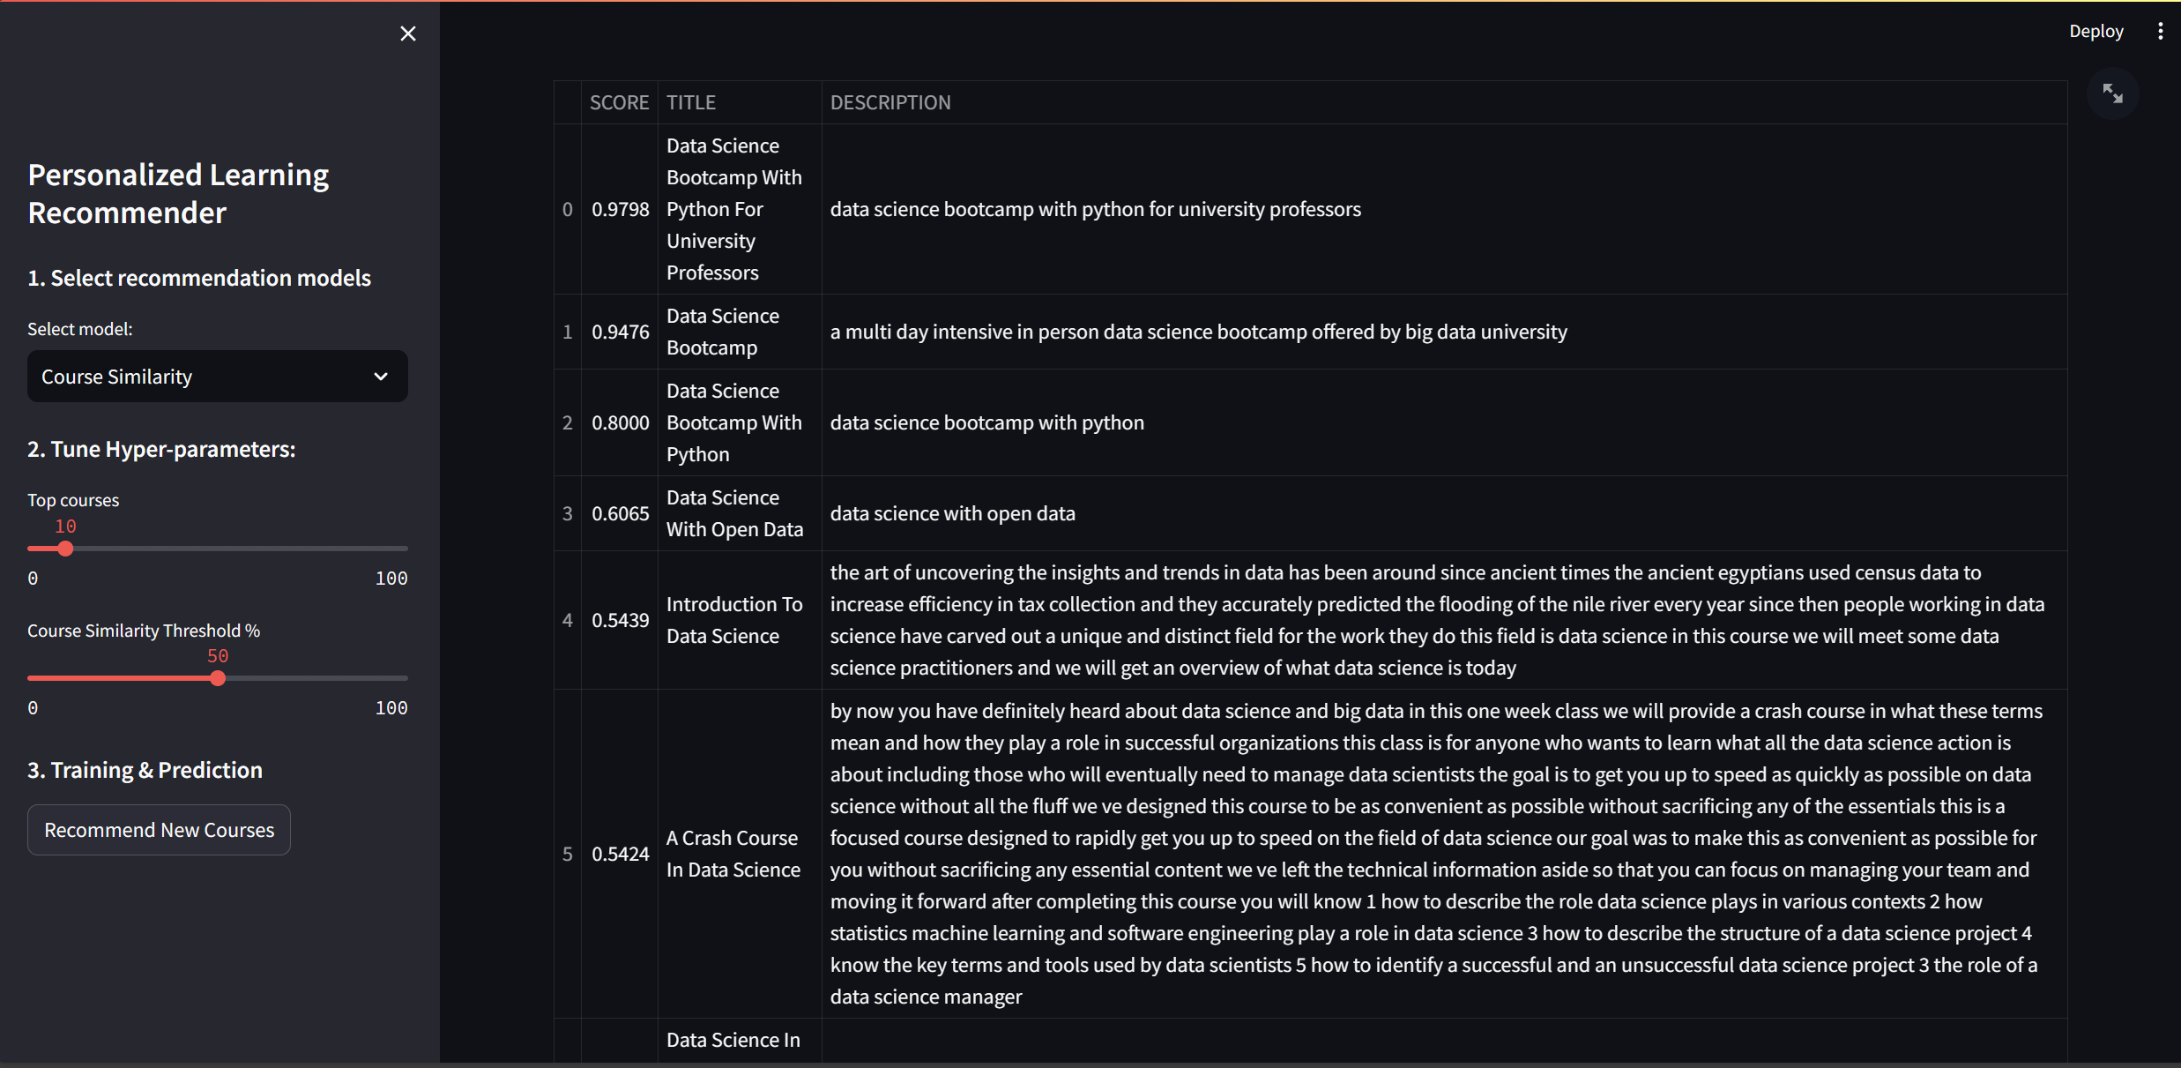
Optional: Build a course recommender system app with Streamlit
Streamlit app screenshot1
Streamlit app screenshot2
A live demo of the app can be found here: Course recommender system app with Streamlit (youtube.com)

Slide 21
Conclusions
As expected, the recommendations generated by each different approach are aligned with the interest of the user. It is also important to mention, that these recommendations differ slightly or greatly between approaches.
It is noticeable that similar approaches (user profile and course similarity for example) generate similar list of recommendations while very different approaches generate very different list of recommendations (user profile and Neural Networks for example).
The variability in the recommendations generated for the different approaches endowed the app with the capabilities to generate different list of recommendations in case of being necessary widening the range of courses that are recommended.
For a live app, the KNN based recommender system might be too slow or even rash at times. It is widely outperformed by the NMF method offering similar results.
Even tough the Neural Network is the slowest approach, given that the model is trained live, the time it takes is sensible and the quality of its recommendations makes it an interesting approach.

Slide 22
Appendix
GitHub: https://github.com/Giorgio36/Course-Recommender-System-Machine-Learning-Project
Instructions to run the project:
An IDE or text editor
Python 3.7 – 3.9
PIP
Create a virtual environment for building the Streamlit
Install the required libraries mentioned in the file requirements.txt
Run the command: streamlit run recommender_app.py

