Slide 1
What do you know about it ?
By
Caculli Giorgio,
Taminiau Tanguy,
Lambert Guillaume

Slide 2
Planning
Who are we ?
What technologies we used
“What do you know about it ?” : The game functionalities
Game architecture

Slide 3
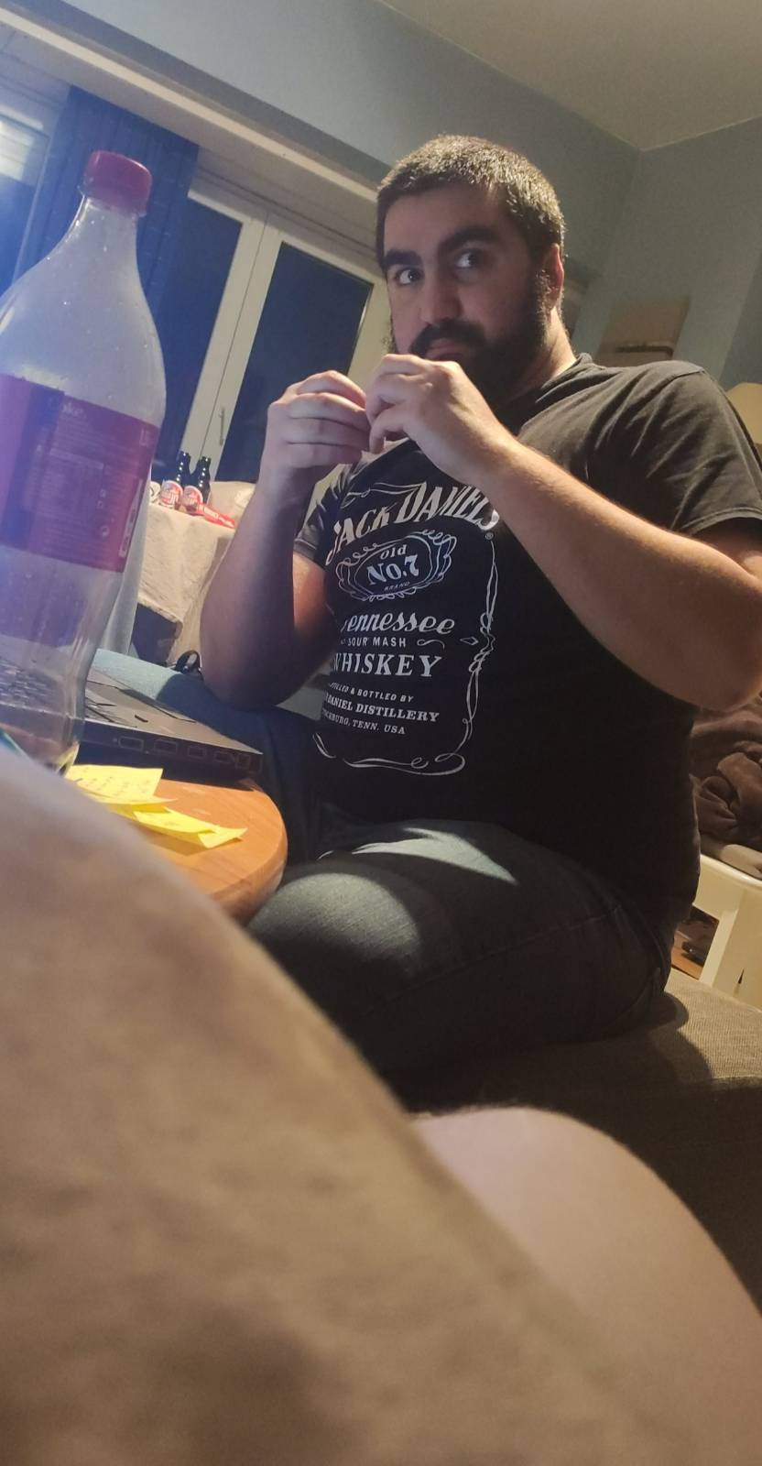
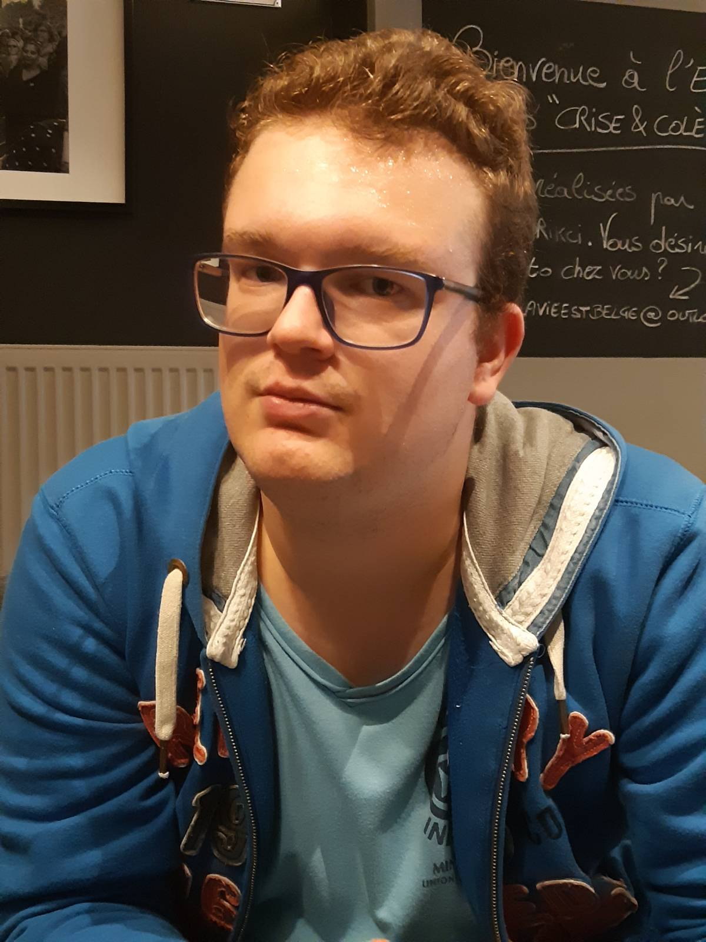
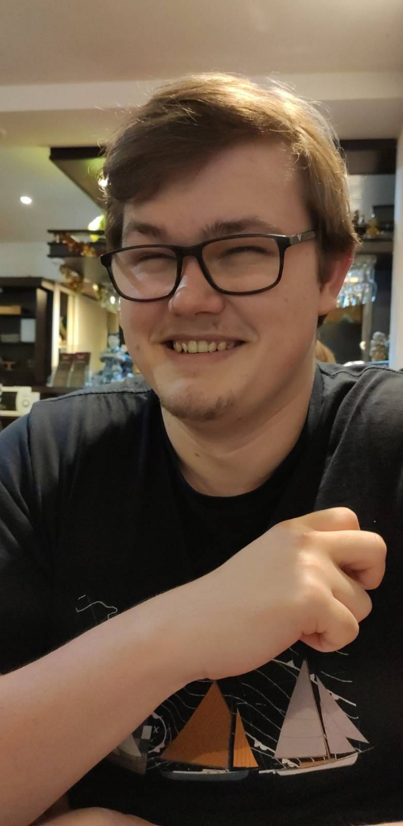
Who are we ?

Slide 4
Gameplay Functionalities
Types of gameplay
Online mode
Ability to send messages to others players via the chat box
Ability to run the game without having to manage dependencies
Ability to load other decks from the client’s computer

Slide 5
Window Management Functionalities
Two different screen sizes ( 1440x900 and 1280x800)
Ability to make the game full screen
Ability to change the volume of the music
Ability to mute the music
Ability to change the language
Four languages available ( English, French, Italian, Japanese)

Slide 6
Administration Functionalities
Restricted and secure access to the administration panel
Ability to add new cards to the deck
Ability to view all of the cards in the deck
Ability to modify cards in the deck
Ability to remove cards in the deck
Import new cards to the deck
Export the current deck

