Slide 1

Albania

Slide 2
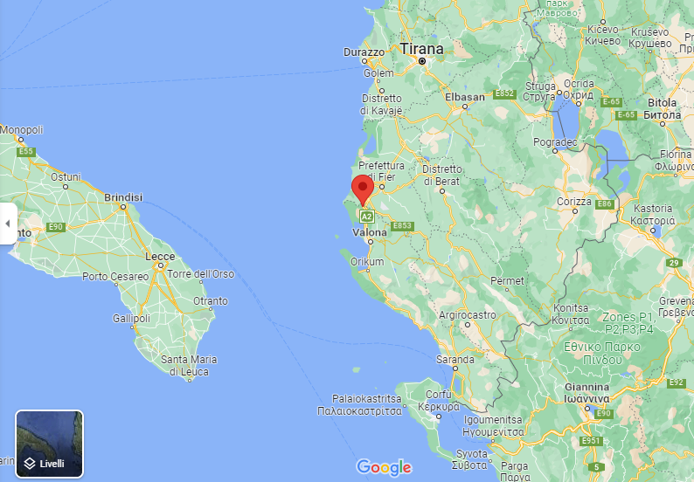
BISHAN
My parents lived in Bishan, Albania.
My parents arrived in Italy:
My dad moved in March 1993 by fishboat.
My mum moved in March 2000 by ferry.

Slide 3
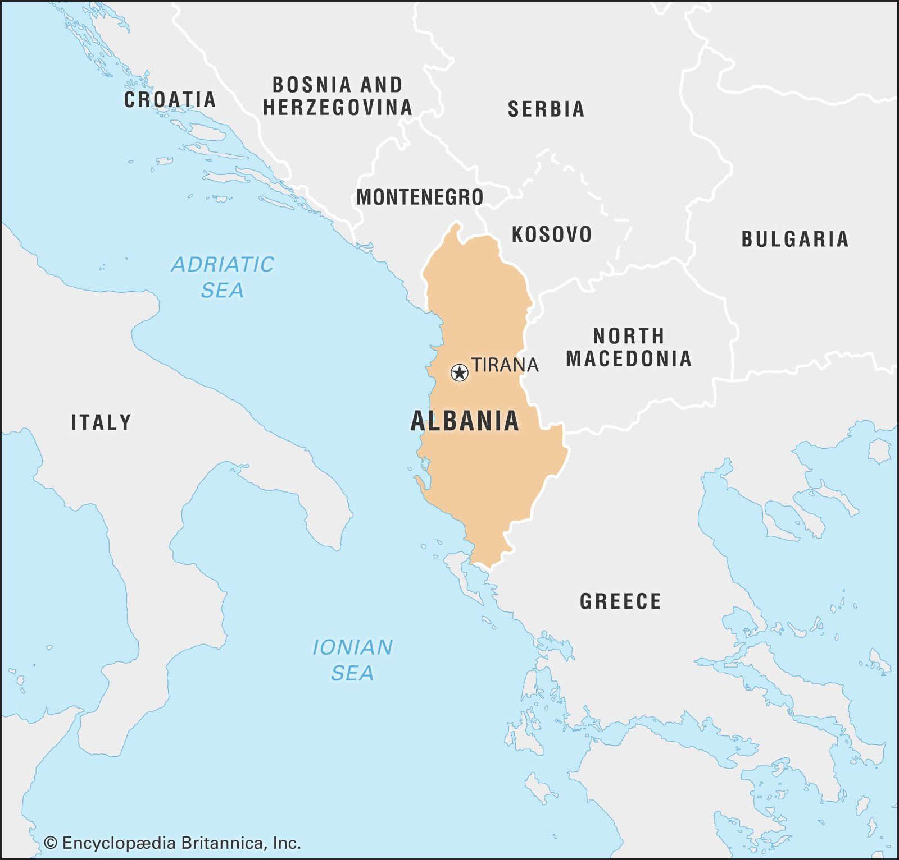
The journey
Dad travelled alone. He arrived in Brindisi harbor and got on a train and arrived in Lombardia. In Casatenovo there were some people dad knew.
Mum travelled with dad’s sister. She arrived in Brindisi harbor and got on a train and arrived in Lombardia.

Slide 4

Italy or Albania?
My dad and my mum came in Italy because they wanted to work.
In Albania there wasn’t any jobs.
They didn’t speak Italian when they arrived.
Now they are happy to live in Italy because they have found stability and a good job.

Slide 5
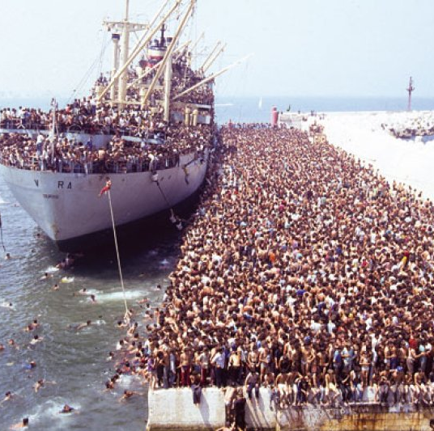
Historical facts
There is a long immigration history between Albania and Italy. Albanians moved to Italy in the 15th century for the first time in order to escape from the war.
This immigration movements continued through the years.
In the 90s two immigrations waves happened after the end of communism.
In March 1991, 27,000 Albanians arrived in Brindisi harbor.
In August of the same year, 20,000 Albanians arrived in Bari.

Slide 6
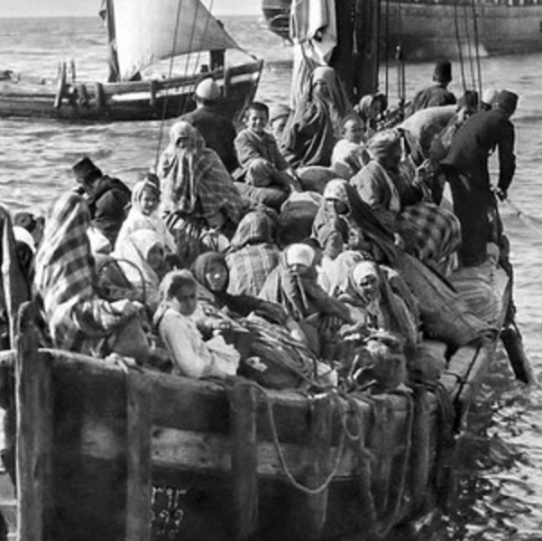
Historical facts
When they arrived in Italy, Albanian communities helped them to learn the language and to find a job.
Now Albanians are well integrated in Italian society. Some of them are business owners of manufactory, for example.
Albania’s economy is developing and some Albanians have decided to go back to their own country.

