Slide 1
Clever Frontier Algorithm

Slide 2


Slide 15
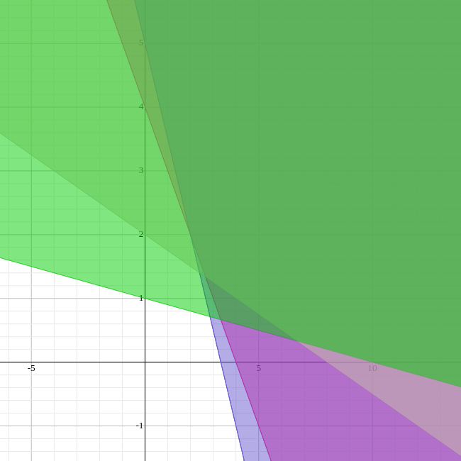
Point: 1 (2 2)
Point: 2 (4 1)
Point: 3 (10 0)
Point: 4 (1 4)
Point: 5 (0 5)
min x
min y
s.t. x+y ≥ 4
1.5x+y ≥ 5
0.25x+y ≥ 2
0.1x+y ≥ 1
x ≥ 0
y ≥ 0

