Slide 1
How to Generate Prediction Intervals using Neural Networks on Python
Paper: “Dual Accuracy-Quality-Driven Neural Network for Prediction Interval Generation”
Giorgio Morales
Gianforte School of Computing
Montana State University
Notes:
10s

Slide 2
Installation
Git and Pytorch have to be already installed
Run pip install -q git+https://github.com/NISL-MSU/PredictionIntervals in the terminal
Training the Models
DualAQD uses two NNs: a target-estimation NN that generates accurate estimates and a prediction interval (PI)-generation NN that produces the PI upper and lower bounds
First, create an instance of the class PredictionIntervals. Parameters:
X: Input data (explainable variables). 2-D numpy array, shape (#samples, #features)
Y: Target data (response variable). 1-D numpy array, shape (#samples, #features)
Xval: Validation input data. 2-D numpy array, shape (#samples, #features)
Yval: Validation target data. 1-D numpy array, shape (#samples, #features)
method: PI-generation method. Options: 'DualAQD’ or 'MCDropout'
normData: If True, apply z-score normalization to the inputs and min-max normalization to the outputs
Notes:
94

Slide 3
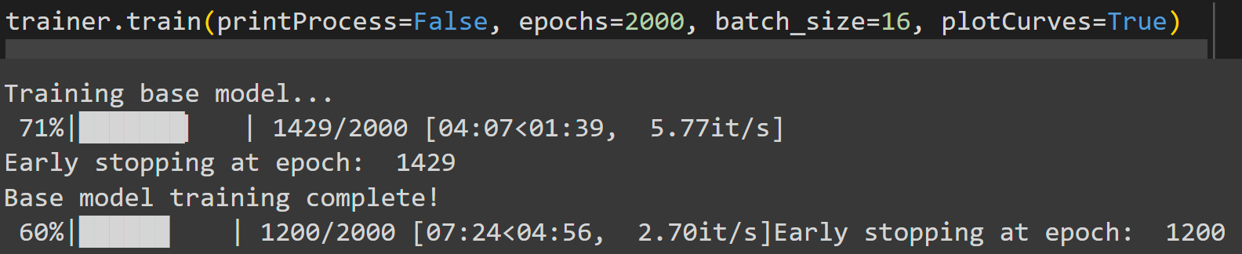
Training the Models
Normalization is applied to the training set; then, the exact same scaling is applied to the validation set.
To train the model, call the `train` method. Parameters:
batch_size: Mini batch size. It is recommended a small number. default: 16
epochs: Number of training epochs. default: 1000
eta_: Scale factor used to update the self-adaptive coefficient lambda (Eq. 6 of the paper). default: 0.01
printProcess: If True, print the training process (loss and validation metrics after each epoch). default: False
plotCurves: If True, plot the training and validation curves at the end of the training process
Notes:
94

Slide 4
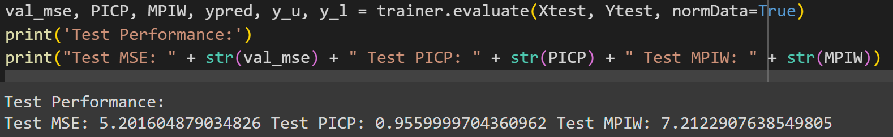
Evaluate the model on a test set
To do this, call the method evaluate. Parameters:
Xeval: Evaluation data
Yeval: Optional. Evaluation targets. default: None
normData: If True, apply the same normalization that was applied to the training set
Returns:
If Yeval is None: It returns predictions ypred, y_u, y_l (i.e., target predictions, PI upper bounds, and PI lower bounds).
If Yeval is not None: It returns performance metrics and predictions mse, PICP, MPIW, ypred, y_u, y_l (i.e., mean square error of target predictions, PI coverage probability, mean PI width, target predictions, PI upper bounds, and PI lower bounds).
Note: Yeval is None in the case that the target values of the evaluation data are not known.
Notes:
94

Slide 5
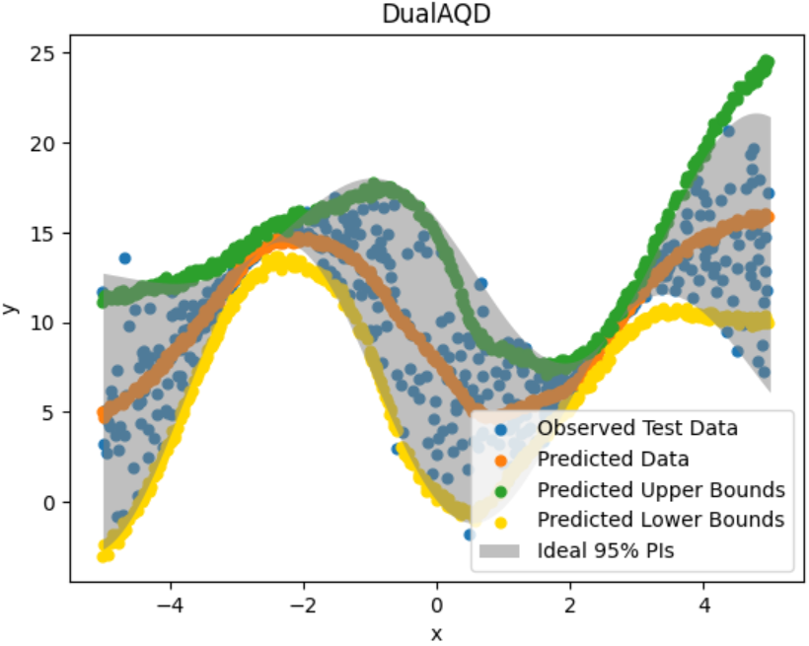
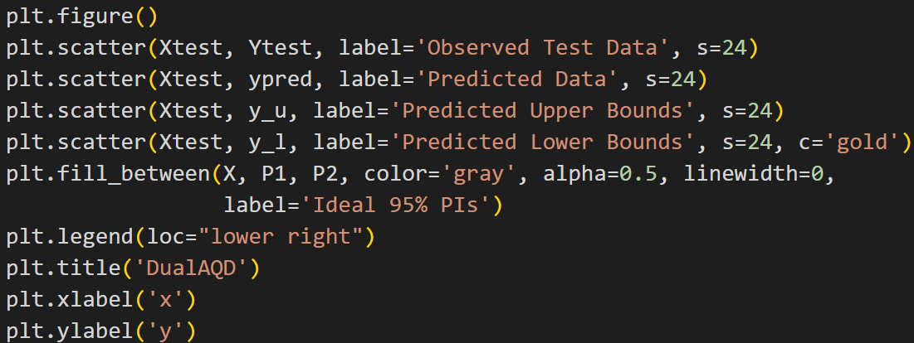
Plot Results
Notes:
94

