Slide 1

Arduino 101

Slide 2
Who am I?
Sanat Chugh
Engineer | Developer
MS in Computer Science, Northeastern University Currently – Developer at SyncThink
@_flow_zc || linkedin.com/in/sanatchugh
Notes:
In Slide Show mode, click the arrow to enter the PowerPoint Getting Started Center.

Slide 3
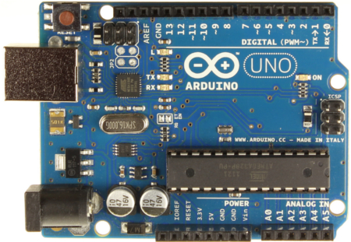
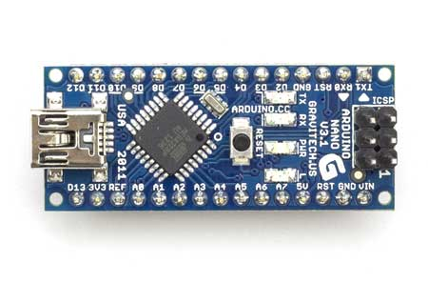
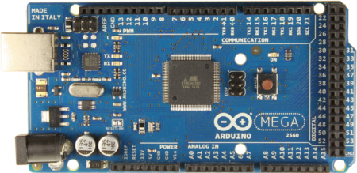
What is Arduino
Arduino is an open-source project that created microcontroller-based kits for building digital devices and interactive objects that can sense and control physical devices.
For programming the microcontrollers, the Arduino project provides an integrated development environment (IDE) based on a programming language named Processing, which also supports the languages C and C++.

Slide 4
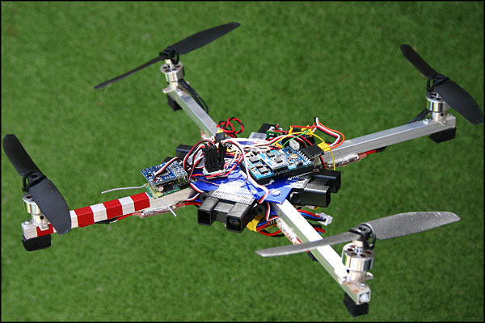
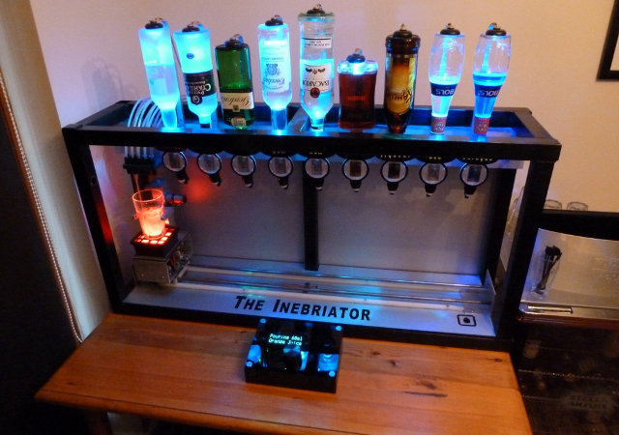
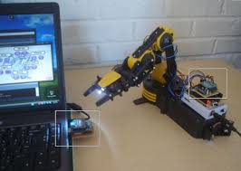
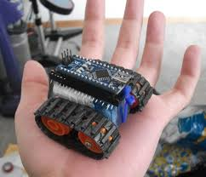
Why use Arduino
Open Source Hardware and Software
Inexpensive Hardware Additions
Cross-Platform
Programming and device learning curve is simple.
Foundation Projects

Slide 5
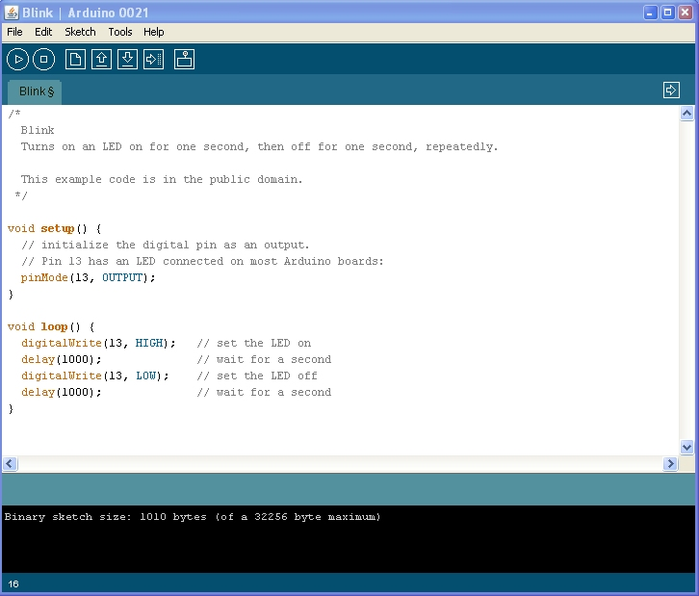
Arduino IDE
The IDE has a lot of built-in examples that are very useful. I highly recommend looking at them. Teaches you to interface with different sensors and devices based on need.
The IDE supports programming via Sketches. Save your sketches as “*.ino”.
Since it is open-source has support libraries that are vast. Range of applications are supported.

Slide 6

Demo

Slide 7
Questions?

Slide 8
References
http://forefront.io/a/beginners-guide-to-arduino/ - Highly recommended start point.
https://www.arduino.cc/en/Tutorial/BuiltInExamples - Great way to get accustomed to basic usage of Arduino. Shows you different kind of example considering a number of sensors.
https://www.arduino.cc/en/Tutorial/HomePage - Official tutorial homepage. This page has the list of libraries and examples.
http://www.robotshop.com/blog/en/arduino-5-minute-tutorials-lesson-1-software-3640 - Five minute guides to basics of using Arduino and a few useful sensors.
http://playground.arduino.cc/Main/InterfacingWithHardware - A huge list of integration options with Arduino, mainly advanced, but also has simple applications.

Slide 9
Thank You!

