Slide 1
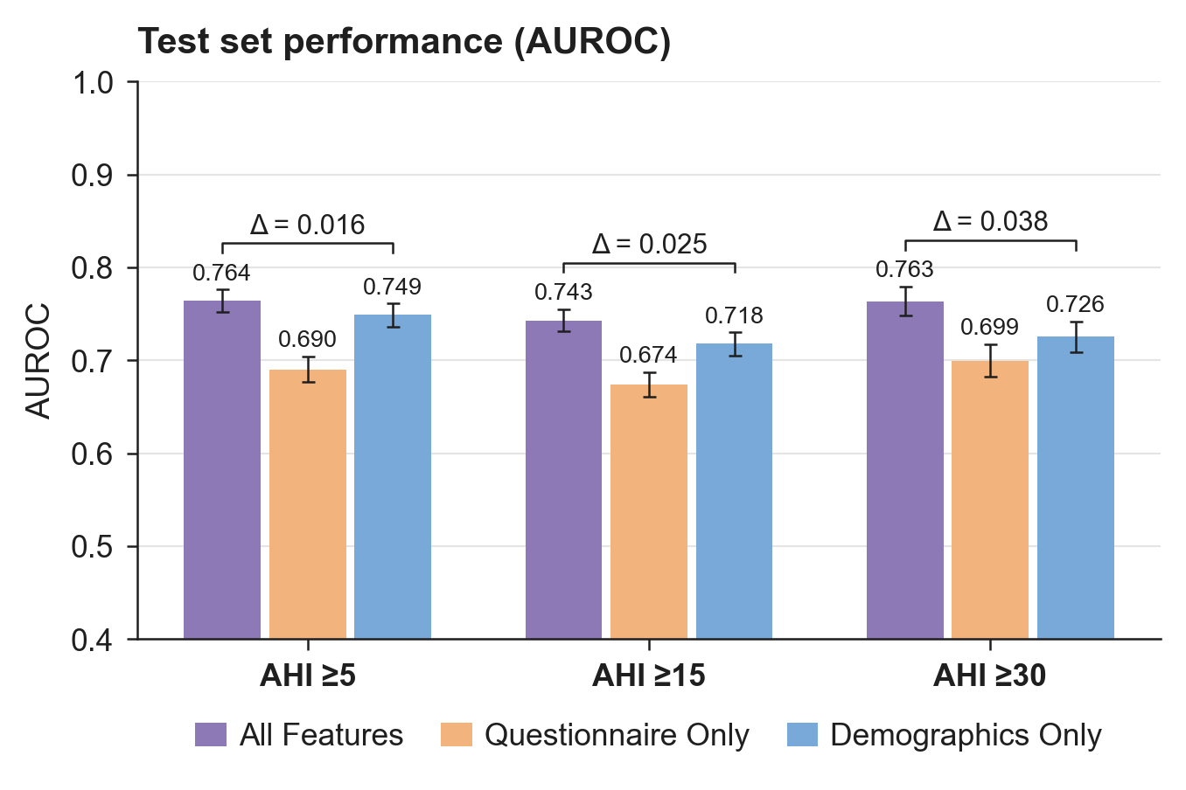
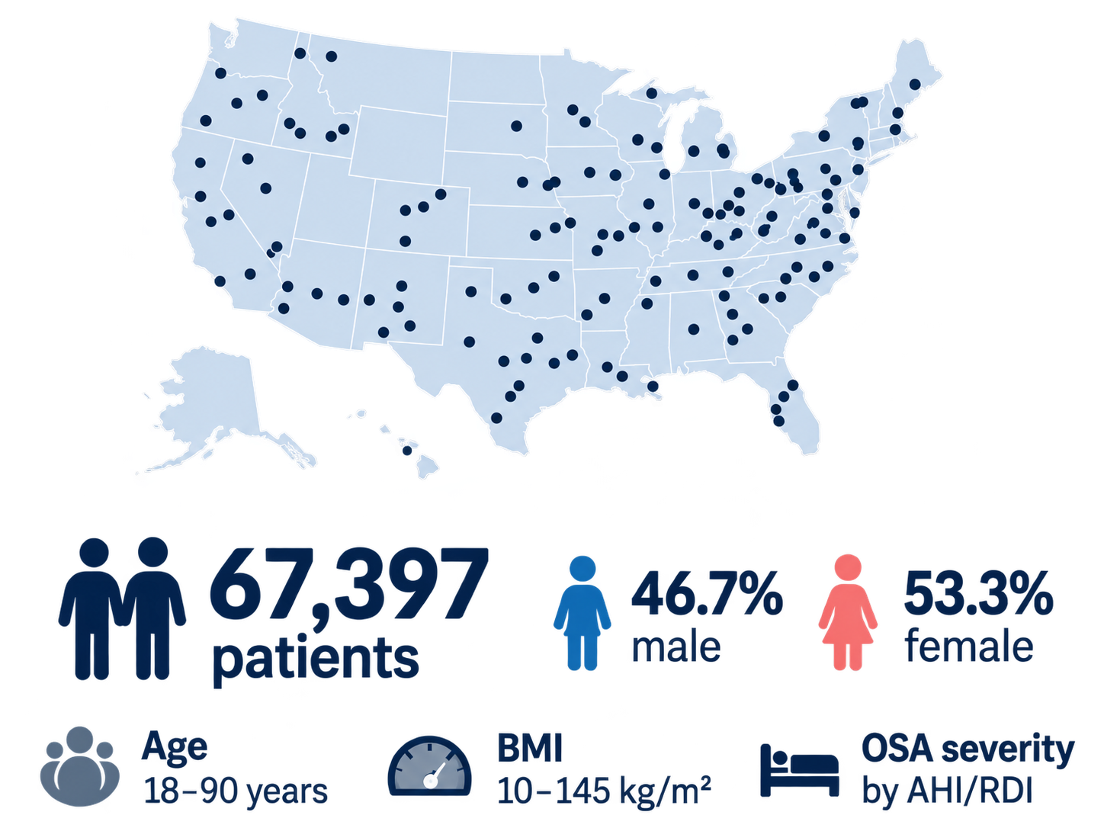
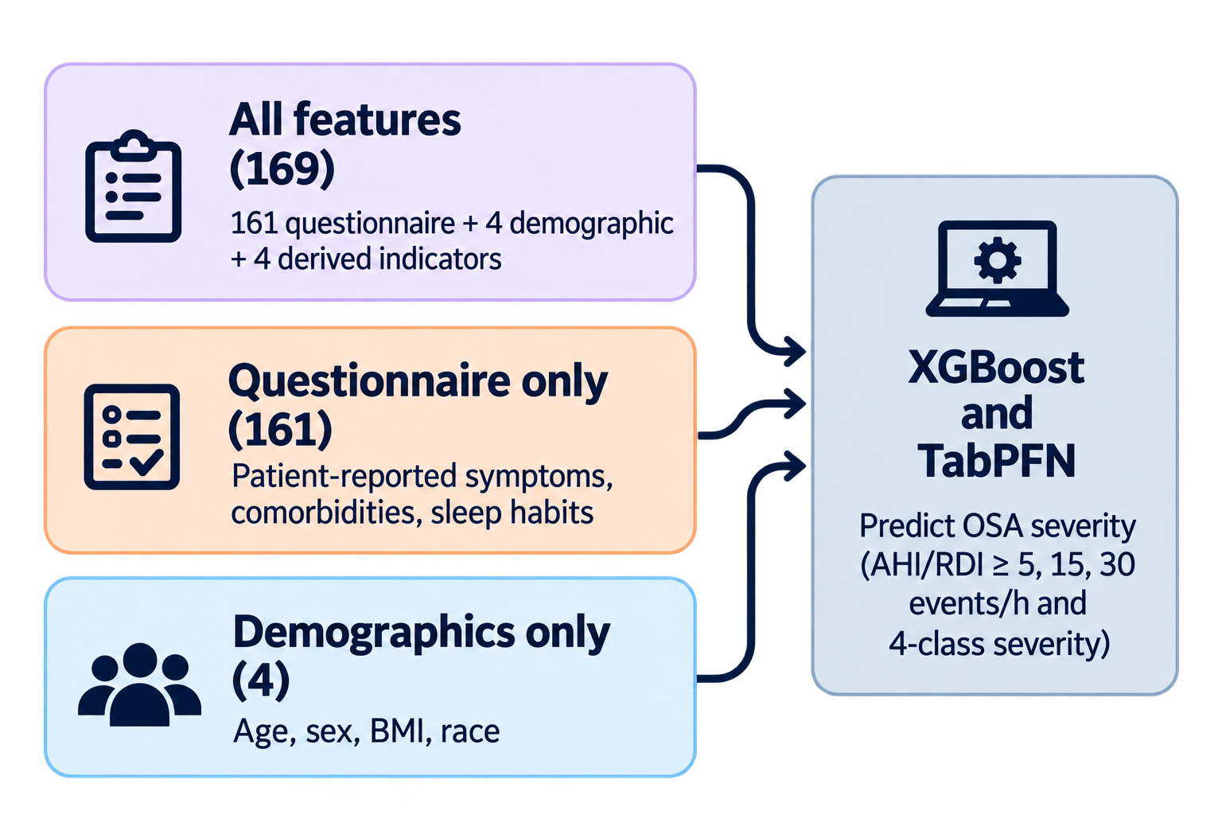
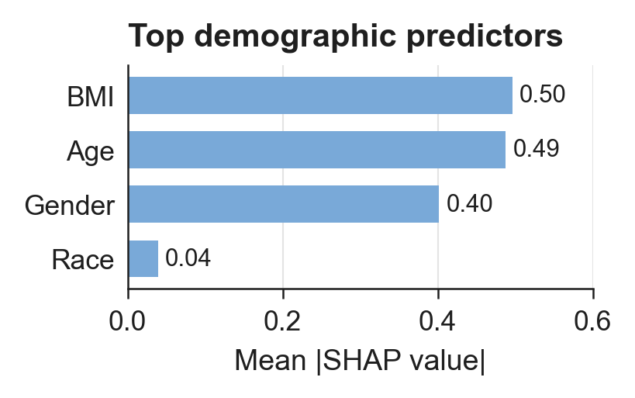
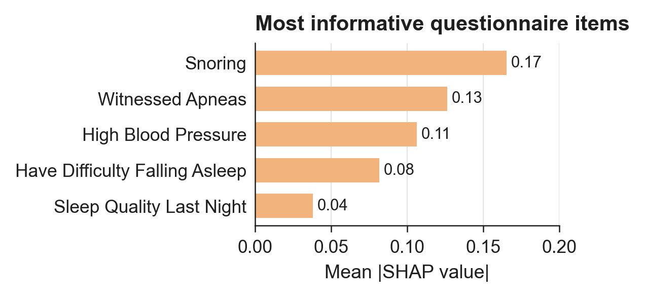
Do sleep questionnaires add predictive value beyond demographics for OSA severity?
Multicenter cohort
Controlled feature comparison
Incremental predictive value
240 facilities, 30 US states, 2004–2019
Prior work and current study
What drives prediction?
Sleep Questionnaires add limited predictive value beyond demographics
Previous machine learning models using sleep questionnaires report a wide range of performance and small sample size, with limited direct comparison to demographics
Gap: limited direct comparisons of questionnaire vs demographic value
Age, BMI, and sex show subgroup-dependent predictive contributions.
0.66–0.96
Prior reported AUROC
mean over AHI ≥5/15/30

Slide 2
Do sleep questionnaires add predictive value beyond demographics for OSA severity?
Multicenter study | 67,397 PSG-evaluated adults | XGBoost + TabPFN
Multicenter cohort
Controlled feature comparison
Incremental predictive value
240 facilities · 30 U.S. states
169
161
4
540,941
source records
All features
Questionnaire
Demographics
Demographics + questionnaires
Symptoms + medical history
Age · sex · BMI · race
67,397
adults with questionnaire + PSG
XGBoost · TabPFN
OSA severity: AHI / RDI
Six binary AHI/RDI endpoints (≥5, ≥15, ≥30)
Prior literature
What drives prediction?
Clinical interpretation
Strongest overall
Demographics retained
Gap: limited direct comparisons of questionnaire vs demographic value
Age · BMI · Sex
86–94%
0.66–0.96
Prior reported AUROC
Questionnaire signals
of above-chance AUROC
High blood pressure · Snoring · Witnessed apneas
Adding 161 questionnaire items improved AUROC by ≤0.038.

Slide 3


