Slide 1
Distributed Systems - Project
Raft Consensus Algorithm
Giorgio Romeo
Daria-Maria Preda

Slide 2
Contents:
Brief Description of Raft
Network elements & Data Structures
Implementation Details
Configuration
Results & Statistics
Scenarios

Slide 3
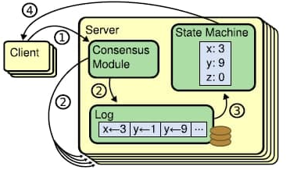
Brief description of Raft
Raft is a consensus algorithm for managing a replicated log. Its two main strong points are:
Strong leader: log entries only flow from the leader to other servers;
Leader election: using randomized timers to elect leaders for resolving conflicts simply and rapidly;
Membership changes: for changing the set of servers uses a new joint consensus approach where the majorities of two different configurations overlap during transitions. This allows the cluster to continue operating
Figure 1: Replicated state machine architecture.

Slide 4

2. Network Elements - Client
Client
Client Data Structure
int addr | client source address
int serialNumber | request message serial number
int servers_number | total number of servers (used to randomly send a request to one of the servers)
int serverLeader | address of the most recent leader
Command currentCommand
simtime_t requestMsgTimeout | timeout to make the client resend a request
cOutVector responseTimeVector | statistics to monitor

Slide 5

2. Network Elements - Server (1)
Server
Server Data Structure
General Parameters | Persistent State on Each Server
int clients_number | int currentTerm = 0
int failureProbability | int currentLeader = -1
int recoveryProbability | int votedFor = -1
int messageLossProbability | int votesNumber = 0
 | list<LogEntry> logEntries
 | list<Command> stateMachine
initial values
+ timeouts!
simtime_t electionTimeout, heartbeatTimeout, appendEntriesTimeout, checkFailureTimeout, checkRecoveryTimeout

Slide 6
2. Network Elements - Server (2)
Server
Volatile state on each server
int commitIndex = 0 | index of highest log entry known to be committed (increases monotonically)
int lastApplied = 0 | index of highest log entry applied to state machine (increases monotonically)
vector<ServerClientRequestInfo> clientRequestInfoVect | for each server, info about the most recent executed client
Volatile state on leader (reinitialized after election)
vector<int> nextIndex | for each server, index of the next log entry to send to that server
vector<int> matchIndex | for each server, index of highest log entry known to be replicated on server
vector<ServerAppendEntriesMsg *> appendEntriesVect | for each server, current appendEntries message sent by the Leader

Slide 7
3. Implementation Details - Messages
3.1. Messages exchanged during an election, between a candidate and other servers:
ServerRequestVoteMsg
int term
int candidateId
int lastLogIndex
int lastLogTerm
ServerReplyVoteMsg
int source
int term (current term of the replying server (for candidate to update itself)
bool voteGranted
CANDIDATE
reply from a server during an election
Notes:
message ServerRequestVoteMsg
{ int term; // candidate’s term
int candidateId; // candidate requesting vote
int lastLogIndex; // index of candidate’s last log entry
int lastLogTerm; // term of candidate’s last log entry}
message ServerReplyVoteMsg
{ int source; // address of the sender server
int term; // current term of the replying server (for candidate to update itself)
bool voteGranted; // true means candidate received vote}

Slide 8
3. Implementation Details - Messages
3.2. Messages exchanged between a client and the servers:
serverReplyClientRequestMsg
int sourceAddr
int destAddr
int leaderAddr (if the request is sent to a FOLLOWER, it replies with the address of the most recent leader known)
int result
int serialNumber (serial number of the request message the Leader is responding to)
clientRequestMsg
int sourceAddr
int destAddr
int serialNumber (to uniquely identify a client request between all the ones sent by the same client)
Cmd command
typedef struct _command{
char var;
int value;
} Command;
server reply to a client
Notes:
message ClientRequestMsg
{ int sourceAddr; // address of the client that sent the request
int destAddr; // address of the server
int serialNumber; // to uniquely identify a client request between all the ones sent by the same client
Cmd command; // command to process}
message ServerReplyClientRequestMsg
{ int sourceAddr; // address of the server replying
int destAddr; // address of the client that sent the request
int leaderAddr; // if client request is sent to a FOLLOWER server, it replies with the address of the most recent leader it knows.
int result; // to simulate the result response of the leader to the client request message
int serialNumber; // serial number of the request message the Leader is responding to
}

Slide 9
3. Implementation Details - Messages
3.3. Messages exchanged to replicate log entries:
ServerAppendEntriesMsg
int term
int leaderId
int prevLogIndex
int prevLogTerm
logList entries (log entries to store; empty for heartbeat, may send more than one for efficiency)
int leaderCommit
ServerReplyAppendEntriesMsg
int source
int term
bool success (true if follower contained entry matching prevLogIndex and prevLogTerm)
bool isHeartbeatReply (true if the server is replying to a Leader heartbeat message; false if replying to a Leader AppendEntries message)
Notes:
message ServerAppendEntriesMsg
{ int term; // leader’s term
int leaderId; // so follower can redirect clients
int prevLogIndex; // index of log entry immediately preceding new ones
int prevLogTerm; // term of prevLogIndex entry
logList entries; // log entries to store (empty for heartbeat; may send more than one for efficiency)
int leaderCommit; // Leader’s commitIndex}
message ServerReplyAppendEntriesMsg
{ int source; // source address
int term; // currentTerm, for leader to update itself
bool success; // true if follower contained entry matching prevLogIndex and prevLogTerm
bool isHeartbeatReply; // true if the server is replying to a Leader heartbeat messagge (false if replying to a Leader AppendEntries message)}

Slide 10
3. Implementation Details
struct _logEntry
int index
int term
Command entryCommand
int source
int serialNumber
enum serverState
FAILED = -1
FOLLOWER = 0
CANDIDATE = 1
LEADER = 2
Notes:
enum serverState {
FAILED = -1,
FOLLOWER = 0,
CANDIDATE = 1,
LEADER = 2
}
struct _logEntry
{
int index; // index of the log entry
int term; // term of the log entry
Command entryCommand; // command of the log entry
int source; // address of the client that sent the command
int serialNumber; // serial number of the request sent by the client ---> in the beginning
}

Slide 11
4. Network Configuration
sim-time-limit = 3000s
repeat = 3
clients_number = 5
client.requestMsgTimeout = normal(7.0s, 1.5s)
cloud.propDelay = uniform(0.1s, 0.3s)
servers_number = ${3, 5, 9}
server.electionTimeout = ${normal(5.0s, 1s), 6s}
server.heartbeatTimeout = 2s
server.appendEntriesTimeout = 4.5s
server.checkFailureTimeout = ${5s, 10s}
server.checkRecoveryTimeout = 1s
server. failureProbability = ${1, 5}
server. recoveryProbability = 7
server. messageLossProbability = {0, 2}

Slide 12
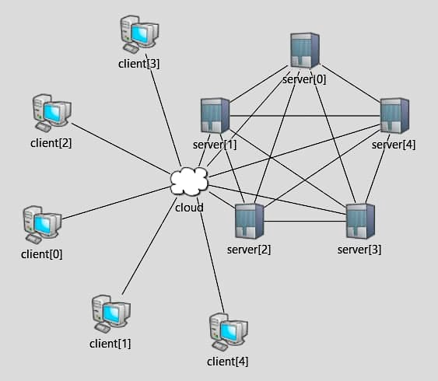
4. Network Configuration
5 Servers
5 Clients
1 Cloud

Slide 13
5. Results & Statistics: why to use randomized election timeouts
Configuration:
clients_number = 5
client.requestMsgTimeout = normal(7.0s, 1.5s)
cloud.propDelay = uniform(0.1s, 0.3s)
servers_number = 3
server.electionTimeout = 6s
server.heartbeatTimeout = 2s
server.appendEntriesTimeout = 4.5s
server.checkFailureTimeout = 5s
server.checkRecoveryTimeout = 1s
server. failureProbability = 1
server. recoveryProbability = 7
server. messageLossProbability = 0

Slide 14
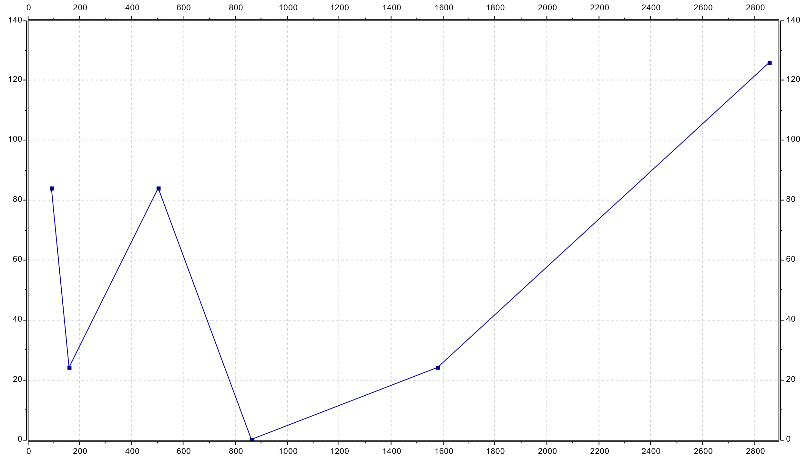
5. Results & Statistics: why to use randomized election timeouts
Mean leader election time
Total_Elections = 6 Mean_Election_Time = 57.07279 s

Slide 15
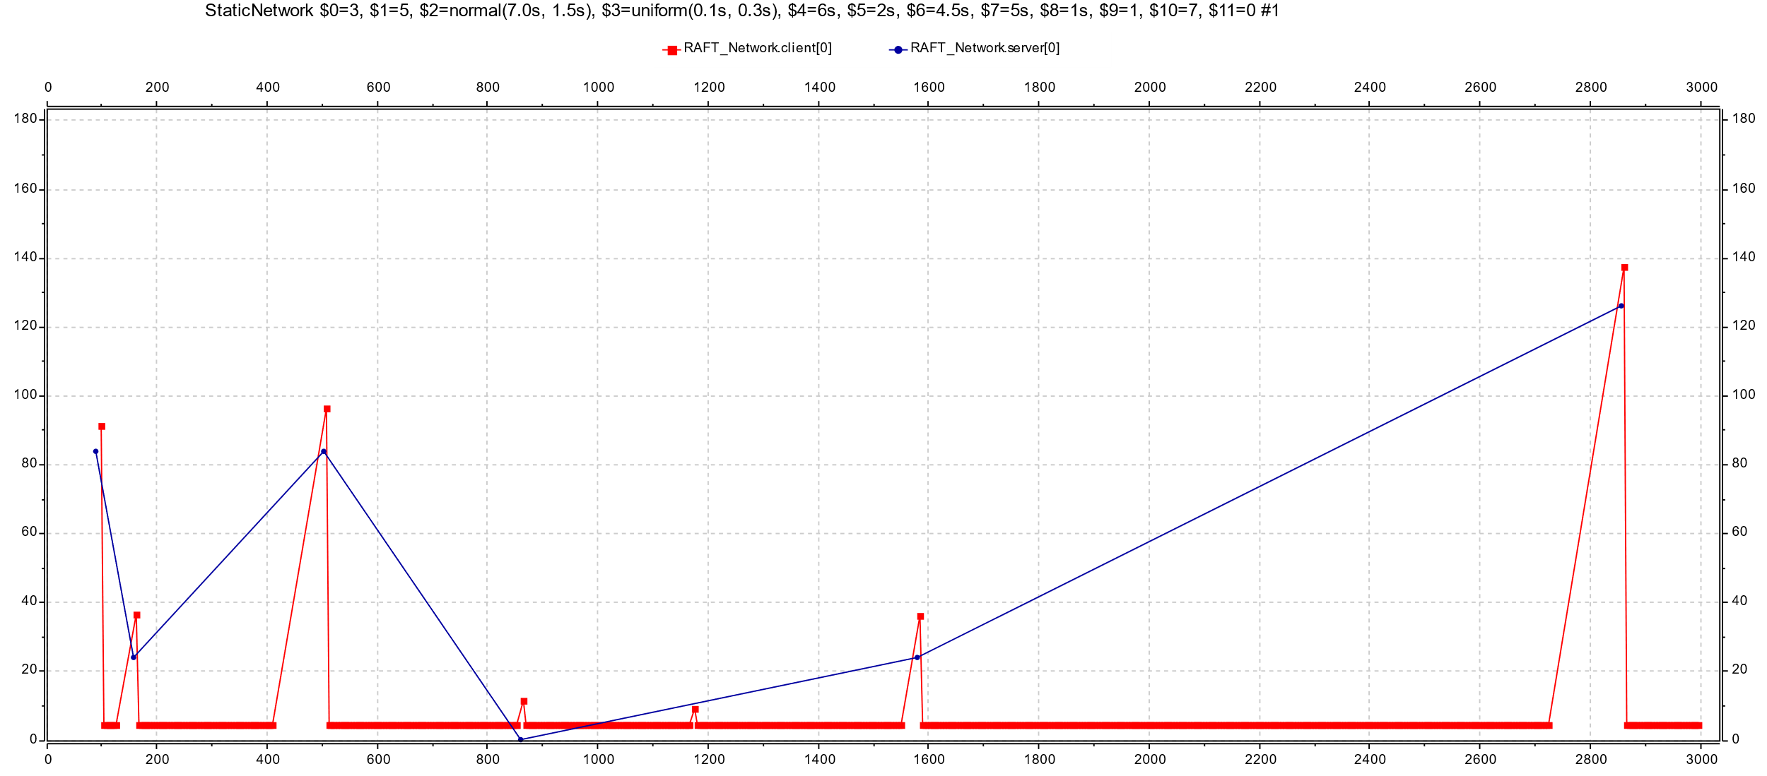
5. Results & Statistics: why to use randomized election timeouts
Mean leader election time - Mean response time to client requests
Total_Elections = 6 Mean_Election_Time = 57.07279 s Total_Responses = 578 Mean_Response_Time = 5.1703076 s

Slide 16
5. Results & Statistics: why to use randomized election timeouts
Configuration:
clients_number = 5
client.requestMsgTimeout = normal(7.0s, 1.5s)
cloud.propDelay = uniform(0.1s, 0.3s)
servers_number = 3
server.electionTimeout = normal(5.0s, 1s)
server.heartbeatTimeout = 2s
server.appendEntriesTimeout = 4.5s
server.checkFailureTimeout = 5s
server.checkRecoveryTimeout = 1s
server. failureProbability = 1
server. recoveryProbability = 7
server. messageLossProbability = 0

Slide 17
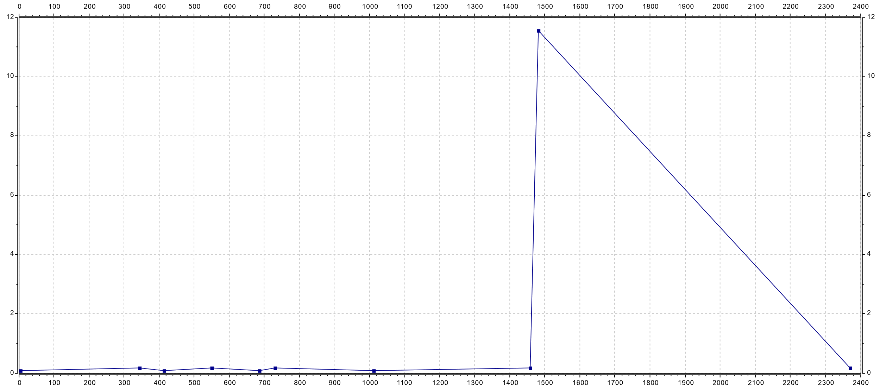
5. Results & Statistics: why to use randomized election timeouts
Mean leader election time
Total_Elections = 10 Mean_Election_Time = 1.27462 s

Slide 18
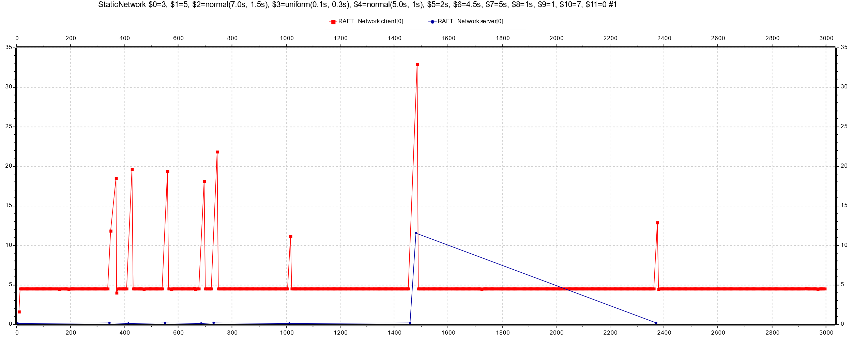
5. Results & Statistics: why to use randomized election timeouts
Mean leader election time - Mean response time to client requests
Total_Elections = 10 Mean_Election_Time = 1.27462 s Total_Responses = 637 Mean_Response_Time = 4.691656 s

Slide 19
5. Results & Statistics: why to use randomized election timeouts (3 servers)
Configuration:
clients_number = 5
client.requestMsgTimeout = normal(7.0s, 1.5s)
cloud.propDelay = uniform(0.1s, 0.3s)
servers_number = 3
server.electionTimeout = 6 s
server.heartbeatTimeout = 2s
server.appendEntriesTimeout = 4.5s
server.checkFailureTimeout = 5s
server.checkRecoveryTimeout = 1s
server. failureProbability = 1
server. recoveryProbability = 7
server. messageLossProbability = 0
Configuration:
clients_number = 5
client.requestMsgTimeout = normal(7.0s, 1.5s)
cloud.propDelay = uniform(0.1s, 0.3s)
servers_number = 3
server.electionTimeout = normal(5.0s, 1s)
server.heartbeatTimeout = 2s
server.appendEntriesTimeout = 4.5s
server.checkFailureTimeout = 5s
server.checkRecoveryTimeout = 1s
server. failureProbability = 1
server. recoveryProbability = 7
server. messageLossProbability = 0
Results averaged over 3 runs:
Mean_Response_Time = 6.35498 s
Total_Responses = 480 Mean_Election_Time = 161.79004 s
Total_Elections = 6
Results averaged over 3 runs:
Mean_Response_Time = 4.64554 s
Total_Responses = 643.93333
Mean_Election_Time = 2.17914 s
Total_Elections = 8

Slide 20
5. Results & Statistics: why to use randomized timeouts (3 servers, failureProbability = 5%)
Configuration:
clients_number = 5
client.requestMsgTimeout = normal(7.0s, 1.5s)
cloud.propDelay = uniform(0.1s, 0.3s)
servers_number = 3
server.electionTimeout = 6 s
server.heartbeatTimeout = 2s
server.appendEntriesTimeout = 4.5s
server.checkFailureTimeout = 5s
server.checkRecoveryTimeout = 1s
server. failureProbability = 5
server. recoveryProbability = 7
server. messageLossProbability = 0
Configuration:
clients_number = 5
client.requestMsgTimeout = normal(7.0s, 1.5s)
cloud.propDelay = uniform(0.1s, 0.3s)
servers_number = 3
server.electionTimeout = normal(5.0s, 1s)
server.heartbeatTimeout = 2s
server.appendEntriesTimeout = 4.5s
server.checkFailureTimeout = 5s
server.checkRecoveryTimeout = 1s
server. failureProbability = 5
server. recoveryProbability = 7
server. messageLossProbability = 0
Results averaged over 3 runs:
Mean_Response_Time = 6.95388 s
Total_Responses = 433 Mean_Election_Time = 41.65734 s
Total_Elections = 24
Results averaged over 3 runs:
Mean_Response_Time = 5.8001 s
Total_Responses = 518
Mean_Election_Time = 15.16024 s
Total_Elections = 25

Slide 21
5. Results & Statistics: why to use randomized timeouts (number of servers increased to 5)
Configuration:
clients_number = 5
client.requestMsgTimeout = normal(7.0s, 1.5s)
cloud.propDelay = uniform(0.1s, 0.3s)
servers_number = 5
server.electionTimeout = 6 s
server.heartbeatTimeout = 2s
server.appendEntriesTimeout = 4.5s
server.checkFailureTimeout = 5s
server.checkRecoveryTimeout = 1s
server. failureProbability = 5
server. recoveryProbability = 7
server. messageLossProbability = 0
Configuration:
clients_number = 5
client.requestMsgTimeout = normal(7.0s, 1.5s)
cloud.propDelay = uniform(0.1s, 0.3s)
servers_number = 5
server.electionTimeout = normal(5.0s, 1s)
server.heartbeatTimeout = 2s
server.appendEntriesTimeout = 4.5s
server.checkFailureTimeout = 5s
server.checkRecoveryTimeout = 1s
server. failureProbability = 5
server. recoveryProbability = 7
server. messageLossProbability = 0
Results averaged over 3 runs:
Mean_Response_Time = 20.12901 s
Total_Responses = 119.93333
Mean_Election_Time = 292.622206 s
Total_Elections = 7
Results averaged over 3 runs:
Mean_Response_Time = 4.97557 s
Total_Responses = 600.26667
Mean_Election_Time = 1.34867 s
Total_Elections = 29.66667

Slide 22
5. Results & Statistics: why to use randomized timeouts (number of server increased to 9)
Configuration:
clients_number = 5
client.requestMsgTimeout = normal(7.0s, 1.5s)
cloud.propDelay = uniform(0.1s, 0.3s)
servers_number = 9
server.electionTimeout = 6 s
server.heartbeatTimeout = 2s
server.appendEntriesTimeout = 4.5s
server.checkFailureTimeout = 5s
server.checkRecoveryTimeout = 1s
server. failureProbability = 5
server. recoveryProbability = 7
server. messageLossProbability = 0
Configuration:
clients_number = 5
client.requestMsgTimeout = normal(7.0s, 1.5s)
cloud.propDelay = uniform(0.1s, 0.3s)
servers_number = 9
server.electionTimeout = normal(5.0s, 1s)
server.heartbeatTimeout = 2s
server.appendEntriesTimeout = 4.5s
server.checkFailureTimeout = 5s
server.checkRecoveryTimeout = 1s
server. failureProbability = 5
server. recoveryProbability = 7
server. messageLossProbability = 0
Results averaged over 3 runs:
Mean_Response_Time = N/A
Total_Responses = N/A
Mean_Election_Time = N/A
Total_Elections = N/A
Results averaged over 3 runs:
Mean_Response_Time = 4.99308 s
Total_Responses = 585.93333
Mean_Election_Time = 0.39129 s
Total_Elections = 29.33333

Slide 23
5. Results & Statistics: fixed number of servers, increasing failure probability
Configuration:
clients_number = 5
client.requestMsgTimeout = normal(7.0s, 1.5s)
cloud.propDelay = uniform(0.1s, 0.3s)
servers_number = 5
server.electionTimeout = normal(5.0s, 1s)
server.heartbeatTimeout = 2s
server.appendEntriesTimeout = 4.5s
server.checkFailureTimeout = 25s
server.checkRecoveryTimeout = 1s
server. failureProbability = 1
server. recoveryProbability = 7
server. messageLossProbability = 2
Configuration:
clients_number = 5
client.requestMsgTimeout = normal(7.0s, 1.5s)
cloud.propDelay = uniform(0.1s, 0.3s)
servers_number = 5
server.electionTimeout = normal(5.0s, 1s)
server.heartbeatTimeout = 2s
server.appendEntriesTimeout = 4.5s
server.checkFailureTimeout = 10s
server.checkRecoveryTimeout = 1s
server. failureProbability = 1
server. recoveryProbability = 7
server. messageLossProbability = 2
Configuration:
clients_number = 5
client.requestMsgTimeout = normal(7.0s, 1.5s)
cloud.propDelay = uniform(0.1s, 0.3s)
servers_number = 5
server.electionTimeout = normal(5.0s, 1s)
server.heartbeatTimeout = 2s
server.appendEntriesTimeout = 4.5s
server.checkFailureTimeout = 5s
server.checkRecoveryTimeout = 1s
server. failureProbability = 1
server. recoveryProbability = 7
server. messageLossProbability = 2
Results averaged over 3 runs:
Mean_Response_Time = 4.69285 s
Total_Responses = 637.6
Mean_Election_Time = 0.4427 s
Total_Elections = 6.66667
Results averaged over 3 runs:
Mean_Response_Time = 4.70468 s
Total_Responses = 638.66667
Mean_Election_Time = 0.07404 s
Total_Elections = 6.7
Results averaged over 3 runs:
Mean_Response_Time = 4.71026 s
Total_Responses = 634.86667
Mean_Election_Time = 0.7794 s
Total_Elections = 7

Slide 24
5. Results & Statistics: fixed number of servers, increasing failure probability
Configuration:
clients_number = 5
client.requestMsgTimeout = normal(7.0s, 1.5s)
cloud.propDelay = uniform(0.1s, 0.3s)
servers_number = 5
server.electionTimeout = normal(5.0s, 1s)
server.heartbeatTimeout = 2s
server.appendEntriesTimeout = 4.5s
server.checkFailureTimeout = 25s
server.checkRecoveryTimeout = 1s
server. failureProbability = 5
server. recoveryProbability = 7
server. messageLossProbability = 2
Configuration:
clients_number = 5
client.requestMsgTimeout = normal(7.0s, 1.5s)
cloud.propDelay = uniform(0.1s, 0.3s)
servers_number = 5
server.electionTimeout = normal(5.0s, 1s)
server.heartbeatTimeout = 2s
server.appendEntriesTimeout = 4.5s
server.checkFailureTimeout = 10s
server.checkRecoveryTimeout = 1s
server. failureProbability = 5
server. recoveryProbability = 7
server. messageLossProbability = 2
Configuration:
clients_number = 5
client.requestMsgTimeout = normal(7.0s, 1.5s)
cloud.propDelay = uniform(0.1s, 0.3s)
servers_number = 5
server.electionTimeout = normal(5.0s, 1s)
server.heartbeatTimeout = 2s
server.appendEntriesTimeout = 4.5s
server.checkFailureTimeout = 5s
server.checkRecoveryTimeout = 1s
server. failureProbability = 5
server. recoveryProbability = 7
server. messageLossProbability = 2
Results averaged over 3 runs:
Mean_Response_Time = 4.77813 s
Total_Responses = 626.4
Mean_Election_Time = 0.78457 s
Total_Elections = 12.33
Results averaged over 3 runs:
Mean_Response_Time = 4.87761 s
Total_Responses = 613.46667
Mean_Election_Time = 0.74284 s
Total_Elections = 20
Results averaged over 3 runs:
Mean_Response_Time = 5.22675 s
Total_Responses = 571.73333
Mean_Election_Time = 1.85236 s
Total_Elections = 27

Slide 25
5. Results & Statistics: fixed failure probability, increasing number of servers
Configuration:
clients_number = 5
client.requestMsgTimeout = normal(7.0s, 1.5s)
cloud.propDelay = uniform(0.1s, 0.3s)
servers_number = 3
server.electionTimeout = normal(5.0s, 1s)
server.heartbeatTimeout = 2s
server.appendEntriesTimeout = 4.5s
server.checkFailureTimeout = 5s
server.checkRecoveryTimeout = 1s
server. failureProbability = 5
server. recoveryProbability = 7
server. messageLossProbability = 2
Configuration:
clients_number = 5
client.requestMsgTimeout = normal(7.0s, 1.5s)
cloud.propDelay = uniform(0.1s, 0.3s)
servers_number = 5
server.electionTimeout = normal(5.0s, 1s)
server.heartbeatTimeout = 2s
server.appendEntriesTimeout = 4.5s
server.checkFailureTimeout = 5s
server.checkRecoveryTimeout = 1s
server. failureProbability = 5
server. recoveryProbability = 7
server. messageLossProbability = 2
Configuration:
clients_number = 5
client.requestMsgTimeout = normal(7.0s, 1.5s)
cloud.propDelay = uniform(0.1s, 0.3s)
servers_number = 9
server.electionTimeout = normal(5.0s, 1s)
server.heartbeatTimeout = 2s
server.appendEntriesTimeout = 4.5s
server.checkFailureTimeout = 5s
server.checkRecoveryTimeout = 1s
server. failureProbability = 5
server. recoveryProbability = 7
server. messageLossProbability = 2
Results averaged over 3 runs:
Mean_Response_Time = 5.48449 s
Total_Responses = 545.06667
Mean_Election_Time = 5.21581 s
Total_Elections = 28.33333
Results averaged over 3 runs:
Mean_Response_Time = 5.22675 s
Total_Responses = 571.73333
Mean_Election_Time = 1.85236 s
Total_Elections = 27
Results averaged over 3 runs:
Mean_Response_Time = 5.0305 s
Total_Responses = 594.86667
Mean_Election_Time = 0.74552 s
Total_Elections = 30.33333

Slide 26
6. Scenarios
Two server begin an election phase with the same term
(StaticNetwork-3,5,normal(7.0s,_1.5s),uniform(0.1s,_0.3s),normal(5.0s,_1s),2s,4.5s,5s,1s,5,7,2, repet=0, time = begin)
Leader election failing because majority is not reached (3/5 servers failed), 2/3 servers recover, subsequent leader election succeeds because the majority of 3 servers is achieved
(StaticNetwork-5,5,normal(7.0s,_1.5s),uniform(0.1s,_0.3s),normal(5.0s,_1s),2s,4.5s,5s,1s,5,7,0, repet=1, time = 1585 s)
Stuck leader election because one server sends requestVote to the other two servers but its log entries is not as updated as the other ones, thus the requestVote fail
(StaticNetwork-3,5,normal(7.0s,_1.5s),uniform(0.1s,_0.3s),normal(5.0s,_1s),2s,4.5s,5s,1s,5,7,0, repet=2, time = 1800 s)
RequestVote not granted because candidate currentTerm is less than the one of the replying server
(StaticNetwork-5,5,normal(7.0s,_1.5s),uniform(0.1s,_0.3s),normal(5.0s,_1s),2s,4.5s,5s,1s,5,7,0, repet=1, time = 2615 s, server_0
is candidate)

Slide 27
Thank you!

