Slide 1
a)
b)
c)

Slide 2
Function Call graph for H264
scale_residual4x4_and_trans_inverse
ProcessSlice
decode_main
process_luma
process_croma
Clip3
showbits
TrailingOnes_TotalCoeff
residual_block_cavlc_16

Slide 3
scale_residual4x4_and_trans_inverse
prediction_Chroma
residual_block_cavlc_16
inter_prediction_chroma_subblock_double
ACCELSEEKER

Slide 4
scale_residual4x4_and_trans_inverse
inter_luma_double_bitzero_skip
copy_V
TrailingOnes_TotalCoeff
Clip3
showbits
total_zeroes
GPROF1
inter_prediction_chroma_subblock_double
run_before

Slide 5
residual_block_cavlc_16
GPROF2

Slide 6
scale_residual4x4_and_trans_inverse
inter_luma_double_bitzero_skip
Clip1y
Clip3
residual_block_cavlc_16
inter_prediction_chroma_subblock_double
GPROF3

Slide 7
A
B
A
C
a)
b)
c)

Slide 8
conflict graph
A
C
A
B
C
b)
B
A
C
B
a)
c)

Slide 9
call graph
conflict graph
maximum independent sets
1
2
3
4
4
4
5
6
7
5
2
1
3
8
7
5
2
1
3
8
6
6
7
8
C_max = 40
(merit: 800
cost: 40)
a)
b)
C_max = 25
(merit: 700
cost: 24)
AccelCand | 1 | 2 | 3 | 4 | 5 | 6 | 7 | 8
Merit | 900 | 800 | 150 | 50 | 300 | 400 | 100 | 50
Cost | 100 | 40 | 60 | 20 | 12 | 12 | 10 | 30
d)
c)

Slide 10
cr.path(BB1)
BB1
#exec(BB1)
BB2
BB3
candidate
. . . . . . . .
-
+
BB4
f1()
*
*
cr.path(BB5)
f2()
f3()
f4()
cr. path
-
+
BB5
#exec(BB5)
*
BB6
. . . .
f5()
a)
b)
c)

Slide 11
Application
source code
Set of selected
AccelCands
AccelSeeker
A
AccelCand list,
Conflict Graph
C
AccelCand
Identification
and Compiler
Analysis
Selection
algorithm
AccelCand list,
Basic blocks frequency,
CFGs,
DFGs, [….]
B
M() and C()
estimation
M and C
of each
AccelCand
Architectural
characterization
C_max

Slide 12
End of figures considered by the gen-figs script (names of figures given in figs.txt)

Slide 13
conflict graph
A
C
A2
A
B
A1
C2
C
b)
C1
B
A
B1
C
B
B2
a)
c)
d)

Slide 14
Architectural
characterization
C_max
AccelCands list,
bb frequency,
CDFGs
[….]
Set of
selected
AccelCands
application
source
code
Accelseeker
Compiler
Analysis
Accelseeker
M() and C()
estimation
Accelseeker
Selection
algorithm
M() and C()
of each
AccelCand
Conflict Graph
AccelSeeker
Experimental
Validation
with SDSOC
LLVM passes
LLVM passes
Manual selection of accelerators
according to profiling information only
Set of manually
selected
accelerators
Baseline strategy for comparison
Obtained speedup

Slide 15
Architectural
characterization
C_max
AccelCands list,
bb frequency,
CDFGs
[….]
Set of
selected
AccelCands
application
source
code
AccelCand
Identification
and Compiler
Analysis
M() and C()
estimation
Selection
algorithm
3
1
M() and C()
of each
AccelCand
2
Conflict Graph
AccelSeeker

Slide 16
Architectural
characterization
AccelSeeker
C_max
AccelCands list,
Application
Source
code
Accelseeker
Selection
algorithm
Accelseeker
LLVM passes
M() of each,
Set of selected
AccelCands
C() of each,
Experimental
Validation
Conflict Grapn
LLVM passes
Validation, with
SDSOC Costs
and Merits
Manual selection of accelerators
according to profiling information only
(baseline strategies gprof1, gprof2, gprof3)
LLVM passes
selected
accelerators
Obtained speedup
Baseline strategy for comparison

Slide 17
Region (Merit, Cost)
A (10,4)
B (20,8)
4
F (70,30)
7
5
2
1
3
8
6
E (60,10)
D (20,2)
C (100,30)
Results of selection:
4
Max Cost = 4 → Selected: {D} (Merit: 20)
Max Cost = 20 → Selected: {B, E} (Merit: 80)
Max Cost = 40 → Selected: {C, E} (Merit: 160)
5
2
1
3
8
6
7

Slide 18
call graph
conflict graph
1 100 110
2 90 20
5 80
80 30
5 1 20
6 1 20
7 10 10
8 5 15
1
2
3
4
4
5
6
7
5
2
1
3
8
6
7
8
Cands | 1 | 2 | 3 | 4 | 5 | 6 | 7 | 8
Merit | 100 | 200 | 300
Cost | 20 | 40 | 50

Slide 19
1
conflict graph
3
A
2
C
A2
B
A1
C2
4
5
6
b)
C1
A
B1
C
B
B2
a)
c)
d)

Slide 20
A
A2
C
A1
A
B
C2
C
b)
C1
B
A
B1
C
B
B2
a)
c)
d)

Slide 23
SELECTION FOR ACCELSEEKER 20k
scale_residual4x4_and_trans_inverse
TrailingOnes_TotalCoeff
inter_prediction_chroma_subblock_double

Slide 24
SELECTION FOR GPROF3 20k
scale_residual4x4_and_trans_inverse
Clip1y
Clip3
residual_block_cavlc_16

Slide 25
A2
A
A1
C2
C
C1
B
B1
B2

Slide 26
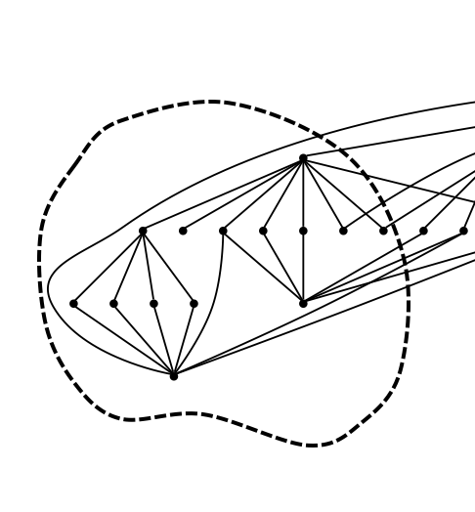
a)
b)
c)

Slide 28
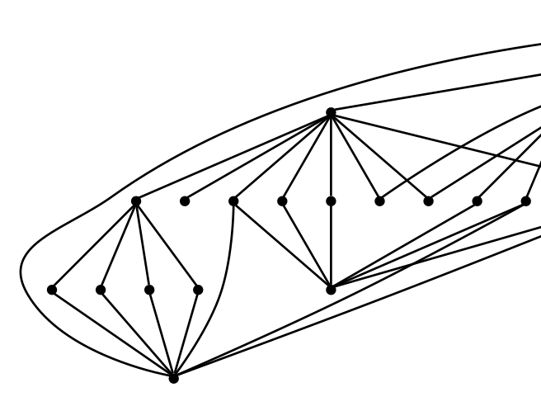
a)
b)
c)

Slide 29
Clip1y
showbits
Clip3
byte_reverse_32

Slide 30
scale_residual4x4_and_trans_inverse
Clip1y
showbits
Clip3
byte_reverse_32

Slide 33
A
B
A
C
a)
b)
c)

