Slide 1
MLCB TEAM PROJECT
Communication-Aware Machine Learning
for Major Depressive Disorder
Testing a microglia → neuron communication axis from single-nucleus RNA-seq of the human prefrontal cortex
Giorgos Boulogeorgos · Andreas Mici
Re-analysis of Maitra et al. (2023), Nature Communications 14, 2912
National and Kapodistrian University of Athens · MSc in Data Science and Information Technologies · Supervisor: Prof. E. Manolakos · June 2026
Notes:
Title. One line: we take two sex-specific MDD findings from Maitra 2023 and ask whether they are actually two ends of one cell-cell communication axis. Honest, leakage-controlled answer at the end.

Slide 2
BACKGROUND
Two cell types, two sexes — reported separately
Major depressive disorder (MDD) has a poorly resolved molecular substrate in the human brain. Single-nucleus RNA-seq of the dorsolateral prefrontal cortex lets us ask which cell types carry the disease signal.
FEMALES Microglia (cluster Mic1)
Maitra et al. (2023) profiled ~160,000 nuclei from 71 donors and found the strongest case/control differences in:
MALES Deep-layer neuron (ExN10_L46)
Presented as two distinct, sex-specific results.
1
Notes:
Maitra found microglia drive the signal in females, a deep-layer excitatory neuron in males. They framed these as two separate sex-specific findings. Set up the tension: are they really unrelated?

Slide 3
OUR HYPOTHESIS
Not two findings — one axis
Microglia sender
ExN10_L46 deep-layer neuron
receiver
ligand → receptor signalling
The apparent sex-specificity is partly an artefact of per-cluster differential expression, which treats each cell type in isolation and cannot see a signal that lives between cell types.
Notes:
The core idea. If microglia (sender) signal to deep-layer neurons (receiver), then a DEG analysis looking at each cell type alone would see the microglial end in females and the neuronal end in males and call them separate. Explicitly modelling communication should expose one shared axis active in both sexes.

Slide 4
APPROACH
An end-to-end, checkpointed pipeline
A
B
C
D
Reproduction
Communication
Machine learning
Interpretation
Load & annotate ~160k nuclei; confirm the cell-type signal
Per-donor LIANA → 4D tensor → 5 programs (CP decomposition)
3 feature sets, rigorous nested CV, 5 estimators
SHAP + directed hypothesis test on Factor 4
Each expensive step is checkpointed — a runtime timeout never costs more than one step.
2
Notes:
Four phases. A: reproduce. B: infer communication and compress to 5 programs. C: the ML comparison. D: interpret. Everything checkpointed because runs were long.

Slide 5
DATA
71 donors — and one confound that shaped everything
71
37 / 34
THE CONFOUND TO TRACK
donors (the CV unit)
MDD / Control
Sex is perfectly confounded with cohort/library: females = GSE213982, males = GSE144136.
38 / 33
160,711
Any train-on-one-sex / test-on-the-other split is also a train/test across-batch split — so a failure to generalise could be batch, not biology.
female / male
high-quality nuclei
This single fact reshaped the entire evaluation design (no leave-one-sex-out).
3
Notes:
71 donors, balanced labels. The killer detail: the two sexes come from two separate GEO datasets, so sex and batch are the same variable. We cannot do cross-sex testing — it would confound biology with batch. This drove us to within-sex value-add evaluation.

Slide 6
PHASE A · REPRODUCTION
Confirm the cell-type signal, leakage-aware
Annotations already validated
We do not re-cluster (stochastic); the authors' QC and cell-type labels are reused, baked into each cell ID.
HONEST CAVEAT
Nucleus-level Wilcoxon pseudoreplicates — nuclei from one donor are not independent, inflating “significant” DEG counts.
DEG sanity check passes
Mic1 (female): synaptic/adhesion genes up. ExN10_L46 (male): metabolic/synaptic genes (GAPDH, PKM, CKB, VAMP2, SNCB) down.
Fix: all definitive donor-level statistics downstream use pseudobulk — exactly why the authors did too.
4
Notes:
Phase A is lean because the authors already annotated. We sanity-check the DEG signal at nucleus level but flag pseudoreplication honestly, and use donor-level pseudobulk everywhere that matters.

Slide 7
PHASE B · COMMUNICATION
From ligand–receptor scores to 5 programs
1
2
3
4
Per-donor LIANA
4D tensor
−log10 magnitude
Non-negative CP
rank_aggregate.by_sample gives each of the 71 donors its own L–R scores (not per-condition, which would be degenerate).
71 donors × 1650 L–R pairs × 8 senders × 8 receivers. Masked slices left as NaN (borrow strength, not impute).
magnitude_rank (small = strong) transformed so large = strong, matching LIANA's convention.
PARAFAC, elbow-selected rank 5 → five communication programs; a donor's loading = how active that program is.
Methodology shift: LIANA (Python) instead of CellChat (R) — native per-donor inference, no fragile rpy2 setup.
5
Notes:
Phase B in four moves. Per-donor LIANA (per-condition would be degenerate — every donor in a group gets an identical vector). Arrange as a 4D tensor. The -log10 transform was a real bug we caught: without it the factors inverted and two linear models collapsed to chance. Then non-negative CP, rank 5 by elbow.

Slide 8
PHASE B · THE FIVE PROGRAMS
One program is diagnosis-leaning and cohort-clean
Factor | Program (sender → receiver) | p(diagnosis) | p(sex/cohort) | note
1 | ExN → ExN | 0.348 | 0.778 | no signal
2 | ExN → Ast/OPC | 0.398 | 0.0025 | cohort/batch
3 | OPC/Ast → mixed | 0.479 | 0.0002 | cohort/batch
4 | End + Mic → ExN10_L46 | 0.057 | 0.108 | hypothesis program
5 | mixed → End | 0.886 | 0.00002 | cohort/batch
Why Factor 4: the microglia-sender × ExN10_L46-receiver product is 0.40 × 0.54 ≈ 0.22 — far above any other factor. Selected a priori by biology, not by p-value. The batch confound self-segregates into Factors 2/3/5.
6
Notes:
Five programs. Factors 2/3/5 are strongly sex/cohort-linked and diagnosis-null — the batch confound conveniently isolates itself there. Factor 4 is the only diagnosis-leaning, cohort-clean one, and it is exactly the microglia->ExN10_L46 axis we pre-specified. p=0.057 is a trend, not significance — say so. Note its top sender is actually Endothelial; we address that in limitations.

Slide 9
PHASE C · MACHINE LEARNING
Three feature sets, one decisive comparison
Expression-only
Communication-only
Combined
Per-cell-type pseudobulk (logCPM). The baseline.
The 5 factor loadings.
Pseudobulk + 5 factors. The decisive test.
Communication is computed from expression (a ligand's “signal” is its gene expression), so the two are not independent — which is exactly why the combined comparison is the decisive test of whether communication adds anything.
Validation: repeated nested CV (3×5×3, 20 Optuna trials), 5 estimators, bootstrap 95% CIs. Leakage rules: CV unit = donor (M24 merged); all feature selection fit in-fold; tensor re-fit inside each fold for the headline numbers.
7
Notes:
Three feature sets. The key conceptual point: communication is derived FROM expression, so combined-vs-expression is the real test. Rigorous nested CV with strict leakage rules — crucially we re-fit the tensor inside each fold so held-out donors never shape the factors. Stratify by sex x diagnosis so no fold crosses batch.

Slide 10
RESULTS · DONOR-LEVEL CLASSIFICATION
Expression wins; combined never separates
Estimator | Communication | Expression | Combined
LR | 0.633 | 0.646 | 0.694
GNB | 0.633 | 0.643 | 0.673
LDA | 0.633 | 0.667 | 0.653
RF | 0.536 | 0.688 | 0.667
XGB | 0.490 | 0.714 | 0.714
0.714 → 0.714 best model (XGB): identical with or without factors
VALUE-ADD (combined − expression)
Positive on average but not CI-separated: LR +0.048, GNB +0.031; LDA/RF slightly negative; XGB flat.
Median AUC, rigorous nested CV. Communication-only: linear models ≈ 0.633, trees at chance.
Honest read: communication carries weak real signal (linear models only) but adds no statistically demonstrable value beyond expression at n = 71.
8
Notes:
The results table. Read it in two beats. One: communication-only — linear models reach 0.633 (real but weak), trees collapse to chance because 5 features are too few for them. Two: the decisive column — combined never CI-separates from expression. XGB is literally 0.714 to 0.714. The honest read: weak real signal, no demonstrable added value at this n.

Slide 11
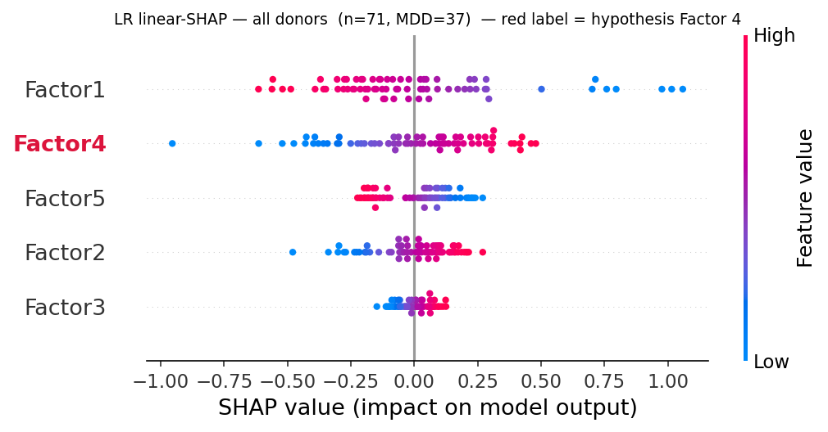
PHASE D · DOES FACTOR 4 TRACK MDD?
Higher in MDD donors of both sexes
0.632
0.702
0.578
AUC · overall
AUC · males · p=0.05
AUC · females · p=0.42
Communication-only LR SHAP (all donors). Factor 4 in red.
Standalone, the program discriminates MDD with AUC 0.632, concentrated in males. SHAP ranks Factor 4 #2 of 5 — comparably across sexes (F 0.234, M 0.227); high values push the prediction toward MDD.
9
Notes:
Step 4, first angle. Factor 4 is higher in MDD in both sexes — consistent direction, which is the shared-axis prediction. The effect is stronger in males (0.702, borderline p=0.05) than females. In the SHAP beeswarm, red (high Factor 4) sits on the positive/MDD side.

Slide 12
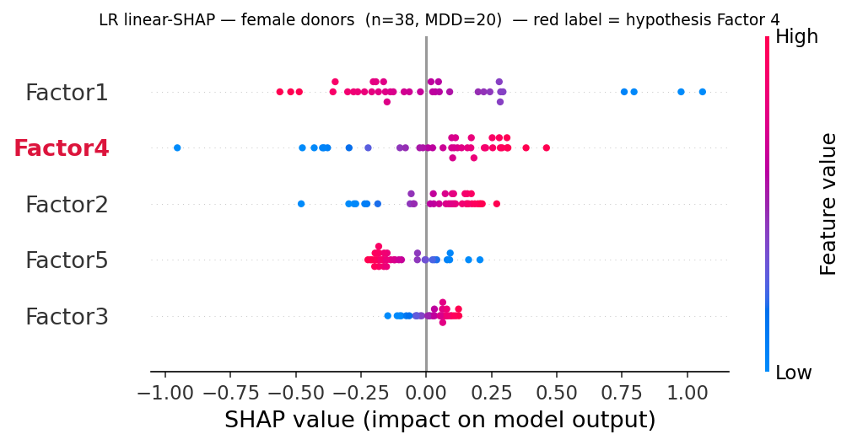
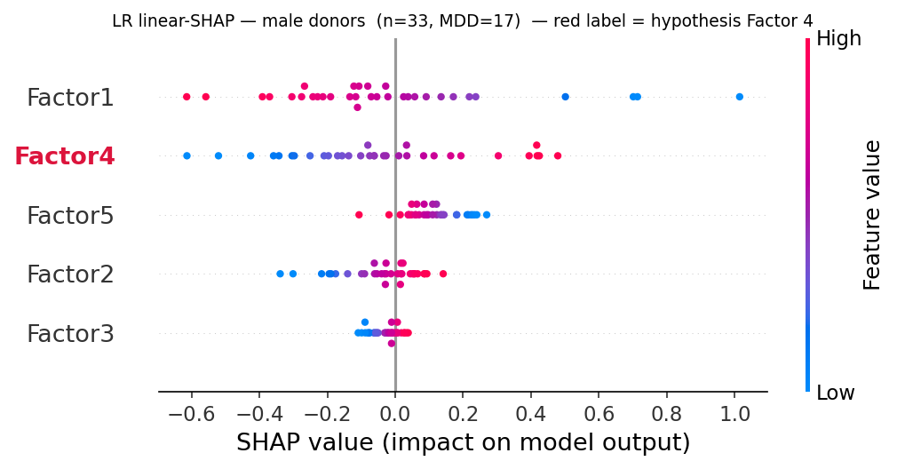
PHASE D · SHARED ACROSS SEXES
Factor 4 carries weight in females and males alike
Female donors (n = 38)
Male donors (n = 33)
The hypothesis program is not a male-only artefact: Factor 4 (red) sits among the top contributors in both sexes, with high values on the MDD side — the signature of a shared axis, not two unrelated findings.
10
Notes:
Same story split by sex. Factor 4 is a top contributor in both — this is the visual core of the shared-axis claim. If it were purely male-driven we would not expect it ranked highly in the female panel too.

Slide 13
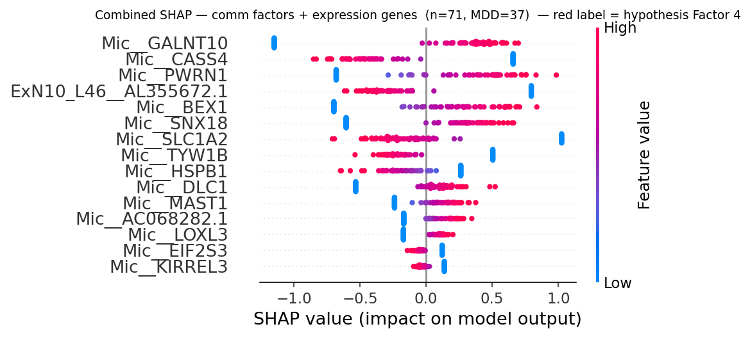
PHASE D · THE DECISIVE TEST
When factors compete with genes, genes win
Combined-space SHAP: mRMR keeps 15 features — almost all microglial genes (Mic__*). Every communication factor is dropped.
Given variance-top-1000 genes + 5 factors, feature selection keeps 15 genes and discards every factor. This is the feature-level reason combined adds no value: the program is a low-rank summary of microglial state, captured at least as well by the raw Mic genes.
11
Notes:
The decisive test, visually. Put all 1000 genes and 5 factors in one pool and let mRMR choose 15. It keeps genes — almost all microglial — and drops every factor, including Factor 4. So the factor is redundant FOR PREDICTION: a compressed shadow of microglial expression the raw genes already encode at full resolution.

Slide 14
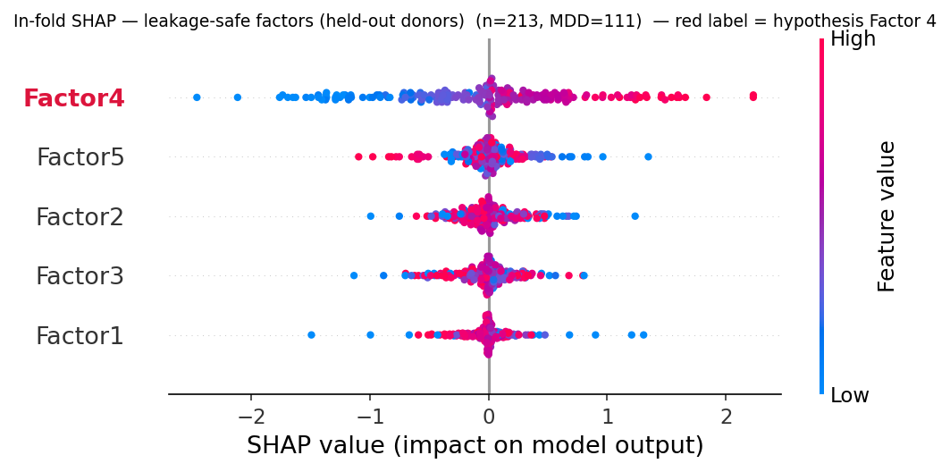
PHASE D · LEAKAGE-SAFE VIEW
Remove the leak, and Factor 4 leads
0.649 held-out AUC — matches the rigorous 0.633, validating the in-fold path
Factor 4 → #1 communication factor
mean|SHAP| 0.610, again stronger in males (0.651) than females (0.575). Removing the mild all-donor leak makes the axis more prominent, not less.
In-fold (leakage-safe) factors on held-out donors, pooled across 3 CV rounds (71 × 3 = 213).
So the biology is robust to the strictest leakage control.
12
Notes:
Third angle, the strongest for the biology. When we re-estimate factors inside each fold (no leak at all) and score held-out donors, Factor 4 becomes the #1 communication factor and the held-out AUC matches our rigorous number. So the axis is not a leakage artefact — if anything it is clearer once the leak is removed. n=213 is 71 donors x 3 rounds, pooled held-out.

Slide 15
DISCUSSION
A coherent, two-part answer
✓ THE BIOLOGY IS SUPPORTED
— BUT IT ADDS NO PREDICTIVE VALUE
Factor 4 is the dominant, reproducible communication program.
It self-separates from the batch confound, leans toward MDD in both sexes, and becomes the #1 communication feature under leakage-safe estimation.
Directionally supports the shared microglia → neuron axis. L–R drivers (synaptic, glutamatergic, Ca²⁺; CACNA1C, IL1RAPL1) are biologically sensible.
When factors and genes compete, mRMR discards every factor; combined never CI-separates from expression.
This is expected, not paradoxical: communication is derived from expression. A rank-5 program is a lossy summary of the same microglial state the raw genes encode at full resolution.
At n = 71 the compression buys interpretability, not discriminative power.
The signal is real, but not independent.
Notes:
The heart of the talk. Two cards, deliberately balanced. Left: the biology checks out — Factor 4 is real, reproducible, MDD-leaning in both sexes, robust to leakage control. Right: but as a predictive representation it adds nothing, because it is derived from the very expression it competes with. Land the one-liner: real but not independent.

Slide 16
CONCLUSION
A qualified yes — honest by design
Modelling cell–cell communication recovers a single, reproducible microglia → ExN10_L46 program, elevated in MDD donors of both sexes and the most important communication feature under leakage-safe estimation — directionally supporting the shared-axis hypothesis. But it carries no predictive information independent of microglial expression at n = 71: when the two compete, expression wins.
KEY LIMITATIONS
n = 71 — wide CIs; a +0.05 AUC value-add is not resolvable (and why no GNN).
Sex = cohort
— no clean cross-sex test; within-sex value-add instead.
Factor 4 ≠ pure microglia
— top sender is Endothelial (0.79); vascular + immune → neuron.
Trend-level
— p = 0.057 overall, p = 0.05 in males (borderline).
The shared axis is visible and real — a low-rank shadow of microglial transcriptional state, not an independent, value-adding signal.
13
Notes:
Close. The honest conclusion for a course project: a qualified yes. The axis is real and reproducible, but it is a shadow of microglial state, not an independent predictor. Limitations up front — small n is the binding constraint, sex=cohort prevents transfer testing, Factor 4 is vascular+immune as much as microglial, and the signal is trend-level. Thank you — questions?

Slide 17
Thank you
Questions?
Giorgos Boulogeorgos · Andreas Mici | MLCB Team Project · NKUA, MSc Data Science and Information Technologies · Supervisor: Prof. E. Manolakos · June 2026
Notes:
Close. Thank you — happy to take questions. Likely Q&A topics: why n=71 limits a GNN; why Factor 4 is vascular+immune not pure microglia; the -log10 bug and how we caught it; why combined never beats expression (communication derived from expression).

