Slide 1

CoviD
A web application developed by
Arapakis Haris Gialouris George Michalopoulos Marios Skylakos Kostantinos
A new way to be vaccinated and get tested against the COVID-19 Plague

Slide 2
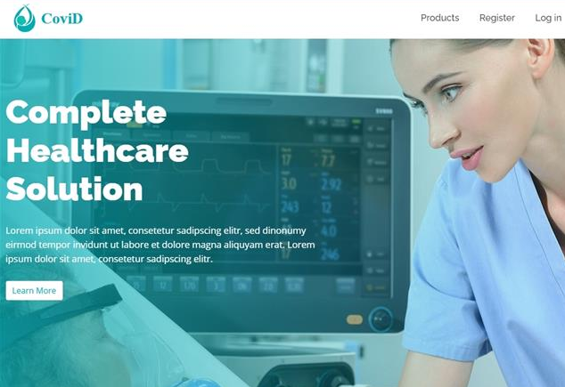
A m i n i m a l i s t i c i n d e x p a g e w h e r e t h e p a t i e n t c a n l e a r n a b o u t t h e C O V I D - 1 9 s i t u a t i o n , r e g i s t e r / l o g i n a n d b o o k a n a p p o i n t m e n t.

Slide 3
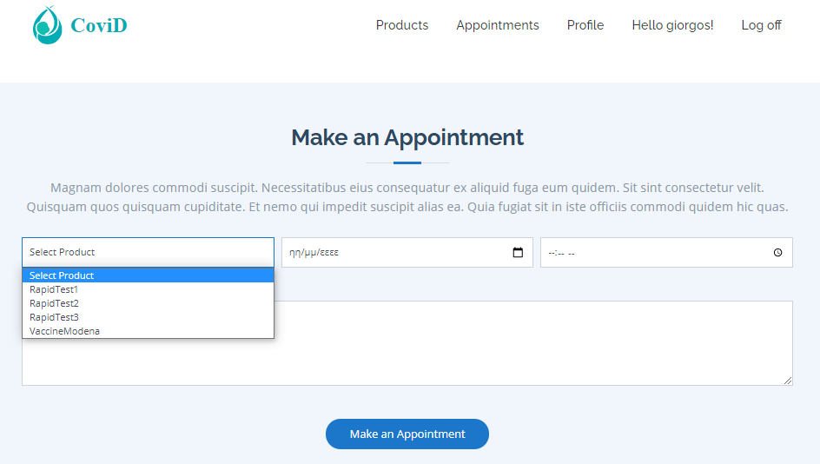
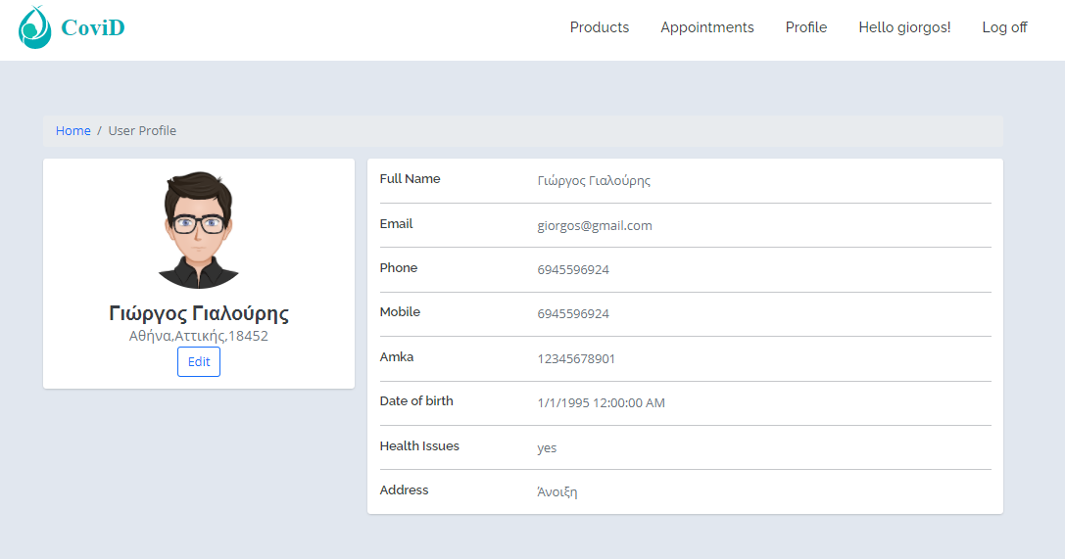
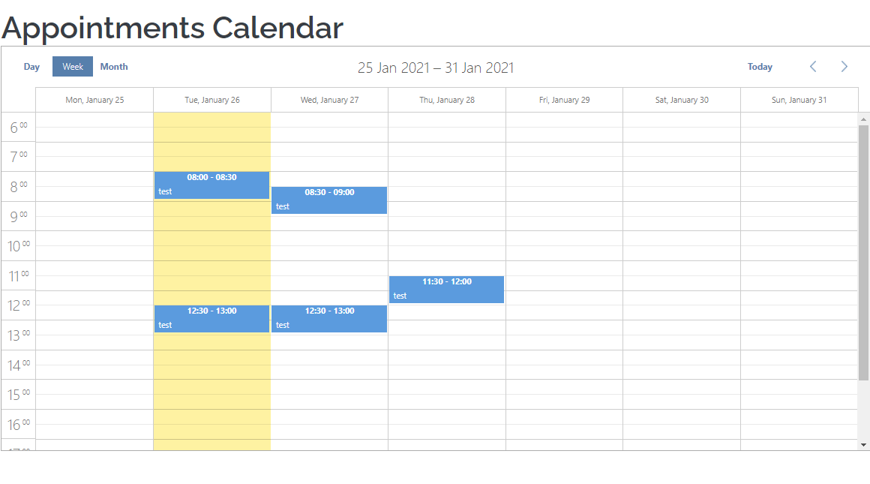
Book An Appointment
Once the user is registered, they will be able to book an appointment. They can select from a variety of products, and opt for their desired date and time.
View And Edit Profile
Users will be able to view their profile at any time
Users will be able to edit their profile and change their details
Appointments Calendar
Medical staff can check its upcoming appointments

Slide 4
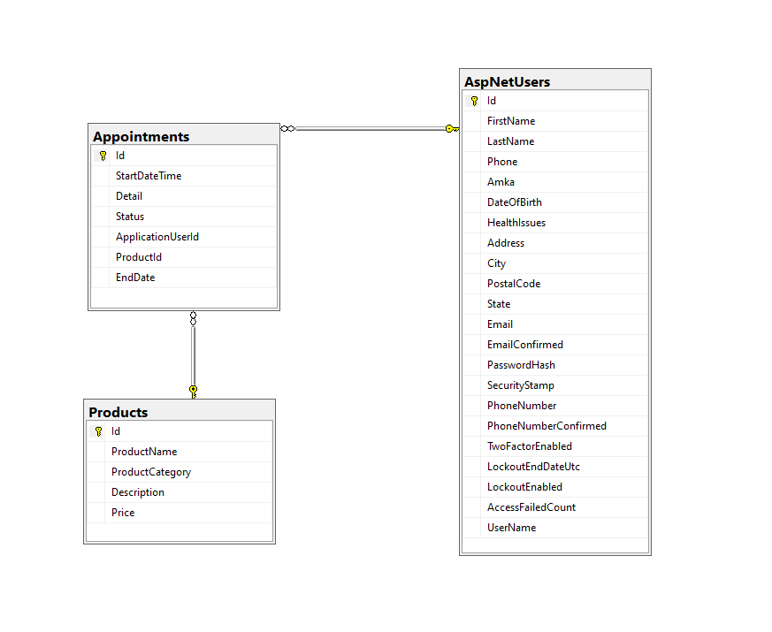
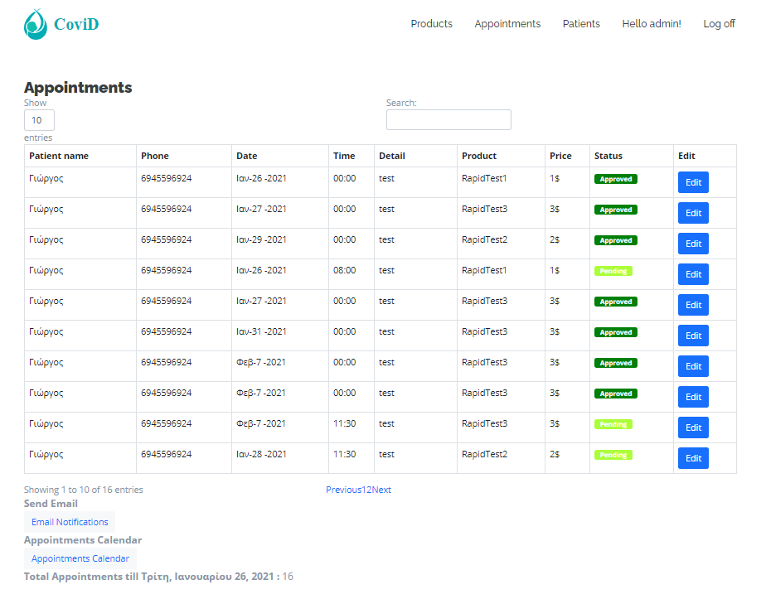
Database – Where all the magic happens
The database consists of 3 tables
Products
Appointments
AspNetUsers
Appointments of Patients
The medical staff can view all the appointments in this view
Upcoming appointments are set to -Pending until the admin changes the status to -Approved
4

Slide 5

Thank you
Questions?

