Slide 1
Business Intelligence &
Big Data Analytics
Γιώργος Παπουτσάκης 8200137

Slide 2



Dataset
Coffee Shops Transactions
149.116 rows
11 columns
116.789 transactions
1/1/2023 – 30/6/2023
3 coffee shops

Slide 3

Columns
transaction_id
product_id
store_id
transaction_date
product_category
store_location
transaction_time
product_type
unit_price
transaction_qty
product_detail

Slide 4
New Columns
time_of_day
is_weekend
day_name
month_name
day
month
year
hour
minutes
seconds
latitude
longitude
Transformation: transaction_id
index

Slide 5

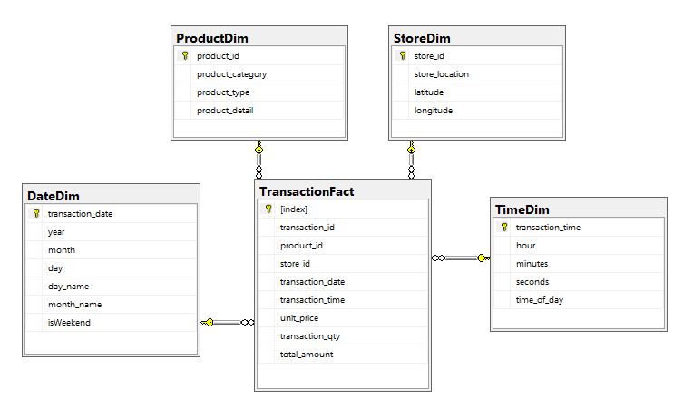
Star schema

Slide 6

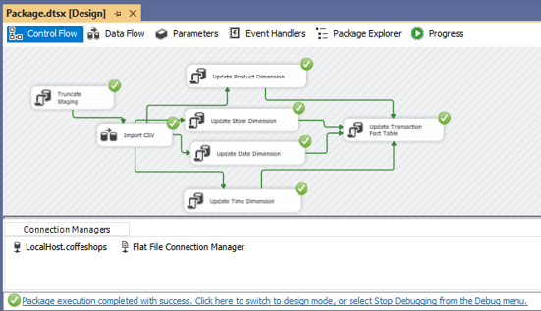
ETL
SQL SERVER Integration Services (SSIS)
Truncate Staging Table
Load CSV to Staging Table
Update Dimension Tables
Update Fact Table

Slide 7

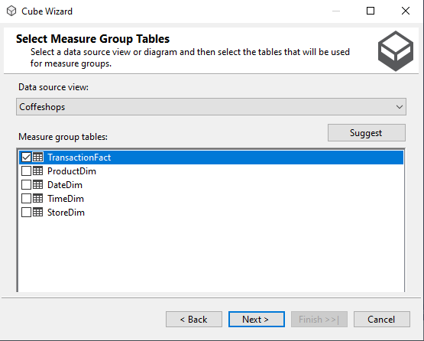
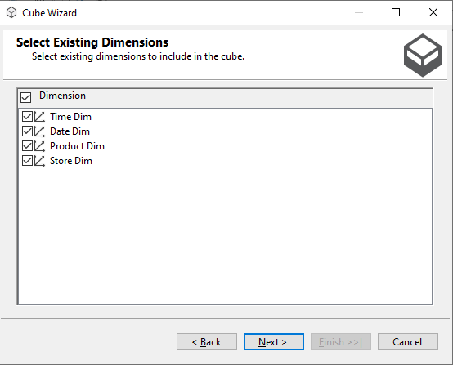
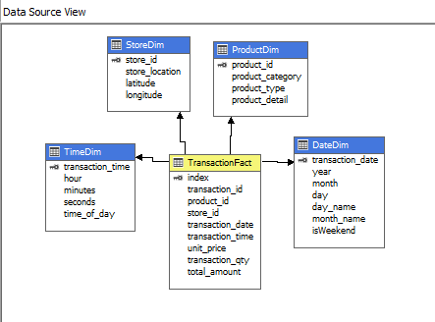
CUBE
SQL SERVER Analysis Services (SSAS)

Slide 8
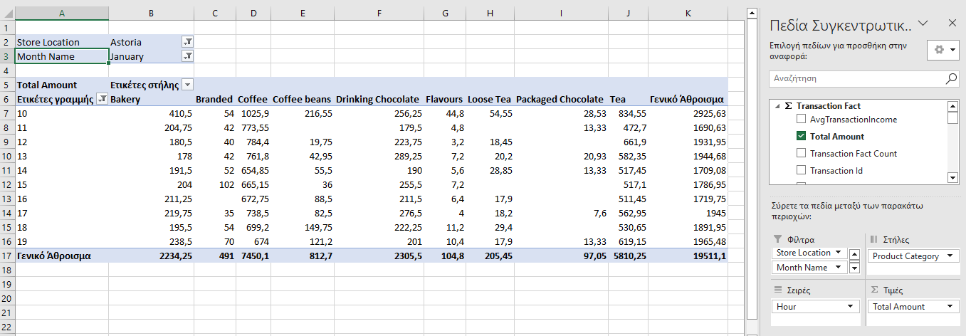
CUBE
Cube Browser (SSAS)
January Income
Astoria Store
10.00 – 19.59
Per product category

Slide 9

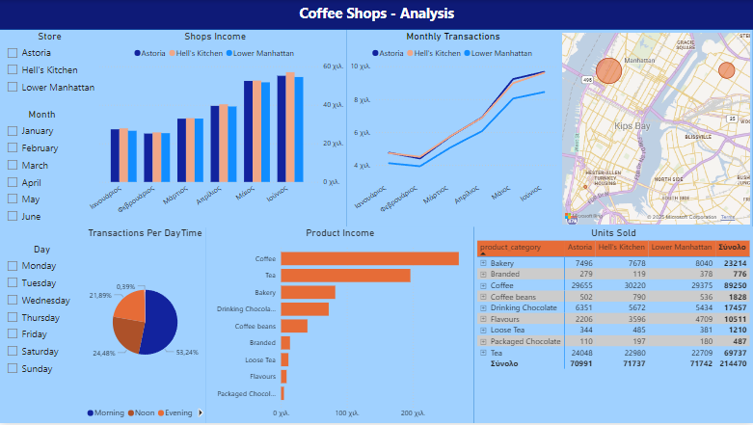
Visualizations

Slide 10
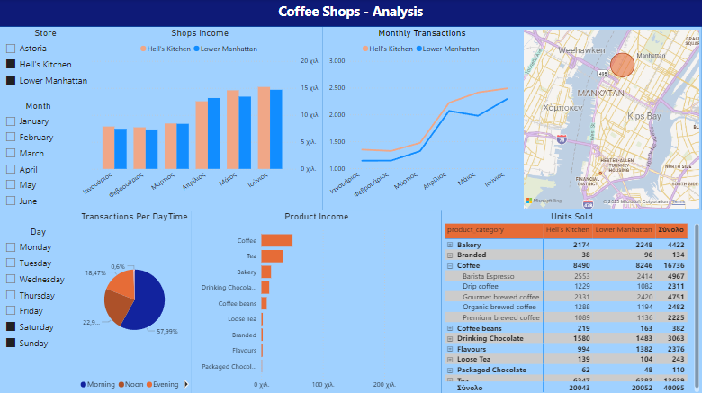
Visualizations
Filters
Two stores
Weekends only
Coffee types units sold

Slide 11
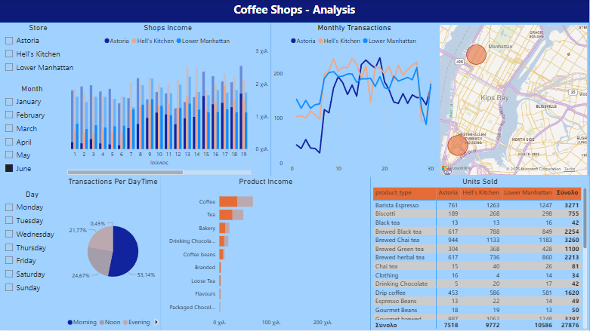
Visualizations
Filters
Drill-down June
Morning
Product Types

Slide 12
Clustering

Slide 13



WARM beverage enjoyers
49%
5.9$
1.72

Slide 14

Gourmet coffee lovers
14%
5.3$
1.74

Slide 15

Espresso fans
15%
7.7$
2.45

Slide 16

CLASIC COFFEE LOVERS
7%
4.9$
1.73

Slide 17

CHAI TEA ENTHUSIASTS
15%
5.6$
1.75

Slide 18
Association rules

Slide 19



ASSOCIATION RULES
99.6%
Regular Syrup
Espresso
99.3%
Sugar free Syrup
Espresso
54.7%
Espresso
Regular Syrup

Slide 20



ASSOCIATION RULES
38.5%
Gourmet Brewed Coffee
Scone
37.4%
Brew Chai Tea
Scone

Slide 21
Thank you! Any questions?

