Slide 1
Data-Management-shop
Team number X ,section XXX
Alexandre LOGUT (Leader, developer), Clément CROUAN(developer), Alec Marchal (Designer UX/UI)
Github link: https://github.com/Giougt/DIP392-Data-Management-shop

Slide 2
Project Overview and Motivation
The software helps bakeries manage their inventory efficiently by tracking stock levels and streamlining orders. It ensures smooth operations and reduces waste through accurate stock monitoring.
The users are bakers in mid-sized French cities who need an efficient tool to manage their bakery inventory and orders
This project is relevant because streamline their stock management, reducing waste and improving efficiency. It ensures smooth operations and simplifies the ordering process.

Slide 3
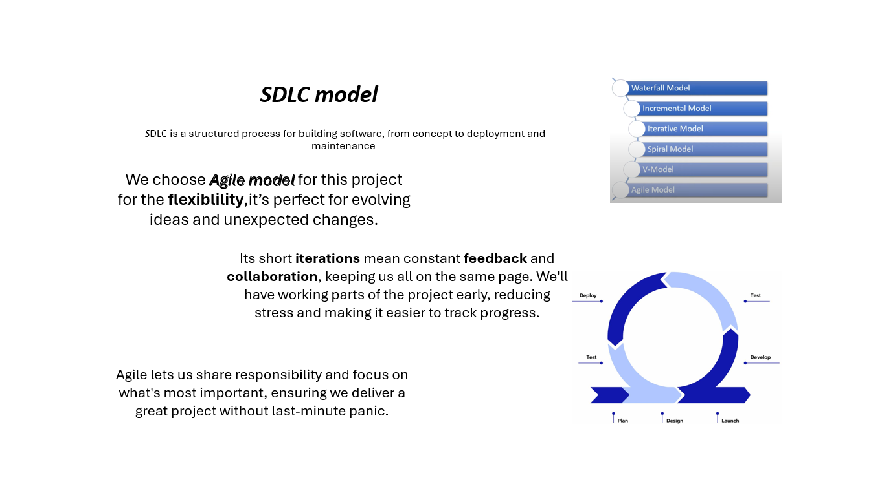

Slide 4
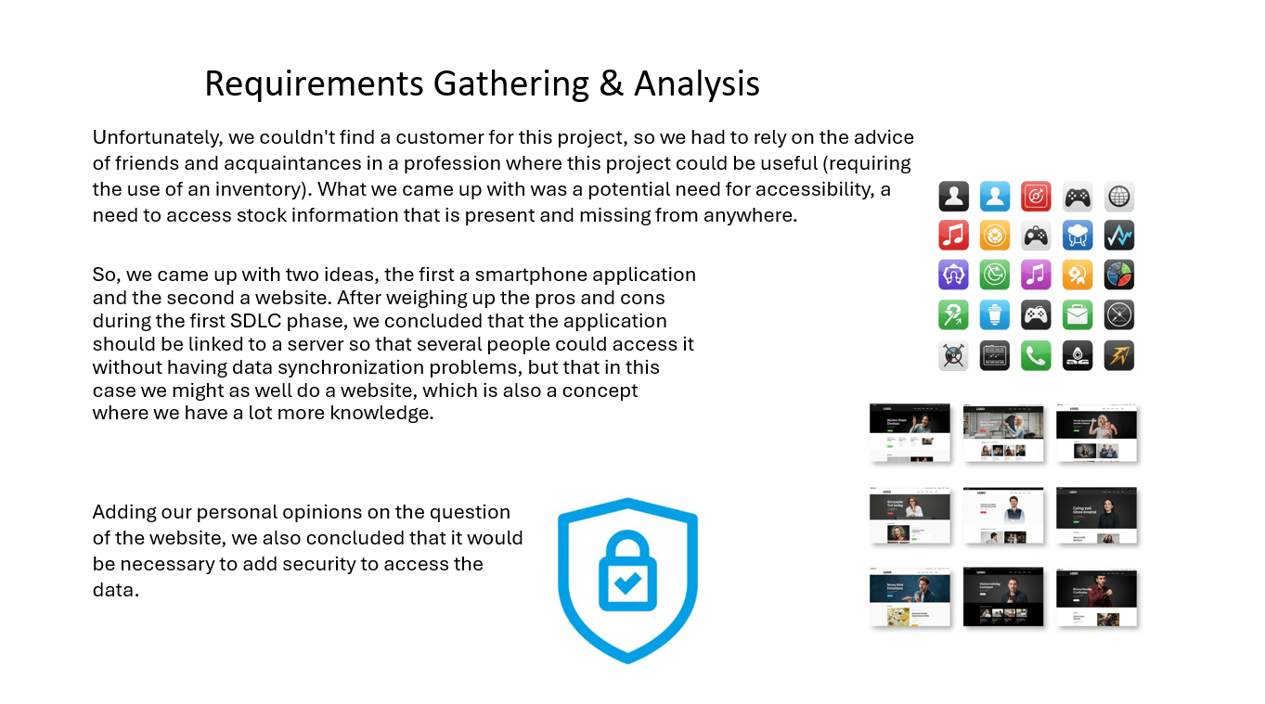

Slide 5
Software Requirements Specification
Functional requirements include a login system for account creation and access control, ensuring users can securely connect. Non-functional requirements focus on adequate database storage, easy data access and modification, and a user-friendly design for intuitive navigation.
These requirements shaped the project by prioritizing security, efficiency, and usability. The team ensured a well-structured database, smooth authentication, and a redesigned interface to enhance accessibility and user experience.

Slide 6
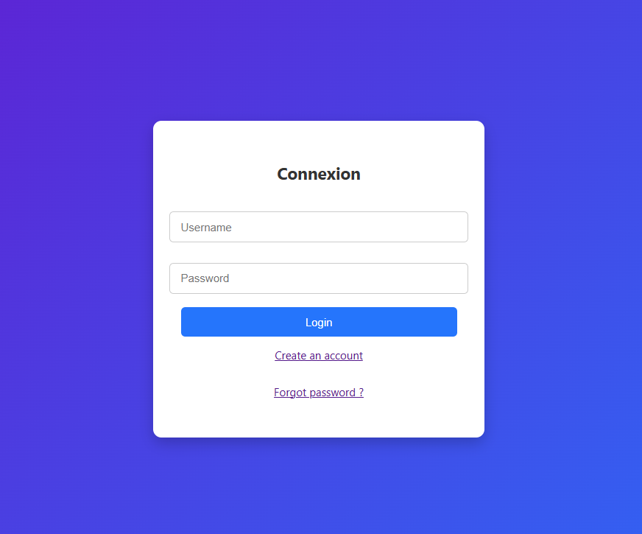
System and Software Design
Since the client had no specific design preferences, multiple design options were created and discussed within the team. The final choice was refined through collaboration to ensure clarity and usability.
Various designs were explored before settling on the best fit. Colors were carefully selected with the UI designer to enhance user experience and ensure a visually appealing interface.

Slide 7
Implementation Phase
The project utilizes npm for package management, MySQL for database operations, and HTTP requests to handle data communication. These technologies enable smooth data insertion, modification, and retrieval for efficient stock management.
The team collaborates through GitHub, working on different features and committing changes to the main branch. Regular meetings and coding sessions at the university help ensure synchronization, brainstorming, and continuous improvement.

Slide 8
Testing Strategy
The team implemented HTTP request testing to validate the functionality of POST, GET, and DELETE operations. Automated and manual tests ensured smooth data handling, security, and user experience consistency.
Key scenarios included new user account creation, normal site usage, and bug detection. The tests simulated real interactions, verifying database updates, proper request handling, and potential system errors.

Slide 9
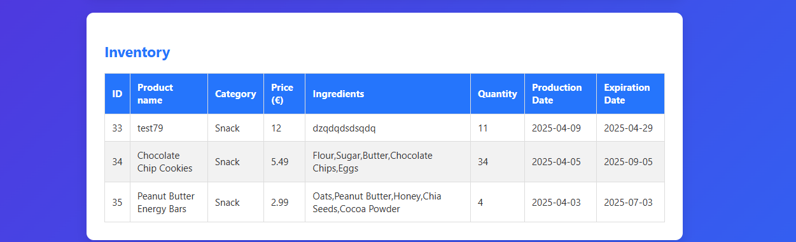
Test Results and Validation
The database performed well during testing, handling requests smoothly with no lost data. No error messages were detected from the script, and controllers functioned correctly, ensuring reliable operations.
The tests confirmed that the software meets the objectives. The system efficiently manages inventory and orders, providing a stable and user-friendly experience that aligns with customer expectations.

Slide 10
Process Reflection and Lessons Learned
The team faced difficulties in ensuring seamless database integration and maintaining error-free request handling. Debugging scripts and optimizing controllers were crucial to prevent data loss and improve system reliability.
Through these challenges, the team gained valuable experience in database management, error detection, and collaborative development. They learned the importance of rigorous testing, clear code organization, and teamwork.

Slide 11
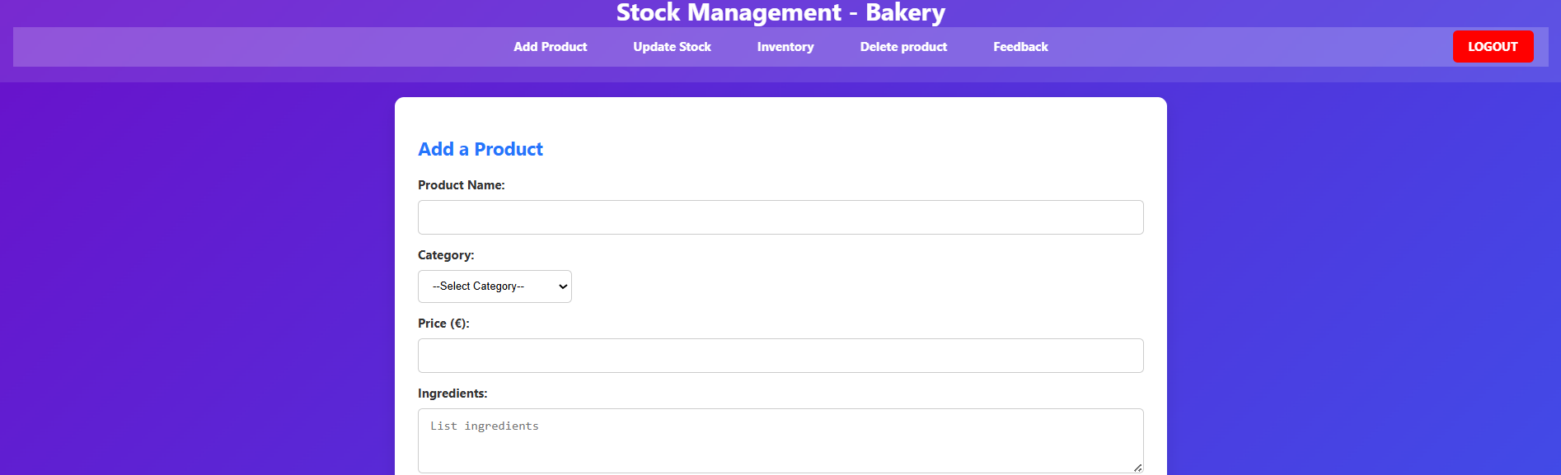
Demo Overview
The demo showcases key functionalities, including user authentication, inventory tracking, and seamless order management. It highlights how the system efficiently handles stock updates and allows bakers to manage their inventory with ease.
The demonstration highlights the Agile methodology, emphasizing iterative development and teamwork. The project was continuously tested in collaboration, ensuring that each feature met user needs efficiently. Regular evaluations, feedback loops, and team discussions allowed for quick improvements, refining the design and functionality throughout development.

Slide 12
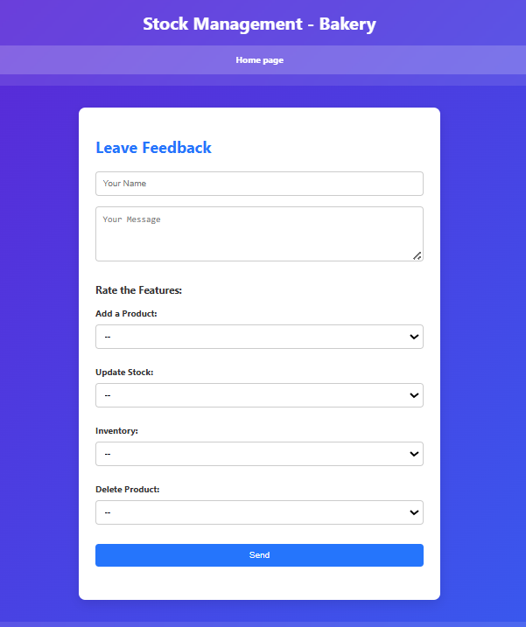
Conclusion and Future Work
The project successfully delivered a functional inventory management system tailored. Testing confirmed smooth database operations, effective request handling, and a user-friendly interface. No data loss or system errors were detected, ensuring reliability and efficiency.
Future enhancements could include adapted visual styles for accessibility, ensuring better usability for individuals with visual impairments. Improved database control on the user side would provide more flexibility and security in managing inventory. A mobile-responsive version would enhance accessibility across different devices, making bakery management more convenient

