Slide 1

Exploring the effectiveness of number formats in GPU-accelerated programs
Giovanni Santangelo

Slide 2

Motivations and Objectives

Slide 6
First Verification Procedure Flow

Slide 7
FloatingPoint First Verification Results, RANGE Operands: (-1,1)

Slide 8
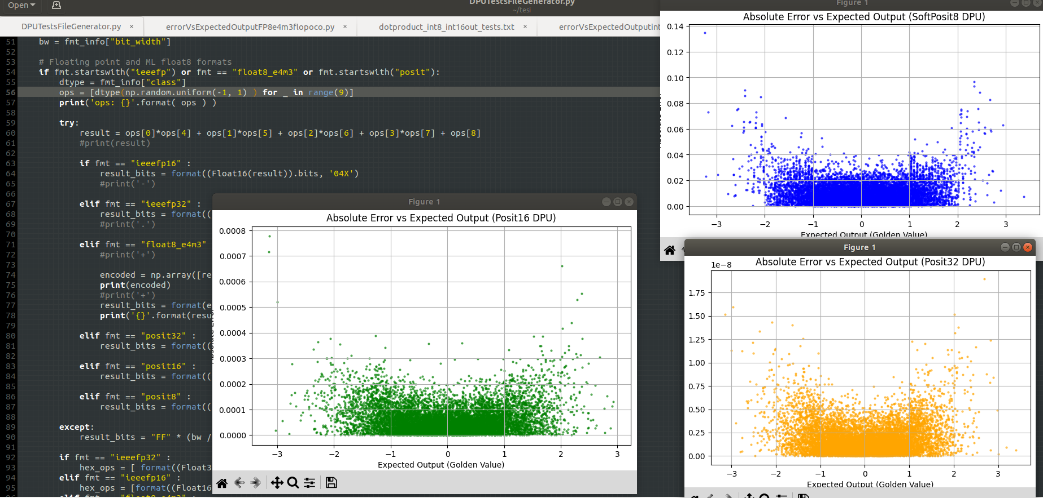
Posit: First Verification Results, range operands: (-1,1)

Slide 9
Works Cited, (for the Pictures)

