Slide 1
Integrating Space and Time for the Visualization of Events in a 2D plot
Fundação Getúlio Vargas
Escola de Matemática Aplicada
Giovani de Almeida Valdrighi
Advisor: Jorge Poco

Slide 2
Summary
Introduction
Literature Research
Expected Results
Methodology
Reference

Slide 3
Introduction

Slide 4
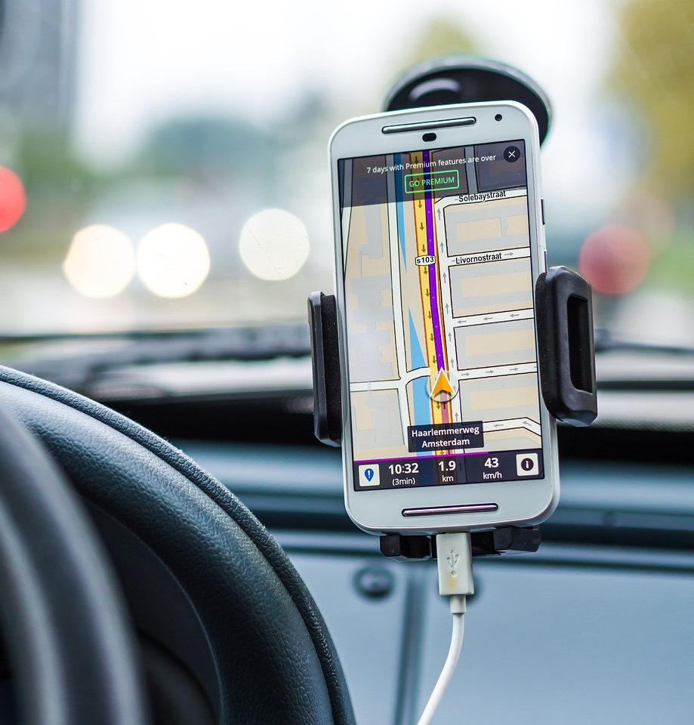

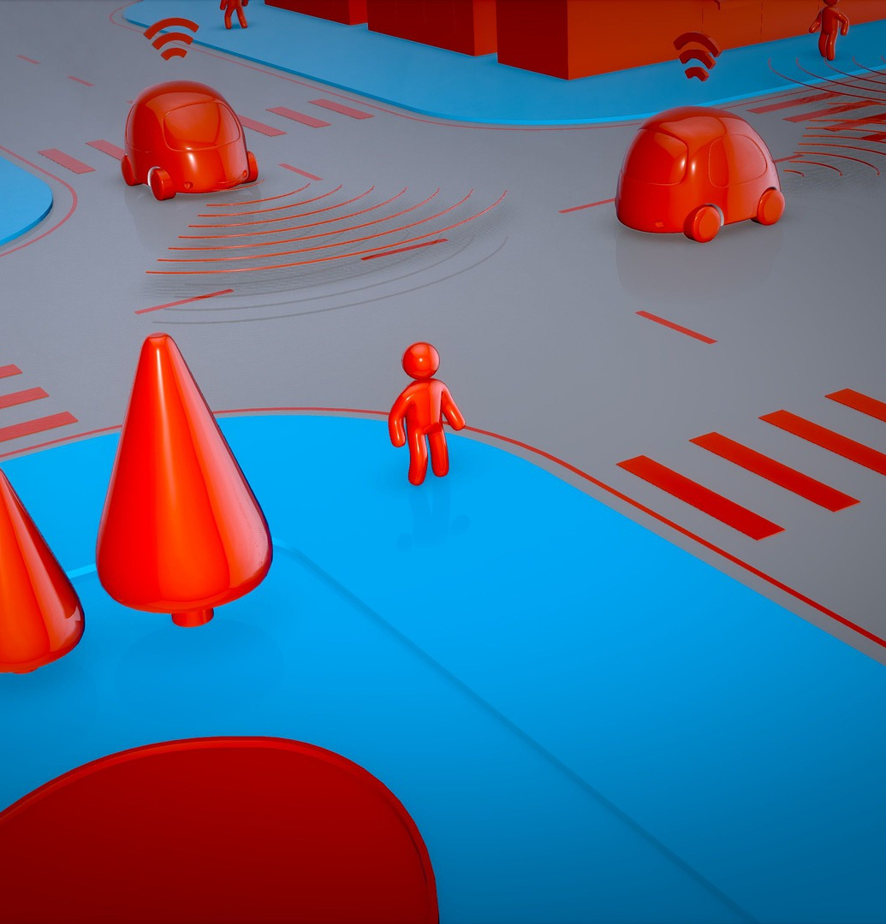
GPS data
Weather and traffic
street sensors
Smartphone apps
Smart cars
Image by Dariusz Sankowski on Pixabay
Image by Sebastiaan Stam on Unsplash
Image by Julien Tromeur on Pixabay

Slide 5
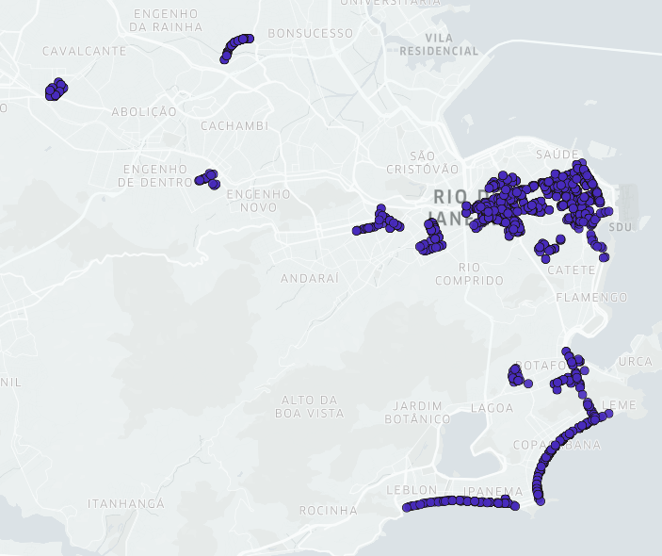
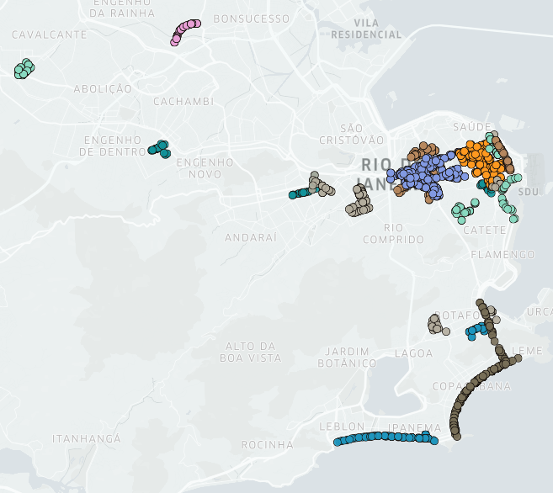
Clustering Methods

Slide 6
Literature Research

Slide 7
Clustering methods
Widely used unsupervised learning methods. Some examples are:
SNN: uses the shared neighbors between points as a measure of similarity.
SNN+: spatio-temporal adaptation of SNN that considers space and time distances when looking for neighbors.
DBSCAN: compute neighborhoods of points, and for each point in this set, identify following neighborhoods, that are all classified to the same cluster.
ST-DBSCAN: spatio-temporal adaptation of DBSCAN that considers a spatial and a time distance when looking for neighborhoods.

Slide 8
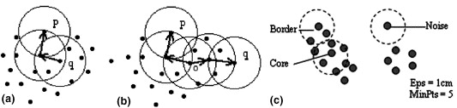
DBSCAN on 2D points
Image from ST-DBSCAN: An algorithm for clustering spatial–temporal data, Birant and Kut (2007).

Slide 9
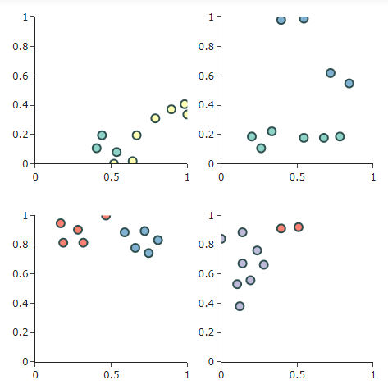
Space-Time Visualizations
Space-Time Cube
Animations
Small Multiples
Misinterpretations due to
projection on a 2D screen.
Difficult to keep track of changes.
Plot space limitation.

Slide 10
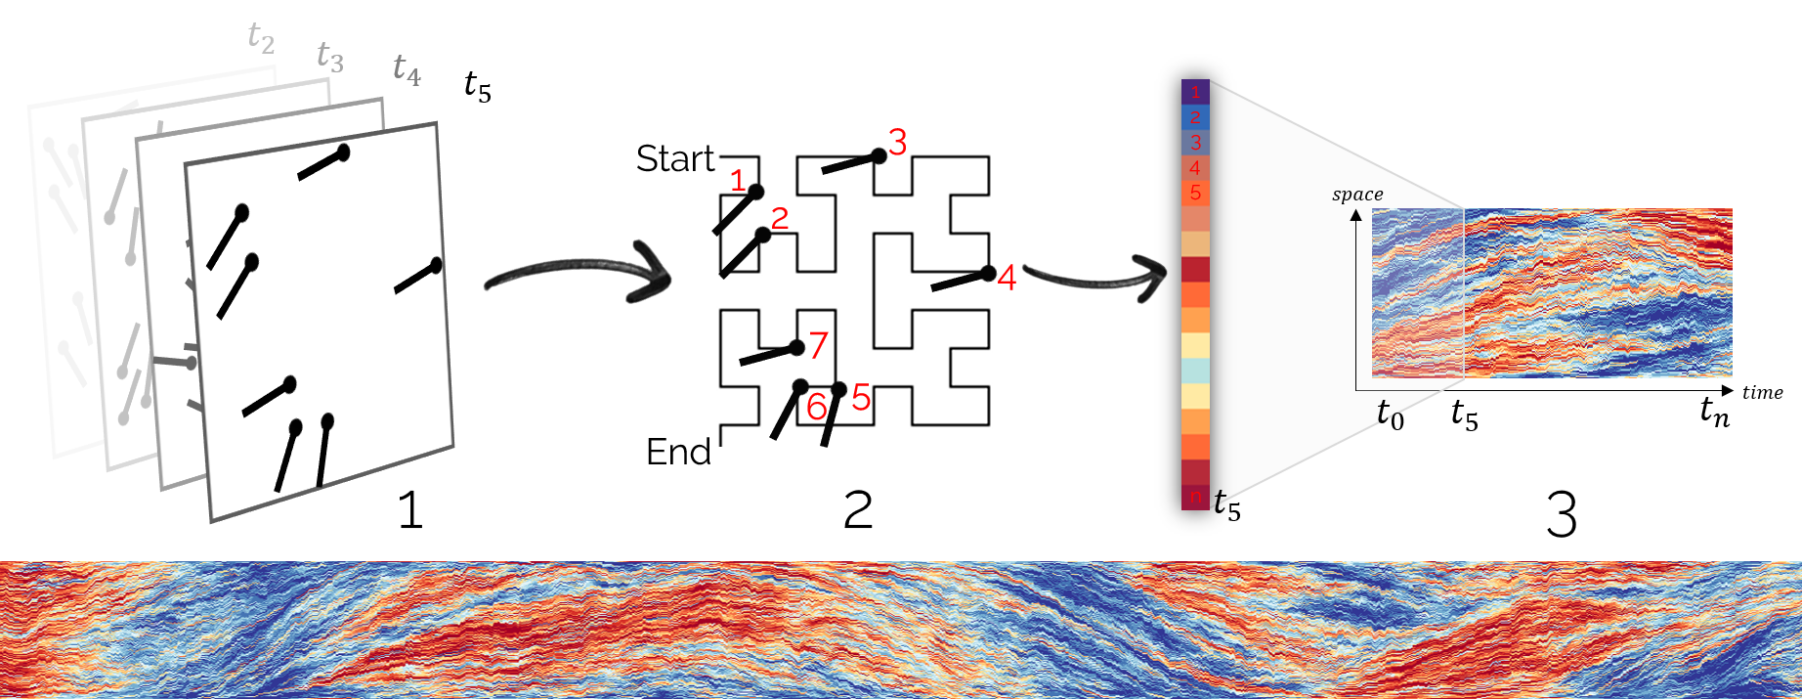
MotionRugs
Image from MotionRugs: Visualizing Collective Trends in Space and Time, Büchmueller et al. (2019).

Slide 11
Expected Results

Slide 12
Expected Results
The objectives of this work are:
To present a method for the visualization of grouped spatio-temporal data that is able to represent the general distribution of groups in a static 2D plot.
A intuitive and fast web interface that implements the presented method.
An evaluation of the presented method with the use of error metrics and users feedback.
Case studies with real world data to demonstrate the applicability.

Slide 13
Methodology

Slide 14
Methodology
Method development:
Deeper research for the currently methods for visualizing spatio-temporal events.
Evaluation:
A metric that will be used is the preservation of neighborhood, distinct metrics must be considered.
Web Interface:
Will be developed with Javascript, the plot will be created with D3.js to manipulate SVG, if necessary, it will be used WebGl.
Case Studies:
Datasets from traffic alerts created by Waze users and from criminality reports.

Slide 15
References

Slide 16
References
AIGNER, Wolfgang et al. Visualization of time-oriented data. [S.l.]: Springer Science & Business Media, 2011.
ANDRIENKO, Natalia et al. Space Transformation for Understanding Group Movement. IEEE transactions on visualization and computer graphics, v. 19, p. 2169–78, Dec. 2013.
ARYAL, Amar; WANG, Sujing. Discovery of patterns in spatio-temporal data usingclustering techniques. In: p. 990–995.
BACH, Benjamin et al. A descriptive framework for temporal data visualizations based on generalized space-time cubes. In: WILEY ONLINE LIBRARY. COMPUTER GraphicsForum. [S.l.: s.n.], 2017. P. 36–61.
__________. A review of temporal data visualizations based on space-time cube operations.In: EUROGRAPHICS conference on visualization. [S.l.: s.n.], 2014

Slide 17
References
BIRANT, Derya; KUT, Alp. ST-DBSCAN: An algorithm for clustering spatial–temporaldata. Data & Knowledge Engineering, v. 60, n. 1, p. 208–221, 2007. Intelligent Data Mining. ISSN 0169-023X.
BUCHMÜLLER, Juri et al. MotionRugs: Visualizing Collective Trends in Space and Time. IEEE Transactions on Visualization and Computer Graphics, v. 25, n. 1,p. 76–86, 2019.
ERTÖZ, Levent; STEINBACH, Michael; KUMAR, Vipin. Finding Clusters of Different Sizes, Shapes, and Densities in Noisy, High Dimensional Data.
ESTER, Martin et al. A Density-Based Algorithm for Discovering Clusters in LargeSpatial Databases with Noise. In: PROCEEDINGS of the Second InternationalConference on Knowledge Discovery and Data Mining. Portland, Oregon: AAAI Press,1996. (KDD’96), p. 226–231.
GATALSKY, P.; ANDRIENKO, N.; ANDRIENKO, G. Interactive analysis of event data using space-time cube. In: PROCEEDINGS. Eighth International Conference on Information Visualisation, 2004. IV 2004. [S.l.: s.n.], 2004. P. 145–152.

Slide 18
References
HÄGERSTRAND, Torsten. What about people in Regional Science? Papers of the Regional Science Association, v. 24, n. 1, p. 6–21, Dec. 1970. ISSN 1435-5957.
HARROWER, Mark. The Cognitive Limits of Animated Maps. Cartographica: The International Journal for Geographic Information and Geovisualization, v. 42,n. 4, p. 349–357, 2007.

