Slide 1
Modelling daily ozonio mean
Giovani Valdrighi, Vitória Guardieiro

Slide 2
Data
New York data from 15/07/2001 to 30/04/2016.

Slide 3
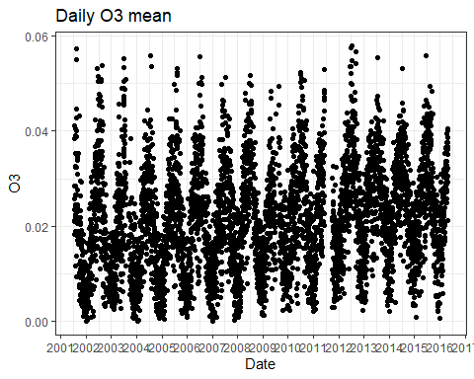

Slide 4
Missing data
There are 52 time skips in the data, in a total of 473 days.
The biggest skips is 108 days in 2011.
The majority of skips are of 1 or 2 days.
Around 9.5% missing data.
The missing observations are distributed along the time without a clear pattern.

Slide 5
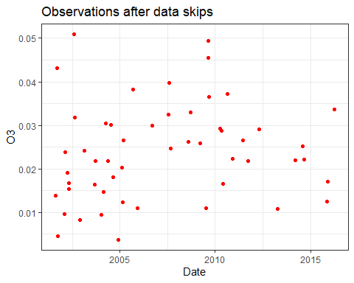

Slide 6
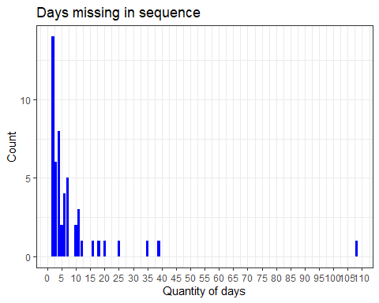

Slide 7
Imputation method
It was used the kNN method to imputate values on missing observations.
The kNN method needs the parameter k, the number of closest points considered.
Starting with k = 7.

Slide 8
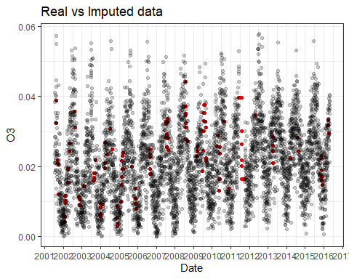

Slide 9
Method create a bad behavior where the size of the skips is bigger than 7 days.

Slide 10
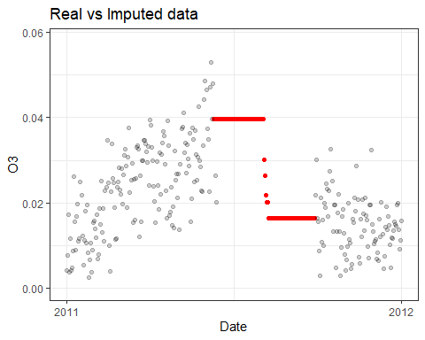

Slide 11
To deal with this, the parameter k used for imputation will be different if the size of the skip is minor tem 30 days, between 30 days and 100 days, or bigger than 100 days.
k = 7, k = 45, k = 120, respectively.
We will aggregate closest points by weighted by distance mean.

Slide 12
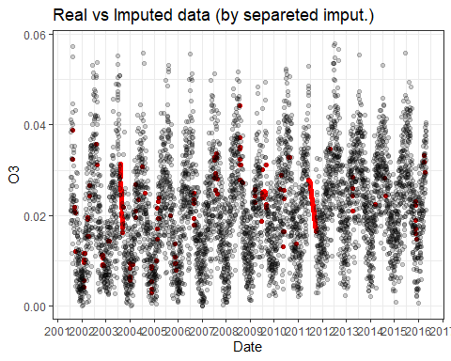

Slide 13
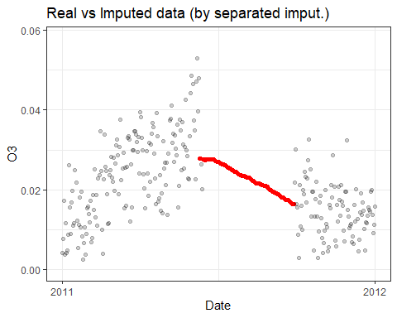

Slide 14
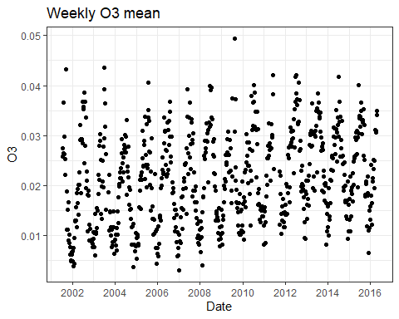
Weekly data

Slide 15
If the data is grouped by week, ignoring the missing values when aggregating, it’ll have 33 missing observations.
Around 4.3% missing data.

Slide 16
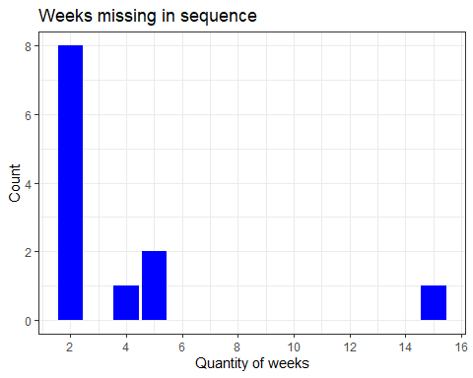

Slide 17
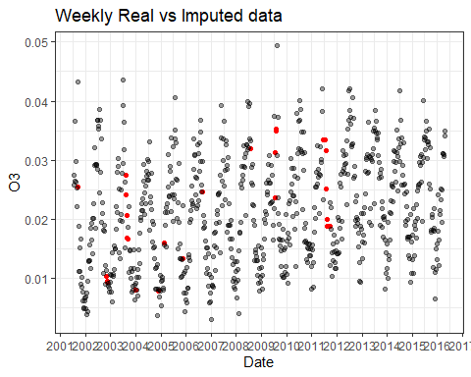

Slide 18
It has the same problem when the sequence of missing data is to big.
Again, if there is more than 5 missing weeks, it will be used k = 16, if it’s less, it’ll be k = 4.

Slide 19
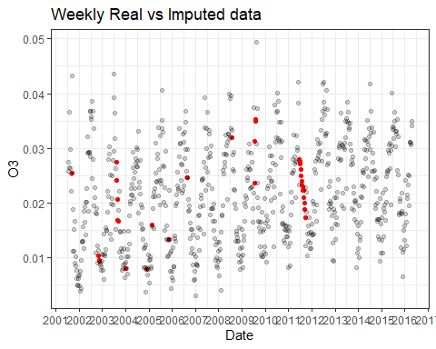

Slide 20
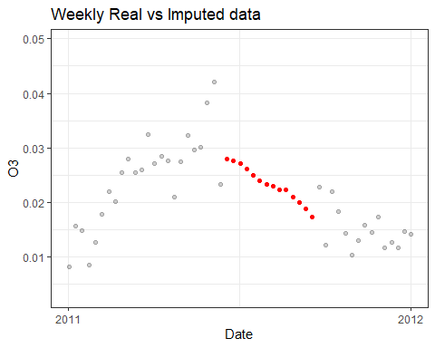

Slide 21
Daily model

Slide 22
Modelling process
Metric to be minimized: MAE = $\frac{1}{n}\sum_{n}^{​}{|}y_{t}−{\hat{y}}_{t}|$.
Rolling window of 2 years (730 days).
Prediction of the next 7 days.
First: Test if there is tendency with Wald-Wolfowitz runs test.
For every 2 years window, the p-value is smaller than $1e−3$.
Second: Fitting of different models and evaluation of MAE error.

Slide 23
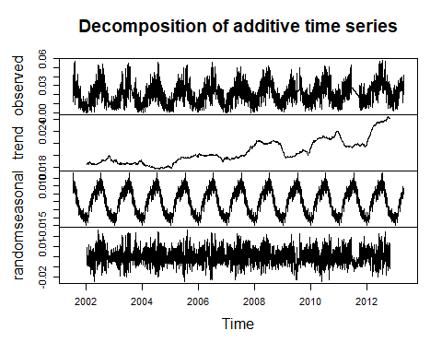
Choice of models - trend

Slide 24
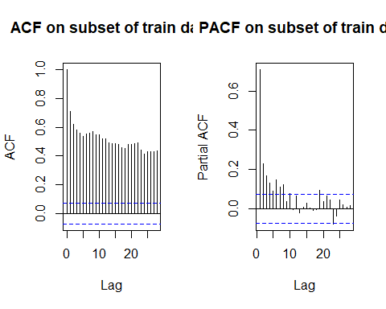
Choice of models - ACF and PACF

Slide 25
Naive model: the next 7 days are predict as the mean of the last 4 weeks.
Exponential smoothing forecast.
Holt model with trend.
ARMA(6,0) model.
Auto ARIMA model.

Slide 26
Process:
For each model:
For each 2 years window:
Fit model.
Generate predictions of next 7 days.
Compute mean of residuals for that window.
Compute MAE for model as the mean of residuals.

Slide 27
Results for train data:
Auto ARIMA model: 0.005986731
Holt model: 0.006142857
SES model: 0.00617229
ARMA(6,0) model: 0.006279533
Naive model: 0.007498889

Slide 28
Evaluating on test data
MAE: 0.006503142

Slide 29
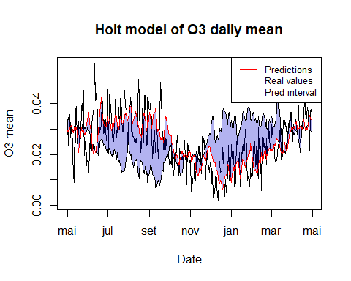

Slide 30
Weekly model

Slide 31
Modelling process
Metric to be minimized: MAE = $\frac{1}{n}\sum_{n}^{​}{|}y_{t}−{\hat{y}}_{t}|$.
Rolling window of 2 years (104 weeks), by skiping 4 weeks.
Prediction of the next 4 weeks.
First: Test if there is tendency with Wald-Wolfowitz runs test.
For every 2 years window, the p-value is smaller than $1e−3$.
Second: Fitting of different models and evaluation of MAE error.

Slide 32
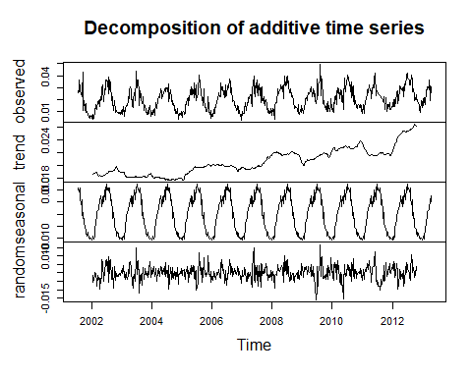
Choice of models - trend

Slide 33
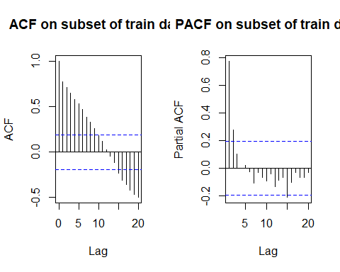
Choice of models - ACF and PACF

Slide 34
Naive model: the next 4 weeks are predict as the mean of the last 4 weeks.
Seasonal model: linear regression on seasonal dummies variable, each month is a factor.
Linear model: linear regression on seasonal dummies and time index.
Poly 2 model: linear regression on seasonal dummies and time index with degree 1 and 2.
Poly 3 model: linear regression on seasonal dummies and time index with degree 1, 2, and 3.
Holt model with trend.
Holt Winters model with trend and seasonality (multiplicative and addtive).
ARMA(1, 0) model.

Slide 35
Process:
For every 2 years window:
Fit all the models.
Generate predictions of next 4 weeks.
With predictions for every week, compute residuals $r_{t}=y_{t}−{\hat{y}}_{t}$.
With residuals, compute MAE.

Slide 36
Results:
Sazonal: 0.003903618
Linear: 0.004032514
Poly 2: 0.004171369
Arma(1, 0): 0.004568415
Poly 3: 0.004739532
Holt: 0.004885386
HoltWinters additive: 0.005008383
HoltWinters multiplicative: 0.005085043
Naive: 0.005122260

Slide 37
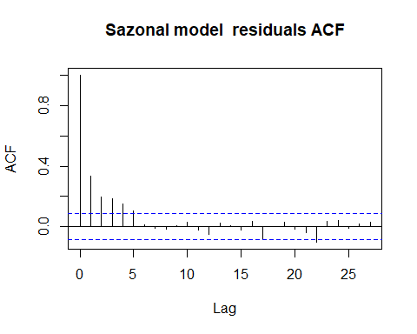
Residuals

Slide 38
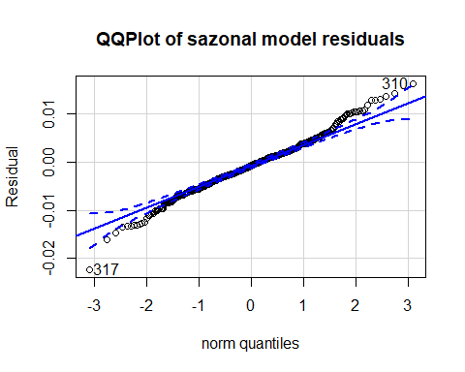

Slide 39
## [1] 317 310

Slide 40
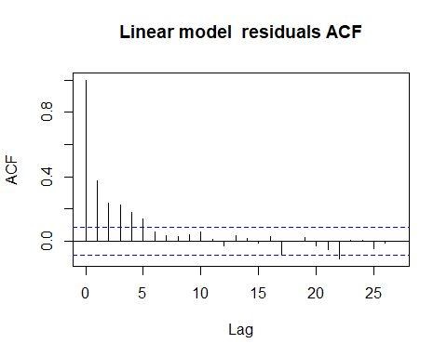

Slide 41
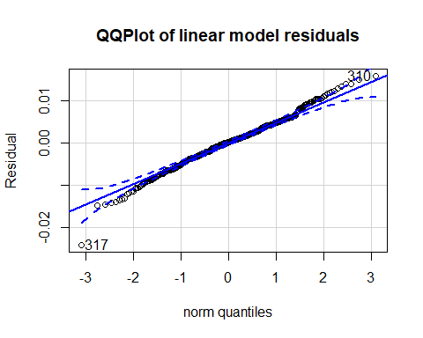

Slide 42
## [1] 317 310

Slide 43
Evaluating on test data
MAE: 0.003438587

Slide 44
