Slide 1
ECFCA System
HCI Project Samuel Blanco Aldar Duran Sebastian Leal Adriel Yerbes

Slide 2
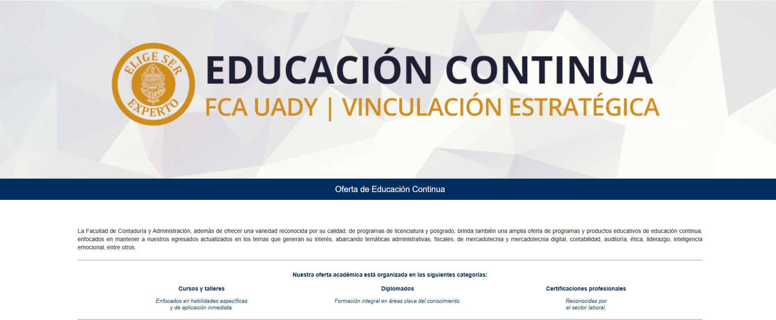
WHAT IS THE PROJECT?

Slide 3
Demographic
The demographic that we targeted are graduates and professionals that seek to further their knowledge by taking the courses.
As per our demographic we decided to focus on professionals around the age of 25-45, persons that often have little time, low tolerance for technological friction.
Based on the prior suppositions we decided on generating the Non-functional requirements with a focus on speed, clarity and accessibility

Slide 4
Non-functional Requirements
The Non-functional requirements categories that we defined based on the demographic and client were:
Usability
Accessibility
Responsive design
Visual consistency
Feedback and interaction
Navigation
Content and readability
Use case specific
Notification and alerts
Usability specific:
Intuitiveness
Error prevention
Error recovery
Consistent navigation
Navigation depth

Slide 5
Advances and Readjustments
Summary of the most significant changes made between the three project deliveries.

Slide 6
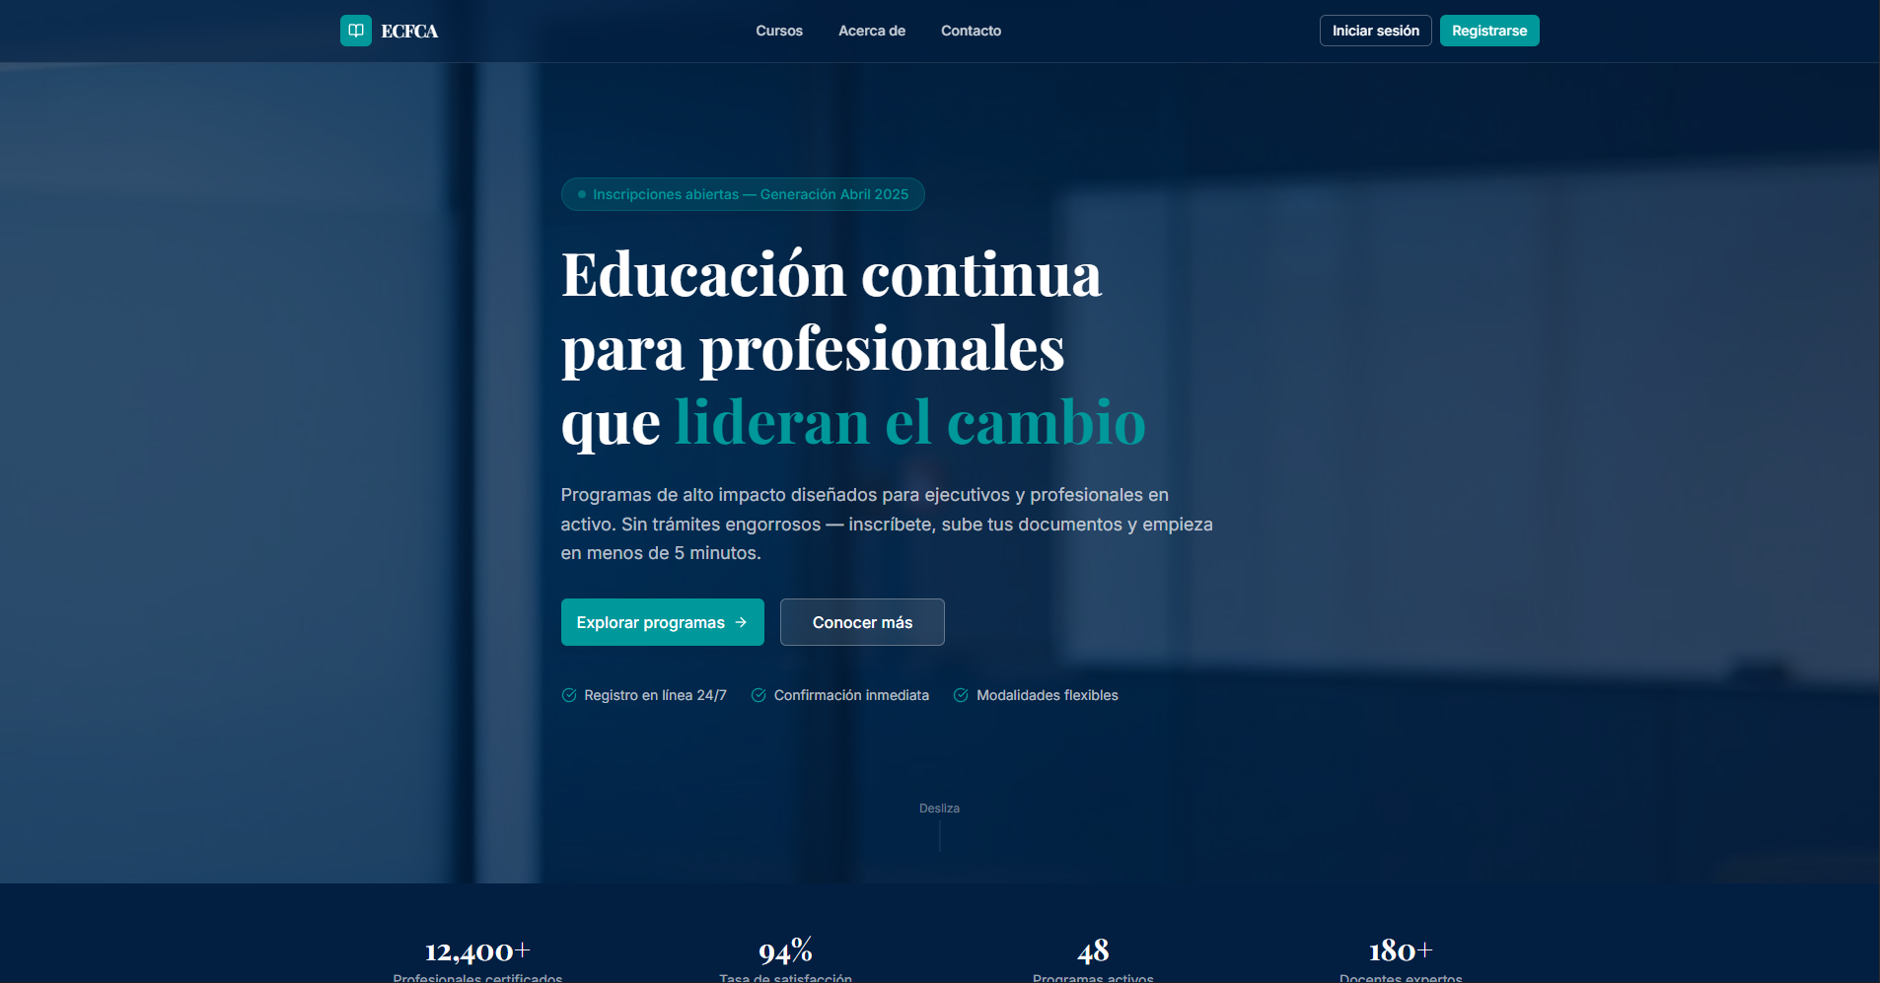
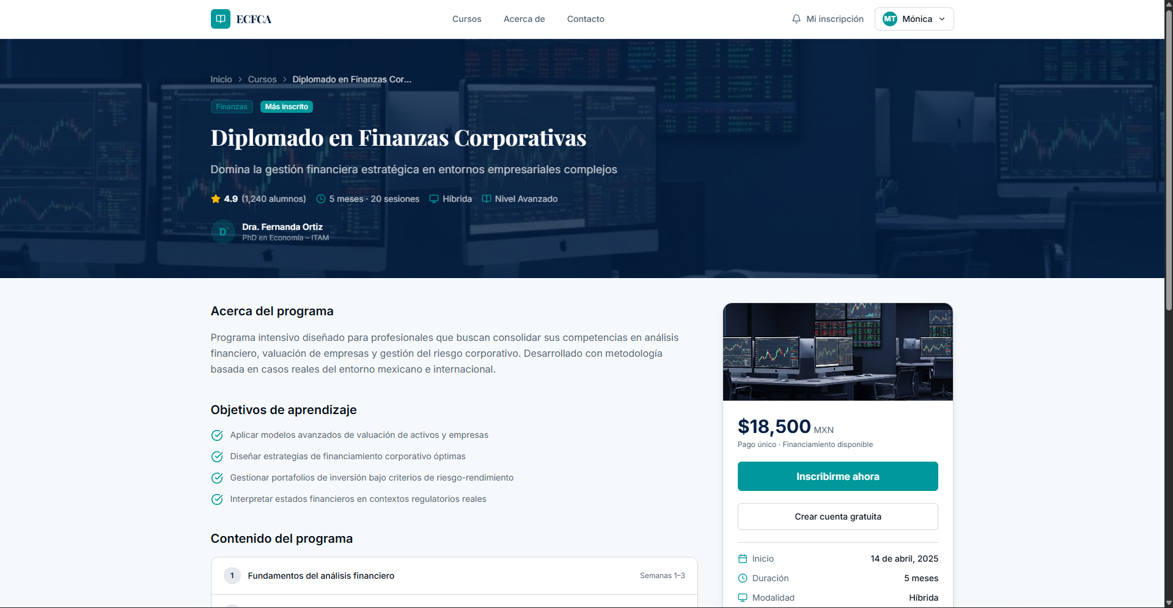
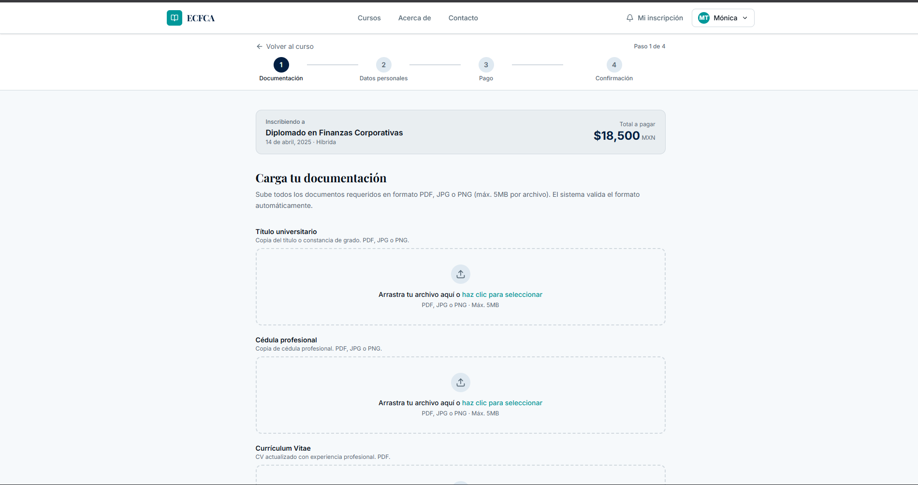
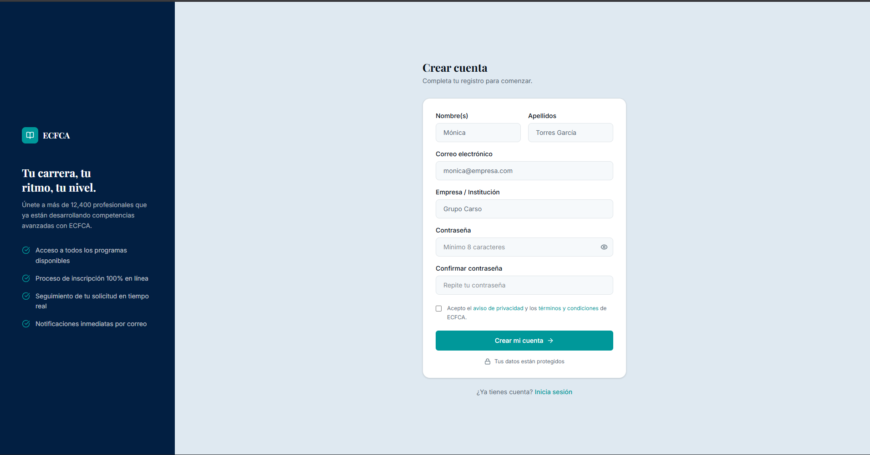
Significant Project Changes (1st Version)

Slide 7
Significant Project Changes (1st Version)
This is the first version based on the functional requirements
It includes:
Landing page
A registration form
A course registration section
Course section

Slide 8
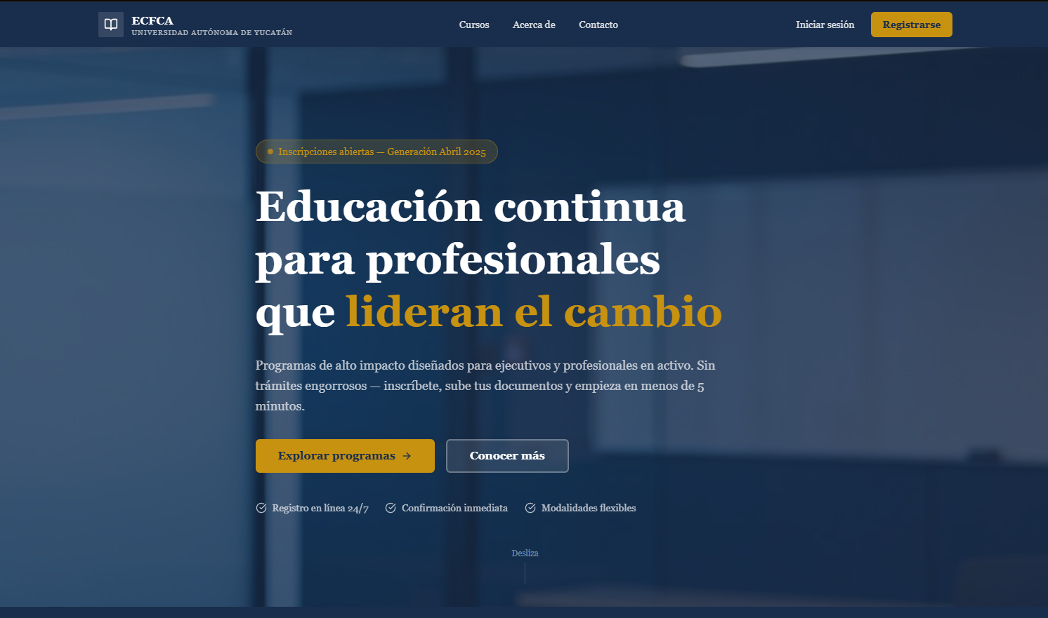
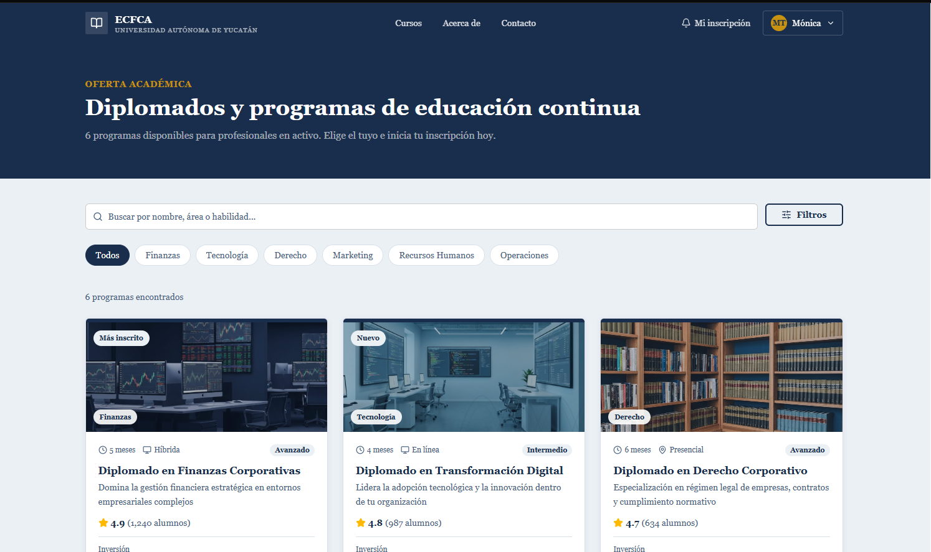
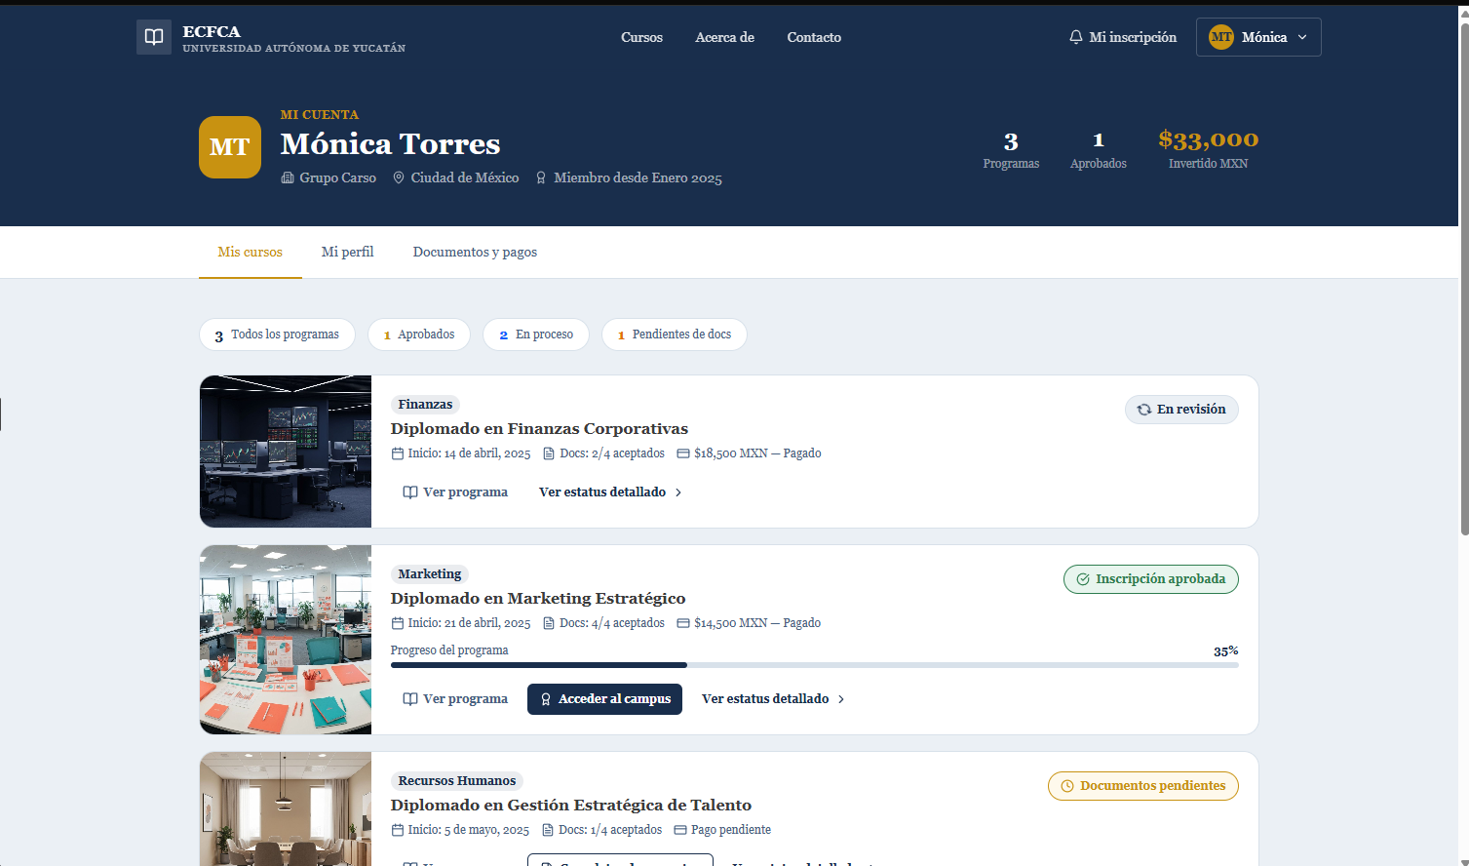
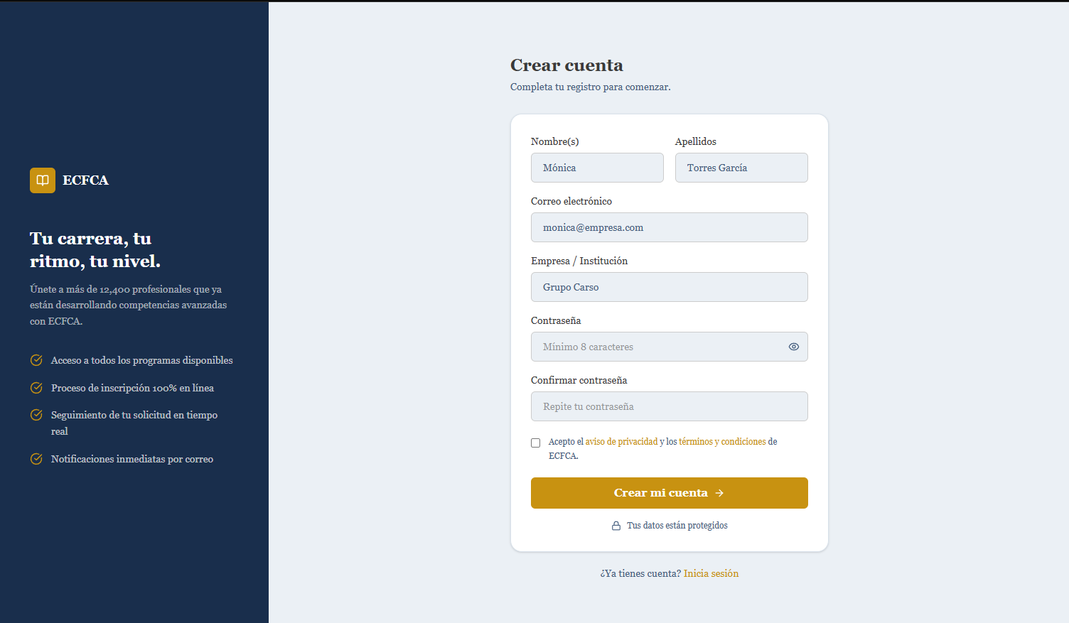
Significant Project Changes (2nd Version)

Slide 9
Significant Project Changes (2nd Version)
This is the second version
What was modified or added:
Colors changed to match the corporate brand
Profile view section based on functional requirements
Validation logic was added to make it a working prototype.

Slide 10
Usability Testing: Analysis and Results
Task | Efficiency metrics | Interaction friction metrics
Register | Success rate: 91% Avg Time taken: 106s Avg clicks: 13 Avg Errors: 1 Avg Time to find button: | Misclick rate: 8.8% Avg mental blocks: 1 Avg help asked: 0.78 Avg happy path adherence: 86%
Login | Success rate: 91% Avg Time taken: 27s Avg clicks: 5 clicks Avg Errors: 0.3 errors Avg Time to find button: | Misclick rate: 3.3% Avg mental blocks: 0.27 Avg help asked: 0.11 Avg happy path adherence: 92%
Enrollment | Success rate: 73% Avg Time taken: 133s Avg clicks: 18 clicks Avg Errors: 1.5 errors Avg Time to find button: | Misclick rate: 12.5% Avg mental blocks: 1.91 Avg help asked: 1.22 Avg happy path adherence: 74%
Status | Success rate: 78% Avg Time taken: 34s Avg clicks: 6 clicks Avg Errors: 0.6 errors Avg Time to find button: | Misclick rate: 8.4% Avg mental blocks: 0.7 Avg help asked: 0.38 Avg happy path adherence: 80%

Slide 11
Usability Testing: Analysis and Results
The data was from the first batch of test that we did, it is somewhat incorrect in some parts (time) as we tried to measure time and do think aloud to the same participants at the same time, making the time based metrics mostly invalid but it still gave us useful information such as:
The button for the first task was hard to find, participant expected it to be on their faces
Some people lacked the patience to wait for the instructions and played with the app during the explication
This lack of patience also affected the rest of the task as some tried to rush and end up not knowing what to do and were expecting us to tell them despite having instructions in the screen

Slide 12
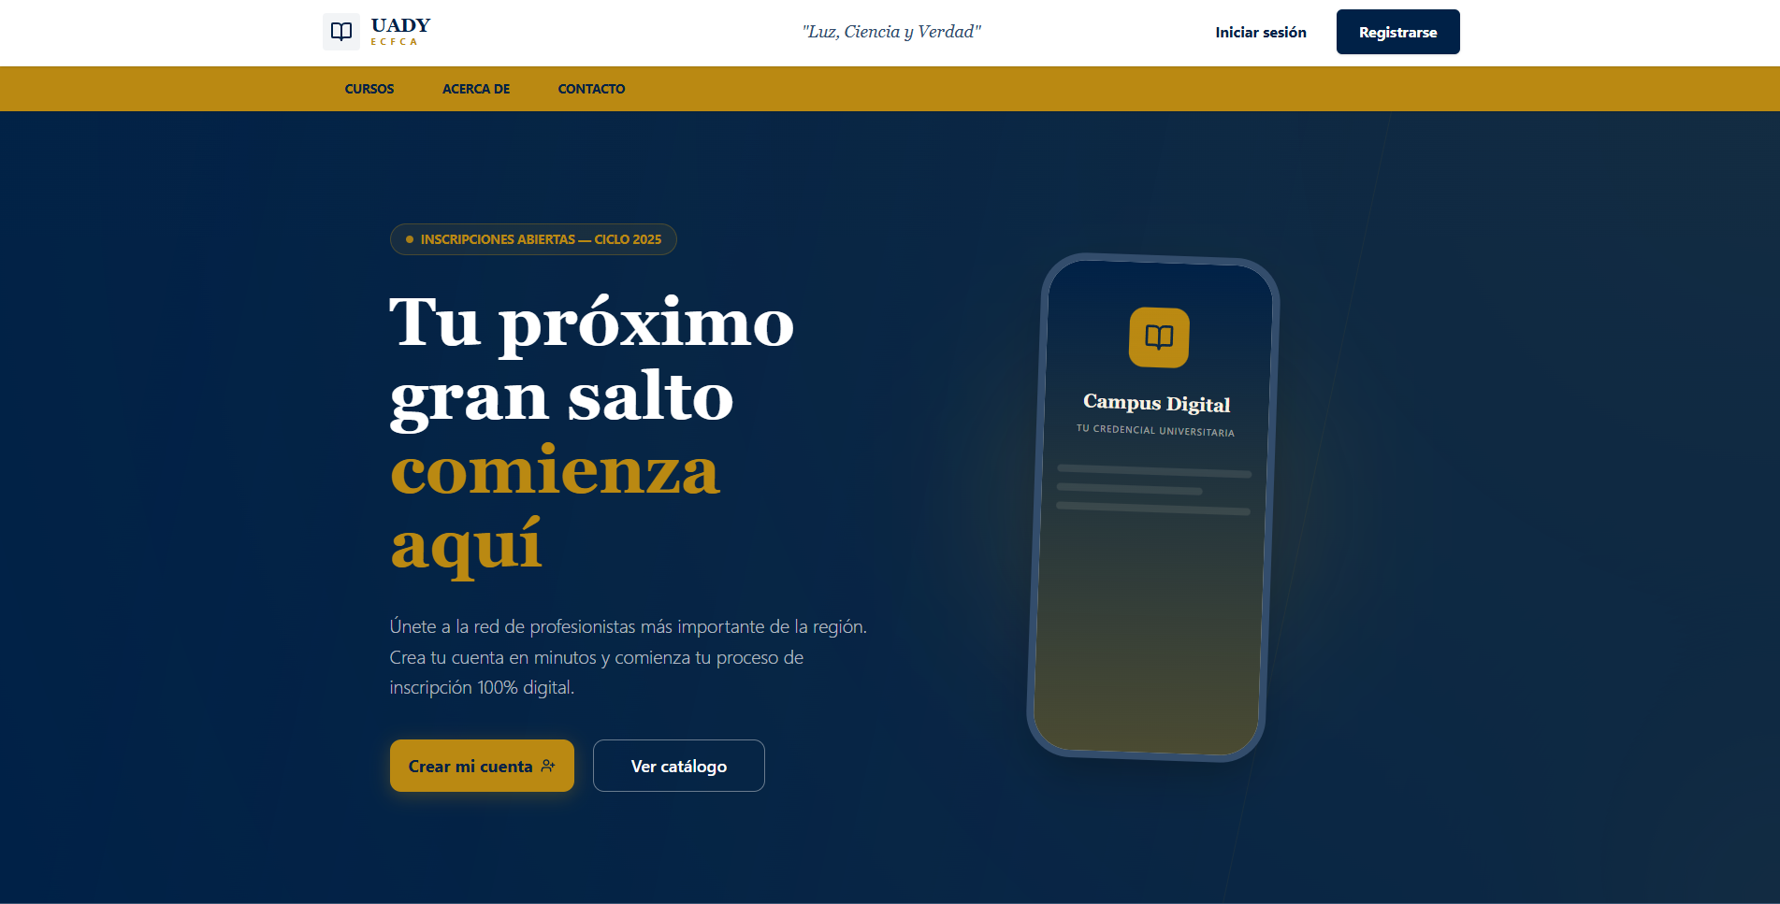
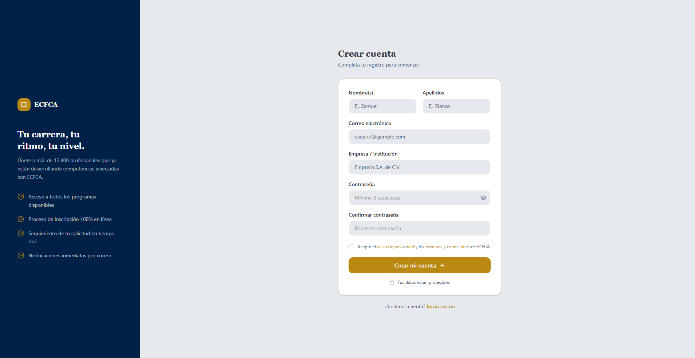
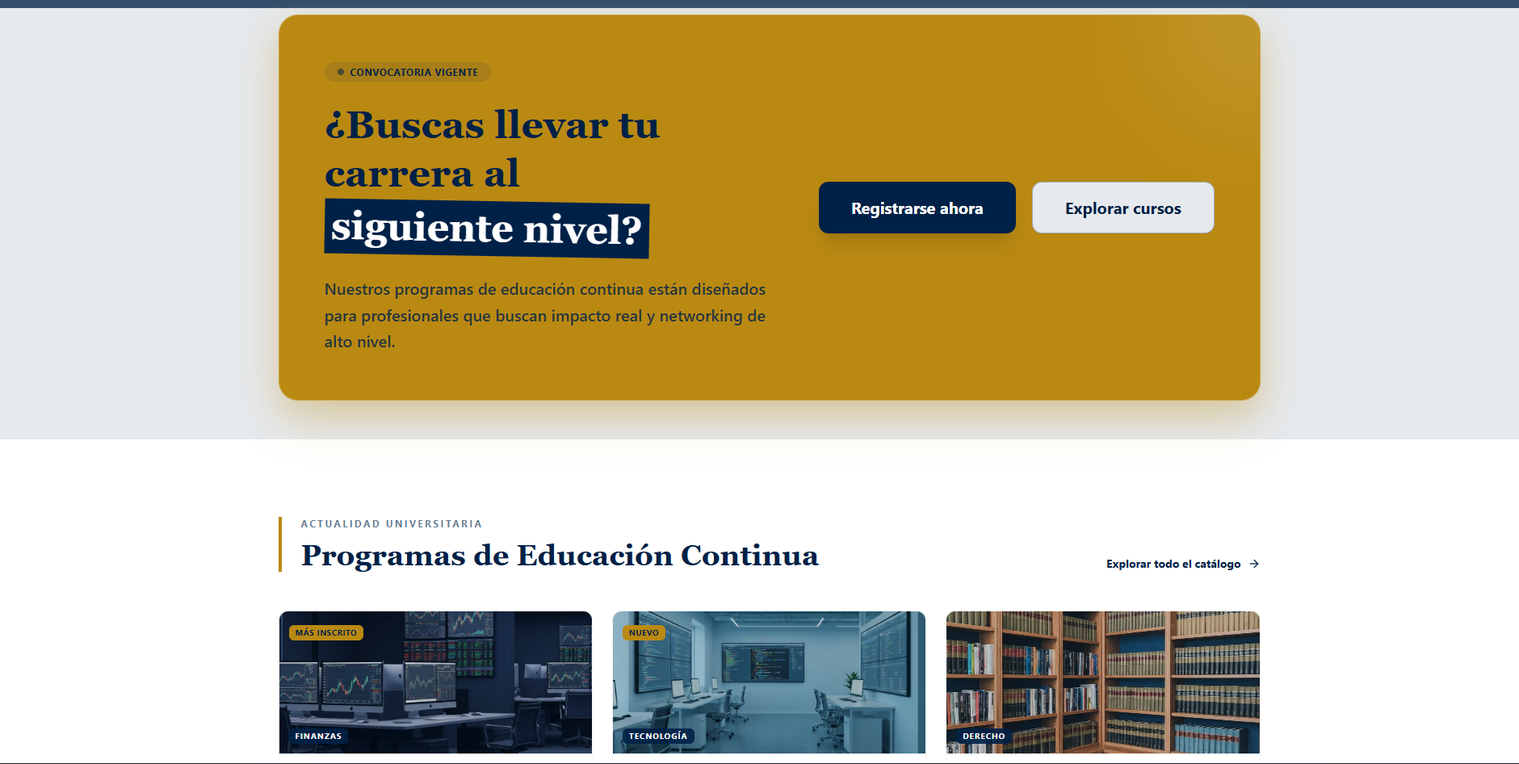
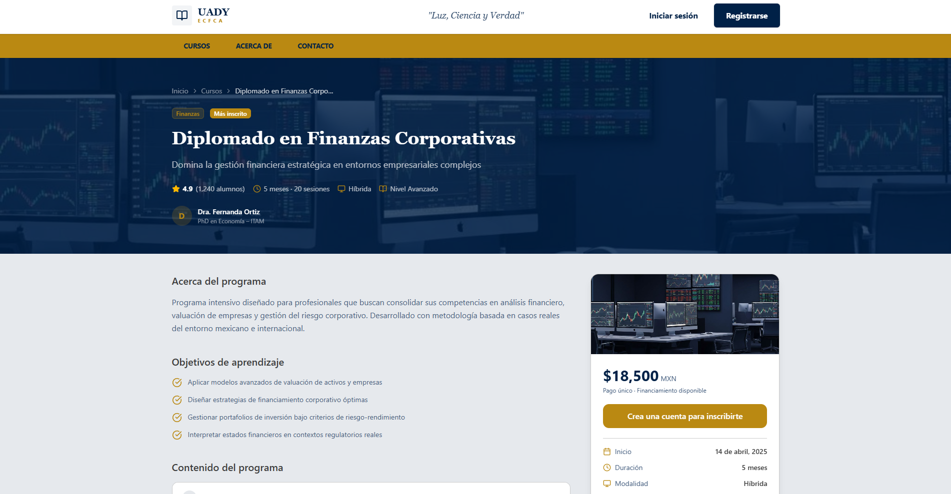
Significant Project Changes (3rd Version)

Slide 13
Significant Project Changes (3rd Version)
This is the third and final version.
What was modified or added:
The design of the hero section was changed.
The header was completely redesigned to better align with UADY’s design and emphasize registration.
A section was added to the landing page to encourage users to sign up.

Slide 14
Usability Testing: Analysis and Results
On the second batch of test we decided to center around the think aloud and do a SUS survey after on the improved system based on the prior results.
The SUS survey results were:
( 92.5 + 100 + 100 ) = 97.5
The data that we collected from this second testing was:
They liked that the app didn’t need from the start all your data to create an account
Couple of misclick on the upload file area, the image and clickable area seem to not line up correctly
There were a couple of error that came to be because the users were aware of the test, example typing less than 16 numbers on the credit card text box

Slide 15
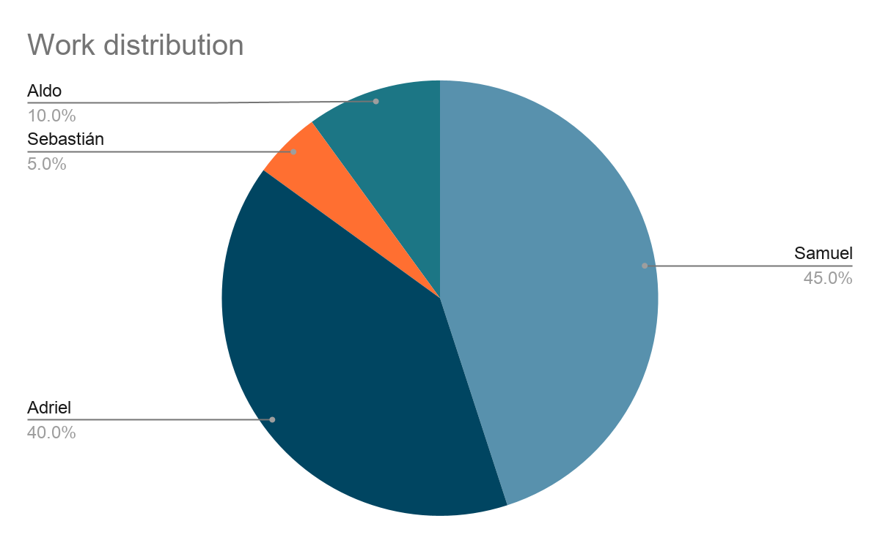
Teamwork: Distribution of Responsibilities
Samuel: UI design, creation of prototypes, Non-functional requirements document, demographics definition, translation of documents,
Adriel: Creation of the database, connection of prototype to database, translation of documents, creation and management of log, user testing, Non-functional requirements document
Aldo: Functional and non-functional requirements first version, changes in the organization of the github
Sebastian: Persona archetype definition

Slide 16
Questions?
Thank you for your attention

