Slide 1
Large-Scale and Multi-Structured Databases
LondonSafeTravel
Ricky Marinsalda
Federico Frati
Dario Pagani

Slide 2
Application Highlights
Our on-line service allows its users to explore, search and visualize a geographical map of London.
Search for POIs and view their data
Compute a travel route between two points
  On foot
  By car
  By bicycle
View and avoid disruptions on the network
  Vehicles’ accidents
  Road works and other road closures

Slide 3
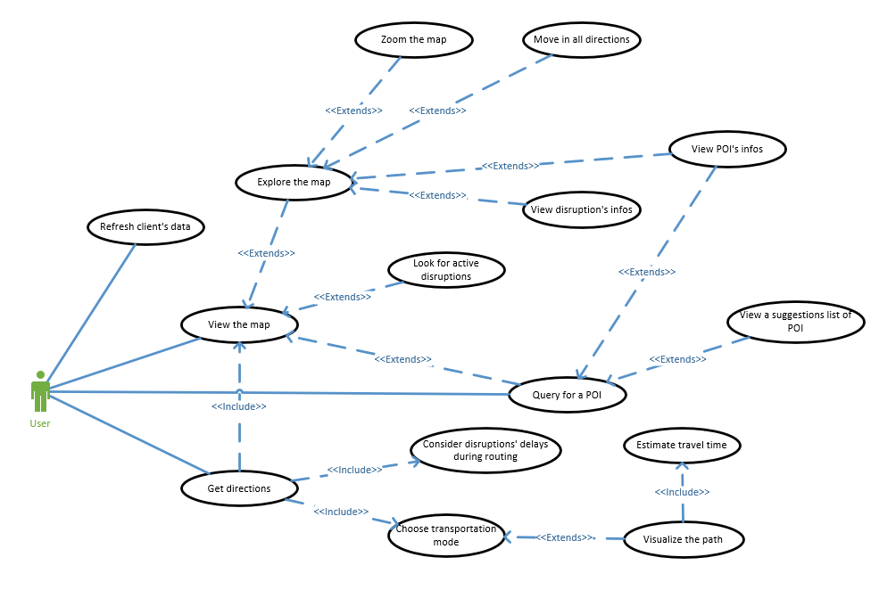
Actors and main supported functionalities

Slide 4
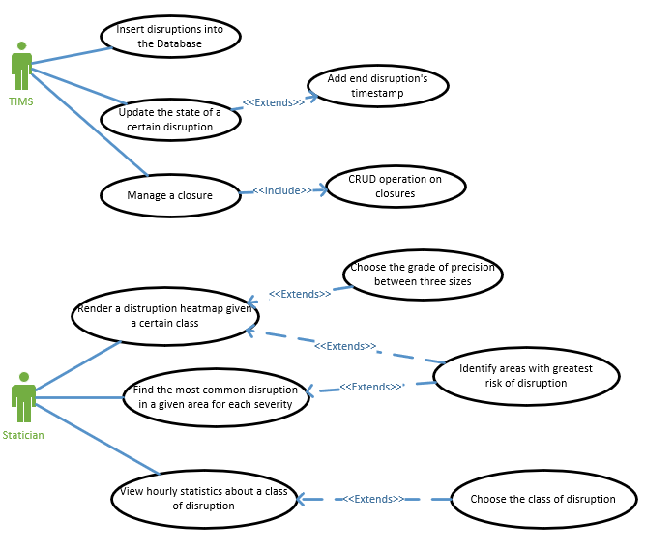
Actors and main supported functionalities

Slide 5
Dataset Description
Sources and Description:
OpenStreetMap for the road network
Transport for London’s TIMS API for disruptions
Volume: circa 200MiB
Variety:
Multiple sources
Multiple formats
Velocity/Variability: TIMS data are like a live feed, older data are moved into an archive for future analytics

Slide 6
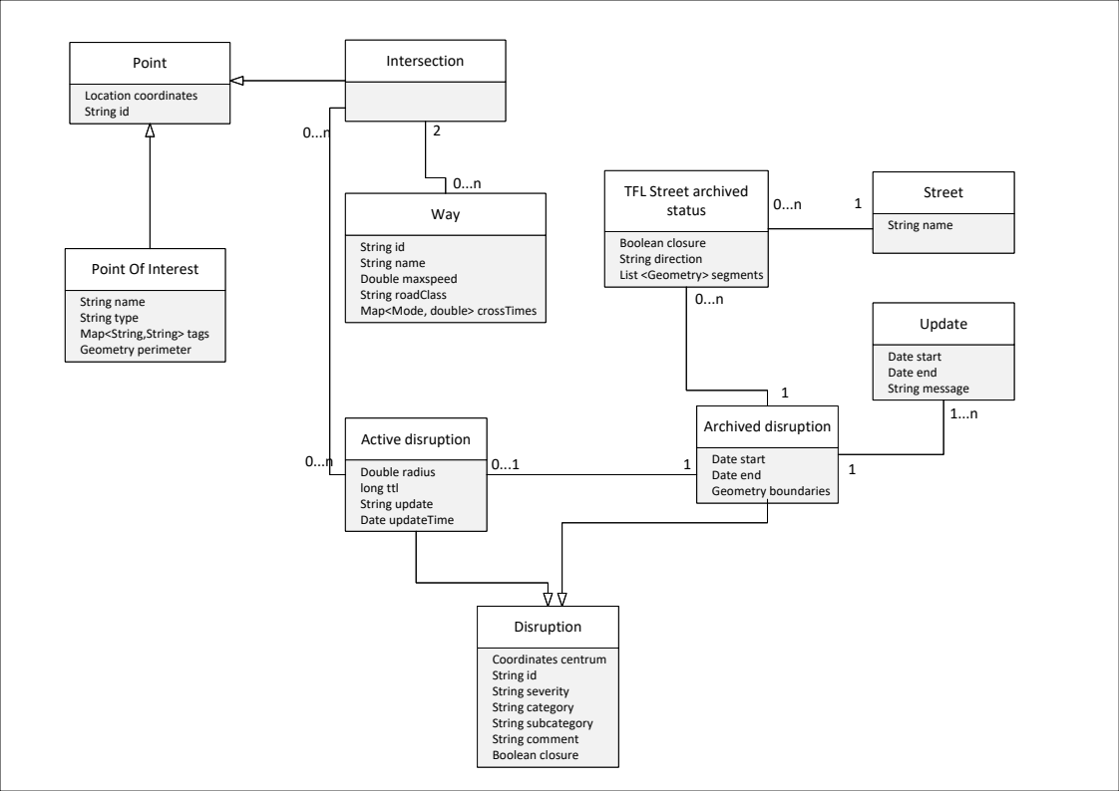

Slide 7
Requirements and Entities handled by Document DB
Entities
POIs (attractions, landmarks etc..)
Disruptions and their boundaries
Queries
Search for POIs by name
List POIs in a given area [map view]
Number of active disruptions by class and hour of day
Build a heat-map of a certain class of disruption
  for broken traffic lights, vehicles collisions, burst water pipes, etc..
Most common disruptions by severity in a given area

Slide 8
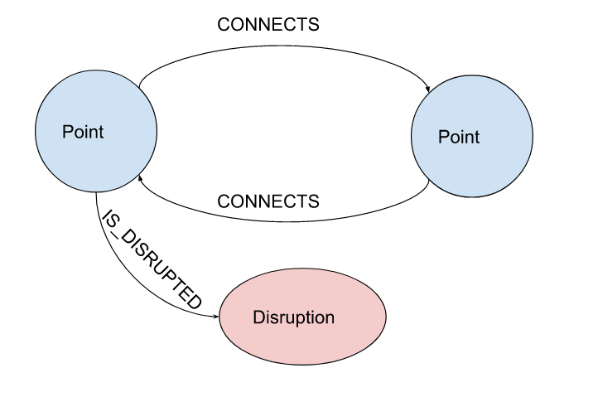
Requirements and Entities handled by Graph DB
Query:
Find a route between two points using AA*
Query:
Find and link all Points affected by a Disruption given its radius
Query:
Find a reasonably reachable Point given a mode of transportation

Slide 9
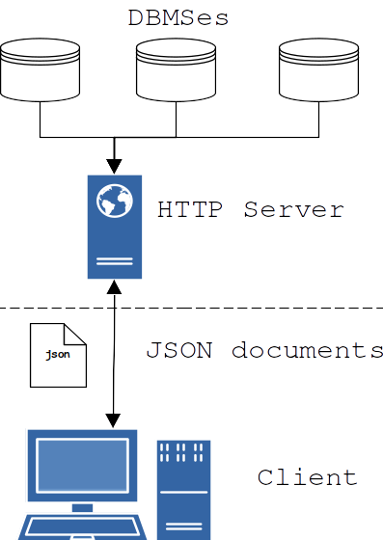
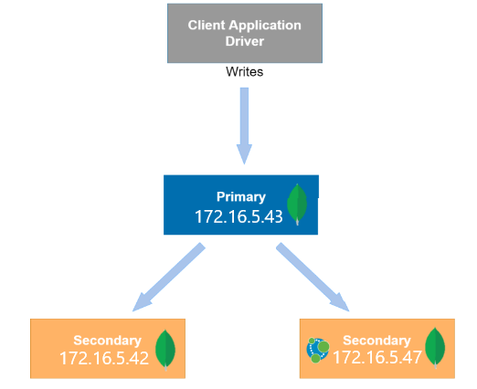
Software Architecture Preliminary Idea

Slide 10
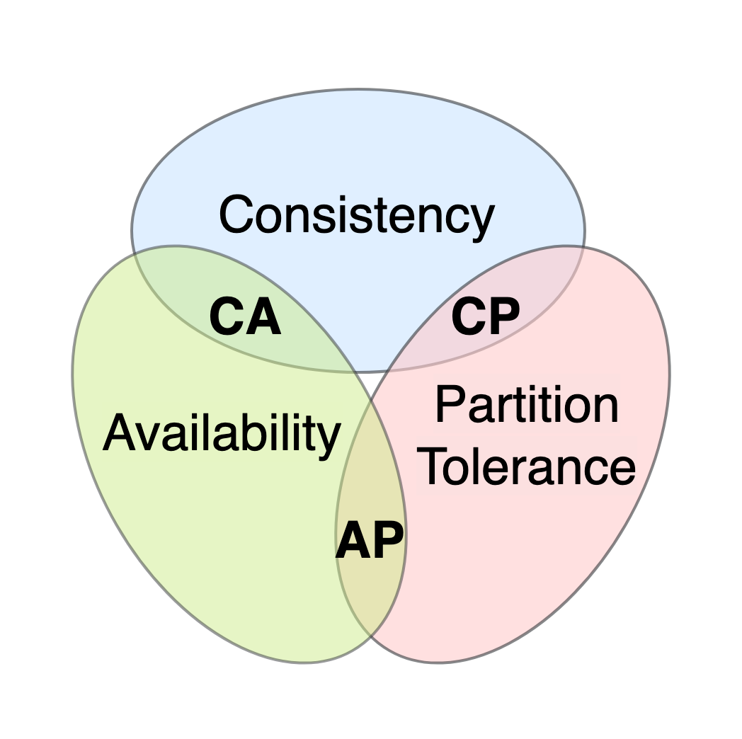
CAP thorem issue
APPLICATION MODEL: AP
We prioritize:
Availability
Partition tolerance
We couldn’t have data consistency

Slide 11



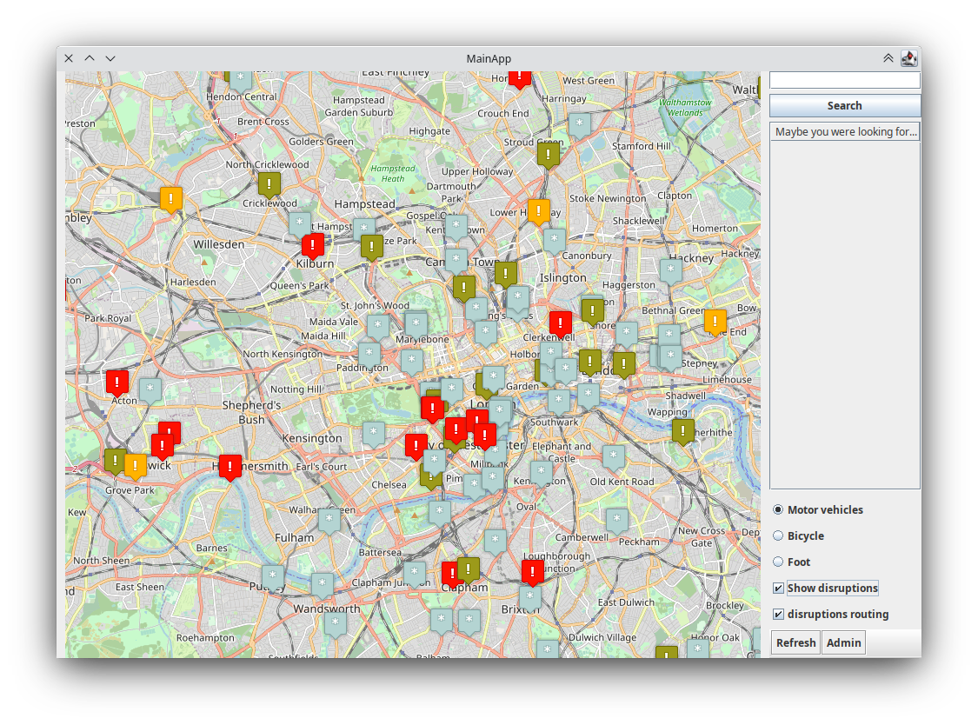
Client Application
Java Swing
jxMapViewer2
jxFreeChart
REST API
Java Web Server
Gson
Databases
neo4j driver
mongodb driver

