Slide 1
Large-Scale and Multi-Structured Databases
Project Design
LondonSafeTravel
Ricky Marinsalda
Federico Frati
Dario Pagani

Slide 2
Application Highlights
Our on-line service will allow its users to explore, search and visualize a geographical map of London and its public transport network.
Search for places such as addresses and POIs
View transit’s timetables
Compute a travel route between two points
  On foot
  By car
  By public transport
View and avoid disruptions on the network
  Vehicles’ accidents
  Road works and other road closures

Slide 3
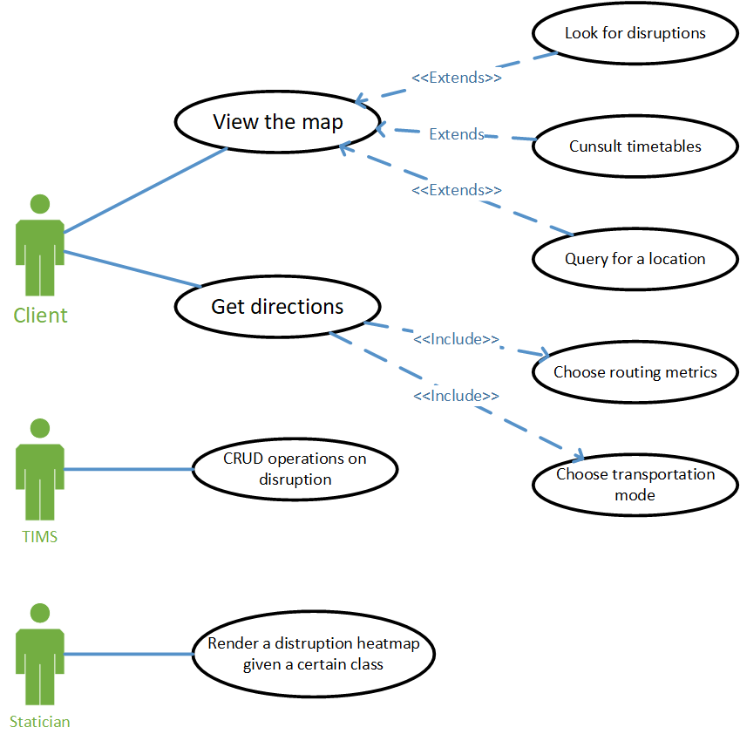
Actors and main supported functionalities

Slide 4
Dataset Description
Sources:
OpenStreetMap for the road network
Transport for London for the timetables and routes
Transport for London’s TIMS API for disruptions
Description: A road and transit’s network
Volume: circa 200MiB
Variety: CSVs files, JSONs files and OSM.PBFs files
Velocity/Variability: TIMS data are like a live feed, older data are moved into an archive for future analytics

Slide 5
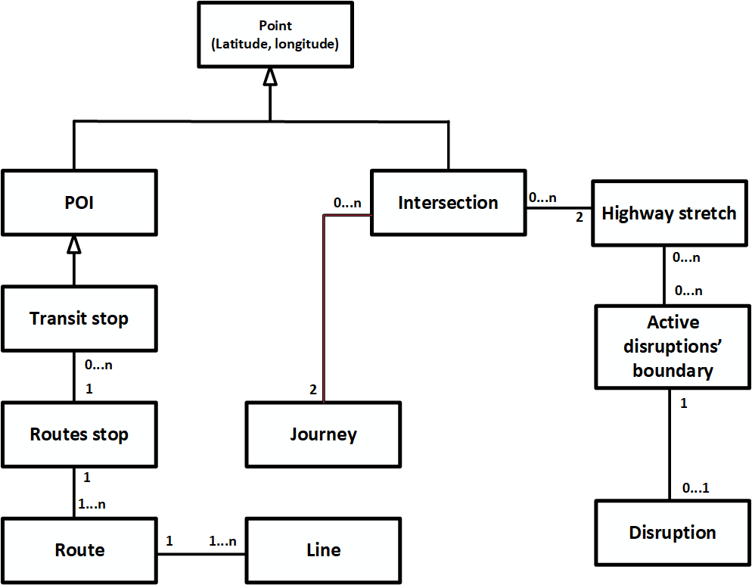
Preliminary Simplified UML Class Diagram

Slide 6
Requirements and Entities handled by Document DB
Entities
POIs (transit stops, landmarks etc..)
All entities related to public transportation
Disruptions and their boundaries
Queries
List POIs in a given area [map view]
Routing between two public transport’s stops [simplified]
Build a heatmap of a certain class of disruption
  for broken traffic lights, vehicles collisions, burst water pipes, etc..
Find the most common disruption in a given area

Slide 7
Requirements and Entities handled by Key-Value DB
COMPUTE_ROUTE(
SOURCE: WGS84 coords,
DESTINATION: WGS84 coords):
IF <SOURCE, DESTINATION> IN CACHE:
INCREASE HITS
RESET TTL
RETURN CACHED ROUTE
ELSE
ROUTE ← COMPUTE_ROUTE(…)
CACHE ROUTE FOR N MINUTES
RETURN ROUTE
Journey
KEY: <SOURCE, DESTINATION>
VALUE: <ROUTE, HITS>
Another query: find the most common recent destinations

Slide 8
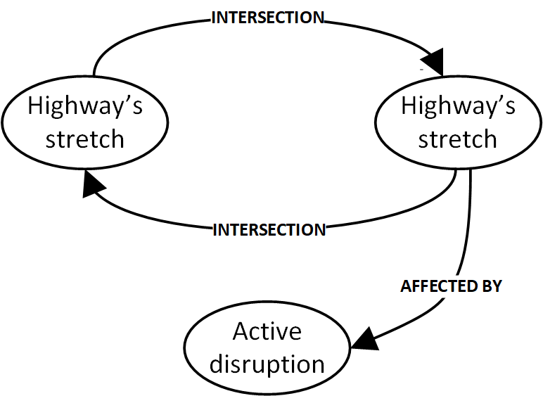
Requirements and Entities handled by Graph DB
A possible schema:
OSM vertexes → edges
OSM edges → vertexes
Query:
Find a route between two points using an algorithm such as A* or ARA*
Query:
All elements in an area [map view]

Slide 9
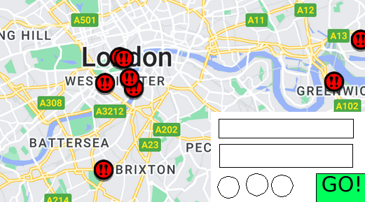
Software Architecture Preliminary Idea
DBMSes
DBMSes
DBMSes
MongoDB for transit and TIMS’ data
Neo4j for road network’s data
Redis for routing paths’ cache
Mockup
Technologies
One of the following:
(yet to decide)
Java & TomCat (web client)
Python & Flask(web client)
Java Swing (Java client)

